Slide 1
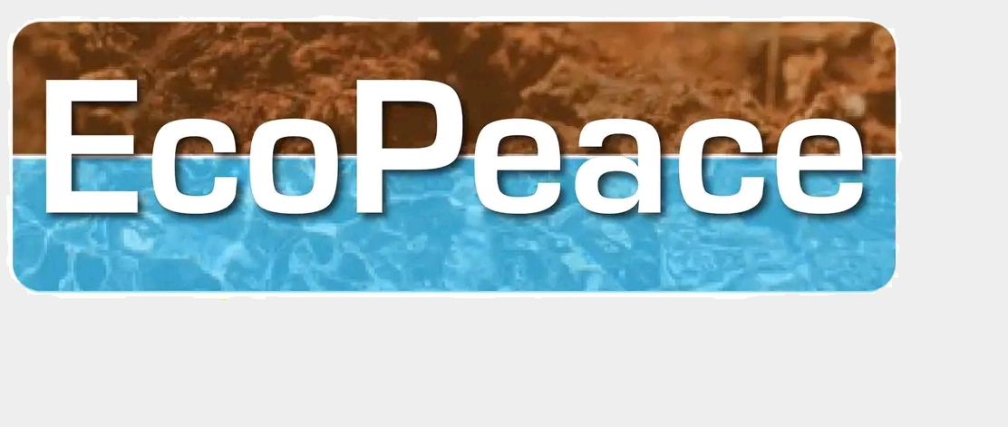
EcoPeace MC Enterprise (Pty) Ltd
South Africa
An economy by means of peace

