Slide 1


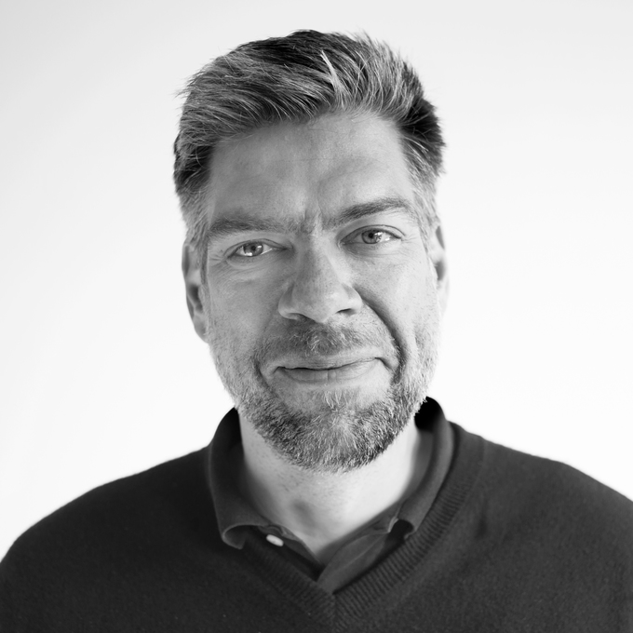
EuregJUG Maas-Rhine – all Things JVM!
Java User Group Aachen — regelmäßige kostenlose Fachvorträge
Wait, what? Our Microservices have actual human users?
— Mittwoch, 22.03.2017, 18:30 Uhr (Beginn Vortrag 19:00 Uhr) —
— inside Unternehmensgruppe, Auf der Hüls 190, Aachen —
Microservice API styles, service lookups, datastores, scaling – all of our typical discussions about microservices seem to be centered around backend topics. But what about the user interface? How are we supposed to structure what is arguably the most important part of our applications – the one facing our users? In this session we’ll explore the role of the UI aspect in a microservice architecture, look at various methods of modularization, and derive a set of guidelines for avoiding monolithic frontends.
Stefan Tilkov
Stefan Tilkov is a co-founder and principal consultant at innoQ, a technology consulting company. He has been involved in the design of large-scale, distributed systems for more than two decades, using a variety of technologies and tools. He has authored numerous articles and a book (“REST und HTTP”, German), and is a frequent speaker at conferences around the world.
Anmeldung erbeten: http://www.euregjug.eu

