Slide 1


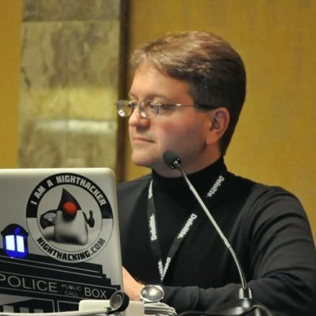
EuregJUG Maas-Rhine – all Things JVM!
Java User Group Aachen — regelmäßige kostenlose Fachvorträge
Going Reactive with Spring 5 & Project Reactor
— Freitag, 21.04.2017, 18:30 Uhr (Beginn Vortrag 19:00 Uhr) —
— KISTERS AG, Pascalstr. 8+10, Aachen —
Spring 5 is almost here! One of the most exciting introductions in this release is support for reactive programming, building on Pivotal’s Project Reactor to support message-driven, elastic, resilient, and responsive services. Spring 5 integrates an MVC-like component model adapted to support reactive processing and a new type of web endpoint, functional reactive endpoints. In this talk, we’ll dive into the net-new Netty-based web runtime and see how to integrate it with existing Spring-stack technologies, learn how to leverage powerful new testing mechanisms to make code better and life easier, and tie it all together with a live coding demo.
Mark Heckler
Mark Heckler is a Pivotal Principal Technologist & Developer Advocate, conference speaker, and published author focusing upon software development for the Internet of Things and the Cloud. He has worked with key players in the manufacturing, retail, medical, scientific, telecom, and financial industries and various public sector organizations to develop and deliver critical capabilities on time and on budget.
Anmeldung erbeten: http://www.euregjug.eu

