Slide 1

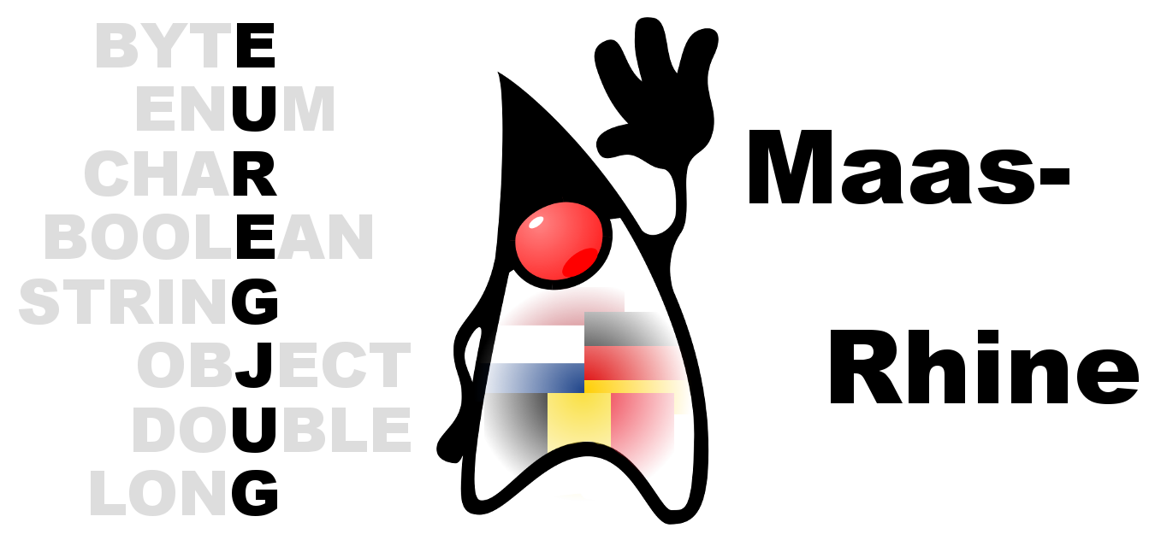

EuregJUG Maas-Rhine – all Things JVM!
Java User Group Aachen — regelmäßige kostenlose Fachvorträge
MICROSERVICES <3 DOMAIN DRIVEN DESIGN, WHY & HOW?
— Mittwoch, 08.02.2017, 18:30 Uhr (Beginn Vortrag 19:00 Uhr) —
— Traveltainment GmbH, Carlo-Schmid-Straße 12, Würselen (Gewerbegebiet Aachener Kreuz) —
Without any doubt Eric Evans' book "Domain Driven Design" is being considered as a "must have read" among many IT specialists from various domains. With the emergence of Microservices, Domain Driven Design has become more relevant then ever. This talk explains how the patterns and concepts of Domain Driven Design relate to Microservice architectures. In addition to that I will show how Domain Driven Design will help you to structure and model your Microservices in terms of granularity, business context and interface design.
Michael Plöd
Michael works a a Principal Consultant for innoQ. He has over 10 years of practical consulting experience in software development and -architecture. His main areas of interest are currently CQRS, Event Sourcing, Microservices, Polyglot Persistence and presentation techniques for developers and architects.
Anmeldung erbeten: http://www.euregjug.eu

