Slide 1

Welcome!

Slide 2

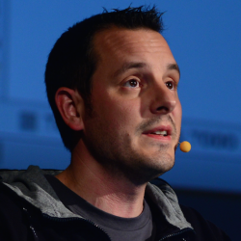
Next Talk:
Thursday, 2015 – 10 – 06
Stéphane Nicoll
Spring Boot Committer
Pivotal, Inc.
„Building cloud native apps with Spring Boot“
EuregJUG Meetup: 2015-09-15 18:00, Bar Elementa, Aachen

