Slide 1
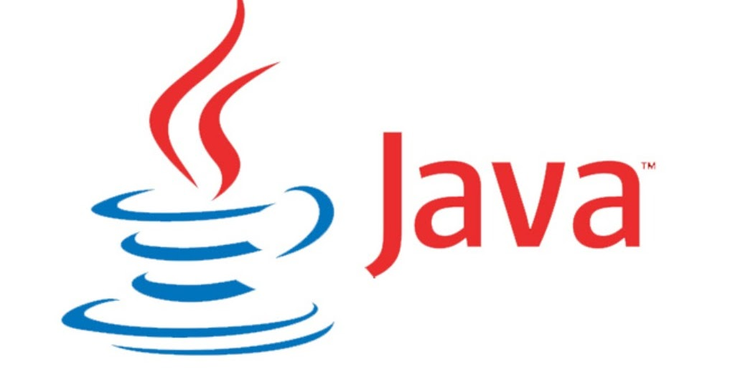
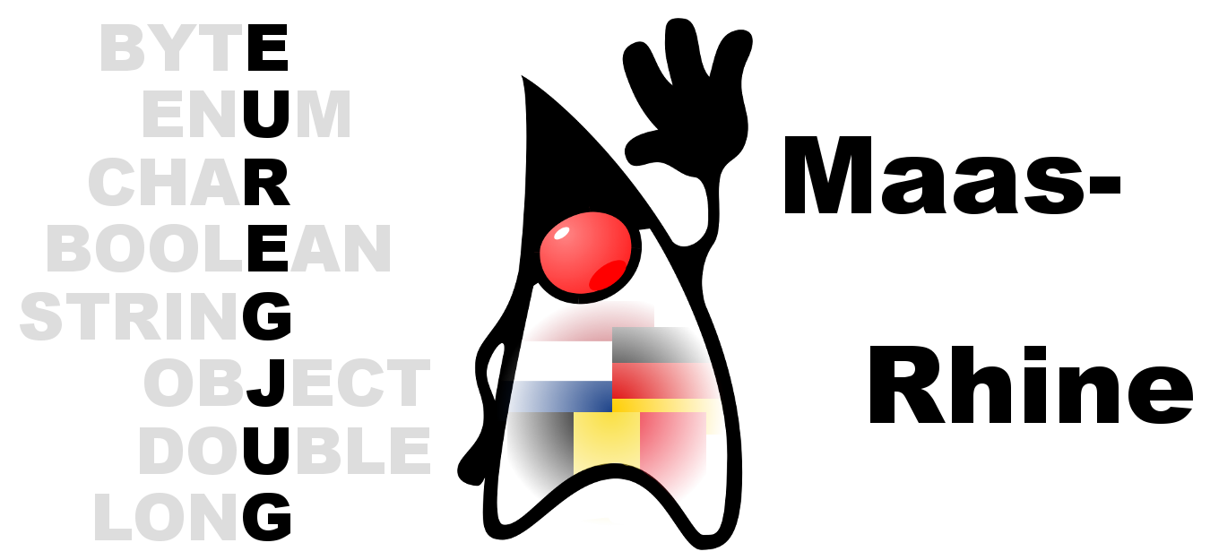
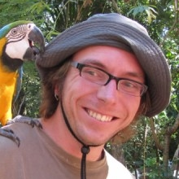
EuregJUG Maas-Rhine – all Things JVM!
Java User Group Aachen — regelmäßige kostenlose Fachvorträge
IMMUTABLE INFRASTRUCTURE: RISE OF THE MACHINE IMAGES
— Dienstag, 06.12.2016, 19:00 Uhr —
— ENERKO Informatik, Markt 45-47, Aachen —
The cloud is the new normal and it is time to rethink how we see machines and deployments. We have been piling layer upon layer of complexity for too long. But why should it be this way? It is time to radically simplify all this. In this talk, we’ll throw general-purpose operating systems, snowflake servers and runtime provisioning out the door. Instead you’ll see how servers become disposable, how machine images are generated from scratch in seconds and how to achieve perfect environment parity from dev to prod. This is Immutable Infrastructure. It is a profoundly important change as to how we view and treat our systems. We’ll go deep. We’ll look at how this affects scaling, logging, sessions, configuration, service discovery and more. We’ll also look at how containers and machine images compare and why some things you took for granted may not be necessary anymore.
AXEL FONTAINE
Axel Fontaine is an entrepreneur, public speaker and software development expert based in Munich. He is the founder and CEO of boxfuse as well as the creator of database migration tool Flyway DB and a 2016 Java Champion recognized for his work in the Java World and evangelizing and enabling Continuous Delivery.
Anmeldung erbeten: http://www.euregjug.eu

