Slide 1

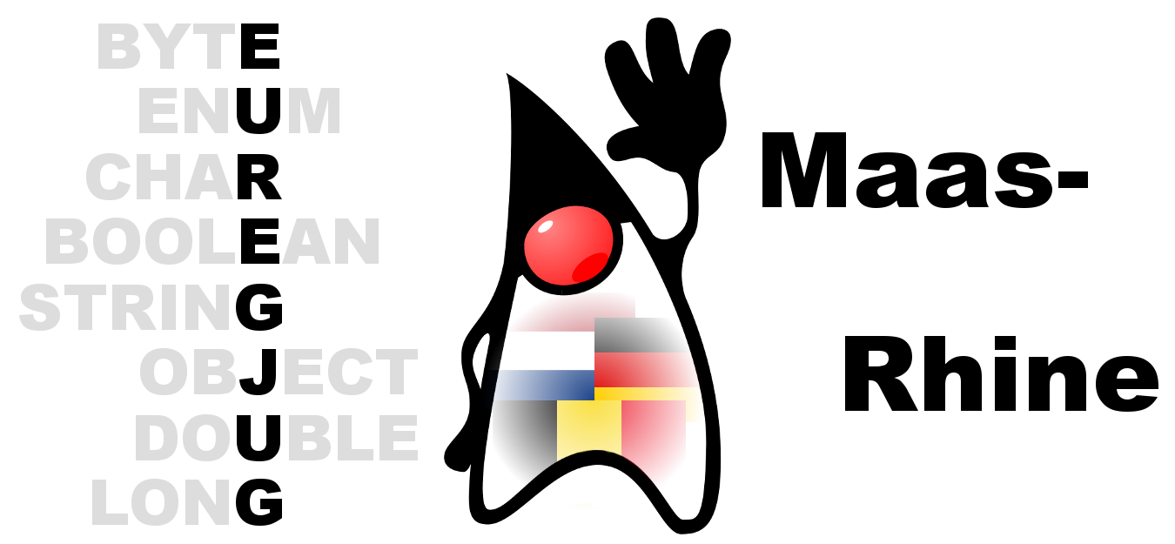
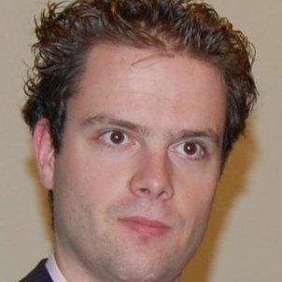
EuregJUG Maas-Rhine – all Things JVM!
Java User Group Aachen — regelmäßige kostenlose Fachvorträge
USING ACTORS FOR THE INTERNET OF (LEGO) TRAINS
— Mittwoch, 18.01.2017, 18:00 Uhr —
— Osthus GmbH, Eisenbahnweg 9-11, Eingang TH 6, Aachen —
Last year this session’s speaker and his colleagues started a new Internet of Things project: Internet of (Lego) Trains. They wanted to figure out if they could use Java or Scala/Akka on IoT hardware. The Lego trains are equipped with a Raspberry Pi, camera, wireless dongle, infrared transmitter, speaker, RFID reader, and battery pack. Next to that are automated switch tracks and cameras, again with the help of Raspberry Pi’s. To control the trains and other parts, they built an actor-based application with Scala, Akka, Akka HTTP, and AngularJS. The session covers when and how to use Akka HTTP and remote actors to create a new generation of applications. It also presents the results of the performance tests they did to compare the two options. A live demo is of course included.
JOHAN JANSSEN
Johan is working as a Java architect, trainer and competence center Java lead at Info Support. He has been working for various demanding companies where rapidly delivering quality software was very important. He likes sharing his knowledge about Java, continuous delivery, DevOps, IoT, software quality and numerous other subjects. Johan regularly writes articles and gives presentations about those subject for instance at JavaOne, Devoxx BE/UK, J-Fall, Jfokus, JAX, various Voxxed events, JavaLand, Scala Days Berlin/New York, GeeCON, JBCNConf, Java Forum Nord, Coding Serbia, Javantura, JavaCro and ConFESS.
Anmeldung erbeten: http://www.euregjug.eu

