Slide 1


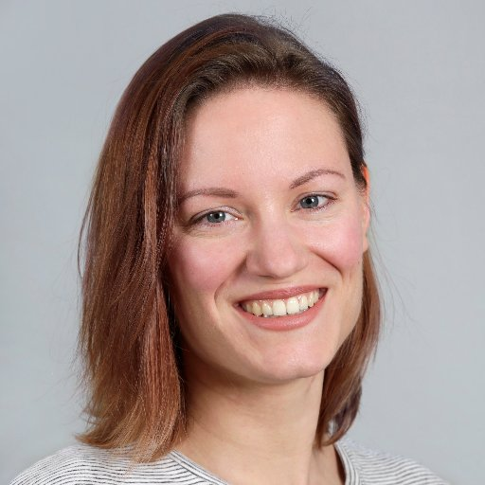
EuregJUG Maas-Rhine – all Things JVM!
Java User Group Aachen — regelmäßige kostenlose Fachvorträge
Changing your view on testing
— Mittwoch, 07.06.2017, 18:30 Uhr (Beginn Vortrag 19:00 Uhr) —
— DocMorris Versand Apotheke, Avantisallee 152, Heerlen —
My mission for this year is to change how people working in Software Development view testing. Right now, I feel that the pendulum is shifting a bit too much towards 'testing == test automation'. There’s so much more that testers do and what testing is about! In this talk, I will redefine 'testing' for you, explain the wide array of tasks testers do and why they are important. I will also go over some points of contention between testers and developers and how you can solve them. Let’s bust some testing myths, have some fun, and learn to appreciate other roles and their contribution towards awesome software!
Maaike Brinkhof
Maaike is an agile tester from Utrecht, the Netherlands. She loves testing because there are so many ways to add value to a team, be it by thinking critically about the product, working on the team dynamics, working to clarify the specs and testability of the product, coding the automated checks, getting the whole team to test with Exploratory Testing…the options are almost endless!
Anmeldung erbeten: http://www.euregjug.eu

