Slide 1
Feel It, See It, Recover
Cross-Modal Failure Attribution for Safe Quadrupedal-Navigation Recovery
▪ The problem. A legged robot walking over unknown terrain sometimes fails — it slips, gets stuck, or is overloaded. To recover *safely* it must first diagnose why — and the honest evidence is split across two senses that often disagree.
▪ Two senses, each with blind spots.
  – Proprioception — the robot's own body sensing (joint torques, foot slip, IMU) at 1000 Hz: fast and always-on, but it *cannot see*.
  – Vision (RGB-D camera) — reads the surface look, but is fooled by *appearance*: a patch that looks safe but is slippery ice; a glass wall that is invisible.
▪ This work's thesis. Resolving these cross-modal conflicts — deciding which sense to trust, *per situation* — is a distinct cognitive operation that is:
  – (1) necessary — each sense has failures only the other can solve;
  – (2) learned — merely plugging in a camera is not enough;
  – (3) consequential — the diagnosis causally determines whether the robot falls / gets stuck / reaches the goal;
  – (4) generalizes and can self-assess its own uncertainty.
▪ Contributions (this talk): a certified benchmark + a learned cross-modal attributor (KinoVLA) + a measured safe-recovery guarantee — all on a physically-simulated Unitree Go2 with real RTX rendering and real CLIP vision.

Slide 2
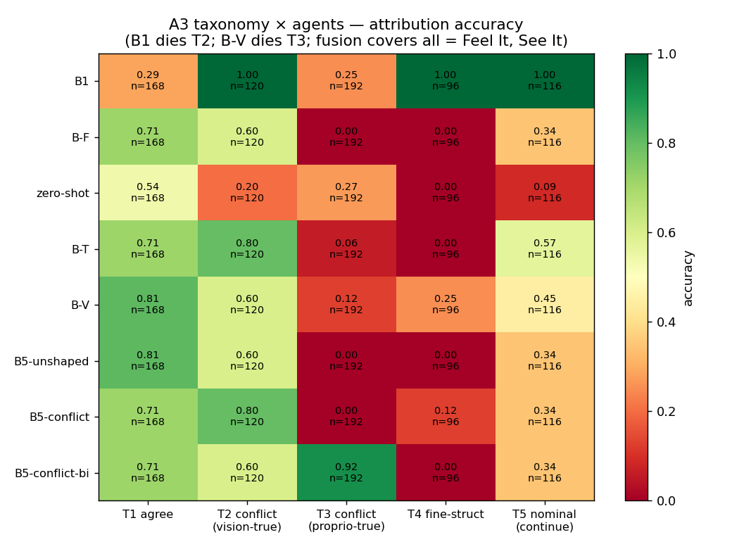
Neither Sense Suffices
A bidirectional necessity result (Claim C1)
▪ We organize every failure by which sense decides it (the *conflict taxonomy*):
  – T2 — vision-decidable: the body-feel is *genuinely ambiguous* — two different hazards feel identical — only the camera separates them.
  – T3 — body-decidable: the camera is *deceived* (slippery ice disguised as safe ground; an invisible glass wall) — only the body-feel reveals it.
▪ Constructive proof (the matched pair). An adhesive / sticky surface (needs back-away) and soft mud (needs high-step-through) are tuned to exert the exact same force on the robot's legs.
  – ⇒ the body-sensor signal is byte-for-byte identical (max difference = 0.0); yet real CLIP vision separates them perfectly (AUC = 1.0). Body-feel alone is provably blind.
▪ Mirror proof (T3). On a patch that *looks* like safe ground but is slippery ice, vision is blind (CLIP AUC = 0.31) while body-feel is decisive (AUC = 1.0); on an invisible wall, body-feel detects it (100%), vision cannot (0%).
▪ ⇒ Necessity is bidirectional: no single modality subsumes the other. "Feel It AND See It."
Feel It, See It, Recover · Cross-Modal Failure Attribution for Safe Quadrupedal Recovery | 2/5

Slide 3
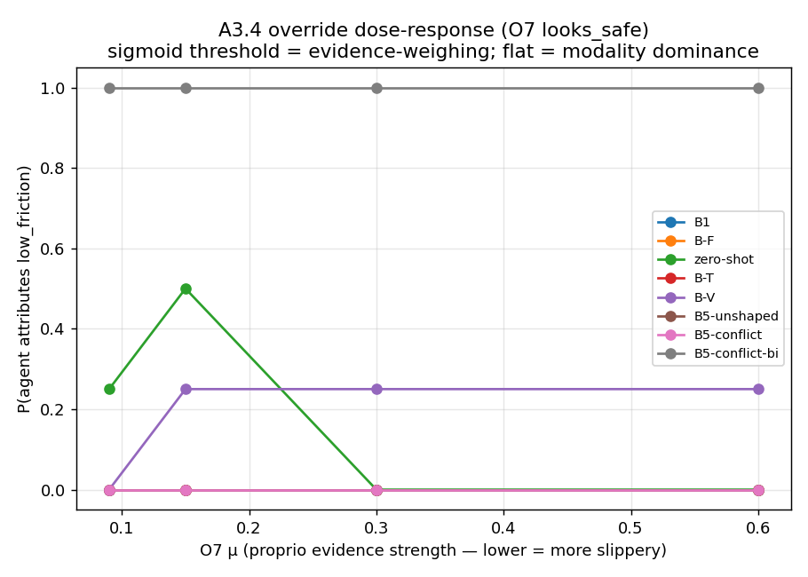
Having Eyes Is Not Using Them
Conflict resolution is a learned skill (Claims C2, C5)
▪ Claim: adding a camera does not solve conflicts — the model must be *taught* to weigh evidence against appearance.
▪ Three-row result (balanced accuracy — a metric immune to gaming):
  – Body-only agent: 0.50 — provably capped (on a byte-identical pair it can only output one constant guess).
  – Four "has-vision" agents (incl. a frozen CLIP+body fusion): all plateau at 0.80 — they solve the vision-decidable cases but crack nothing more.
  – Our full model (latent Kino-Tokens + conflict chain-of-thought): 0.90 — the only one that breaks the ceiling. Paired McNemar test p < 1e-5; reproduced across 3 seeds (0.900 / 0.900 / 0.900).
▪ Shortcut-killer (appearance held-out): trained on some surface looks, tested on never-seen looks → still 0.83 ⇒ it learned the *physics concept*, not a color cue. It even beats a frozen CLIP classifier on looks CLIP cannot separate ⇒ genuine reasoning.
▪ Bidirectional evidence-weighing (figure): a model trained only on "trust-vision" conflicts scores 0 on "trust-body" conflicts; trained bidirectionally it correctly overrides a benign look when the body-signal is strong (probability of "slippery" rises monotonically as slip grows). Genuine weighing — not "always trust the camera."
Feel It, See It, Recover · Cross-Modal Failure Attribution for Safe Quadrupedal Recovery | 3/5

Slide 4
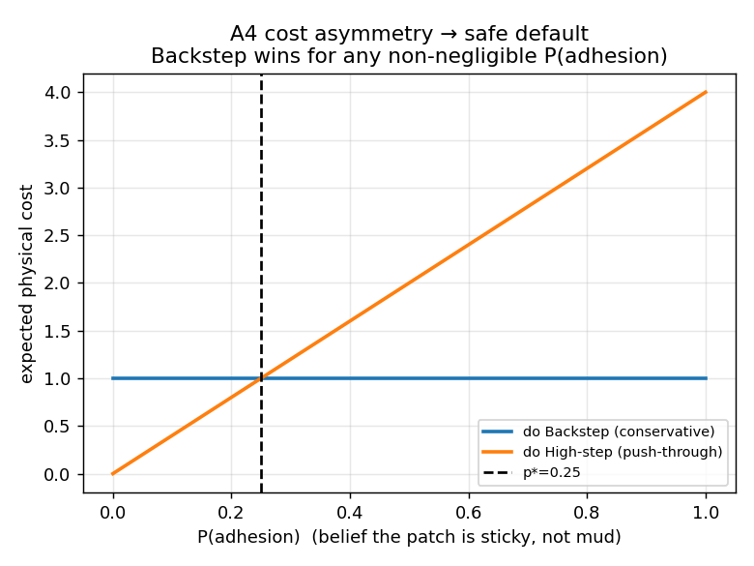
Wrong Diagnosis → Wrong Recovery
Attribution causally determines safety (Claim C3) + the intervention boundary (C4)
▪ The label-swap matrix M. Hold the physical scene fixed, force each recovery action (a *label*), measure the real outcome on the robot — isolating the causal effect of the diagnosis. 630 real-robot episodes, deterministic (reproducible).
▪ The diagonal dominates: each hazard's *correct* recovery succeeds (rate 1.0); wrong recoveries fail (0.0) — statistically separated.
▪ The headline asymmetry:
  – Pushing-through (correct for mud) on a sticky surface → the robot gets stuck (cost 4×);
  – Backing-out (correct for sticky) on mud → merely slow (cost 1×).
▪ ⇒ mis-diagnosis cost is asymmetric.
▪ A safe default emerges (figure). When unsure whether a patch is sticky or mud, backing-out is the expected-cost-minimizing action as soon as sticky-surface belief exceeds just 25% — a decision-theoretic "Safe" rule derived from *measured consequences* (no hard-coded safety filter needed).
▪ Intervention boundary: the severity at which the robot's low-level adaptation stops being enough is a clean, agent-independent, reproducible number — θ\* = 0.275.
Feel It, See It, Recover · Cross-Modal Failure Attribution for Safe Quadrupedal Recovery | 4/5

Slide 5
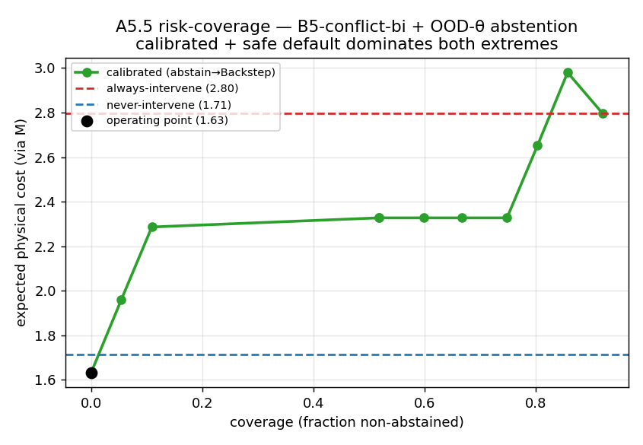
Generalizes — and Knows When It Doesn't
Calibrated abstention + a strict safety advantage (Claim C4)
▪ Generalization. Attribution holds across held-out surface appearances (vision-dependent agents degrade most, body-only least — confirming body-feel is the appearance-invariant channel) and across stacked operator combinations (100% dominant-factor recognition).
▪ A usable "I'm uncertain" signal. A small privileged-physics predictor's prediction-error is a calibrated uncertainty score — it detects the model's own attribution errors with AUROC 0.87.
▪ Abstain → safe default (figure). When uncertain, fall back to back-away: the calibrated policy strictly dominates both *always-act-on-the-diagnosis* and *never-intervene*, on expected physical cost — turning the asymmetric mis-diagnosis cost into a strict safety advantage.
▪ The system (real stack): 1 kHz proprioception → Kino-Tokens (compressed body-signal tokens) → a VLA recovery planner (Qwen3-VL-4B + LoRA); evaluated on a physically-simulated Unitree Go2 + real RTX rendering + real CLIP; every number reproducible (deterministic reset).
▪ One line: Feel It (body-feel is necessary + appearance-invariant), See It (vision is necessary + appearance-decidable), Recover (the diagnosis causally determines safe recovery) — with a calibrated escape hatch when uncertain.
Feel It, See It, Recover · Cross-Modal Failure Attribution for Safe Quadrupedal Recovery | 5/5

