Slide 1

“PESTPATROL”-AGRICULTURE PEST DETECTION
TEAM MEMBERS:
VISHNU R
SUNIL PRASAD A
EUREKA S
JOAN TRISHALA K

Slide 2
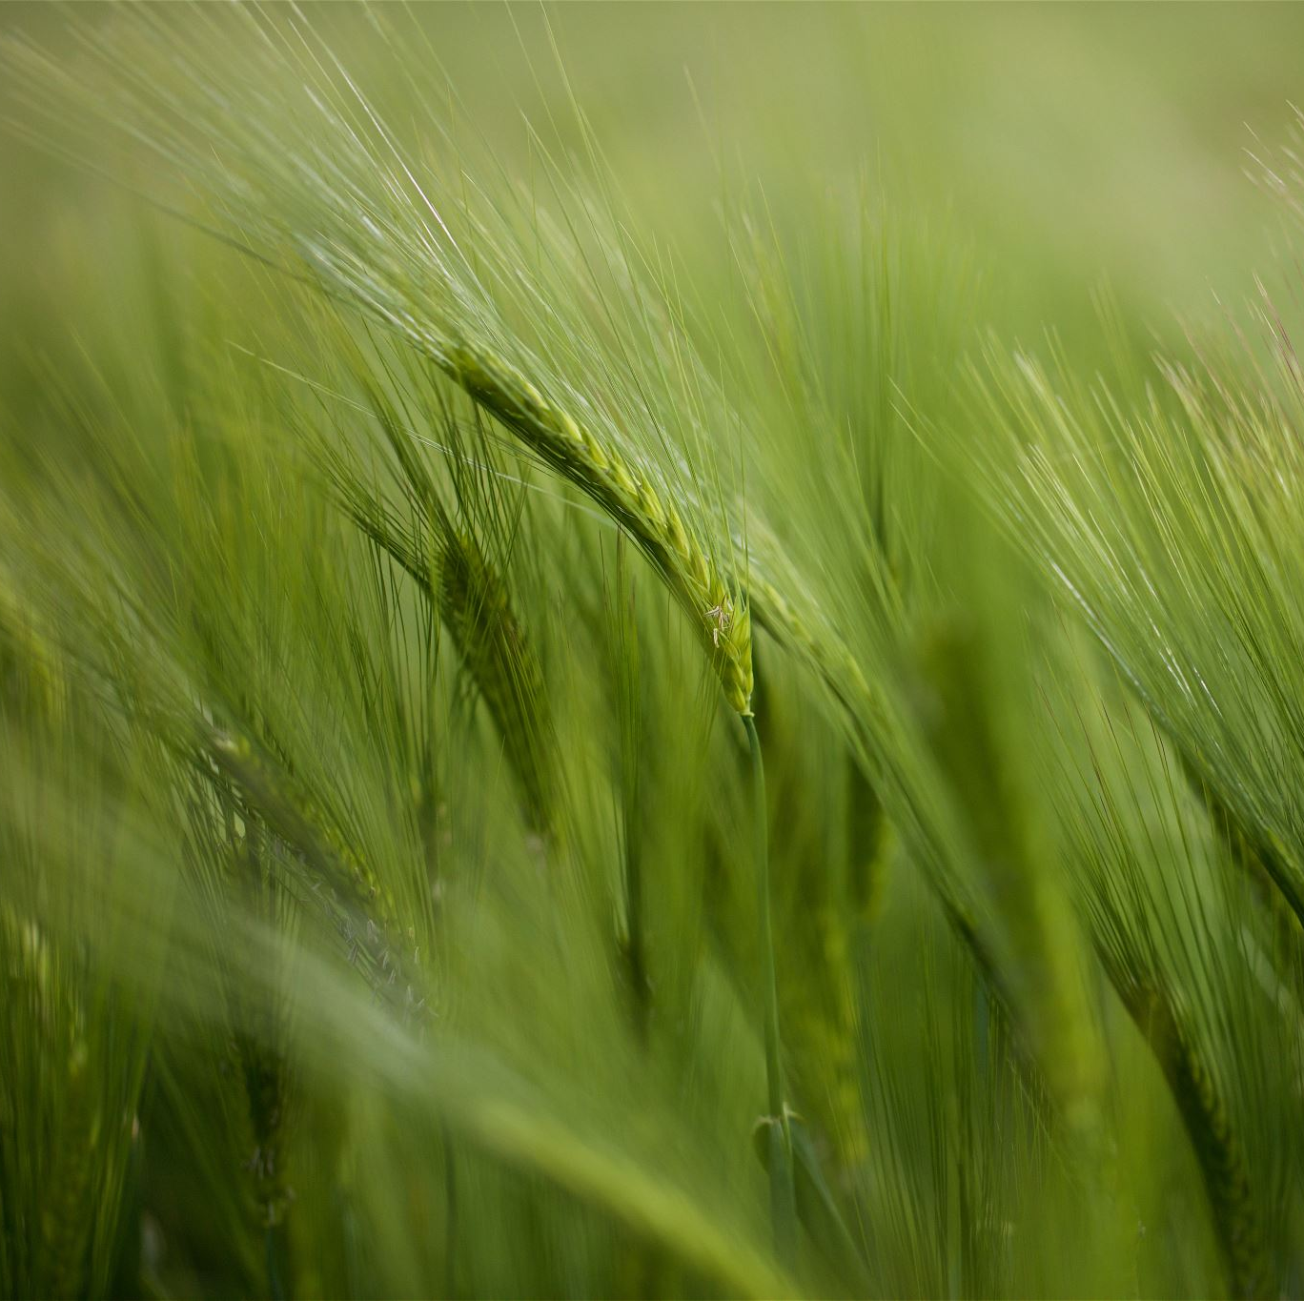
PROBLEM STATEMENT
The agriculture pest detection problem statement involves developing efficient systems or technologies to identify and manage pests in crops.
This may include using sensors, image recognition, or other technologies to detect and classify pests, allowing farmers to take timely and targeted measures to protect their crops.

Slide 3

OBJECTIVE
The objective of agricultural pest detection is to identify and monitor the presence of harmful organisms, such as insects, diseases, or weeds, in crops.
Early detection allows for timely intervention to minimize damage and optimize crop yields through targeted and efficient pest management strategies.

Slide 4
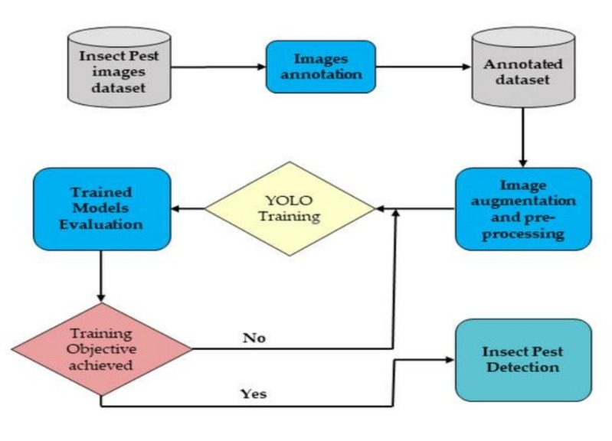
SYSTEM WORKFLOW

Slide 5
TECH STACK
Audio detection:For Convolutional Neural Networks (CNNs)
Video detection:YOLO (You Only Look Once) or Faster R-CNN (Region-based Convolutional Neural Network).
Object detection:Faster R-CNN, YOLO (You Only Look Once), and SSD (Single Shot Multibox Detector).
GUI: Tools like Tkinter (Python) or JavaFX (Java)
Libraries:TensorFlow and PyTorch.

Slide 6
ASSUMPTIONS
Assumptions in agricultural pest detection often include reliable sensor data, consistent environmental conditions, and accurate models for pest identification.
Additionally, assumptions may involve uniform distribution of pests, absence of anomalies in data, and timely response capabilities. Keep in mind that real-world conditions can vary, impacting the effectiveness of pest detection systems.

Slide 7
COST
The cost of agricultural pest detection can vary depending on factors such as the technology used, the scale of the operation, and the specific pests targeted. Common methods include satellite imagery, drones, and sensor networks.
Costs may include equipment, data analysis tools, and personnel training. It's advisable to consult with agricultural experts or technology providers for more accurate and up-to-date cost estimates based on your specific needs.

Slide 8
FUTURE SCOPE
The future scope in agricultural pest detection involves advancements in technologies like AI, machine learning, and IoT. Implementing smart sensors, drones, and data analytics can enhance real-time monitoring, enabling early pest detection and targeted interventions.
This approach improves crop yield, reduces pesticide usage, and promotes sustainable farming practices. Integration of emerging technologies will play a crucial role in shaping the future of pest detection in agriculture.

Slide 9
THANK YOU!!

