Slide 1


FAIR 101 – Depositing bioimage data in open repositories
Isabel Kemmer
FAIR Image Data Steward, Euro-BioImaging Bio-Hub
Trends in Microscopy 2025 17.-21. March 2025

Slide 2



This workshop
Introduction into FAIR principles
Benefits of FAIR data
Metadata
Mix and Match Metadata
Repositories
Explore repositories
Deposition process in BioImage Archive
Deposit your own data

Slide 3
What is FAIR?

Slide 4
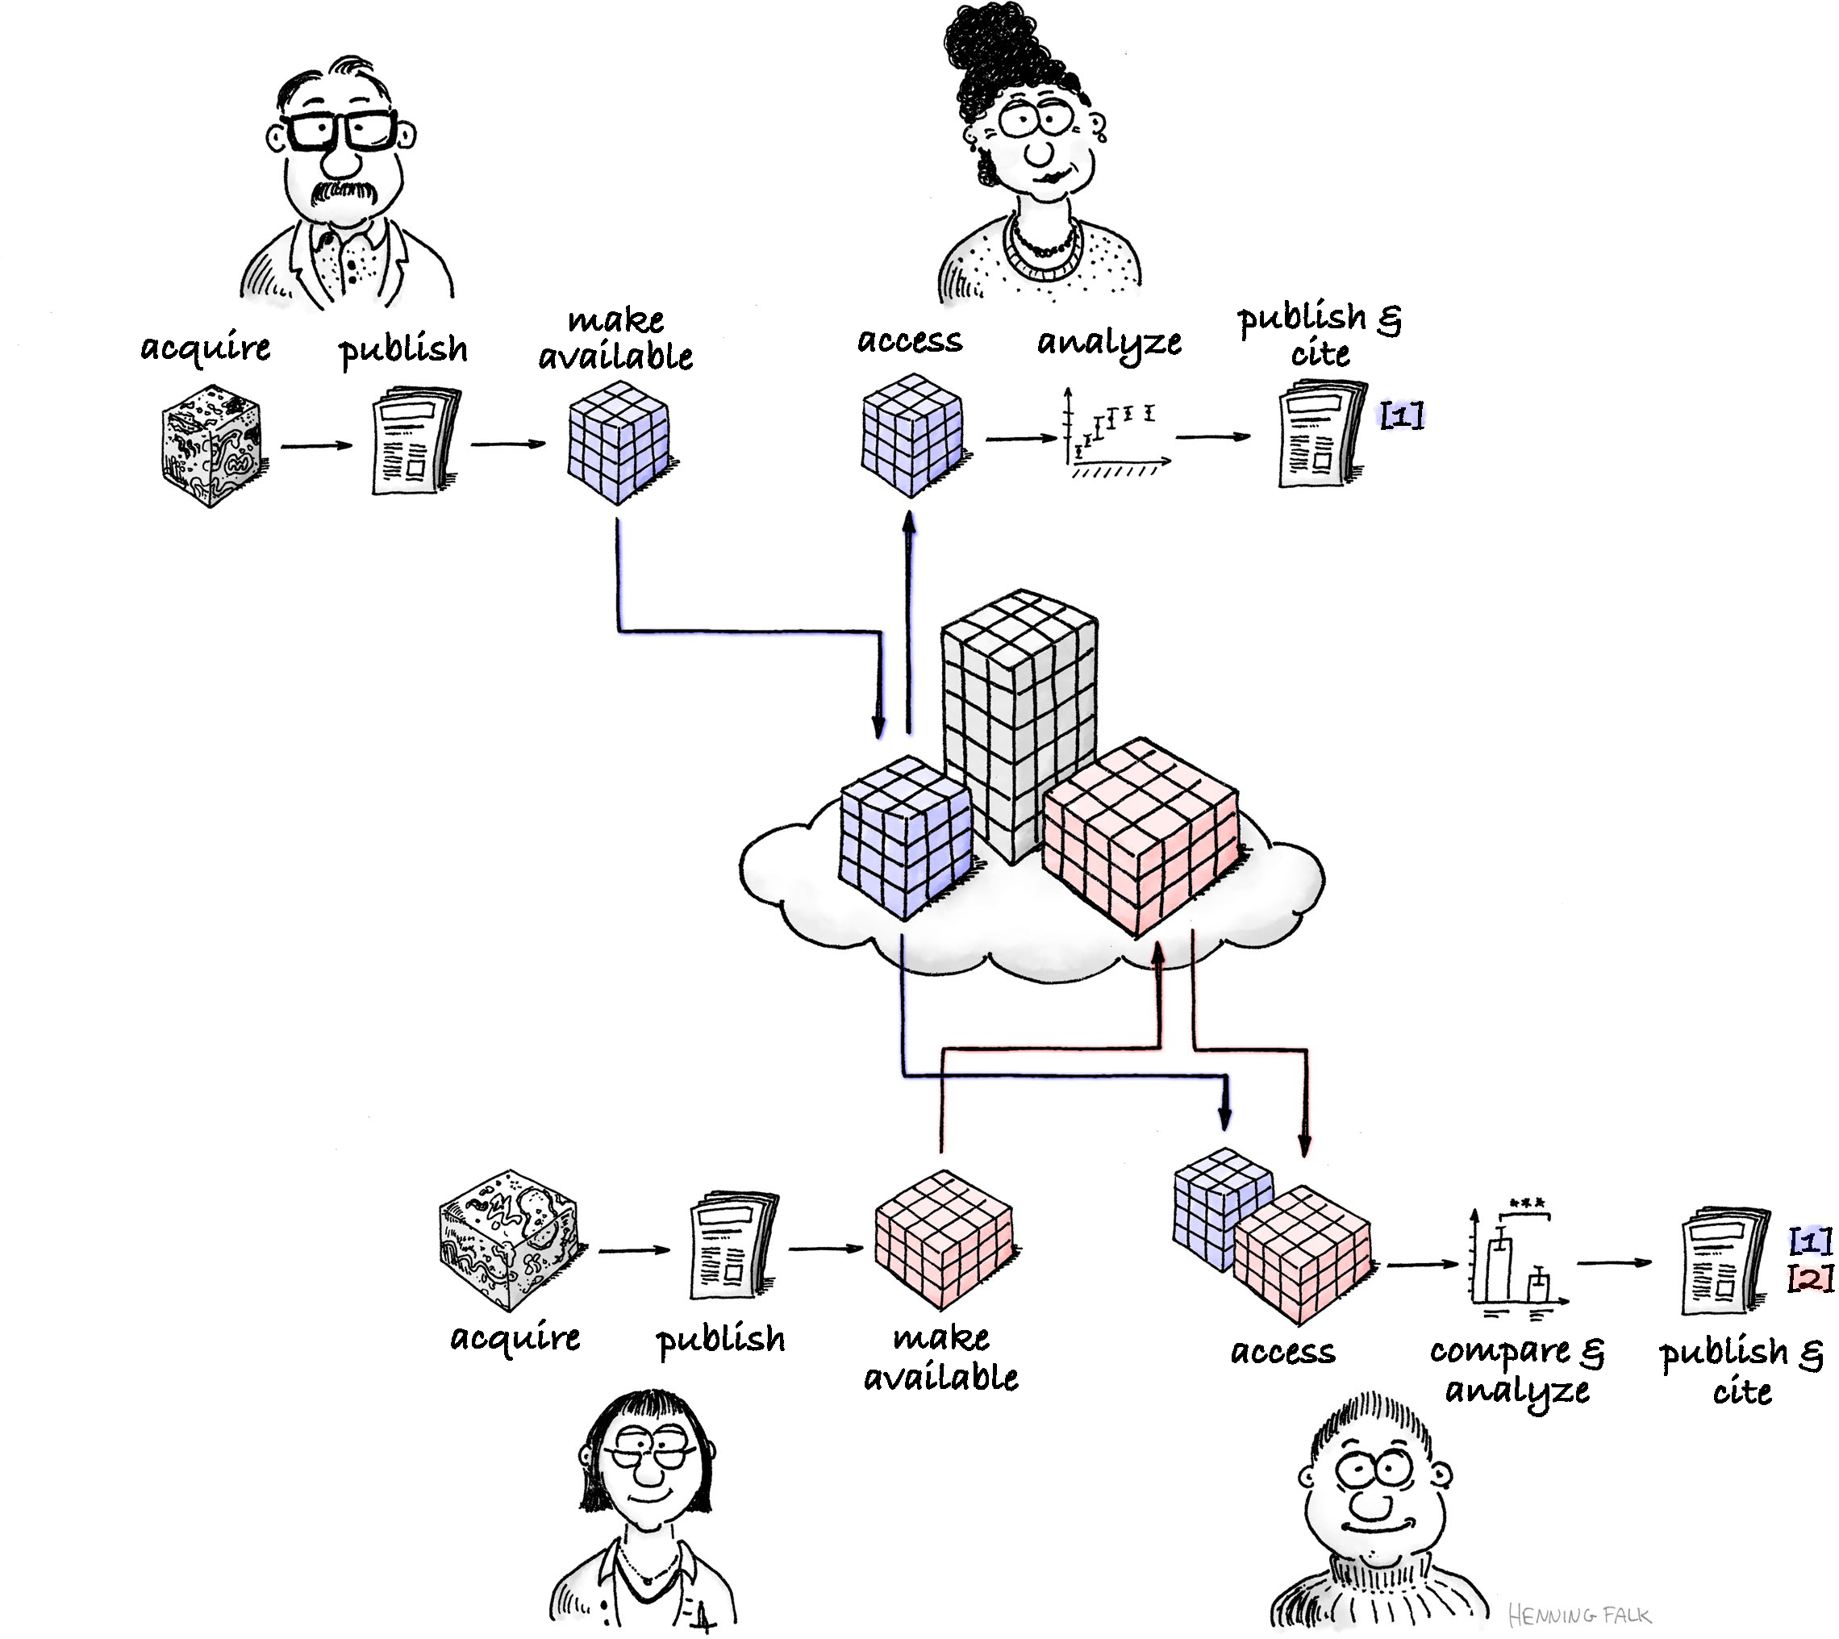
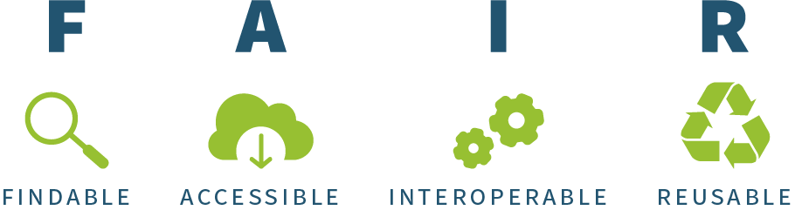
A set of principles and guidelines with the ultimate goal to optimise the reuse of scientific data
Wilkinson, M., Dumontier, M., Aalbersberg, I. et al. The FAIR Guiding Principles for scientific data management and stewardship. Sci Data 3, 160018 (2016). https://doi.org/10.1038/sdata.2016.18
FAIR re-use by Henning Falk, ©2022 NumFOCUS, is used under a CC BY 4.0 license.

Slide 5
FAIR data = Open data
Always managed and shared respecting any ethical, legal or contractual restrictions.
Completely open data can be used, shared and built-on by anyone for any purpose
Managed Data
FAIR
Data
FAIR data may not always be open
Example: a dataset can be accessible only to a closed group, but still be findable, reusable, and interoperable.
Open Data are not necessarily FAIR
Example: Undocumented data dump on a personal homepage is neither findable, reusable nor interoperable.
Open
Data
FAIR tip: Make data „as open as possible, as closed as neccesary“

Slide 6
Data Management
Repository
Metadata
Data are registered in a searchable resource
Machine-readable, persistent identifiers
Described by rich metadata
Standardized and open communication protocol for data retrieval
Authentication and authorization possible
Metadata are longer accessible than data
Open and standard file formats
Metadata use controlled vocabulary
Include references to other data
Clear and accessible license
Metadata according to community standards
Well-described provenance information (documentation of reproducibility)

Slide 7
Data Management
Repository
Metadata
Data are registered in a searchable resource
Machine-readable, persistent identifiers
Described by rich metadata
Standardized and open communication protocol for data retrieval
Authentication and authorization possible
Metadata are longer accessible than data
Open and standard file formats
Metadata use controlled vocabulary
Include references to other data
Clear and accessible license
Metadata according to community standards
Well-described provenance information (documentation of reproducibility)
This workshop
Thanks to TiM organizers and data stewards on-site

Slide 8
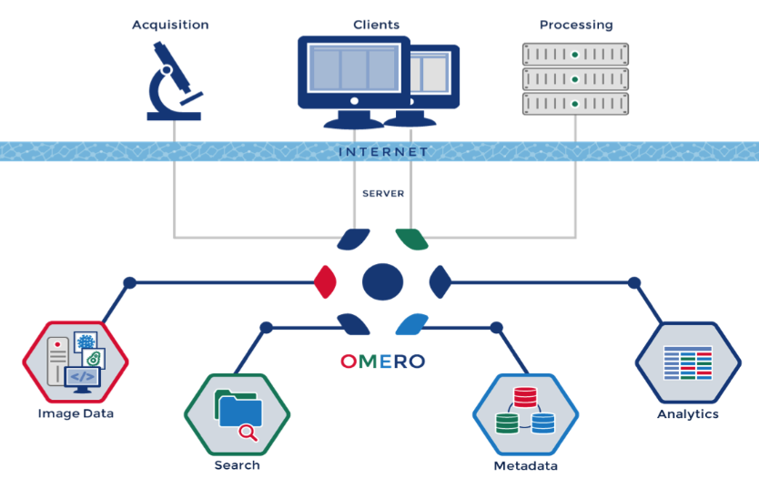
Image management software - OMERO
FAIR tip: and consider using an image management software
Visualize, manage, annotate, and share scientific image data from anywhere in the centralized, client-server platform OMERO.
Stores acquisition metadata and user-added annotations (like ROI & Segmentations) in relational database
https://www.openmicroscopy.org/omero/

Slide 9

In your opinion: What are the benefits of FAIR data?

Slide 10
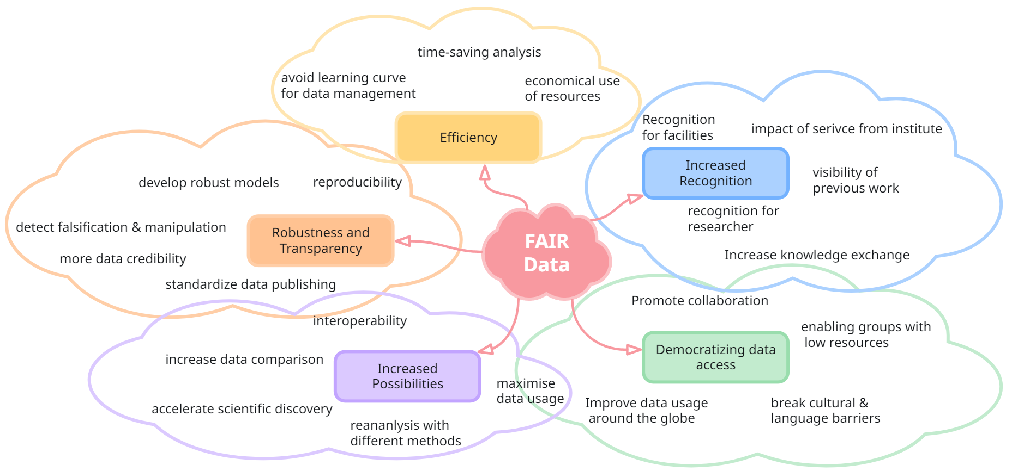
In the future, FAIR will no longer be a choice but a requirement!

