Slide 1





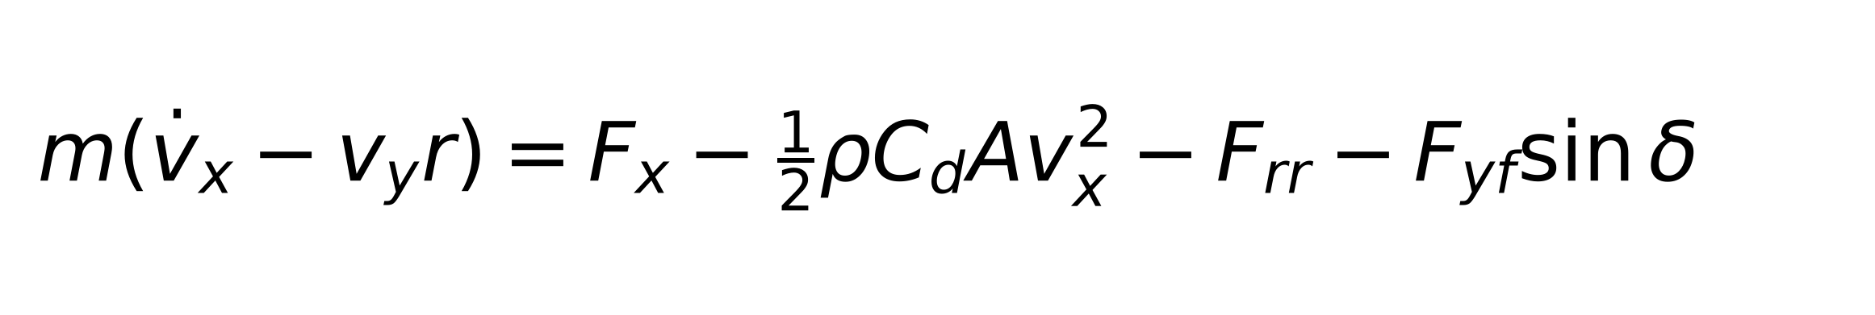
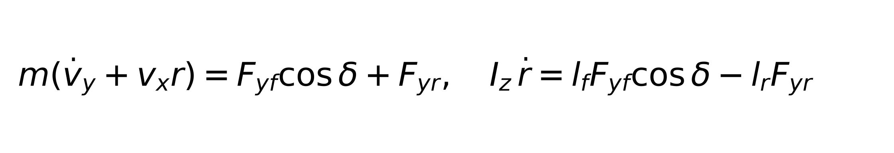
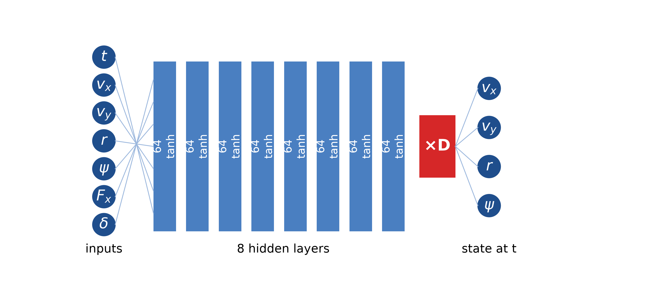
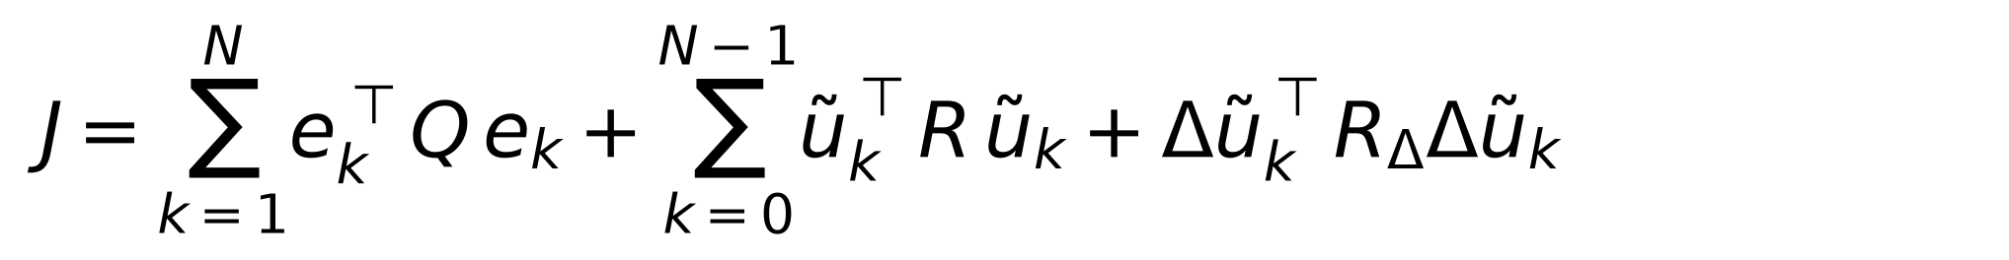
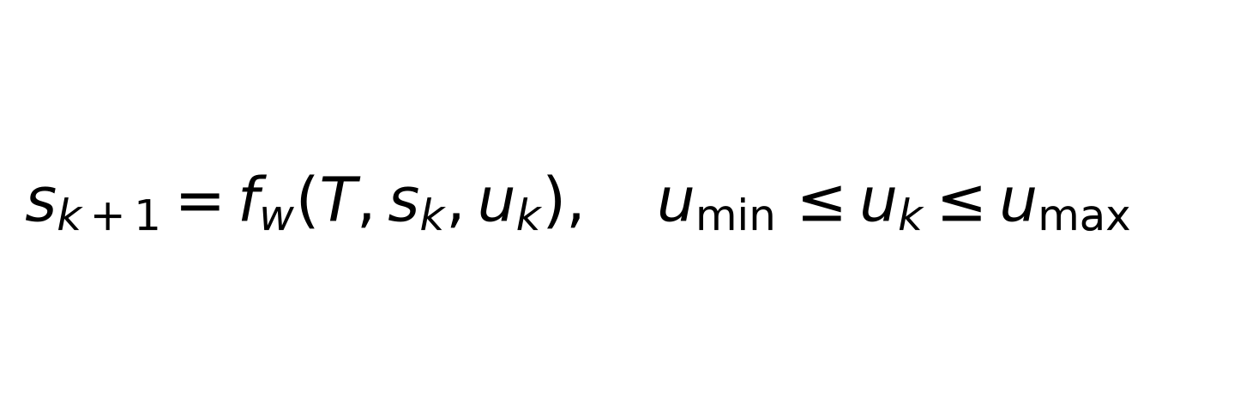

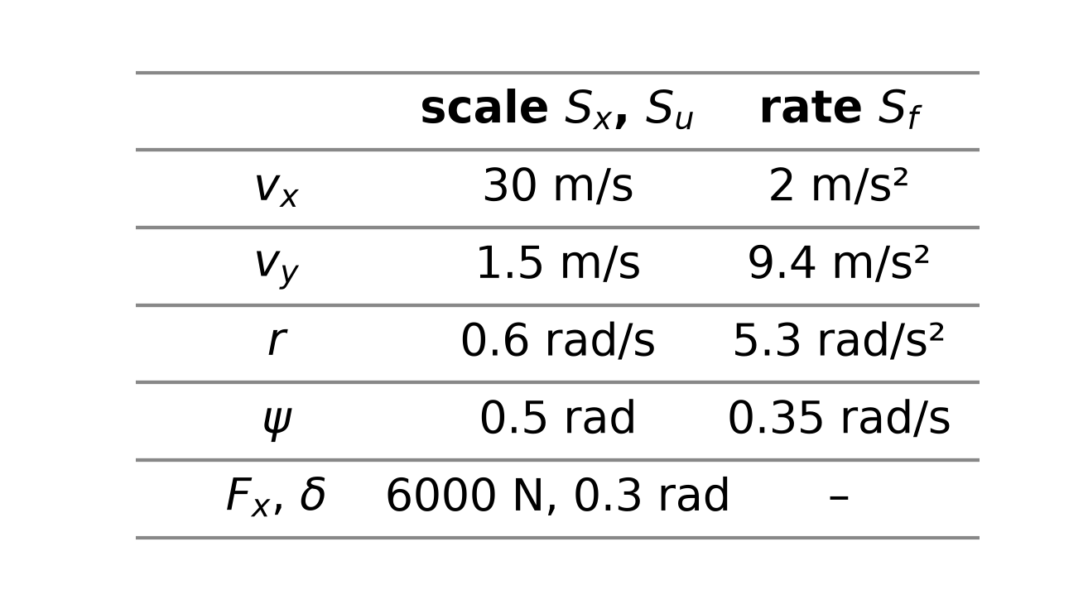
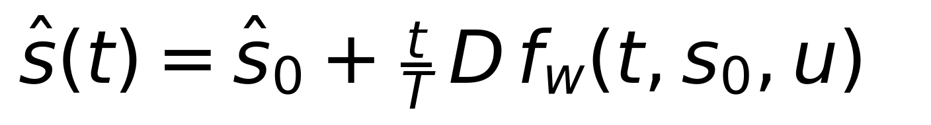

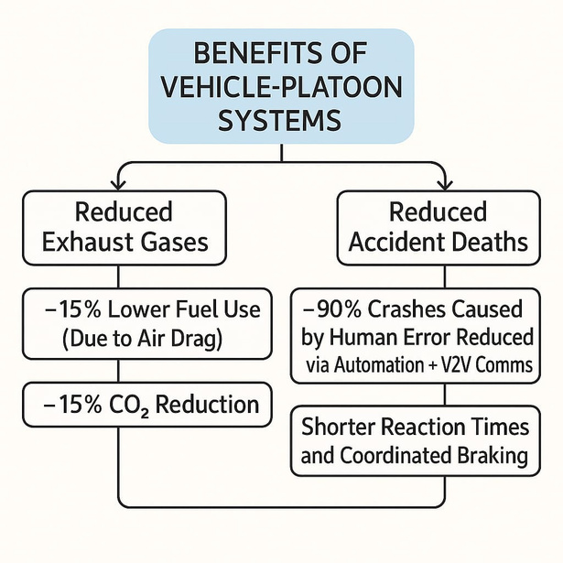
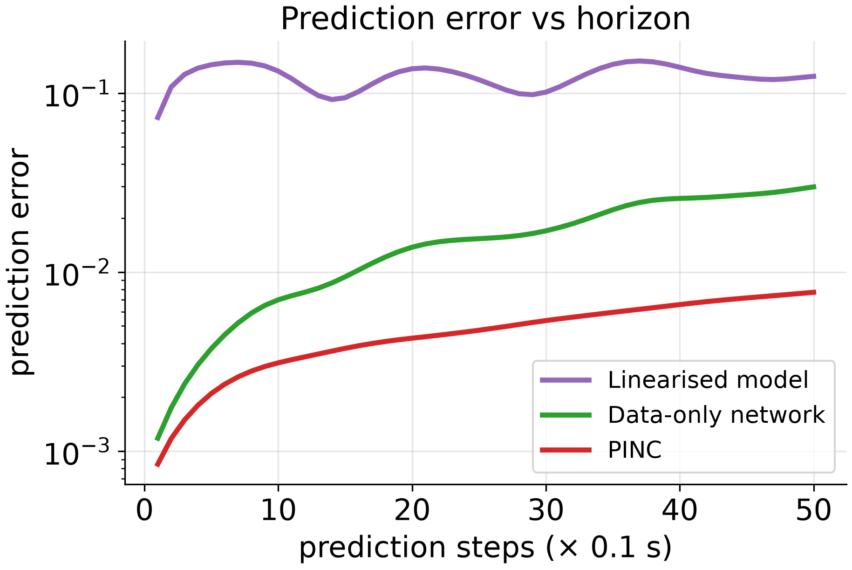
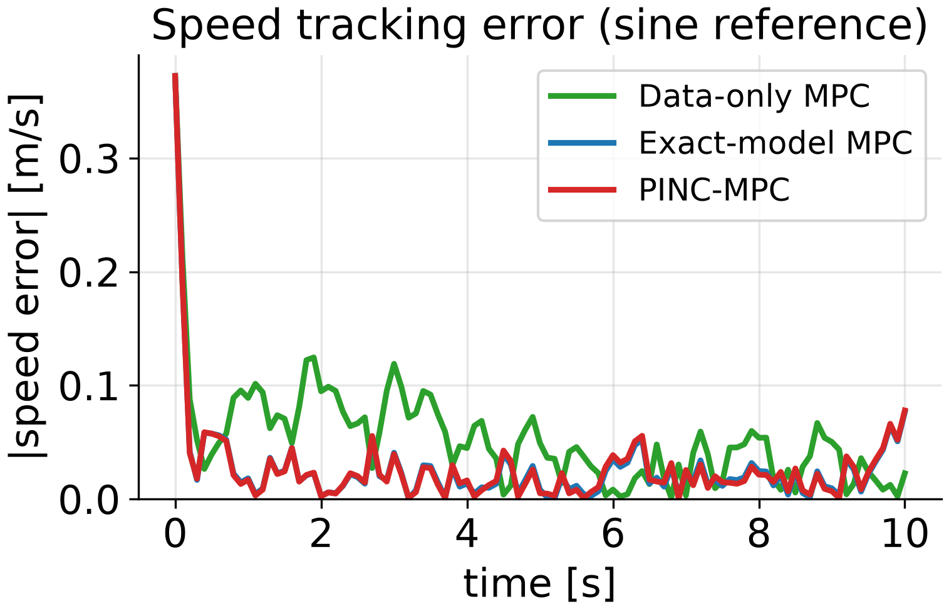
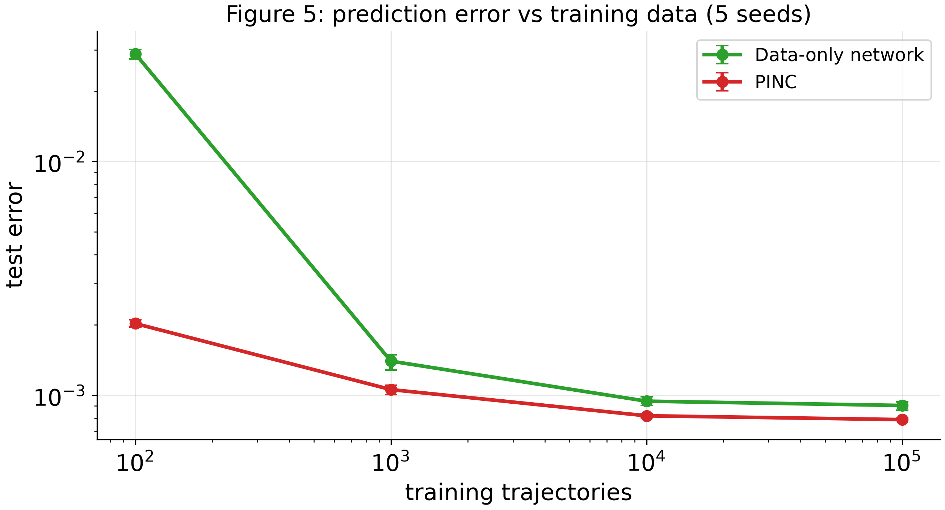
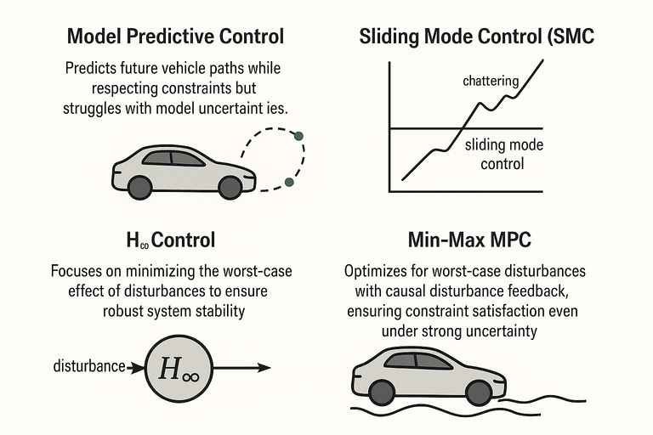
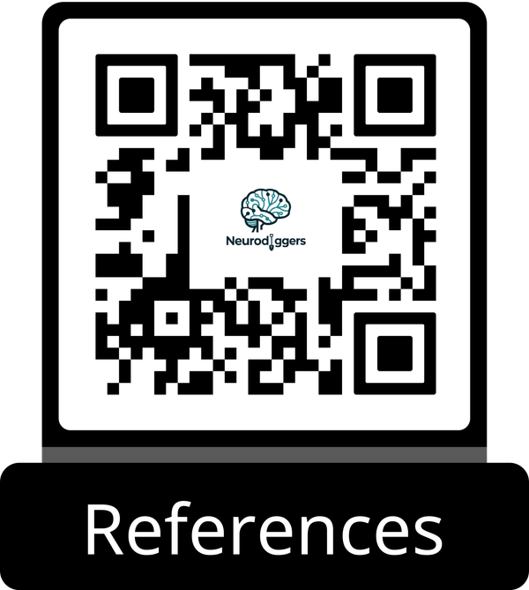
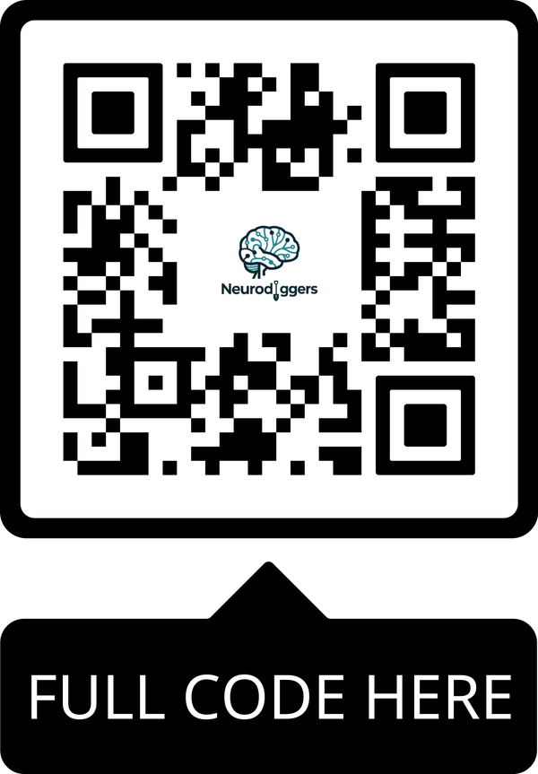


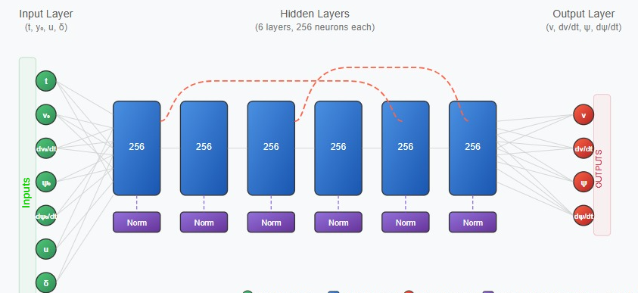
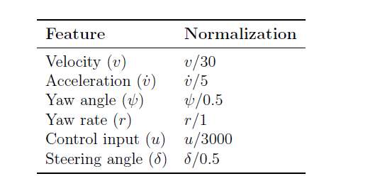

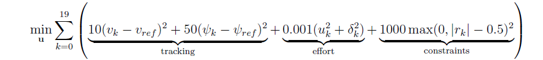



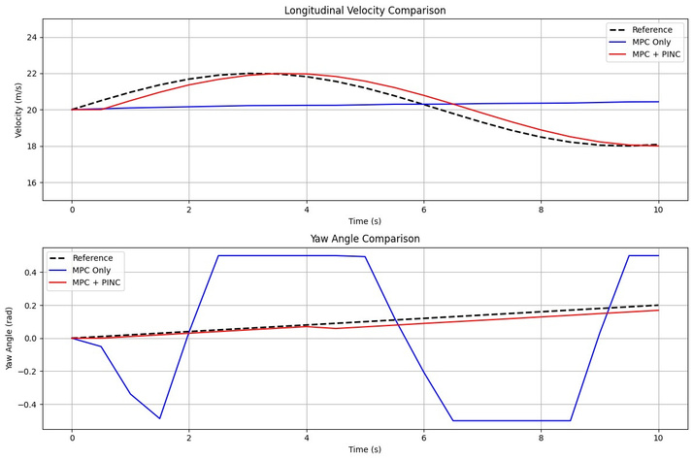
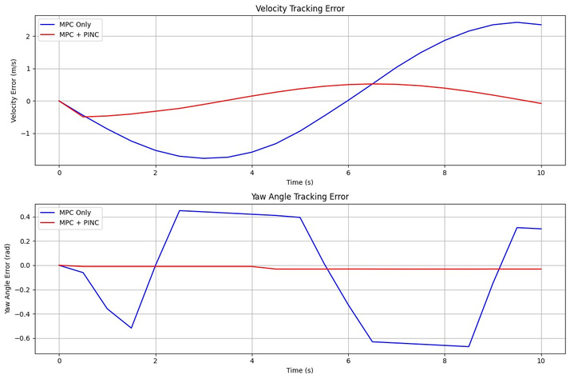


Physics-Informed Neural Networks
for Predictive Vehicle Control
MTHG103E
Supervised by Dr. Samah Tantawy
Digging deep into intelligence & driving the future
Abstract
Mathematical Modeling
Experimental Setup
Model predictive control (MPC) needs a prediction model that is both fast and accurate. We train a physics-informed neural network for control (PINC) on a vehicle model with coupled speed and steering dynamics and use it inside MPC. Against the same network trained on data alone, the physics term made the learned dynamics 13× more accurate and cut 50-step prediction errors 2.2× (17× with only 100 training trajectories). In closed loop, PINC-MPC tracked as well as an MPC using the exact model over four manoeuvres and 30 noisy runs each.
We describe the vehicle with a single-track (bicycle) model: longitudinal speed vx, lateral speed vy, yaw rate r and heading ψ, driven by a longitudinal force Fx and steering angle δ. The tyre forces depend on the front and rear slip angles, so speed and steering are coupled. PINC learns this model and replaces it inside the MPC.
Approach:
  One MPC, four prediction models: exact model, PINC, data-only network, linearised model.
  Data-only network: the same network trained without the physics term (λ = 0).
  Longitudinal Dynamics:
Neural Network Architecture
  7 inputs: time, initial state (vx, vy, r, ψ), force and steering
  8 hidden layers × 64 neurons, tanh activation
  Exact initial condition, per-state output scaling D
  4 outputs: vx, vy, yaw rate r and heading ψ
  Lateral and Yaw Dynamics:
  MPC's Cost Function:
Problem Definition
which is subject to:
Figure 4
Road crashes cause 1.19 million annual deaths globally, primarily due to human error and limitations in current vehicle automation. While connected and automated vehicles (CAVs) promise significant safety improvements, existing systems struggle with real-world complexities unpredictable driver behavior, and imperfect sensors. The critical challenge lies in developing accident prevention systems that reliably handle these uncertainties while maintaining traffic flow efficiency and reducing emissions (potential 15% fuel savings). This demands fundamentally new approaches to vehicle coordination and avoidance.
  Our Contribution: Physics-Informed Model
1.
A neural network trained with a physics-informed loss maps time t, initial state and input u to the predicted state; chaining it over the horizon gives the MPC its model.
Training Protocol
  Loss:
  Optimizers: Adam then L-BFGS (lr = 0.001)
  Data: 20 000 simulated trajectories
  Normalization:
2.
Exact initial condition and a per-state scaling D, which keeps the four physics terms balanced:
  Test manoeuvres
Results
Conclusion
Does PINC learn the physics?
Prediction (5 training seeds):
  Learned dynamics 13× more accurate than the data-only network.
  50-step prediction error 2.2× lower, and 2.6× lower outside the training range (Figure 3, left).
  With only 100 training trajectories, 14× more accurate (Figure 5).
Closed-Loop Control:
4 manoeuvres × 30 noisy runs:
  PINC-MPC matches the exact-model MPC (lane change: 3.3 cm vs 3.3 cm error).
  The data-only MPC drifts in speed: median error 1.8× higher, in all 30 runs (Figure 3, right).
  Not faster than the exact model at short horizons; 1.5× faster at 40 steps.
Physics-informed training made the network learn the vehicle dynamics instead of only fitting data. Next steps:
  Unknown vehicles: learn from measured data, with physics as a prior.
  Higher-fidelity vehicle models, where the surrogate's speed advantage grows.
  Hardware-in-the-loop and on-vehicle tests.
Key lesson: scale the physics loss per state; without it, physics made the model less accurate.
Figure 3
Figure 1
Literature Review
.
This review compares control methods for Connected and Automated Vehicles (CAVs). Model Predictive Control (MPC) predicts future states but struggles with uncertainties. Sliding Mode Control (SMC) counters disturbances but causes actuator wear. H∞ control ensures robust stability, while Min-Max MPC optimizes for worst-case scenarios. Integrating these with physics-informed neural networks shows strong potential for managing complex vehicle dynamics, as shown in Figure 2.
References
[1] S. Wei et al. An integrated longitudinal and lateral vehicle-following control system with radar and V2V communication. IEEE Trans. Veh. Technol., 68(2):1116–1127, 2019.
[2] A. Farea et al. Understanding physics-informed neural networks: techniques, applications, trends, and challenges. AI, 5(3):1534–1557, 2024.
[3] E. A. Antonelo et al. Physics-informed neural nets for control of dynamical systems. Neurocomputing, 579:127419, 2024.
Figure 2
Authors:
Ahmed H. Labib
Ahmed W.ElMarsafy
Ziad M. ElGendy
Zeyad E.Farghaly
Ziad H. Karawia
Zeyad M. ElSonney
Mohammed D.ElHosary

