Slide 1


RAD
www.itu.dk
www.dasya.dk
@dasyaITU
https://rad.itu.dk
dff.dk
Profiling & Monitoring Deep Learning Training Tasks
Ehsan Yousefzadeh-Asl-Miandoab (ehyo@itu.dk), Ties Robroek (titr@itu.dk), Pınar Tözün (pito@itu.dk)
IT University of Copenhagen
3rd EuroMLSys workshop – EuroSys ’23, Rome, Italy
08/05/2023

Slide 2
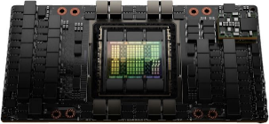
GPU Underutilization for ML Workloads
An analysis of 100,000 jobs run by 100s of users for ~2 months on a real-world cluster shows ~52% GPU utilization on average*
Energy-inefficient & waste of hardware resources
Compute/memory requirements of models don’t match with the giant GPUs
e.g., transfer learning, small models
Memory: 80GB
BASIC-L: ~2.44billion parameters
L2 cache: 50MB
CAIT-M-48-448: ~438million parameters
Memory Bandwidth: 3000 GB/sec
ResNet50: ~25million parameters
Thus, understanding the profilers and monitoring tools for GPUs is necessary.
* Jeon, Myeongjae, et al. "Analysis of Large-Scale Multi-Tenant GPU Clusters for DNN Training Workloads." USENIX Annual Technical Conference. 2019.

Slide 3

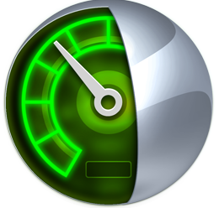

Profilers
PyTorch Profiler
Trace-based
Runs as part of the training process
Easier to use
a few lines of additional code
NVIDIA Nsight Systems (nsys)
Trace-based system-wide
Runs as a separate process
More detailed insights to OS & network
Doesn’t work when Multi-Instance GPU (MIG) is enabled on the GPU
NVIDIA Nsight Compute (ncu)
Kernel-level tracing of microarchitectural behavior
Runs as a separate process
Intrusive to program behavior
Runs the program several times
Ehsan Yousefzadeh-Asl-Miandoab et al. “Profiling & Monitoring Deep Learning Training Tasks”

Slide 4
Monitoring tools
NVIDIA System Management Interface (nvidia-smi)
Performance configuration (frequency changing, MIG config)
Tracking a range of high-level performance metrics
GPU Utilization
Memory Consumption
…
Doesn’t monitor MIG instances
NVIDIA Data Center GPU Manager (dcgm)
Easier management by grouping option
Finer-grained performance metrics for monitoring
SM Active (SMACT)
SM Occupancy (SMOCC)
…
Can monitor MIG instances
Ehsan Yousefzadeh-Asl-Miandoab et al. “Profiling & Monitoring Deep Learning Training Tasks”

Slide 5
Experimental Setup
Goal: Understanding GPU utilization metrics; overheads and strengths of the tools
Experiment 1: A microbenchmark to analyze GPU utilization metrics
Experiment 2: Model runs to analyze the overheads
On PyTorch 1.13.1 with 5 epochs
Light workload: Small CNN on MNIST
Heavy workload: ResNet50 on ImageNet, batch-size = 32
Hardware: NVIDIA DGX A100 Station
4X A100 40 GB
1X EPYC 7742, 64 cores
RAM: 512 GB
Tools
Default settings for PyTorch Profiler and Nsight Systems
Omitted Nsight Compute due to its intrusive nature
Ehsan Yousefzadeh-Asl-Miandoab et al. “Profiling & Monitoring Deep Learning Training Tasks”

Slide 6
GPU Utilization
GPU Utilization: % of time one or more kernels were executing on the GPU
GRACT: % of time any portion of the graphics or compute engines were active
SMACT: the fraction of active time on an SM, averaged over all SMs
SMOCC: degree of parallelism / max supported parallelism on SM
Coarse-grained
Fine-grained
Coarser-grained utilization metrics can be misleading.
Ehsan Yousefzadeh-Asl-Miandoab “Orchestration of Deep Learning Tasks on CPU-GPU Co-Processors for Multi-Tenant Settings”

Slide 7
Time overhead of tools
Average Epoch Time
High Overhead
Monitoring tools have negligible time overhead.
Profilers’ overhead is noticeable.
Profiling just for one iteration might be enough.
Ehsan Yousefzadeh-Asl-Miandoab et al. “Profiling & Monitoring Deep Learning Training Tasks”

Slide 8
Space overhead of tools
Tool | Small CNN | ResNet50
top | ~20KB | ~2MB
nvidia-smi | ~20KB | ~2MB
dcgm | ~85KB | ~8MB
nsys | ~40MB | ~5GB
pytorch | ~1.4GB | -
Trends for space overhead are similar to time overhead for all tools.
Ehsan Yousefzadeh-Asl-Miandoab et al. “Profiling & Monitoring Deep Learning Training Tasks”

Slide 9
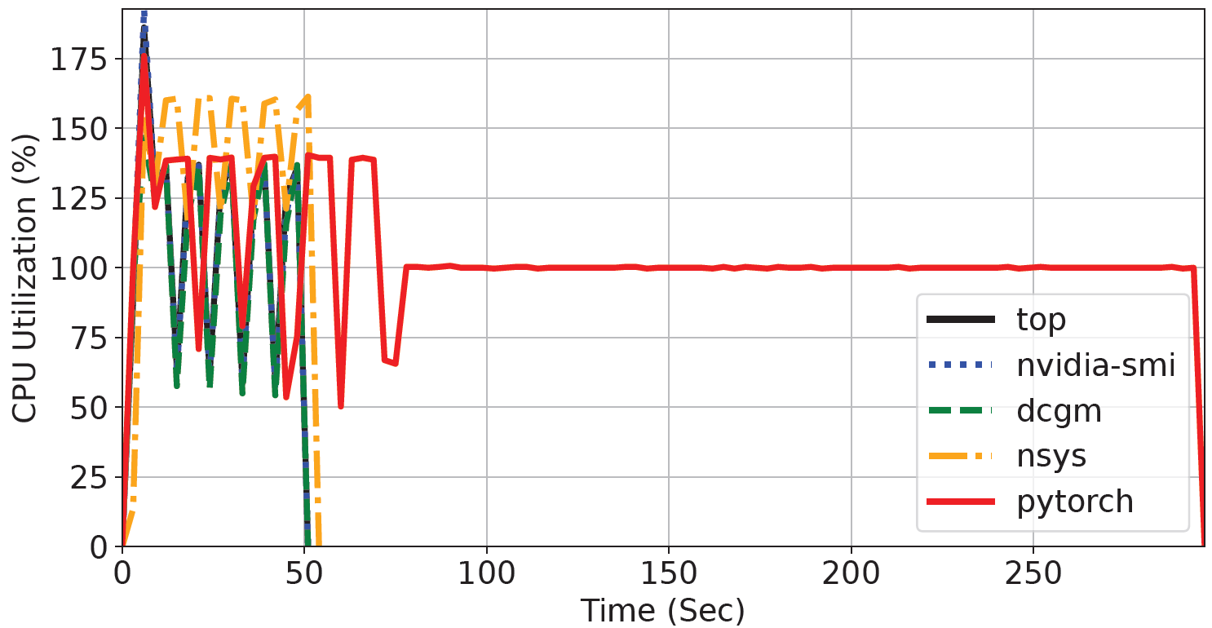
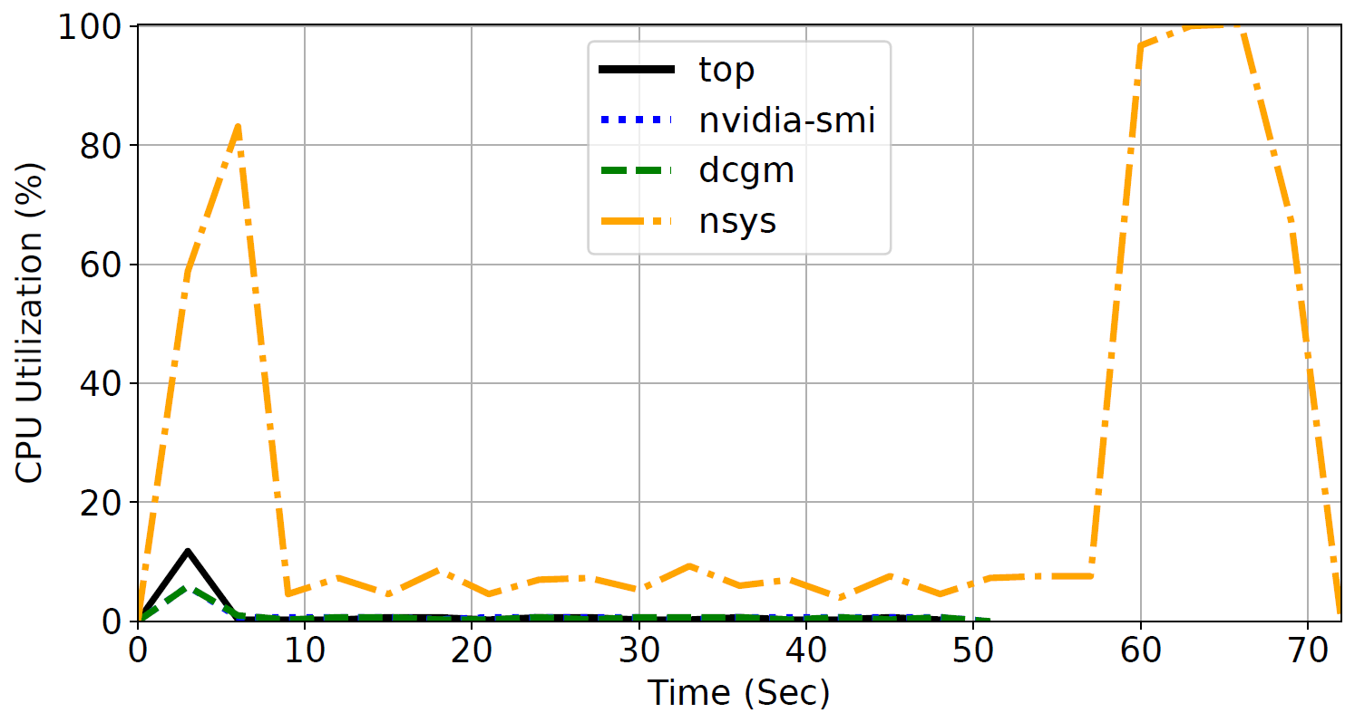
CPU overhead
Light model
Training processes
Tools’ processes
CPU usage overhead of profiling tools is higher than monitoring ones.
Profiling tools also need time for post-processing of collected traces.
Ehsan Yousefzadeh-Asl-Miandoab et al. “Profiling & Monitoring Deep Learning Training Tasks”

Slide 10
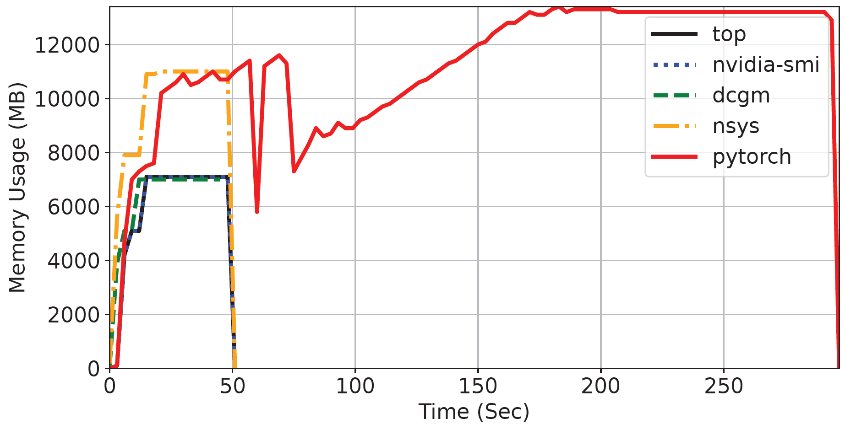
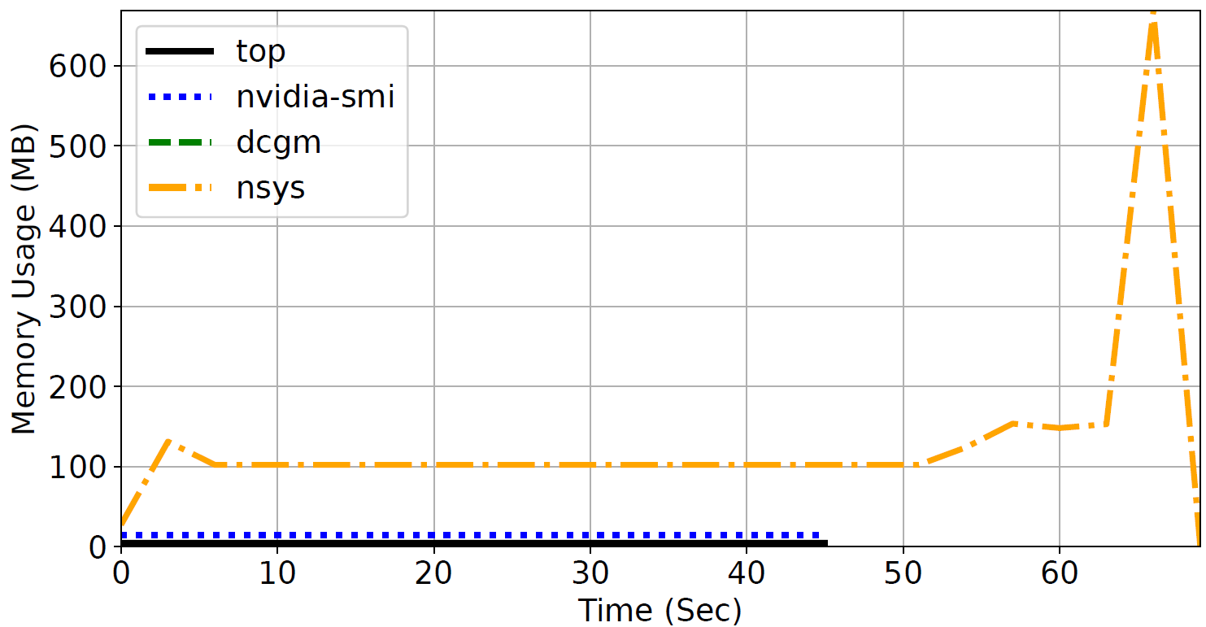
CPU memory overhead
Light model
Training processes
Tools’ processes
Memory overhead of profiling tools is also higher than monitoring tools’!
Ehsan Yousefzadeh-Asl-Miandoab et al. “Profiling & Monitoring Deep Learning Training Tasks”

Slide 11
GPU overhead
GPU overhead of all the tools is negligible!
Ehsan Yousefzadeh-Asl-Miandoab et al. “Profiling & Monitoring Deep Learning Training Tasks”

Slide 12
Summary – Insights
For model level optimization purposes
Use framework specific profilers
For digging deeper into OS and system
Use Nsight Systems
For kernel-level optimizations
Use Nsight Compute
Profile the needed amount of code for a reasonable range of time
Profiling for an iteration might be enough to show the behavior of training a model
For online decision-making purposes
Use monitoring tools with representative fine-grained metrics
Thanks! ☺
Ehsan Yousefzadeh-Asl-Miandoab et al. “Profiling & Monitoring Deep Learning Training Tasks”

Slide 13
Backup Slides

Slide 14
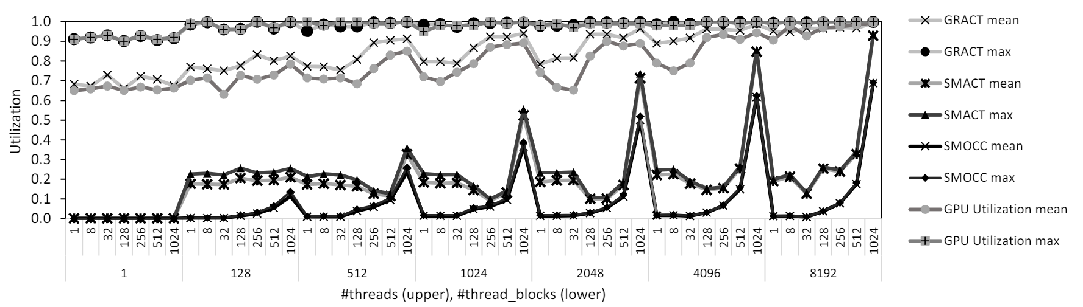
GPU Utilization Metrics

Slide 15
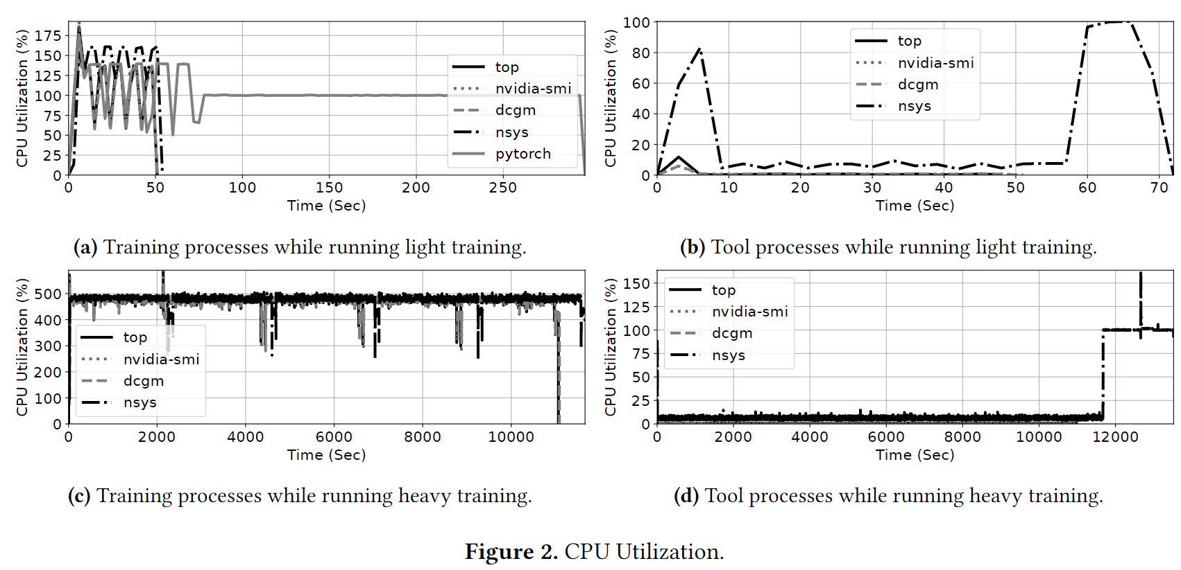
Tools Overhead experiments (2)

Slide 16
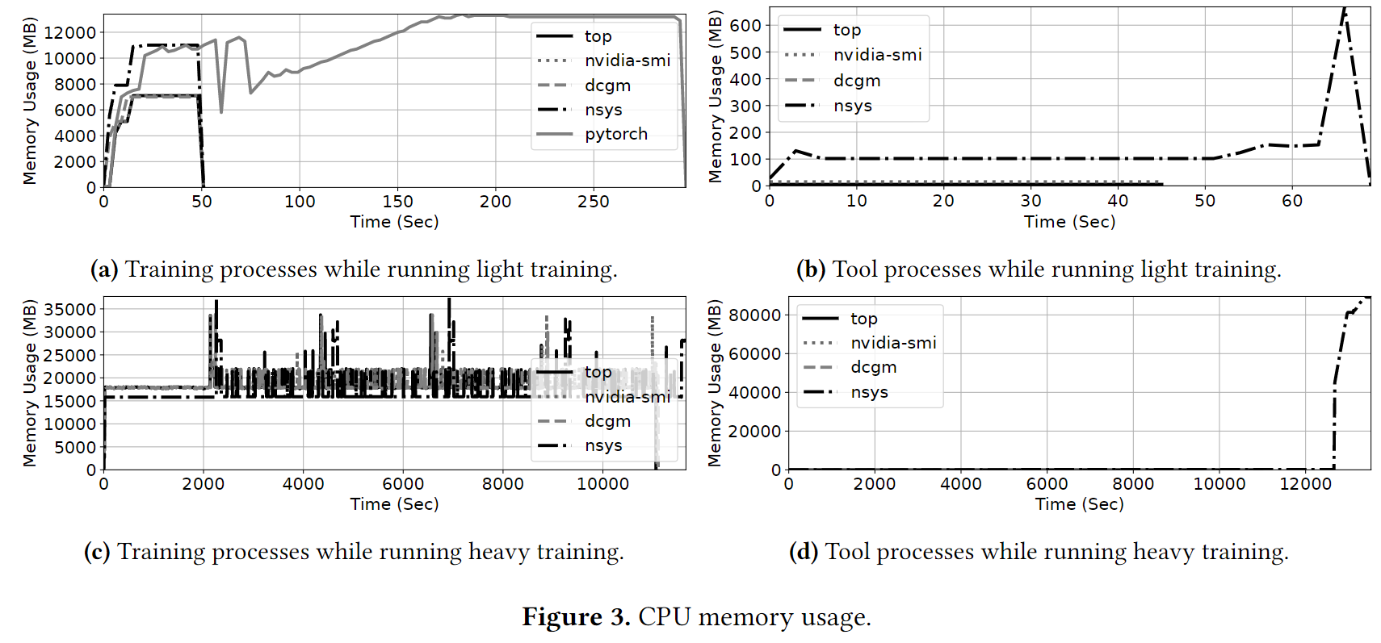
Tools Overhead experiments (3)

