Slide 1

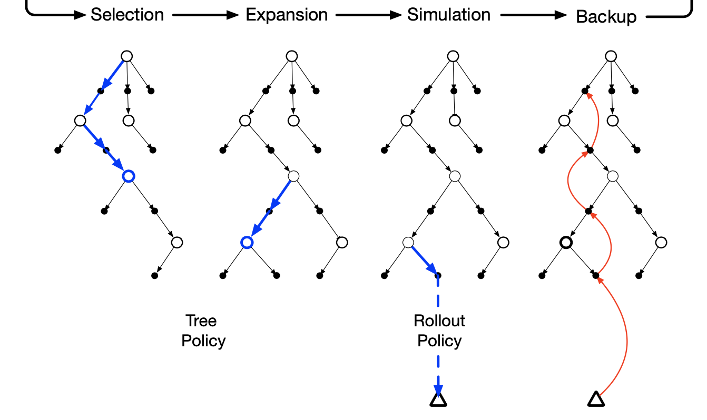
MCTS-GEB: MCTS is a Good E-graph Builder
Guoliang He, Zak Singh, Eiko Yoneki
University of Cambridge, UK
1

Slide 2
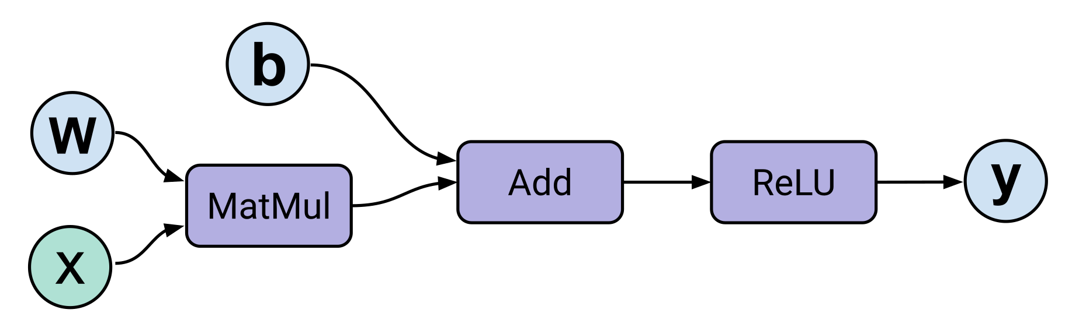
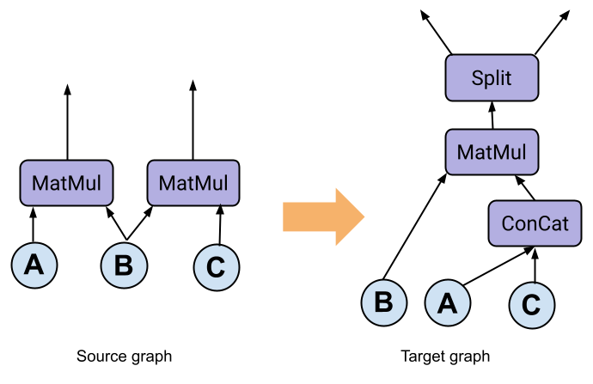
Background: rewrite
Optimizing compilers often apply a sequence of rewrite to the target program
The program is transformed to a more optimized form
For example, DNNs are represented as dataflow graph, and compilers may perform graph-level rewrite to transform the dataflow graph
2

Slide 3
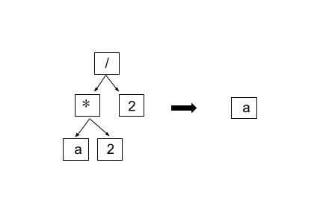
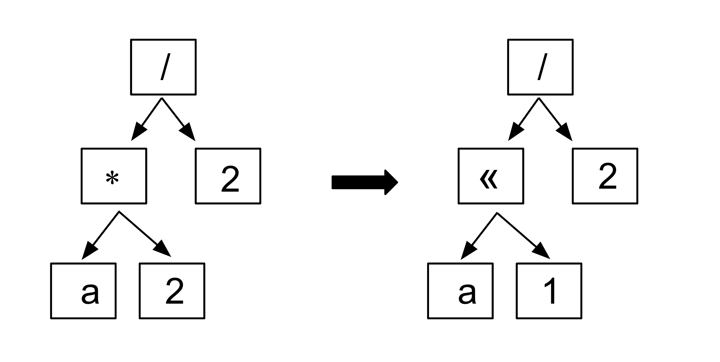

Background: A rewrite example
Goal:
$$(a∗2)/2→a$$
Rewrite rules sets:
$\left(x∗2\right)→x≪1$
$(x∗y)/z→x∗(y/z)$
$(x/x)→1$
$x∗1→x$
Ordering matters:
Apply rule 1: $(a≪1)/2$
Apply rule 2 + rule 3 + rule 4: $a$
Apply rule 3: fail
Applying rewrite rules are destructive
3

Slide 4
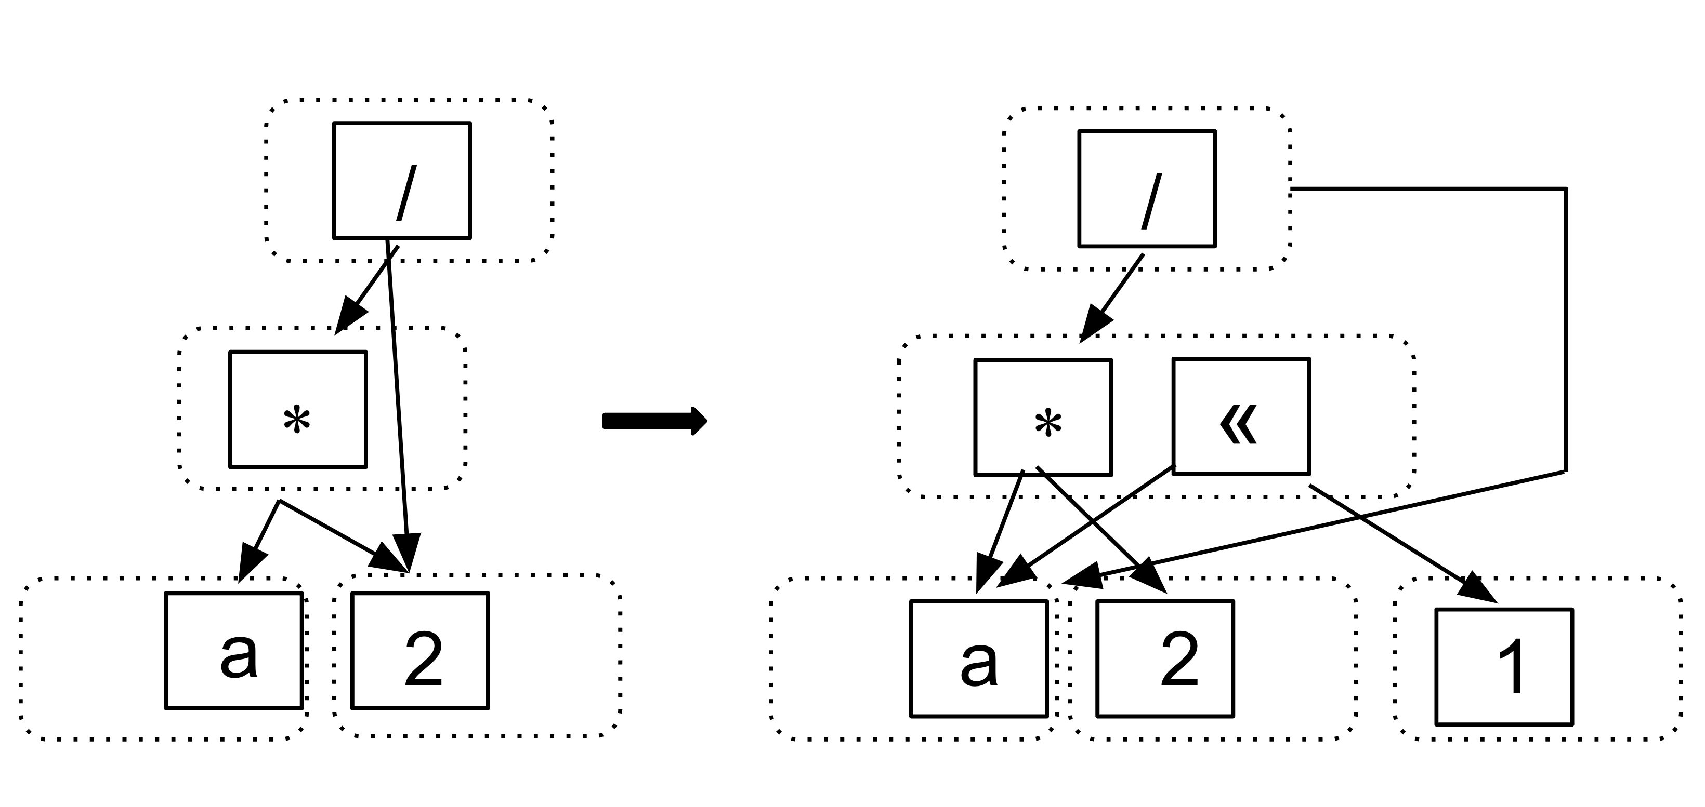
Background: Equality saturation
An E-graph is a data structure that can simultaneously represent many equivalent IRs
Equality Saturation:
Construction: applying rewrite rules to build an e-graph to represent many equivalent IRs
Extraction: extract the optimal IR from the e-graph
4

Slide 5

Motivations
Limitations:
E-graphs can easily grow to very large graph data structures and continue indefinitely
The construction phase is upper-bounded by a pre-defined node limit
Observation:
The phase-ordering problem is re-introduced during the construction phase
Method:
Use MCTS to build a better e-graph
5

Slide 6
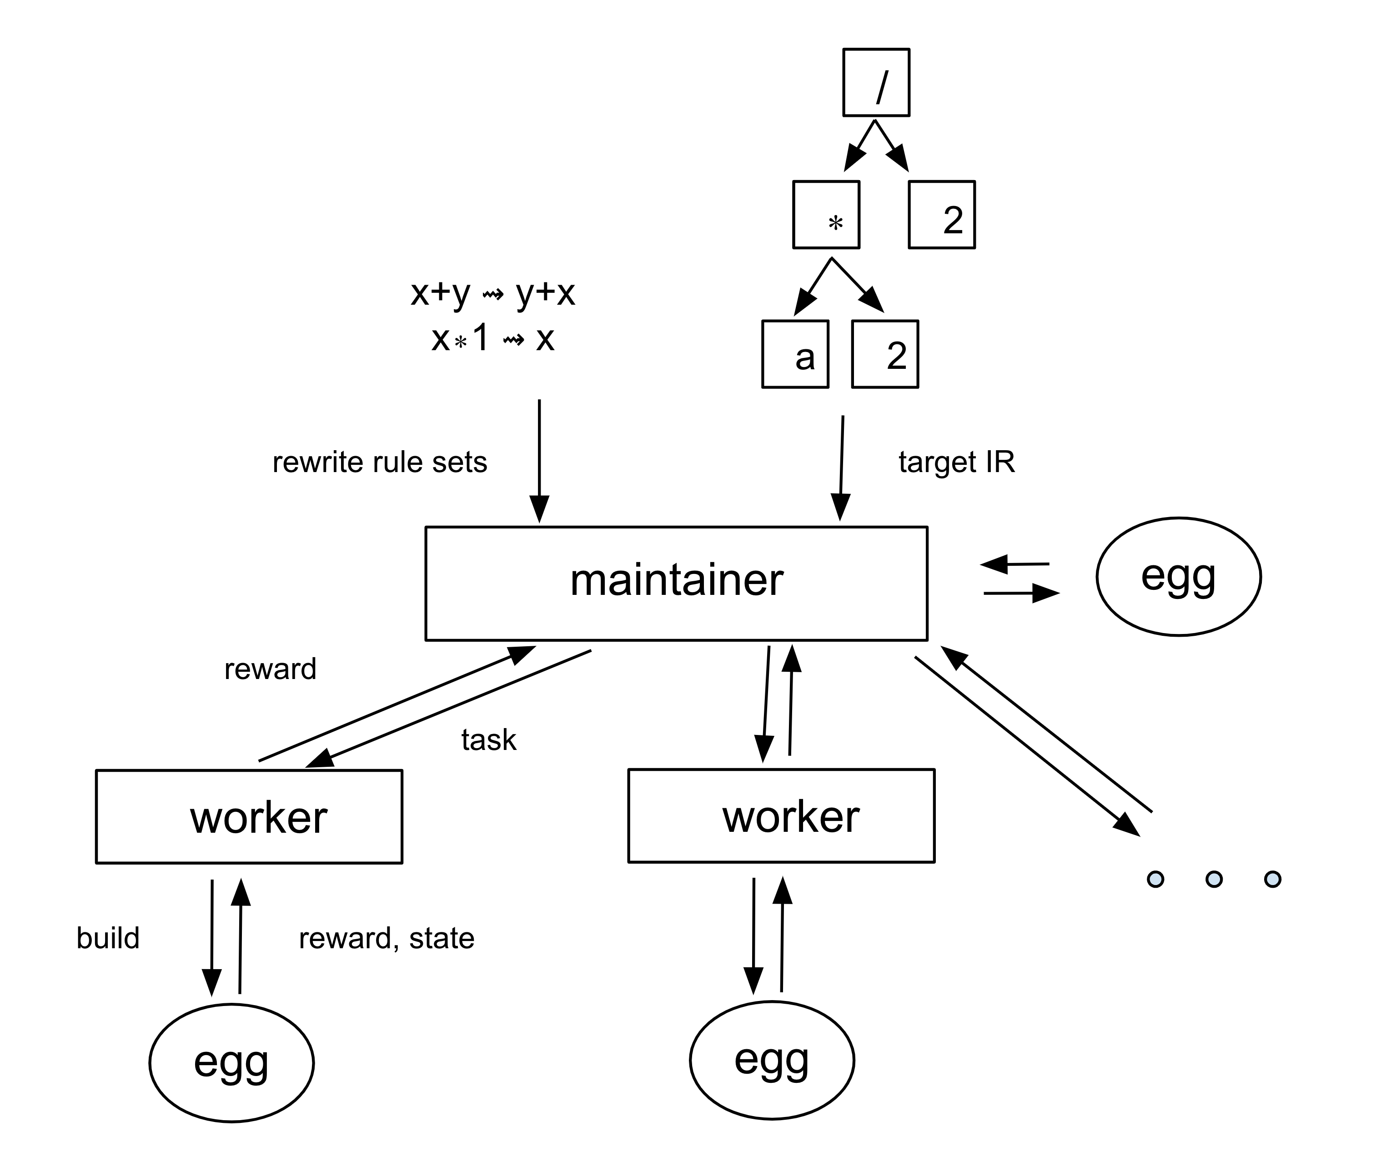
MCTS-GEB
End-to-end:
Inputs: the target IR and the rewrite rule set
Outputs: the optimized IR
System design:
A maintainer centrally manages its e-graph (via the egg library), and builds a MCTS search tree
Workers receive expansion and simulation tasks from the maintainer
6

Slide 7
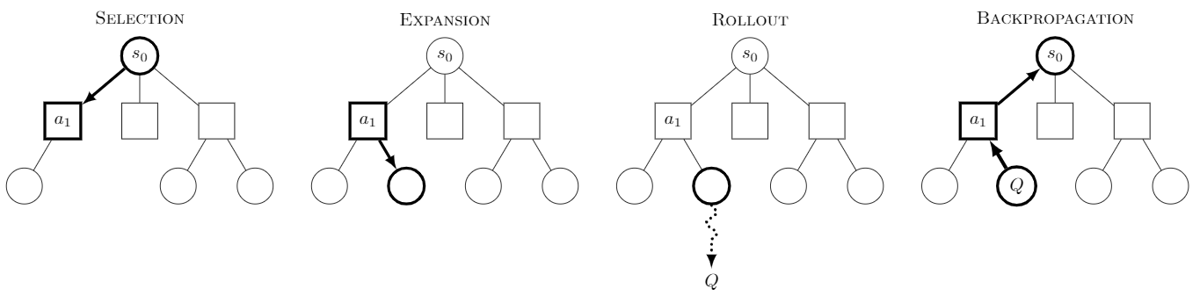
MCTS-GEB
Algorithm overview:
Loop until construction is done
MCTS root <- maintainer’s current e-graph;
Loop until search budgets
The maintainer’s select a tree node to be expanded;
A worker performs expansion;
A worker performs simulation;
The node’s value estimate is returned to the maintainer, and then added to the MCTS search tree;
Select the maximal value child node and updates its e-graph;
7

Slide 8
initial Experiment results
Data: randomly generate expressions from Math/Prop domain
Goal: simplify expressions
Platform: A 24 CPU cores machine
Baseline: standard Equality Saturation (the egg library)
8

Slide 9
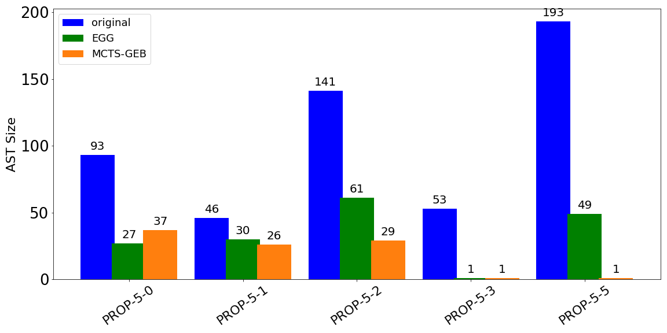
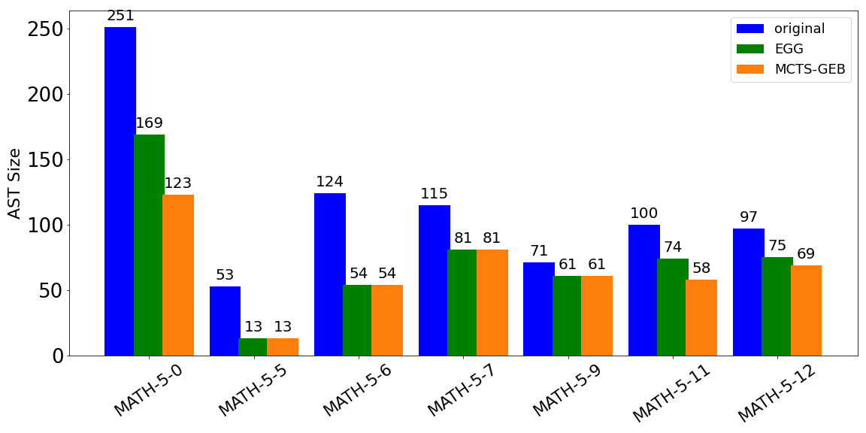
End-to-end
MCTS-GEB has better performance among 50% of the test expressions
For PROP-5-5, MCTS-GEB directly finds the optimal result
Planning generally leads to better performance
9

Slide 10
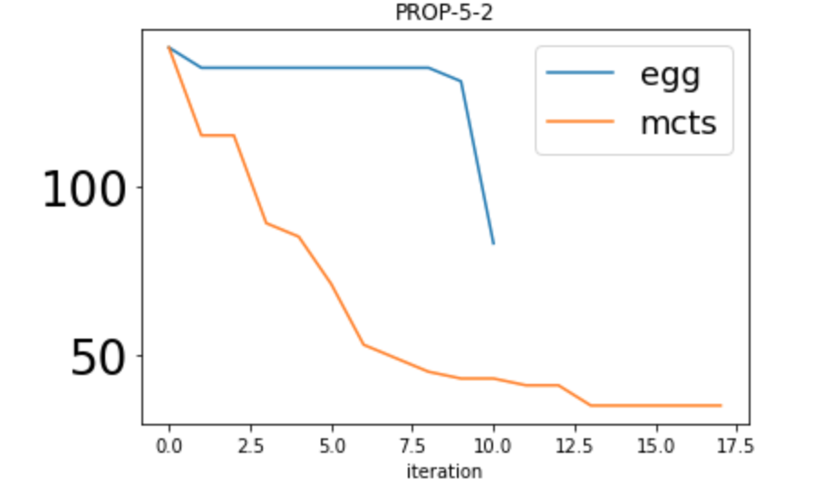
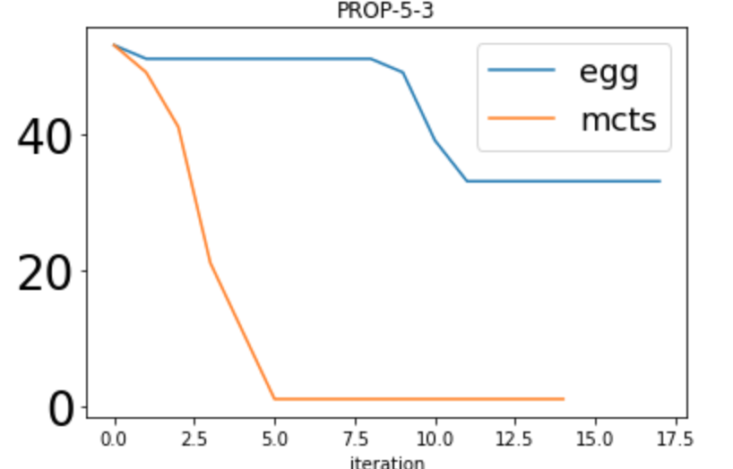
Rollout plot
For PROP-5-2, MCTS is able to apply more rules before hitting the node limit
For PROP-5-3, MCTS applies less rules, but achieves better performance
Apply the “right” rule is important
10

Slide 11
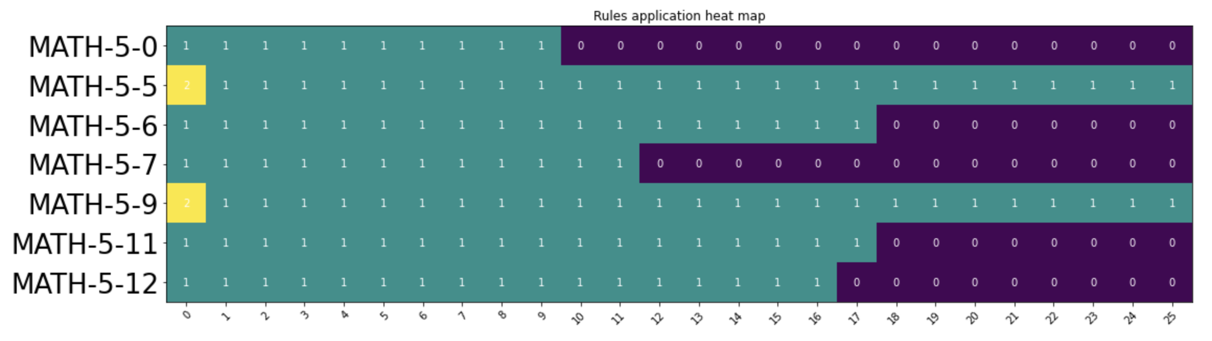
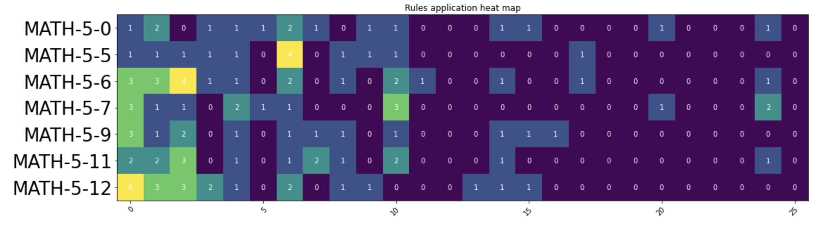
Rule application heatmap
The default builder may hit node limit before sweeping all rules
MCTS-GEB plans the ”better” rules to apply
11

Slide 12
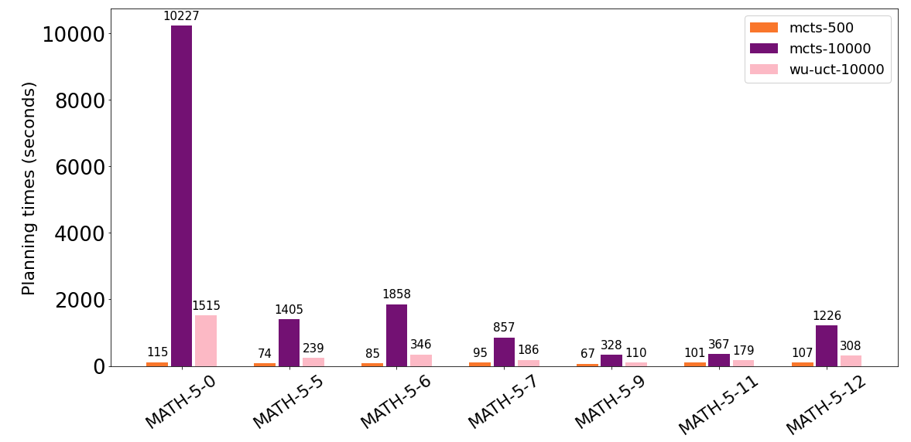
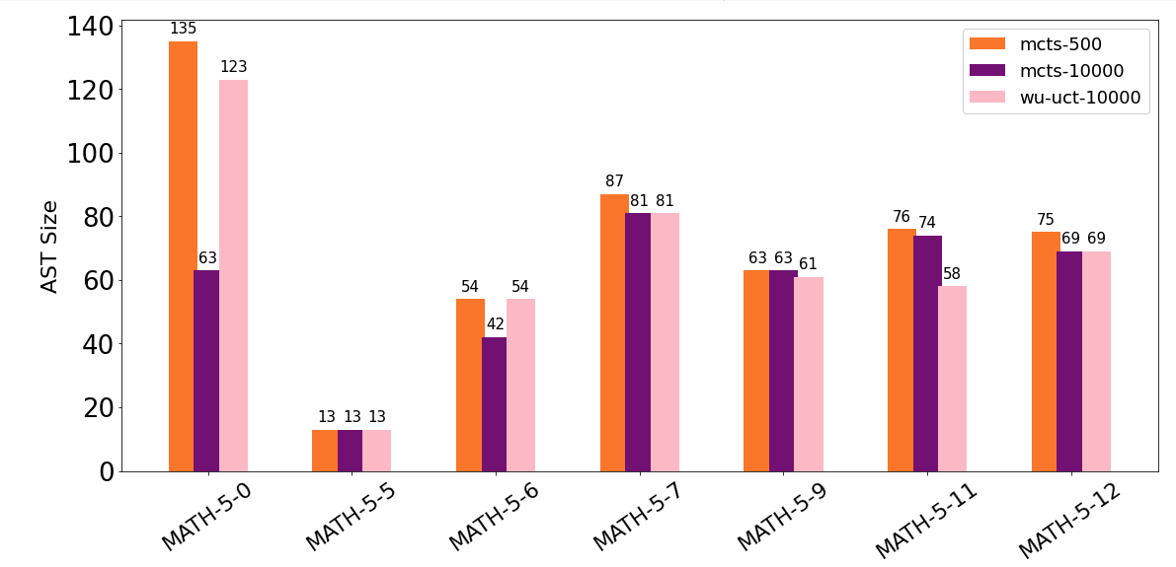
Accelerating MCTS
MCTS(-UCT): single-threaded algorithm
WU-UCT¹: a SOTA parallel variant
Multi-core parallelism
Some optimization is added
Prune action space
Respawn stragglers
1: https://github.com/liuanji/WU-UCT
12

Slide 13

Summary
MCTS-GEB:
Address the phase-ordering for e-graph construction
Plan for better e-graph construction
TODOs:
Perform evaluation on Equality Saturation applications, e.g. Tensat
Questions?
Email: gh512@cam.ac.uk
Thank you!
13

