Slide 1
Best of both, Structured and Unstructured Sparsity in Neural Networks
Sven Wagner, 09.05.2023
Christoph Schulte
cschulte@techfak.uni-bielefeld.de
Bosch Sicherheitssysteme GmbH
Bielefeld University
Sven Wagner
sven.wagner@de.bosch.com
Bosch Sicherheitssysteme GmbH
Armin Runge
armin.runge@us.bosch.com
Bosch Security Systems LLC
Dimitrios Bariamis
dimitrios.bariamis@de.bosch.com
Bosch Sicherheitssysteme GmbH
Barbara Hammer
bhammer@techfak.uni-bielefeld.de
Bielefeld University

Slide 2
Introduction
Structured and Unstructured Sparsity in Neural Networks
What is sparsity?
store less
parameters
skip Multiply-Add computations
activation
parameters
$$×$$
$$=$$
$$+$$
$$×$$
$$=$$
$$+$$
$$×$$
$$=$$
$$+$$
$$×$$
$$=$$
$$+$$
$$×$$
$$=$$
$$+$$
$$×$$
$$=$$
$$×$$
$$=$$
coefficient sparsity allows to …
Pruning
Decreased latency
Reduced memory bandwith
Less space required
activation
sparsity
coefficient
sparsity
Benefits …
≙ non-zero
≙ zero

Slide 3


Pruning Patterns
Structured and Unstructured Sparsity in Neural Networks
fine-grained
structured
unstructured
structured
≙ non-zero
≙ zero
SPECIAL HARDWARE SUPPORT REQUIERED
STRONGER ACCURACY IMPACT
Notes:
https://developer.nvidia.com/blog/accelerating-inference-with-sparsity-using-ampere-and-tensorrt/

Slide 4

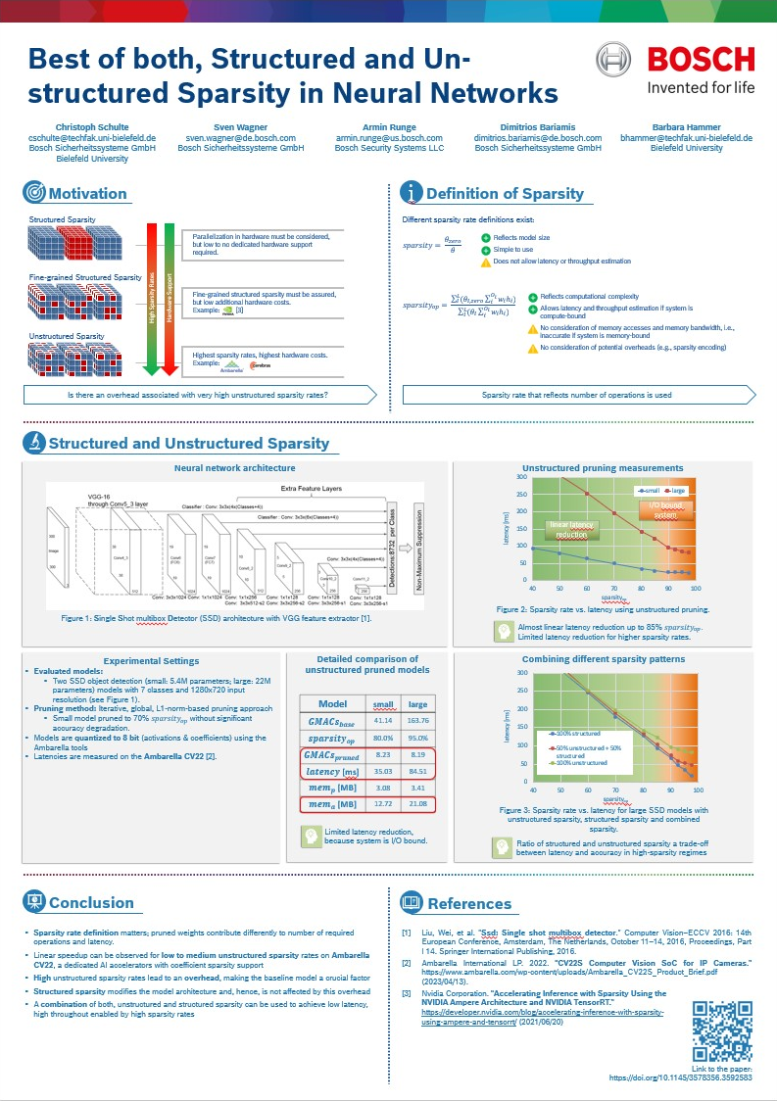

Structured and Unstructured Sparsity in Neural Networks
If you wonder, if a combination of structured/unstructured is useful
Curious about sparsity metrics to estimate the later latency speedup
COME AND CHECK OUT OUR POSTER
Or simply want to get insights to real-world, achievable speedups by sparsity
Link to the paper:
https://doi.org/10.1145/3578356.3592583

