Slide 1
Scalable High-performance Architecture For Evolving Recommender System
Ravi Kumar Singh, Mayank Mishra, Rekha Singhal
(ravik.singh2, mishra.m, rekha.singhal)@tcs.com
Computing Systems Research Group
TCS Research, Mumbai
EuroMLsys23 , 8th May 2023
Rome, Italy
Notes:
Hello Everyone,
I am Ravi Kumar Singh from TCS Research India. Today, I will be talking about our work on re-architecting of an e-retail recommender system, RecServ, into HiServ.

Slide 2
Outline
Motivation & Background
Challenges
Online vs Offline Recommender systems
HiSERV Architecture and Working
Results and Conclusions
Notes:
So that's a quick outline for next 5 mins.

Slide 3
Motivation
- Every customer has an engagement journey
- Different customers are at different
stages of their journey
Model
5
Model
4
Customer’s
Engagement
with Business
Recommendation
Model’s
Sophistication
Model
3
Model
2
Model
1
Time
Notes:
Let’s take a moment and let’s see what’s our motivation behind choosing this work.
As customers interact with a business, their engagement points evolve. Figure illustrates that organizations may utilize various recommendation system of varying sophistication to enhance customer engagement. Essentially, businesses upgrade their recommendation systems by incorporating newer, more advanced models while phasing out outdated ones. It's also common for multiple recommender models to coexist concurrently. Therefore, a customer's recommendation is typically a combination of several recommender models working together.
(engagement points refer to the different ways in which customers interact or engage with a business)\\
( it means the level of complexity or advanced features of a recommendation system model)

Slide 4
Challenges of Scalable Recommendation model
Following are the technical debts are associated with the deployment of models
Requirements (offline vs real-time)
Technology (ML vs DL)
Architecture (on-prem vs cloud-based)
Data features used during training and inference.
Problem Definition
Evolving scalable recommendation systems that can employ multiple recommender models and recommend items with low latency, offer high throughput, and handle such huge volumes of data over time.
Notes:
Let’s talk about Challenges while using multiple recommender models and it is a common way to give recommendations to customers, but it can be difficult because different models have different requirement ,technology, architecture and Data features. This can affect how fast the recommendations are made and how many can be made at once. Our recommender model can handle all these challenges and give recommendations to customers quickly and accurately, even with lots of data.\\
Companies know that personalized recommendations are important for keeping customers, so they need a recommendation system that can handle using multiple models and making recommendations quickly and accurately.

Slide 5
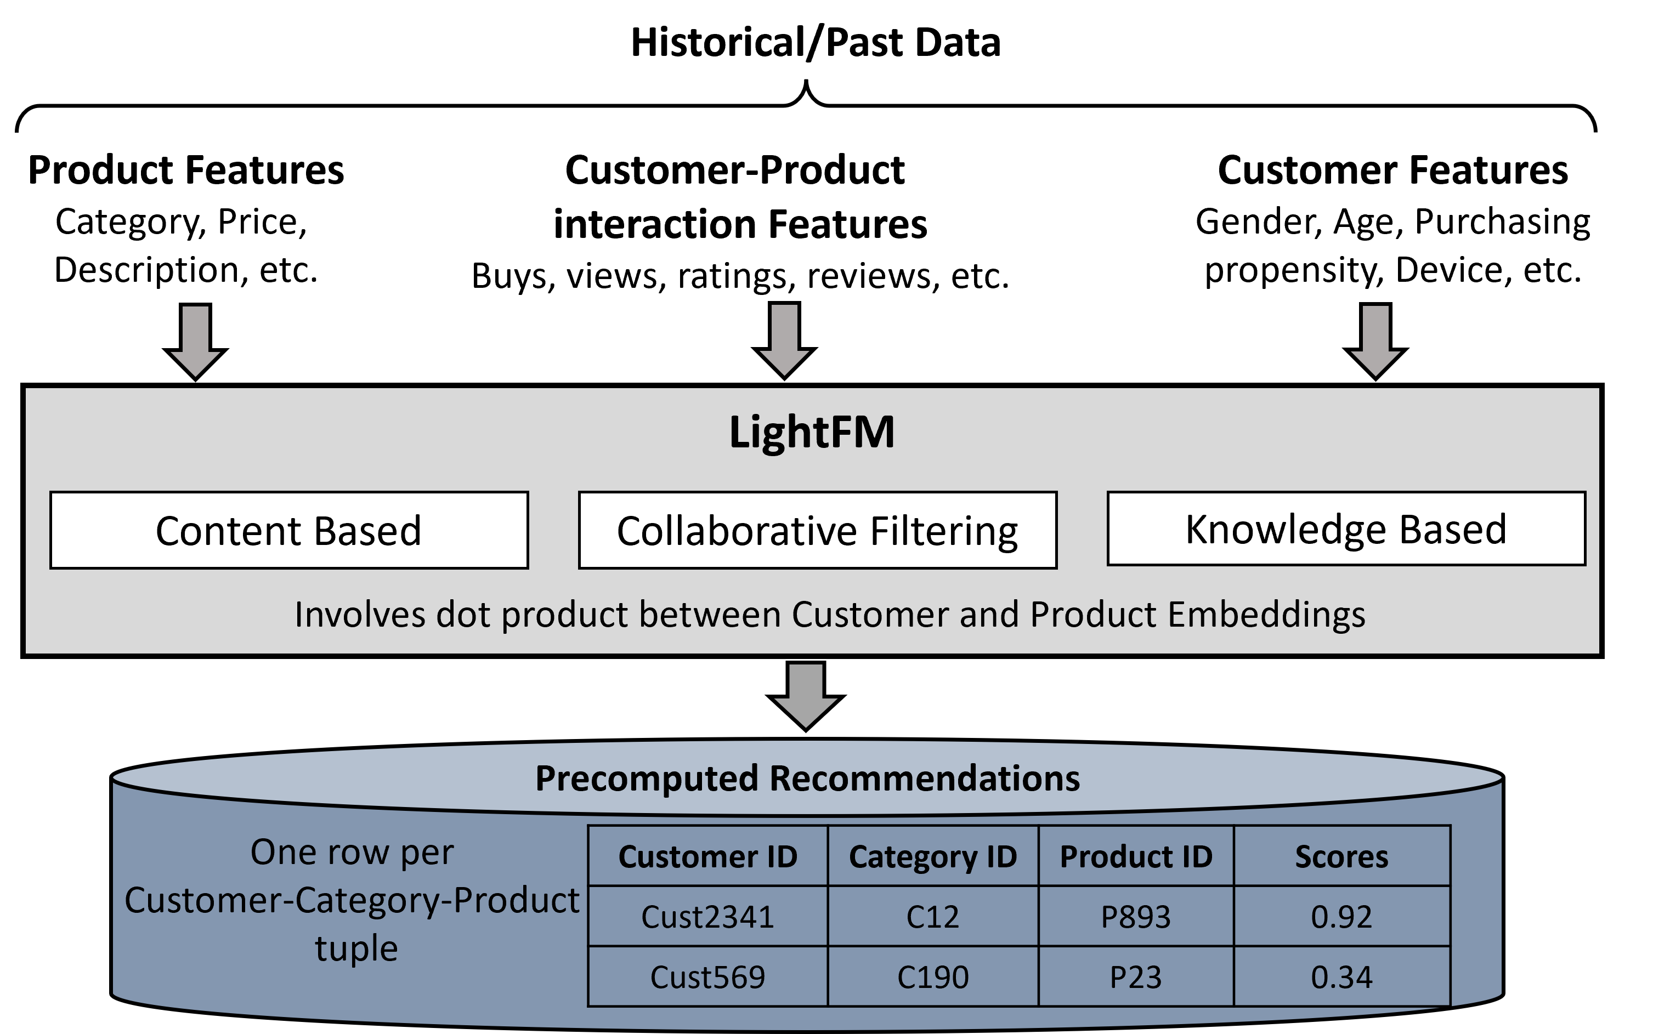
Online Recommender systems
Offline Recommender systems
Offline Recommender systems
Session based Data
Session based Data
Realtime Session
Realtime Session
?
P23
P191
P1055
P5
?
P23
P191
P1055
P5
Product IDs clicked/viewed
Product IDs clicked/viewed
NISER
(A session-based recommender model based on GNN)
NISER
(A session-based recommender model based on GNN)
Recommended Products
Recommended Products
Product ID | Score
P123 | 0.41
P2341 | 0.02
P296 | 0.55
Product ID | Score
P123 | 0.41
P2341 | 0.02
P296 | 0.55
Notes:
We exploits two different types of Recommendation models in Hiserv
NISER is a real-time session-based recommendations model which predicts next likely products to be cliked and viewed using a customer’s past clicks in the current session.
LightFM is an ML-based model which uses product features , customer-product interaction features, and customer features for learning Embeddings for customers and products. This model performs dot product over the learned Customer Embeddings and Product Embeddings and calculates the scores for every product corresponding to each category and customer and store them .

Slide 6



HiSERV Architecture
Historical Data
Customer-Product Interactions,
Customer Features,
Product Features
Current Sessions Data
Product clicks
and views
ASYNC
O1
Done Realtime
R1
Web/App
Server
E-retail
Interface
LightFM
NISER
O2
Done
Offline
R2
Customer
O3
Real-time
Recommendations
R3
Precomputed Recommendations
Recommendations
Filtering and Merging
R4
R6
Offline
Steps
R5
Real Time Steps
Notes:
Now, lets actually walk-through HiServ Architecture and to understand it’s working.
The offline model consists of three steps, namely O1, O2, and O3. O1 is the data preparation step for the Lightfm model, which includes creating data objects for inference such as customer and product embeddings. In the O2 step, the Lightfm model generates scores for each customer-product pair using the dot product between their embeddings. In O3 step, the generated offline recommendations for each customer-category tuple are stored to be accessed later and then merged with real-time recommendations.
The real-time processing steps begin with R1, where the customer’s ongoing session sequence is fed to the NISER model along with an asynchronous query message sent from the web/app server . In the R2 step, Niser model predict the next set of products that the customer might be interested in. In R3, the product recommendation list corresponding to each input session is inferred by Niser. In R4, the product list recommended by Lightfm is accessed from the cache when the asynchronous query message is received from the web/app server before completing R1, R2 and R3.
In step R5, the recommendation lists of both Niser and Lightfm are merged to create the final recommendation list of products. This list is then provided to Wev/App server as shown here in R6.

Slide 7
R1
The ongoing session sequence (product clicks/views) of the customer is converted to adjacency matrix format using product embeddings to be used with the NISER model. We used batching of sessions together to improves the throughput.
R2
The batch of customer sessions is fed to the NISER model to predict the next set of products in which the customer might be interested. The question here is how fast the NISER model can provide inference.
R3
The product recommendation list corresponding to each input session is inferred by NISER. How best can we prepare the lists for merging with recommendations lists predicted by LightFM?
Accessing the product list recommended by LightFM for customers from the cache. The question is how to arrange data in the cache and which cache technology to use
R4
Accessing the product list recommended by LightFM for customers from the cache. The question is how to arrange data in the cache and which cache technology to use
Filtering of NISER’s prediction based on categories along with merging of the recommended product lists from both LightFM and NISER. The question is what kind of data format and Data structures to us to make the process of merging fast.
R5
Filtering of NISER’s prediction based on categories along with merging of the recommended product lists from both LightFM and NISER. The question is what kind of data format and Data structures to us to make the process of merging fast.
Filtering of NISER’s prediction based on categories along with merging of the recommended product lists from both LightFM and NISER. The question is what kind of data format and Data structures to us to make the process of merging fast.
Filtering of NISER’s prediction based on categories along with merging of the recommended product lists from both LightFM and NISER. The question is what kind of data format and Data structures to us to make the process of merging fast.
R6
Final recommendation list of products are prepared for the batch of sessions and provided to the web/App server. The question here is how to cache them for future access
Final recommendation list of products are prepared for the batch of sessions and provided to the web/App server. The question here is how to cache them for future access
Final recommendation list of products are prepared for the batch of sessions and provided to the web/App server. The question here is how to cache them for future access
Final recommendation list of products are prepared for the batch of sessions and provided to the web/App server. The question here is how to cache them for future access
Batch Preparation for LightFM model inference. The idea is to create batches of customers and categories of products as 2D vectors of both customers, and product embeddings become very large. Customer embedding vector has size 2 × 106 customers ×100 embedding size ×8 as each entry is f loat64. Product embedding vector has size 4 × 105 products ×100 embedding size ×8 as each entry is float64.
O1
Batch Preparation for LightFM model inference. The idea is to create batches of customers and categories of products as 2D vectors of both customers, and product embeddings become very large. Customer embedding vector has size 2 × 106 customers ×100 embedding size ×8 as each entry is f loat64. Product embedding vector has size 4 × 105 products ×100 embedding size ×8 as each entry is float64.
Batch Preparation for LightFM model inference. The idea is to create batches of customers and categories of products as 2D vectors of both customers, and product embeddings become very large. Customer embedding vector has size 2 × 106 customers ×100 embedding size ×8 as each entry is f loat64. Product embedding vector has size 4 × 105 products ×100 embedding size ×8 as each entry is float64.
O2
LightFM essentially involves performing the dot product between the customer and product embeddings. The goal is to quickly perform the dot product of such large embedding vectors.
LightFM essentially involves performing the dot product between the customer and product embeddings. The goal is to quickly perform the dot product of such large embedding vectors.
O3
The resultant data containing recommendations for every customer category pair is extremely large. The main focus is how this generated data is put in the cache
The resultant data containing recommendations for every customer category pair is extremely large. The main focus is how this generated data is put in the cache
Notes:
In HiServ, we had to complete six real-time steps and three offline steps, and we encountered several challenges along the way. In this presentation, we will focus on the challenges we faced during step 3. If you want to learn more about other challenges, please refer to our paper.

Slide 8




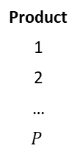
R3: Processing of NISER Recommendations Un-optimized vs Optimized
String
FP64
Filtered List
String
FP64
Product ID | Score
PRL_61 | 0.35
CN_23 | 0.91
… | …
PRJ_692 | 0.02
NISER
S2: Category based Filtering
Product ID | Score
CN_23 | 0.91
PRJ_692 | 0.02
$$P_{c}$$
$$P$$
Category to Product IDs mapping
Category ID | Product IDS
Cat_1 | PRL_61, DG_34
Cat_2 | PRJ_692, CR_45, ..., CN_23
Dataframe
Product
1
2
…
$$P$$
Score
0.35
0.91
…
0.02
S3: Sorting Product IDs on basis of scores
Product ID
CN_23
PRJ_692
S1: Product Index to product ID mapping
$$P$$
String
List of Strings
RecServ (Un-Optimized)
FP64
Tensor
F1: Category based Filtering
HiServ (Optimized)
Filtered Tensors
F2: Sorting Product Indices on basis of scores
Tensor
Category to Product Indices mapping
Product Index
2
N
Score
0.91
0.02
Product Index
2
N
Category ID | Product Indices (sorted)
Cat_1 | 1, 25
Cat_2 | 2, ..., N
$$P_{c}$$
String
Int
FP64
Tensor of Integers
Using tensor.select_index operation
Notes:
Let’s discuss how we overcome the challenges in Step3 where the steps S1, S2, and S3 performed by RecServ using product IDs are replaced by faster Tensor based operations using product index by F1, F2 steps to make pipeline more faster.

Slide 9
Results and Conclusions
Recommendation Pipeline steps | RecServ used | RecServ employed batching? | HiServ used | HiServ employed batching?
Lightfm Inference and Preprocessing (O1, O2, O3) | DataFrame | No | Numpy, Tensor, Dictionary | Yes
NISER Inference (R1, R2, R3) | DataFrame | No | Numpy, Dictionary,List | Yes
Loading of Precomputed Results (R4) | DataFrame | No | Dictionary of Dictionary | No
Merging Results of LightFM and NISER (R5,R6) | DataFrame | No | Numpy, Tensor, Dictionary, List | Yes
Recommender System | Batch Size | Latency (ms) | Throughput (per sec)
RecServ | 1 | 1500 | 1
HiServ | 100 | 65 | 1538
HiServ | 50 | 40 | 1250
HiServ | 10 | 16 | 625
HiServ | 5 | 11 | 454
HiServ | 1 | 5.5 | 181
Notes:
Let’s discuss the results , First Table provides an overview of techniques and technologies used by both RecServ and HiServ in various real time and offline steps. Using better techniques ensured that the performance of HiServ was much better than RecServ. RecServ and HiServ use different methods for processing data. RecServ uses dataframe operations, while HiServ uses numpy, tensor, and dict operations, as well as batching.
Table shows that latency supported by HiServ is close to 65ms, which is roughly 23× lesser than RecServ. The throughput of HiServ is close to 1500 requests per second. The graph is representing the same info.

Slide 10
THANK YOU

