Slide 1

TSMix: time series data augmentation by mixing sources
Luke Darlow¹, Martin Asenov¹, Artjom Joosen¹, Qiwen Deng^{1,2}, Jianfeng Wang³, Adam Barker^{1,4}
 | 1. Edinburgh Research Centre, Central Software Institute, Huawei | 3. Hangzhou Research Centre, Central Software Institute, Huawei
 | 2. School of Informatics, University of Edinburgh | 4. School of Computer Science, University of St Andrews

Slide 2
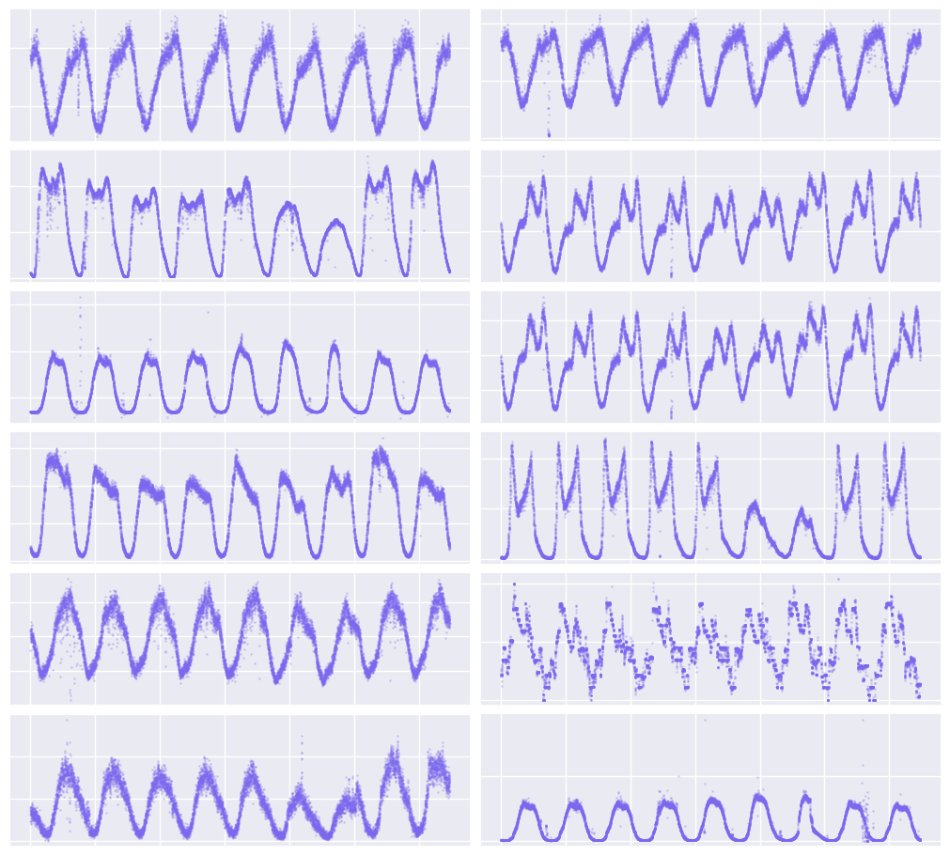
Introduction
Data augmentation improves model generalisation
Data augmentation in time series is challenging
We propose that individual time series can be considered as an i.i.d. sample from a wider set of time series.
Evaluated through TSMix, a simple method to combine multiple univariate time series to increase training dataset size and thereby improve forecast model generalisation.
Particularly relevant to cases with multiple related time series
FaaS platforms produce related time series from function invocation counts of different functions
A sample of function request time series from Azure 2019 dataset. Note the daily periodicity in each.
TSMix: time series data augmentation by mixing sources
Luke Darlow, Martin Asenov, Artjom Joosen, Qiwen Deng, Jianfeng Wang, Adam Barker

Slide 3
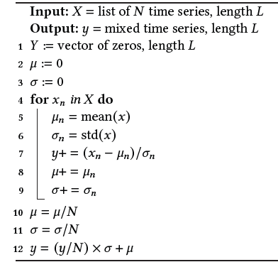
Algorithm
N univariate time series are combined by averaging their standardised versions (i.e., zero mean and unit standard deviation).
Final mixed version is unnormalized by average of incoming means and standard deviations to ensure scale invariance with respect to input series.
TSMix: time series data augmentation by mixing sources
Luke Darlow, Martin Asenov, Artjom Joosen, Qiwen Deng, Jianfeng Wang, Adam Barker

Slide 4
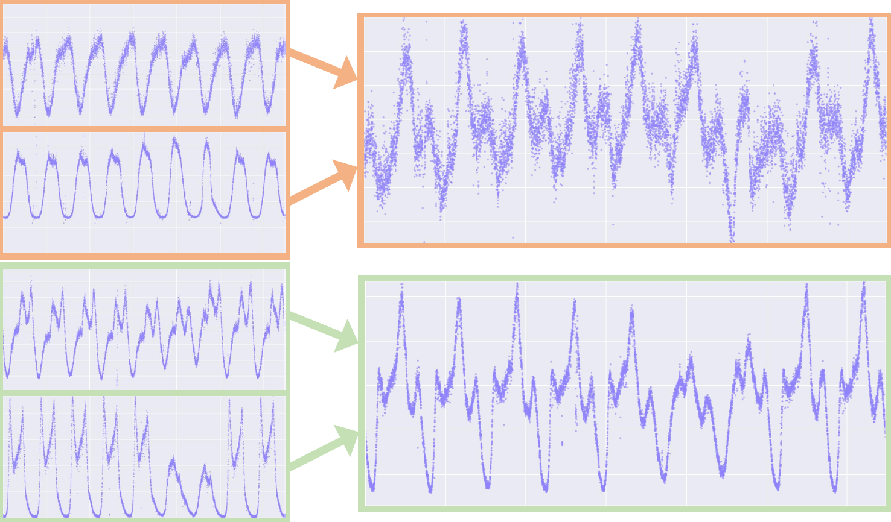
Example
Note how the periodicity is preserved but the variation in the combined data is suitably different from the input data.
Original functions
Resulting pseudo functions
TSMix: time series data augmentation by mixing sources
Luke Darlow, Martin Asenov, Artjom Joosen, Qiwen Deng, Jianfeng Wang, Adam Barker

Slide 5
Experimental setup
Top 12 functions from Azure 2019
Used top 12 functions from Azure 2019 (by median) [2]
14 days per function (9 for training and 5 for testing)
Predictions over the 5 test days computed autoregressively
Evaluated 3 forecasting models
N-HiTS [3]
N-BEATS [4]
Linear regression
The following 31 experiments were conducted for each model:
Training on original 12 functions only.
For N=2 we ran 4 experiments whereby we created 6, 12, 18, and 24 mixed pseudo functions. The original 12 functions were always included. We sampled mixes such that they were always unique. Increments of 6 are needed for N=2 in order to ensure equal sampling of the original 12 functions.
Other mixing combinations for N=3, 4, 6
We then train each forecasting model as a univariate global predictor (train on all time series at once)
When including an additional 24 mixed pseudo functions we are effectively tripling the dataset size (from 12 to 36 functions).
TSMix: time series data augmentation by mixing sources
Luke Darlow, Martin Asenov, Artjom Joosen, Qiwen Deng, Jianfeng Wang, Adam Barker

Slide 6
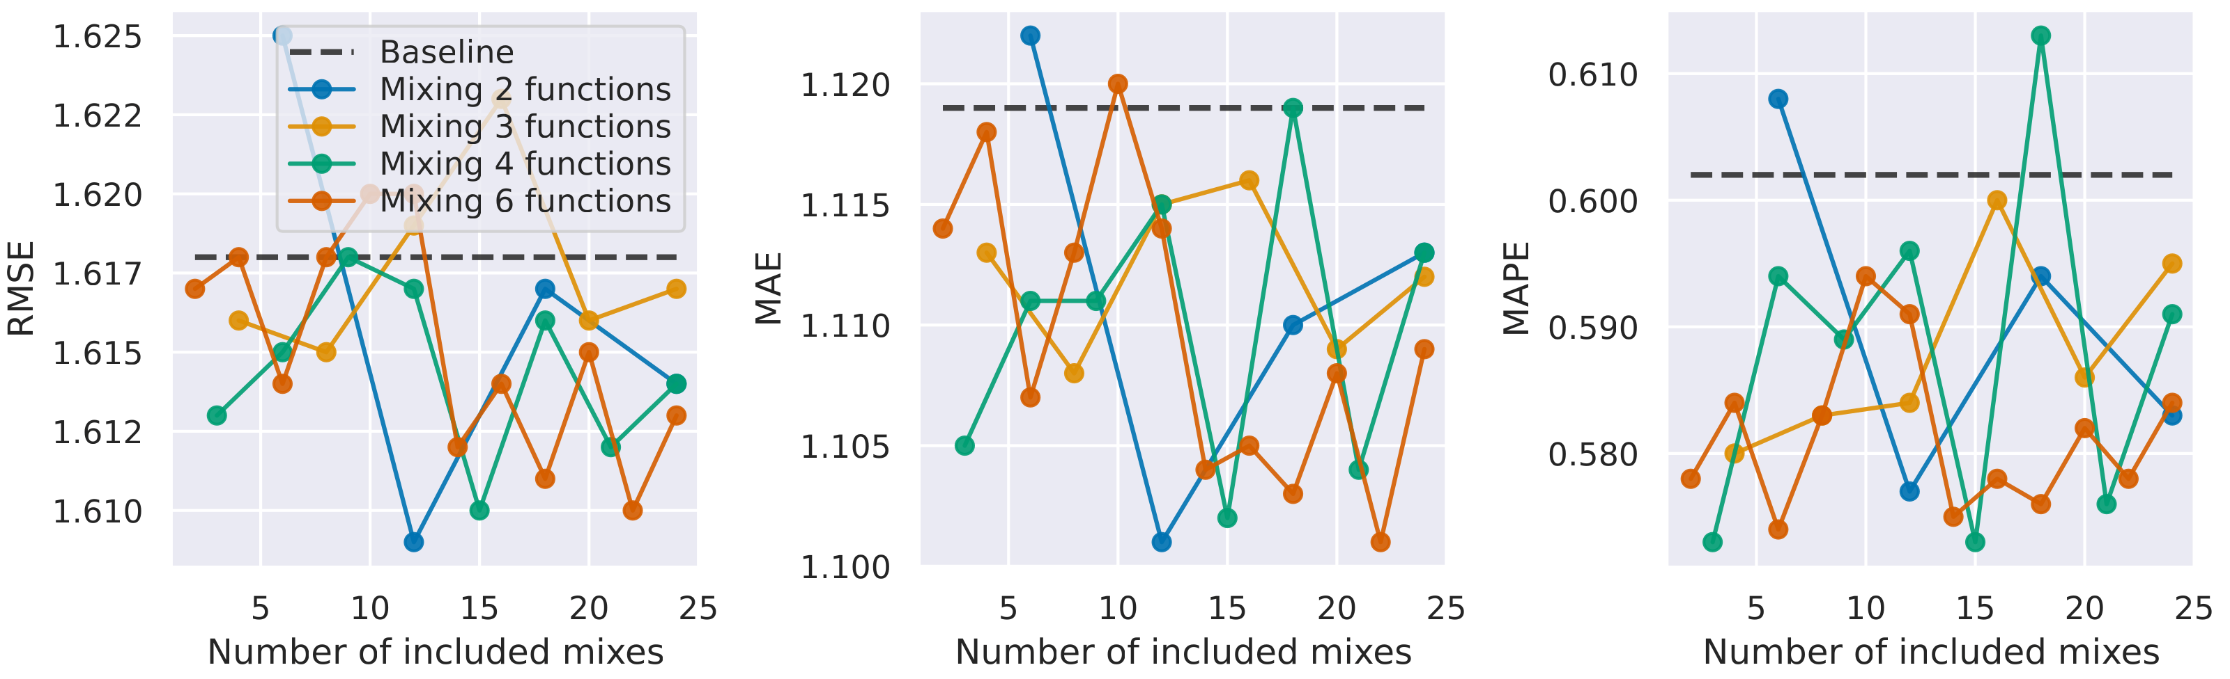
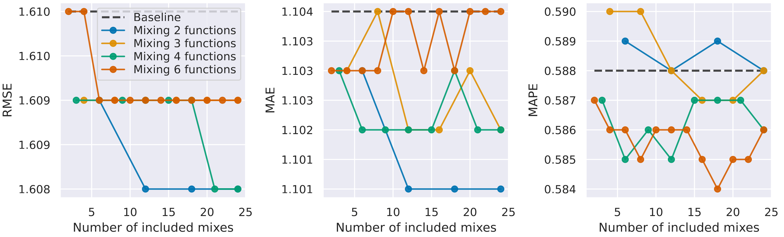
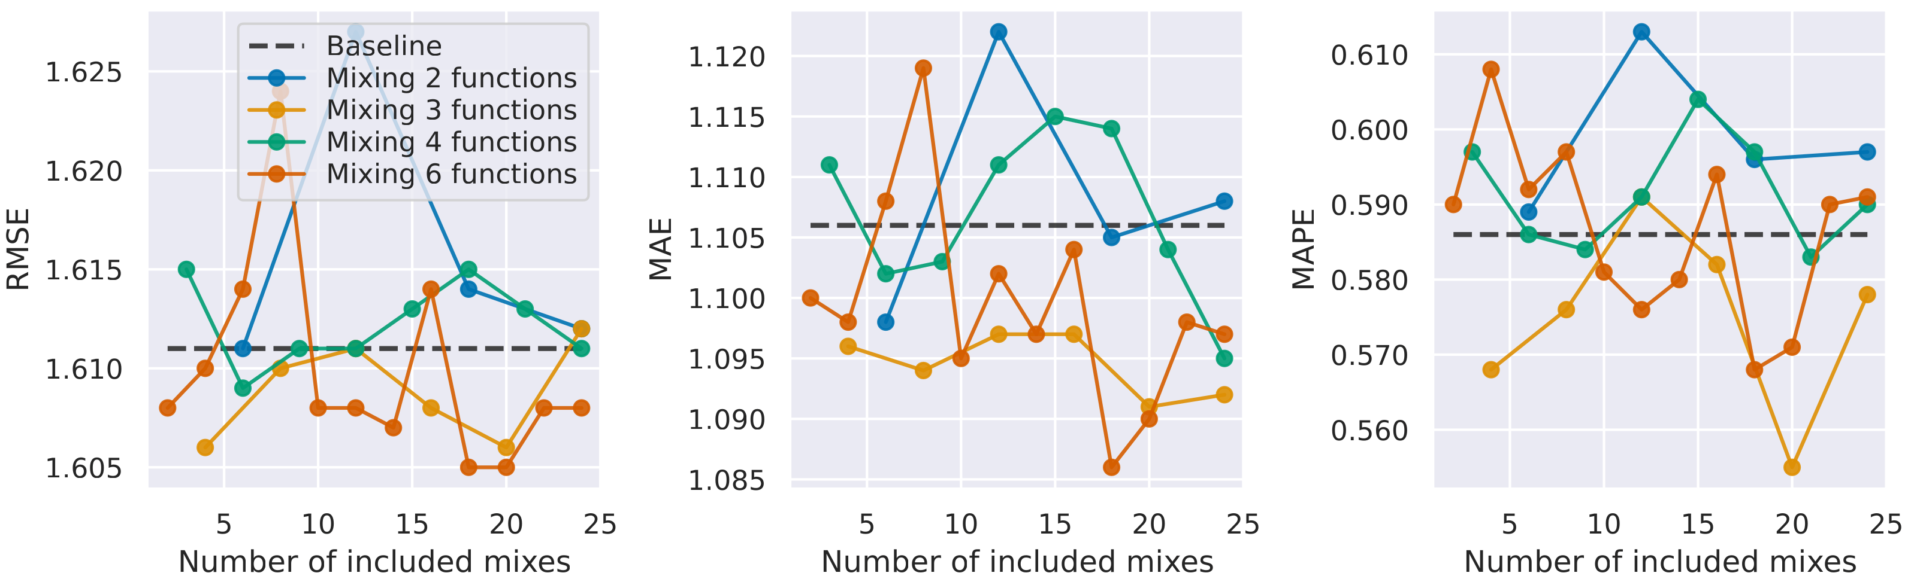
Results
Results using TSMix augmentation when training 3 forecasting models (N-HiTS, N-BEATS, and linear regression)
N-BEATS
Linear regression
N-HiTS
TSMix: time series data augmentation by mixing sources
Luke Darlow, Martin Asenov, Artjom Joosen, Qiwen Deng, Jianfeng Wang, Adam Barker

Slide 7
Conclusion
We presented TSMix:
TSMix operates by averaging two or more standardised (zero mean, unit standard deviation) time series to create pseudo time series.
These time series are then included as additional univariate series when training global forecasting models.
TSMix particularly useful in the FaaS domain due data scarcity when training time series forecasters.
TSMix: time series data augmentation by mixing sources
Luke Darlow, Martin Asenov, Artjom Joosen, Qiwen Deng, Jianfeng Wang, Adam Barker

Slide 8
Future work
Informed version of TSMix
Uses mutual information or cosine similarity to combine dissimilar time series.
Decomposition into trend, seasonal, and residual components
Applying TSMix to those components, and then recombining.
References
Hongyi Zhang, Moustapha Cisse, Yann N Dauphin, and David Lopez-Paz. 2017. mixup: Beyond empirical risk minimization. arXivpreprint arXiv:1710.09412(2017).
Mohammad Shahrad, Rodrigo Fonseca, Inigo Goiri, Gohar Chaudhry, Paul Batum, Jason Cooke, Eduardo Laureano, Colby Tresness, Mark Russinovich, and Ricardo Bianchini. 2020. Serverless in the Wild: Characterizing and Optimizing the Serverless Workload at a Large Cloud Provider. In 2020 USENIX Annual Technical Conference (USENIX ATC 20). USENIX Association, 205–218.
Cristian Challu, Kin G Olivares, Boris N Oreshkin, Federico Garza, Max Mergenthaler, and Artur Dubrawski. 2022. N-hits: Neural hierarchical interpolation for time series forecasting. arXivpreprint arXiv:2201.12886(2022).
Boris N Oreshkin, Dmitri Carpov, Nicolas Chapados, and YoshuaBengio. 2020. N-BEATS: Neural basis expansion analysis for interpretable time series forecasting. In International Conference on Learning Representations.
TSMix: time series data augmentation by mixing sources
Luke Darlow, Martin Asenov, Artjom Joosen, Qiwen Deng, Jianfeng Wang, Adam Barker

Slide 9
Thank you!

