Slide 1

Alex Rader Assignment 7
Assignment 7: Updating a database
Siva R Jasthi
ICS325 Internet Application Development
Summer 2019

Slide 2
Test Cases and Evaluation for Assignment 7
ID | Test Case | Points | Test Case Result
A6.1 | Assignment 6 is done / Solution published is used | 5 | [✓] Pass [ ] Fail
A6.2 | “Update Roster” button is showing up above the table | 2 | [✓] Pass [ ] Fail
A6.3 | Clicking “Update Roster” button shows the “Update Roster” form/page (update_roster.php) | 3 | [✓] Pass [ ] Fail
A6.4 | All the required fields (admin password, training_id and email list) are shows on the form | 5 | [✓] Pass [ ] Fail
A6.5 | Clicking on the Submit button updates the database. Errors / success / failure messages are left to the default behavior of the system. | 5 | [✓] Pass [ ] Fail
A6.6 | Demo is given in the class | 3 | [✓] Pass [ ] Fail
A6.7 | A Zip of the sources is submitted to D2L | 2 | [✓] Pass [ ] Fail
A6.8 | Training ID list is shown as a DROP DOWN list of “scheduled” courses (extra credit) | 5 | [✓] Pass [ ] Fail
A6.9 | Errors / failures messages are elegantly handled and are shown on the same “update_roster.php” page. (extra credit) | 3 | [✓] Pass [ ] Fail
A6.10 | The control goes back to index.php upon successful insertion of the data (extra credit) | 2 | [✓] Pass [ ] Fail

Slide 3
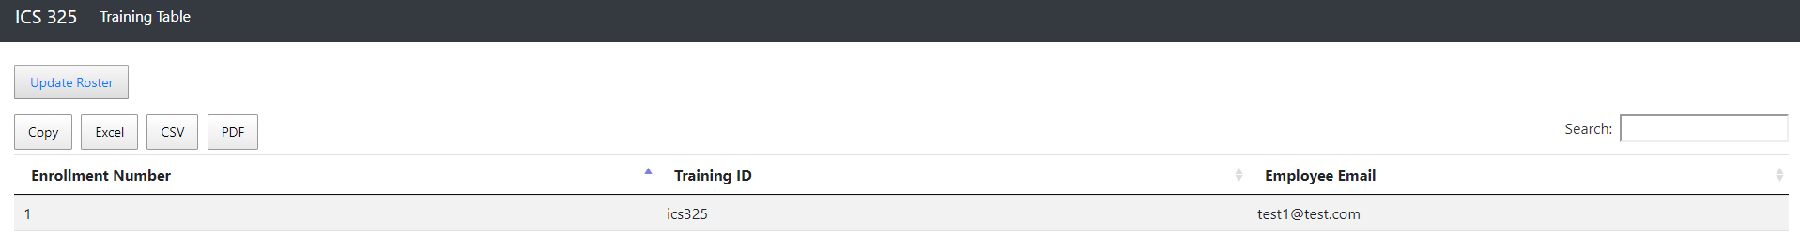
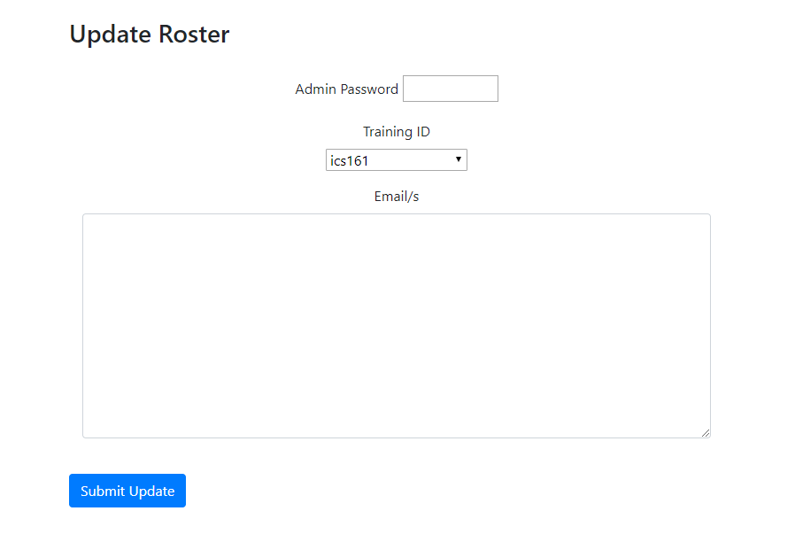
Update Button and Form Extra Credit: Drop Down List

Slide 4
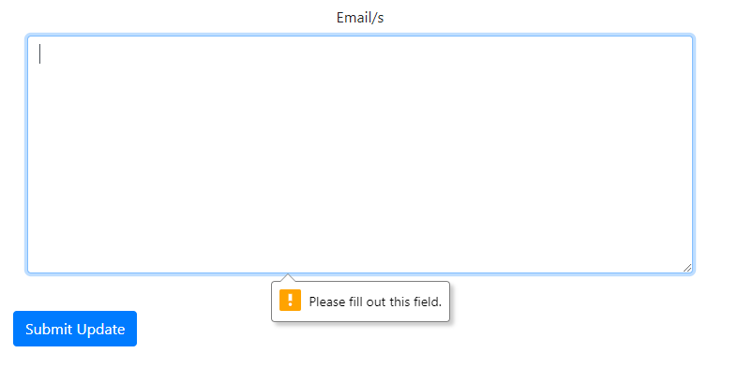

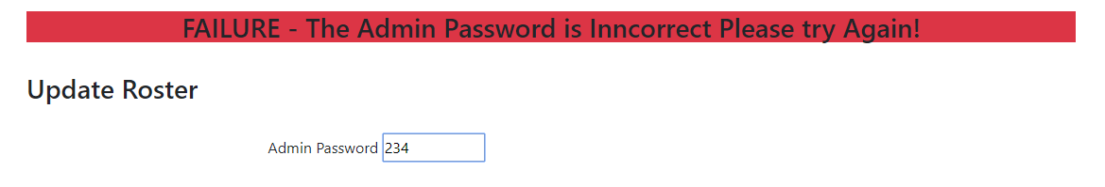
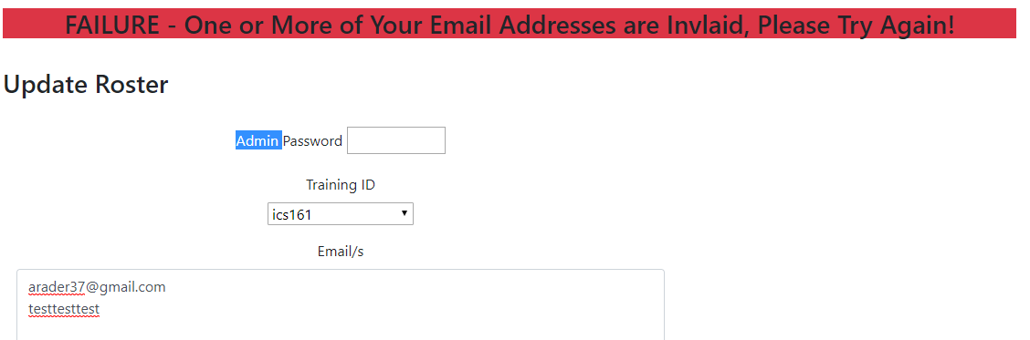
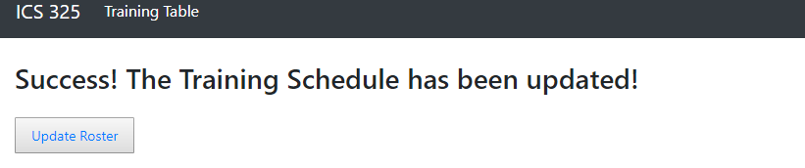
Extra Credit: Error Handling and Successes

