Slide 1


MindGuard AI: Automated Mental Well-being Classifier
Diwakar P 411721104012
Hariprasath T 411721104016
Guided By,
Dr.Dhanalakshmi

Slide 2
ABSTRACT
The growing global mental health crisis calls for scalable, intelligent, and personalized solutions. MindGuard AI is a next-generation AI-powered mental wellness companion that offers emotionally-aware chat-based interaction, psychometric evaluation, cognitive modeling, and adaptive coaching — designed to simulate and extend the role of a human psychologist. This project reimagines how mental health care can be democratized through intelligent software capable of continuous support, dynamic risk evaluation, and therapeutic intervention.
MindGuard AI incorporates multiple layers of intelligence:
1. Conversational AI Engine: At the heart lies an advanced natural language understanding system powered by OpenAI GPT-3.5. It enables emotionally responsive, context-aware conversations. Each user message is analyzed in real-time using HuggingFace emotion and sentiment models, layered with a custom-built Risk Assessment Score (RAS) engine to detect distress, emotional dysregulation, or crisis scenarios.

Slide 3
ABSTRACT
2. Session Memory and Contextual Analysis: The AI maintains both short-term session memory and long-term memory across sessions, allowing it to personalize responses, track progress, and adapt coaching flows accordingly. It uses structured prompt engineering and retrieval mechanisms to summarize prior emotional states and chat content, forming the basis of adaptive behavioral interventions.
3. Mood Tracking and Psychometric Diagnostics: Users begin each session with a mood check-in, which contributes to a daily mood index. Over time, the platform builds mood trajectories, visualized in a calendar heatmap and weekly trend graph. Integrated psychometric tests (e.g., PHQ-9, GAD-7) are triggered contextually and analyzed by the system to provide validated assessments with user-friendly interpretations and improvement goals.
4. Coaching Engine and Self-Care Tracker: A modular AI Coaching Engine maps emotions to micro-recommendations — breathing exercises, affirmations, coping techniques, or journal prompts. These are tracked, evaluated, and fed into a reinforcement loop that enhances recommendation precision over time.

Slide 4
ABSTRACT
The platform also supports micro-journaling, emotion spikes timeline, and self-care activity monitoring.
5. Gamification and Engagement: Emotional wellness is reinforced through gamified rewards, badge achievements, streak counters, and motivational nudges. The entire UX is designed with emotion-aware UI shifts, confetti effects on mood improvement, and risk-based theme adjustments for higher immersion.
6. Architecture and Tech Stack: The system uses a scalable architecture comprising FastAPI, SQLAlchemy + PostgreSQL, and secure JWT authentication for backend logic. The frontend is built using Vite + React, styled with Tailwind CSS and animated with Framer Motion, delivering a premium UI/UX. It also integrates Web Speech API for voice input and playback, along with robust error handling, accessibility support, and deployment-readiness.
MindGuard AI is not just a chatbot. It’s an emotionally intelligent, psychologically grounded, and technically sophisticated ecosystem designed to empower individuals with proactive mental health tools. Whether helping users manage anxiety, reflect on emotions, or recognize cognitive distortions, the platform offers compassionate care, backed by data, and driven by AI.

Slide 5
INTRODUCTION
In an increasingly complex and fast-paced world, mental health challenges have emerged as one of the most pressing public health concerns of the 21st century. Depression, anxiety, emotional dysregulation, and burnout are no longer isolated conditions — they are part of a growing global epidemic that demands immediate, scalable, and innovative solutions. However, traditional mental health services are often inaccessible, costly, and stigmatized, leaving millions without the support they need. It is within this critical context that MindGuard AI is conceived — not just as a digital tool, but as a comprehensive AI-powered mental wellness ecosystem that reimagines how individuals interact with psychological care.
MindGuard AI is an intelligent, emotionally aware platform that combines the cognitive depth of psychological science with the real-time adaptability of artificial intelligence. Designed to function as a virtual psychologist, coach, and emotional wellness companion, the system provides 24/7 support through natural language-based interaction, cognitive diagnostics, therapeutic coaching, and visual self-awareness tools. Leveraging the power of large language models (LLMs) such as OpenAI’s GPT-3.5, alongside

Slide 6
INTRODUCTION
advanced emotion and sentiment analysis models from HuggingFace, the platform interprets user expressions to detect underlying emotional states, thought patterns, and potential psychological risks with remarkable nuance. The platform initiates each session with a mood check-in, and from that point forward, every message is analyzed for sentiment, emotion, and risk. The AI engine adapts its responses in real time — offering empathy when needed, suggesting Cognitive Behavioral Therapy (CBT)-based interventions when irrational beliefs surface, and even escalating to emergency safe modes or therapist referral pathways if the Risk Assessment Score (RAS) crosses critical thresholds. All interactions are logged into a persistent memory system that allows the AI to learn from the user's emotional trajectory over time, making support progressively more personalized and effective.
MindGuard AI is further enhanced through visual dashboards, gamified engagement, and adaptive coaching modules. Features such as mood calendars, emotion frequency radar charts, micro-journals, and badge-based motivation boosters empower users to become active participants in their

Slide 7
INTRODUCTION
emotional well-being. Unlike generic wellness apps, MindGuard AI is built upon clinically inspired logic and educational psychology frameworks that inform its reasoning — ensuring that every intervention is both data-driven and emotionally intelligent.
The technical foundation of the system is built for both robustness and scalability. The backend, developed using FastAPI and PostgreSQL, supports secure, high-performance API interactions and user data management. The frontend, crafted with Vite + React, Tailwind CSS, and Framer Motion, offers a modern, calming, and intuitive user experience — complete with voice input/output capabilities, confetti effects for positive reinforcement, and responsive UI transitions based on emotional state.
Ultimately, MindGuard AI is more than a product — it's a visionary leap toward the future of mental wellness. It transforms AI from passive analyzer to active emotional guide, blending empathy, personalization, and clinical intelligence.

Slide 8
LITERATURE REVIEW
S. No | Journal Type with year | Authors | Title | Outcomes
1 | Journal of Medical Internet Research, 19(6), e206. | Fitzpatrick, K. K., Darcy, A., & Vierhile, M. (2017) | Conversational AI for Mental Health Support | Shows effectiveness of chatbot-based CBT therapy.
2 | World Psychiatry, 13(3), 288–295. | Andersson, G., Cuijpers, P., Carlbring, P., Riper, H., & Hedman, E. (2014) | Guided Internet-based CBT vs Face-to-Face CBT | Confirms digital CBT is effective for mental disorders.
3 | Computational Intelligence, 29(3), 436–465. | Mohammad, S. M., & Turney, P. D. (2013) | Crowdsourcing Emotion Lexicons | Foundation for NLP-based emotion detection models.
4 | CLPsych Workshop, NAACL-HLT, 2015 | Resnik, P., Armstrong, W., Claudino, L., et al. | Supervised Topic Modeling for Depression Detection | Supports risk prediction from language data.

Slide 9
LITERATURE REVIEW
S. No | Journal Type with year | Authors | Title | Outcomes
5 | Journal of Biomedical Informatics, 71, 31–48. | Sardi, L., Idri, A., & Fernández-Alemán, J. L. (2017) | Gamification in eHealth Systems | Improves adherence and engagement in wellness apps.
6 | Nature Machine Intelligence, 1(9), 389–399. | Jobin, A., Ienca, M., & Vayena, E. (2019) | Global AI Ethics Guidelines | Emphasizes transparency, privacy, and trust in AI.
7 | JMIR Formative Research, 6(5), e35045. | Fulmer, R., Joerin, A., Gentile, B., Lakerink, L., & Rauws, M. (2018) | Using AI Coaches for Mental Health (Wysa Study) | Demonstrates user engagement and symptom reduction with AI coaches.

Slide 10
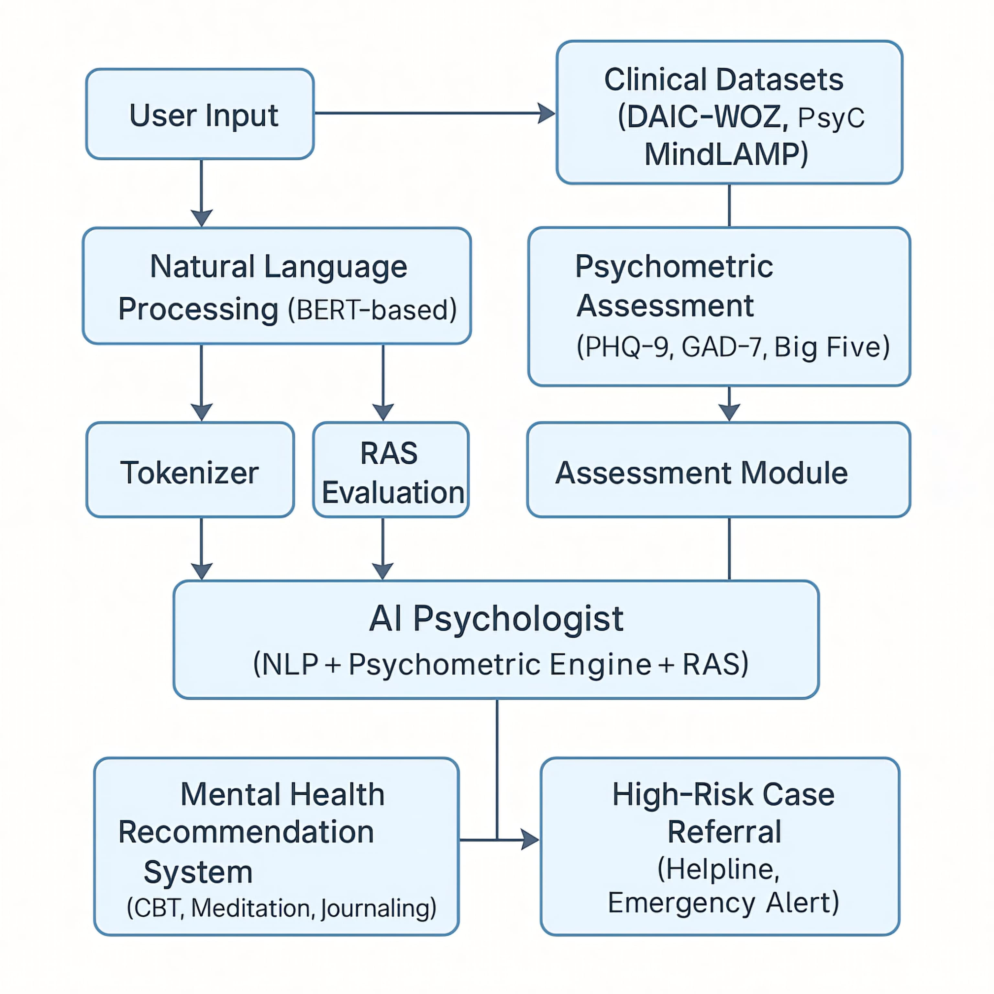
BLOCK DIAGRAM

Slide 11
EXISTING SYSTEM
Several mental health platforms and applications currently exist that provide support through AI-driven chatbots, mood tracking, CBT frameworks, and digital coaching. Some notable systems include:
1. Woebot (2017)
A conversational AI designed for delivering CBT-based mental health support via daily check-ins and mood tracking. It uses simple dialogue-based interaction and is backed by clinical research.
✅ Strengths: Evidence-based CBT delivery, lightweight design.
❌ Limitations: Limited personalization, no adaptive coaching or emotion analytics.
2. Wysa
An AI-based emotional support chatbot that leverages CBT and mindfulness techniques. Offers journaling, breathing exercises, and behavioral self-help content.
✅ Strengths: Anonymous access, varied coping tools.
❌ Limitations: No real-time risk escalation or deep emotion trend analysis.
3. Replika
An AI chatbot that mimics friendly conversation for mental companionship. Focuses on emotional engagement more than therapy.
✅ Strengths: Personalized, human-like conversations.
❌ Limitations: Not clinically validated for CBT or mental health interventions.

Slide 12
PROPOSED SYSTEM
Mind Guard AI is an advanced emotional wellness platform that integrates artificial intelligence, psychology, and human-centered design to offer real-time mental health monitoring, CBT micro-coaching, and adaptive emotional support.
It aims to overcome the limitations of existing systems by combining the power of conversational AI, emotion/sentiment modeling, psychometric testing, and risk prediction—all within a secure, accessible, and privacy-first architecture.
Key Features of the Proposed System:
1. Emotionally Intelligent AI Chatbot
Powered by OpenAI’s GPT-3.5 and HuggingFace models.
Dynamic conversation with tone-adjustment, CBT prompts, and journaling.
Real-time CBT distortion detection (15 types) and reframing suggestions.
2. Mood Tracking & Emotion Analytics Dashboard
Emoji-based daily check-ins with visual summaries.
Graphs like Emotion Radar, Mood Trends, Resilience Timeline, etc.
Tracks weekly emotional changes, journaling patterns, and risk levels.

Slide 13
PROPOSED SYSTEM
3. RAS (Risk Assessment Score) Engine
Calculates emotional risk based on sentiment/emotion + historical data.
If RAS ≥ 90, activates Safe Mode, shows crisis resources, and logs alerts.
Admin panel monitors alerts without accessing full user chats (privacy-focused).
4. Psychometric Test Integration
Chat-triggered tests: PHQ-9, GAD-7, PSS, PTSD, ASRM, UCLA.
Stores test scores, auto-generates severity-based feedback.
Enables escalation or recommendations based on critical scores.
5. CBT Micro-Coaching Engine
3-Step CBT cycle: Identify → Challenge → Reframe.
Stored and visualized on dashboard.
Suggests personalized journaling prompts and wellness content.

Slide 14
PROPOSED SYSTEM
6. Voice Input/Output
Web Speech API for voice-based chat input.
Planned integration of Whisper AI for robust, multilingual transcription.
7. Session Summary Generator
GPT-written summaries including mood, risk, journaling, CBT insight.
Auto-saves each session summary (not the full chat).
Weekly PDF reports downloadable by users.
8. Admin Panel (Minimal)
View flagged users, RAS logs, and risk summaries.
No access to personal data or raw chat—complies with privacy principles.

Slide 15
METHODOLOGY
MODULE 1: Intelligent Conversational Agent & Session Engine
Purpose: Deliver emotionally intelligent, context-aware, memory-persistent chat experiences.
Features & Methodology:
OpenAI GPT-3.5-Turbo API: Used as the core LLM model with controlled prompt orchestration and session-specific context.
Mood Check-in: Triggered at the start of every session via pop-up. Captures user mood → fed into emotional tracking & mood calendar.
Persistent Memory Across Sessions: Conversations are summarized (not full logs), with mood/emotion/risk snapshots stored.
Auto Summarization:

Slide 16
METHODOLOGY
GPT-based session summarizer that logs:
Emotional state
Risk level
Key CBT events
Test recommendations
Microchannel Support: Prompts user mid-session for short reflections. If accepted, logged in dashboard. Output visualized as a widget.

Slide 17
METHODOLOGY
MODULE 2: Mood, Emotion, Risk & Escalation Engine
Purpose: Track psychological state in real-time and escalate when needed.
Features & Methodology:
Multi-Model Inference: HuggingFace-based emotion detection Sentiment scoring GPT prompt-based custom risk assessment
Escalation Engine: Composite scoring from emotion/sentiment/risk modules Escalation logic triggers:
Emergency contact alert
Therapist referral card
Follow-up test suggestion

Slide 18
METHODOLOGY
AI-generated self-help recommendations
Emergency Contact System: Collected during signup Flagged for use during critical escalation
Therapist Referral Card: Automatically appears on dashboard post-risk event
Feedback Learning Loop: User interactions (accept/dismiss) are logged to improve future suggestions

Slide 19
METHODOLOGY
MODULE 3: Psychological Support System (CBT/CAT + Tests)
Purpose: Provide integrated tools to detect, assess, and correct cognitive and emotional patterns.
Features & Methodology:
CBT/CAT Distortion Engine: Detects and classifies:
Catastrophizing
Overgeneralization
Emotional Reasoning
Mind Reading
Black-and-White Thinking
15+ total patterns GPT-3.5 suggests reframes or challenges. Tracked per session.
Integrated Tests (via chat): Embedded conversational delivery of:
PHQ-9 (Depression)
GAD-7 (Anxiety)
Emotional Self-Awareness Test
Distortion Quiz

Slide 20
METHODOLOGY
Scores analyzed on backend and added to dashboard.
Auto-Test Trigger: Based on risk/emotion pattern Suggests user take test during chat
Session-Based Correction Tracker: Logs CBT progress over time

Slide 21
METHODOLOGY
MODULE 4: Dashboard Intelligence Hub
Purpose: Centralize all mood, risk, achievement, and recommendation data in a visually rich UX.
Features & Methodology:
Mood Calendar: Tracks daily mood averages Shows weekly trends + monthly view
Risk Timeline Widget: Plots risk spikes vs mood history
Emotional Graph: Shows emotion frequency distribution
Microchannel Widget: Displays past journal summaries
Test History Widget: View test scores & changes over time
Badges & Gamified Rewards: Based on:
Stability streaks
Test completion
Emotional improvement

Slide 22
METHODOLOGY
MODULE 5: Core Platform, Auth & Profile
Purpose: Support secure login, user data, and profile preferences.
Features & Methodology:
JWT Auth Flow: FastAPI + hashed password + refresh token rotation Secure routes for protected data
Unified Login/Signup Page: Minimalist welcome screen Emergency contact field mandatory Option to edit emergency contact in profile
Profile Page: Edit:
Name
Email
Password
Emergency contact No dark/light mode toggle — calming unified theme enforced
Role-ready backend: Allows admin features to be turned on when needed

Slide 23
METHODOLOGY
MODULE 6: Infrastructure, Testing, Feedback & CI/CD
Purpose: Ensure maintainability, test coverage, and project scalability.
Features & Methodology:
Automated Testing Suite: Unit tests (Pytest) Integration tests for endpoints UI tests (Playwright or Cypress optional) Session simulation with test coverage tracking
Dev & Deployment Strategy: Dockerized backend & frontend GitHub Actions for CI pipeline (Linting, Test, Build) Future deployment via Vercel or Render Modular FastAPI routers + decoupled React components
Feedback Loop System: Every dismissed suggestion, skipped test, or accepted recommendation is logged Used to train future AI recommendations
Admin View (Minimal): Not focused now, only backend logging for escalation events

Slide 24
ALGORITHMS
Module 1: Conversational AI Engine
GPT-3.5-Turbo Prompt Engineering Algorithm
Technique: Structured Prompt → System Instruction + Context Window + Live User Input
Goal: Achieve emotion-aware, contextually grounded responses.
Session Summarization Algorithm
Steps: a. Extract chat history of current session. b. Use GPT to summarize into: • Key emotional insights • Risk score • Cognitive patterns • Suggestions made
Microchannel Trigger & Logging
Algorithm: IF user gives a deep/emotional answer OR triggers keyword set THEN prompt microchannel entry. → Append to journal memory and feed to dashboard summary.

Slide 25
ALGORITHMS
Module 2: Mood, Emotion, Risk & Escalation Engine
Multi-Model Emotion-Sentiment-Risk Fusion Algorithm
Inputs: Live chat text
Outputs: • Emotion: HuggingFace model (e.g., BERT-based) • Sentiment: Transformer polarity model • Risk: Custom GPT classifier with 3-tier output (Low, Medium, High)
Fusion: Weighted average + rule-based fusion (priority to Risk triggers)
Escalation Logic Tree
IF Risk = High OR Mood = Very Low (for 3 sessions) THEN: → Trigger Emergency Contact OR → Show Therapist Referral Card OR → Display Test Suggestion Inline
Risk Scoring Algorithm (Daily Aggregator)
Formula: Risk Score = (3 × High Risk) + (2 × Medium Risk) + (1 × Low Risk) Normalize over daily sessions to visualize on dashboard

Slide 26
ALGORITHMS
Module 3: CBT/CAT & Psychological Pattern Analyzer
Cognitive Distortion Classifier (CBT Engine)
Input: User statements
Method: GPT prompt → Classify distortion from 15+ types (e.g., All-or-Nothing, Catastrophizing)
Output: Detected distortion + GPT-generated reframe
Test Scoring Algorithms
PHQ-9 / GAD-7 / Emotion Scale: • Score individual items (0–3) • Sum and categorize into severity level
Weekly average = (Total score per test per week) ÷ (number of tests)
Auto-Test Suggestion Algorithm
Trigger: Based on change in Mood/Emotion/Risk > threshold over 3 sessions.
Suggest test inside chat or as a widget on dashboard.

Slide 27
ALGORITHMS
Module 4: Dashboard Analytics & Visualization Engine
Mood Aggregation & Weekly Trend Algorithm
Daily Mood = average(mood ratings across sessions)
Weekly Mood = mean(Daily Moods in 7-day window)
Visualized on calendar heatmap & line graphs
Session Data Analytics Algorithm
Pipeline: → Sentiment trend line → Risk spikes (overlay) → Emotion heatmap → Test performance history
Used for dashboard visual summaries
Badge Allocation Algorithm (Gamification)
Rules: • Mood Stability Badge: 7+ days of same mood level • Growth Badge: 2+ tests improved scores • Journal Consistency Badge: 5+ microchannel entries/week

Slide 28
ALGORITHMS
Module 5: Profile, Auth, and Access Control
Secure Password Hashing (bcrypt)
During signup and login
Salting enabled
JWT Token Lifecycle Management
Access token (short-lived)
Refresh token (long-lived)
Stored in HttpOnly cookies for security
Module 6: Testing, Feedback Loop & Learning
Feedback Reinforcement Algorithm
Each dismissed/accepted recommendation is logged
User-specific model can be fine-tuned in future versions (not live now)
Data used to rank future suggestions and reduce irrelevant prompts
Auto-Suggestion Prioritization Algorithm
Based on: • Mood trend • Past dismissals • Last session summary
Suggestions weighted and reordered dynamically per user

Slide 29
SOFTWARE REQUIREMENTS
Front-End Requirements
Framework & Libraries:
React.js – Core frontend library for UI development
Tailwind CSS – For custom styling and utility-first CSS
ShadCN/UI – Advanced UI components for design consistency
Recharts – For charting mood, emotion, risk trends
Framer Motion – For smooth animations and transitions
Other:
Axios – HTTP client for API communication
React Router – For page navigation (Dashboard, Chat, Login, etc.)
Formik & Yup – For form validation (Signup, Mood Check-in)
Browser Compatibility:
Chrome (v90+), Firefox (v85+), Edge (v91+), Safari (v14+)

Slide 30
SOFTWARE REQUIREMENTS
Back-End Requirements
Framework & Environment:
FastAPI (Python) – High-performance backend for APIs
Uvicorn – ASGI server to serve FastAPI
Pydantic – For data validation and serialization
PostgreSQL – Primary database (user data, session logs, risk analysis)
Redis (optional) – For in-memory caching (session summaries, tokens)
Authentication & Security:
JWT (PyJWT) – Token-based auth (access and refresh tokens)
Bcrypt – Password hashing
CORS Middleware – For cross-origin requests between frontend and backend
API Integrations:
OpenAI API – GPT-3.5-Turbo via secured API key
HuggingFace Transformers – For emotion, sentiment, and risk detection models

Slide 31
SOFTWARE REQUIREMENTS
AI & ML Requirements
Models:
GPT-3.5-Turbo (via OpenAI API)
HuggingFace Emotion Detection Model (e.g., BERT-based)
Custom Prompt Chains – For session summary, test scoring, mood interpretation
Psychometric Test Evaluators – Logic for GAD-7, PHQ-9, etc.
DevOps & Deployment (post-MVP)
Note: These will be finalized post-feature completion, but for PPT, you can include:
GitHub – Source code management
Docker – For containerization (optional)
Railway / Render / Vercel – For hosting frontend/backend
PostgreSQL Remote Hosting – Supabase or Railway (cloud DB)
Testing & QA Tools
Pytest – Backend API unit tests
React Testing Library – Component/unit testing frontend
Postman – For backend API testing
ESLint + Prettier – For code quality and formatting
Optional Analytics & Monitoring Tools

Slide 32
CONCLUSION
MindGuard AI is a comprehensive, intelligent mental health companion designed to offer empathetic, real-time emotional support and self-awareness tools. By combining cutting-edge AI models like GPT-3.5-turbo and HuggingFace’s sentiment/emotion/risk detection pipelines with behavioral science methodologies such as CBT (Cognitive Behavioral Therapy), the platform creates a personalized and proactive support environment for each user. With features like in-chat psychometric testing, daily mood tracking, micro-coaching, emotion-aware conversations, crisis detection, and a richly interactive dashboard, MindGuard AI transforms how individuals engage with their mental health. It doesn’t just provide support—it learns, adapts, and evolves with the user. The system promotes early intervention, informed decision-making, and emotional resilience, making it a trusted ally in modern well-being management. MindGuard AI is more than just software; it’s a step forward in human-centered AI for psychological safety and empowerment.

Slide 33
REFERENCES
[1] P. S. Sreeja and G. S. Mahalakshmi, ‘‘Emotion recognition from poems by maximum posterior probability,’’ Int. J. Comput. Sci. Inf. Secur., vol. 14, pp. 36–43, 2016.
[2] J. Kaur and J. R. Saini, ‘‘Punjabi poetry classification: The test of 10 machine learning algorithms,’’ in Proc. 9th Int. Conf. Mach. Learn. Comput. (ICMLC), 2017, pp. 1–5.
[3] G. Mohanty and P. Mishra, ‘‘Sad or glad? Corpus creation for Odia poetry with sentiment polarity information,’’ in Proc. 19th Int. Conf. Comput. Linguistics Intell. Text Process. (CICLing), Hanoi, Vietnam, 2018.
[4] Y. Hou and A. Frank, ‘‘Analysing sentiment in classical Chinese poetry,’’ in Proc. 9th SIGHUM Workshop Lang. Technol. Cultural Heritage, Social Sci., Hum. (LaTeCH), 2015, pp. 15–24.

Slide 34
THANK YOU

