Slide 1
EOSC Governance Layers
Strategic
Measuring results
Institutional, including EU Member States and European Commission
Executive/Operational, including a governance board at the executive level and relevant working committees (e.g. thematic and functional)
Advisory, including a stakeholder forum
Executive
Getting things done
Engaging community
Stakeholders

Slide 2
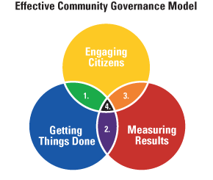
Community Governance Models
1 Community Problems Solving:
Aligns “Engaging Citizens” and “Getting Things Done.”
2 Organizations Managing for Results:
Aligns “Measuring Results” and “Getting Things Done.”
3 Citizens Reaching for Results:
Aligns “Engaging Citizens” and “Measuring Results.”
4 Communities Governing for Results:
Aligns all three core skills.
http://www.rtmteam.net/page.php?pageID=25&section=overview_of_ecg

Slide 3
Stakeholders
(Provider, Consumer, Provider\Consumer)
Executive
Strategic
Performance Against Needs
Requirements
Best Practices
EOSC Resources
Objectives
Metrics

Slide 4
European Interoperability Framework

Slide 5
EIF – Interoperability Context
EOSC Contexts
Policy
Strategy and Funding
Operational
Technical

Slide 6
EOSC Resource Model: Principles of Engagement
Compliant
Compatible
EOSC
EOSC resources = technical, middleware, knowledge, access and facilitation services
EOSC Resource = Services + Data + People
External
Compliant
Most of the resources within EOSC fully compliant with the Principles of Engagement
Compatible
Not fully compliant (yet), technically compatible with the EOSC, of value to EOSC Consumers
External
Resources outside of EOSC, of value to EOSC consumers, may or not be technically compatible with EOSC resources, “non-EOSC approved players are free to explore any role in the Open Science ecosystem they wish, even if they do not adhere to the RoE”

Slide 7
EOSC Resource Model: Principles of Engagement
Compliant
Compatible
EOSC
EOSC resources = technical, middleware, knowledge, access and facilitation services
EOSC Resource = Services + Data + People
External
Externally Supported Resources
EOSC Supported
Resources
EOSC Core\Federating
Resources
Compliant
Most of the resources within EOSC fully compliant with the Principles of Engagement
Compatible
Not fully compliant (yet), technically compatible with the EOSC, of value to EOSC Consumers
External
Resources outside of EOSC, of value to EOSC consumers, may or not be technically compatible with EOSC resources, “non-EOSC approved players are free to explore any role in the Open Science ecosystem they wish, even if they do not adhere to the RoE”

Slide 8
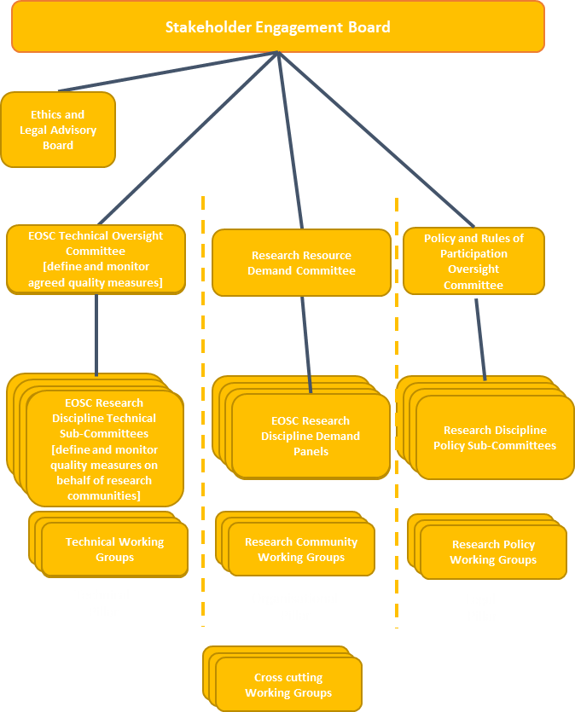
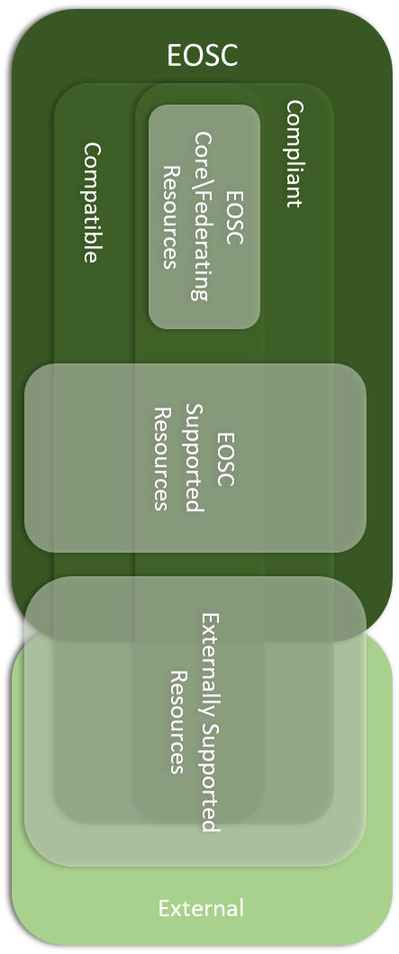
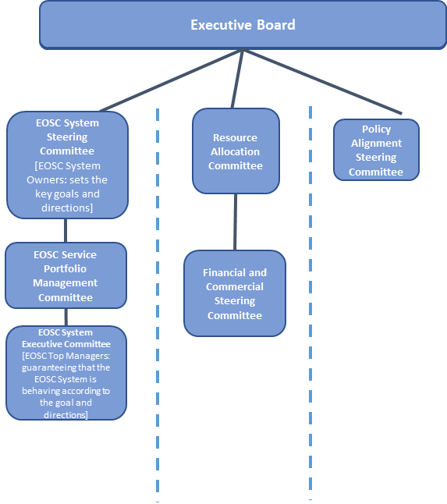
Scientific Case Requirements & Proposals
Technology Requirements & Proposals
Policy\Principles of Engagement Requirements & Proposals
Strategic
Stakeholders
EOSC Member Countries and Funders Governing Board
Objectives
Metrics
Report against Objectives\Metrics
Subsidises
Incentivises
Compensates
Provides Solutions
Executive
Performance and Impact

Slide 9
Oversight Board
Thematic Area Committees
Working Groups
Birds of a Feather Groups (BOFs)

Slide 10
EOSC Core Resources Delivery Model – Option 0
Strategic
Executive
EC Funding
Providers
Open
Aire
EGI
EUDAT
GEANT
PRACE\
EuroHPC
Research Infrastructures
National resources
Institutional resources
Enerprise and SMEs
etc

Slide 11
EOSC Core Resources Delivery Model – Option 1
Strategic
Executive
Commissioning Authority
Commissions
Commissions
Commissions
Providers
Open
Aire
EGI
EUDAT
GEANT
PRACE\
EuroHPC
Research Infrastructures
National resources
Institutional resources
Enerprise and SMEs
etc

Slide 12
EOSC Core Resources Delivery Model – Option 2
Strategic
Executive
Delivery Authority
Providers
Open
Aire
EGI
EUDAT
GEANT
Research Infrastructures
etc
Commissions
PRACE\
EuroHPC
National resources
Institutional resources
Enerprise and SMEs
etc

Slide 13
Strategic
Stakeholders
EOSC Member Countries and Funders Governing Board
Stakeholder Engagement Board
Executive
Executive Board
Ethics and Legal Advisory Board
Executive Board
Technology Requirements & Proposals
Policy\Principles of Engagement Requirements & Proposals
EOSC System Steering Committee
[EOSC System Owners: sets the key goals and directions]
Resource Allocation Committee
EOSC Technical Oversight Committee
[define and monitor agreed quality measures]
Policy Alignment Steering Committee
EOSC Technical Oversight Committee
[define and monitor agreed quality measures]
Research Resource Demand Committee
Policy and Rules of Participation Oversight Committee
Scientific Case Requirements & Proposals
Policy\Principles of Engagement Requirements & Proposals
Policy and Rules of Participation Recommendations
EOSC Service Portfolio Management Committee
Financial and Commercial Steering Committee
EOSC Research Discipline Technical Sub-Committees
[define and monitor quality measures on behalf of research communities]
EOSC Research Discipline Demand Panels
Research Discipline Policy Sub-Committees
EOSC Research Discipline Technical Sub-Committees
[define and monitor quality measures on behalf of research communities]
EOSC Research Discipline Demand Panels
Research Discipline Policy Sub-Committees
EOSC Research Discipline Technical Sub-Committees
[define and monitor quality measures on behalf of research communities]
EOSC Research Discipline Demand Panels
Research Discipline Policy Sub-Committees
EOSC Research Discipline Technical Sub-Committees
[define and monitor quality measures on behalf of research communities]
EOSC Research Discipline Technical Sub-Committees
[define and monitor quality measures on behalf of research communities]
EOSC Research Discipline Demand Panels
EOSC Research Discipline Demand Panels
Research Discipline Policy Sub-Committees
EOSC System Executive Committee
[EOSC Top Managers: guaranteeing that the EOSC System is behaving according to the goal and directions]
Technical Working Groups
Research Community Working Groups
Research Community Working Groups
Technical Working Groups
Research Community Working Groups
Research Community Working Groups
Technical Working Groups
Research Community Working Groups
Technical Working Groups
Research Policy Working Groups
Technical + Semantic
Pillar
Organisational + Semantic
Pillar
Legal + Semantic
Pillar
Technical
Pillar
Organisational
Pillar
Legal
Pillar
Research Community Working Groups
Research Community Working Groups
Cross cutting Working Groups

Slide 14
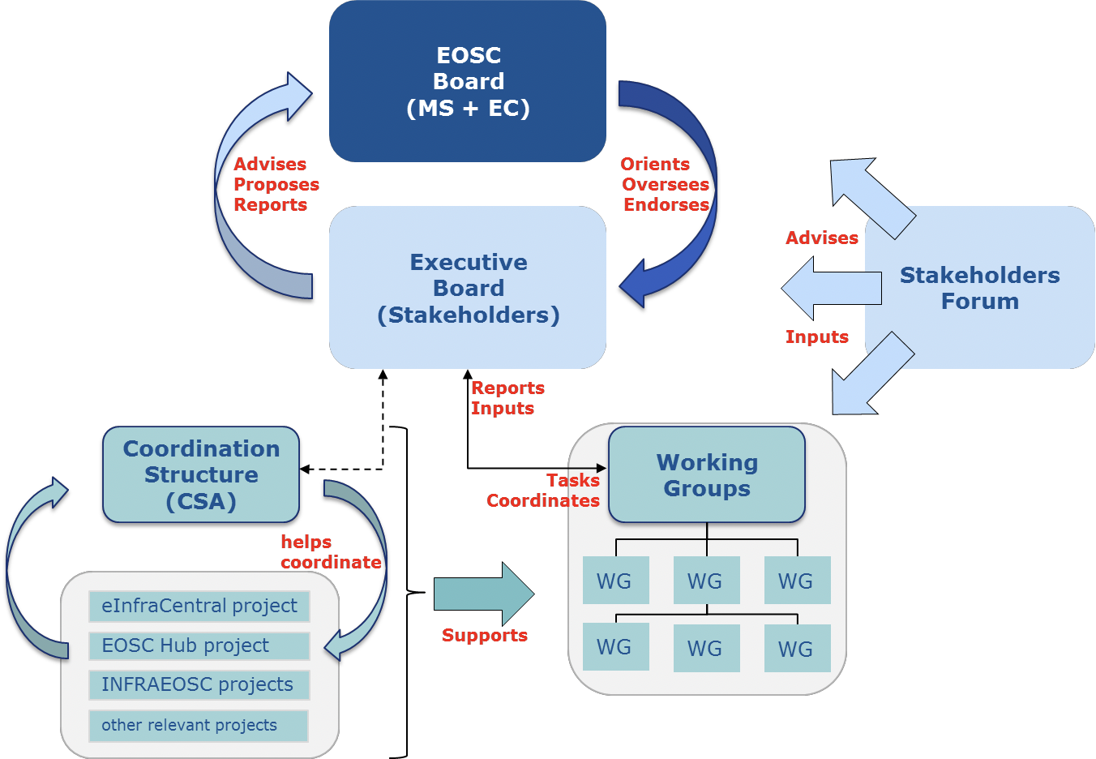
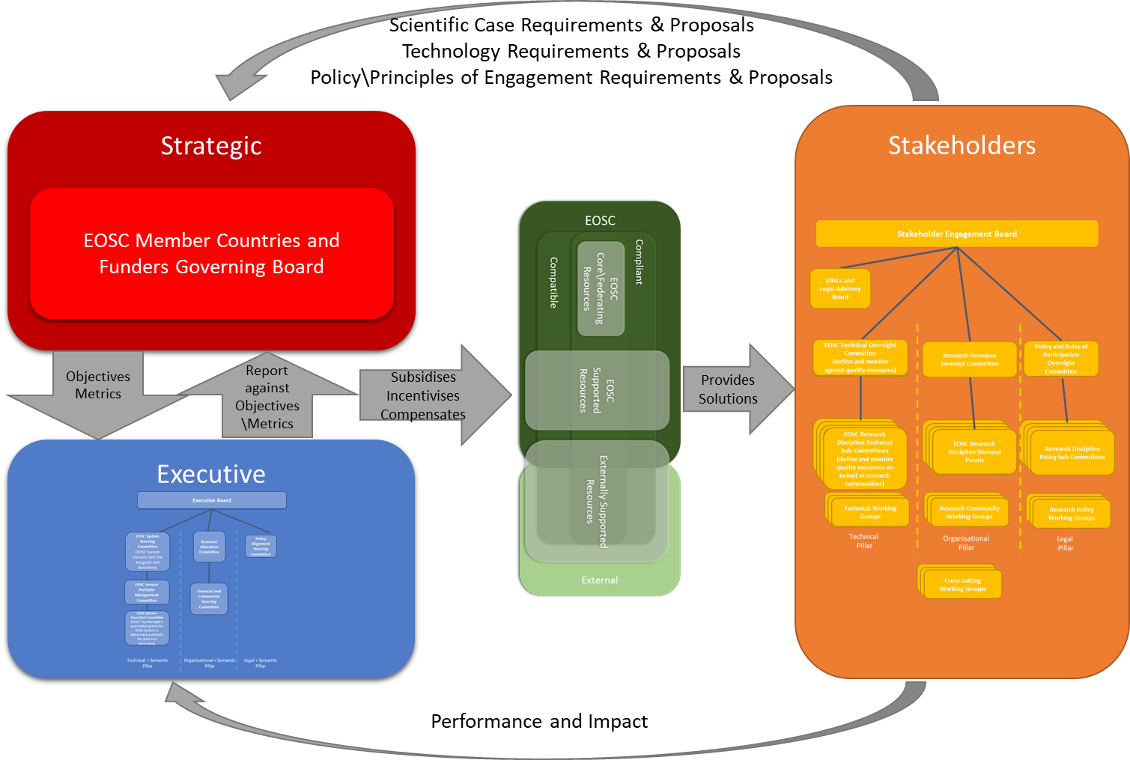
EOSCpilot EC Staff Working Document post-2020 up to 2020
Institutional
Advisory
Operational

