Slide 1
EPICS 4 beginners
Torsten Bögershausen
Many slides stolen from many sources
Steal it all. No, only steal the best.
Questions please at the end
www.europeanspallationsource.se

Slide 2
Outline: What is EPICS
History, overview
How does EPICS look like ?
EPICS IOC, EPICS process variable ”PV”
Records and EPICS ”database”
Network protocol: Channel Access
Questions
Bonus: better network protocol: pvAccess
Questions

Slide 3
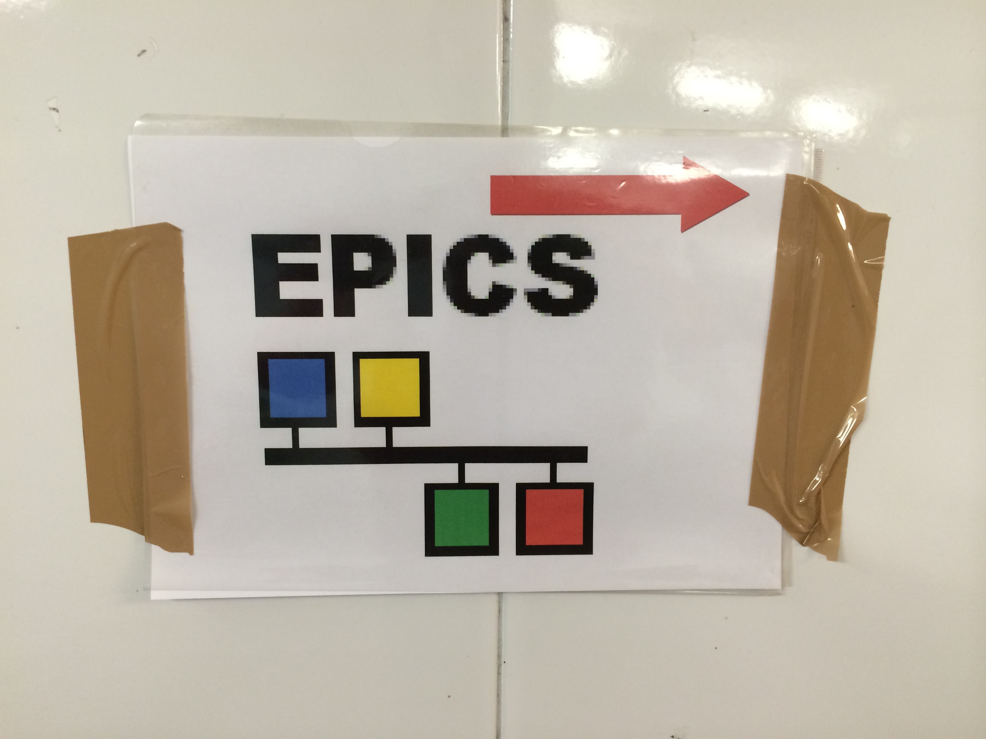
EPICS starting page
'Experimental Physics and Industrial Control System'
  http://www.aps.anl.gov/epics
Mailing list usually provides responses within a few hours
  http://www.aps.anl.gov/epics/tech-talk/index.php

Slide 4
EPICS history and collaboration
~1989: Started between
LANL Ground Test Accelerator and ANL Advanced Photon Source
Now:
  SNS, ANL/APS, SLAC, LANL, JLAB/CEBAF, LBNL, Fermilab D0,
  Gemini, FRIB, Laser Interferometer Gravitational Wave Observatory in the US
  Canadian Light Source
  Kek, J-PARC in Japan, KSTAR in Korea,
  DESY, BESSY, .. in Germany; PSI/SLS in Switzerland;
  ITER, Ganil, SACLAY in France; Diamond light source, ISIS in UK;
  KEK-K, J-Parc in Japan; IHEP in China; NSRRC in Taiwan;
  PLS in South Korea; Australian Synchroton, ESS in Sweden, …
Yearly collaboration meetings
  2 meetings / year, rotating through the continents
  @ ESS, May 25th .. May 27th 2016

Slide 5
EPICS is used in big science
Von: Andrew Johnson anj@aps.anl.gov
Betreff: Congratulations to everyone at LIGO Datum: 11. Februar 2016 17:21
An: EPICS tech-talk tech-talk@aps.anl.gov
... on finally detecting gravitational waves from a pair of merging black holes.
http://www.nature.com/news/einstein-s-gravitational-waves-found-at-last-1.19361
The earliest tech-talk message from a LIGO email address was from David Barker in 1996. I believe EPICS has always been a fundamental part of the observatories' control systems.
- Andrew

Slide 6
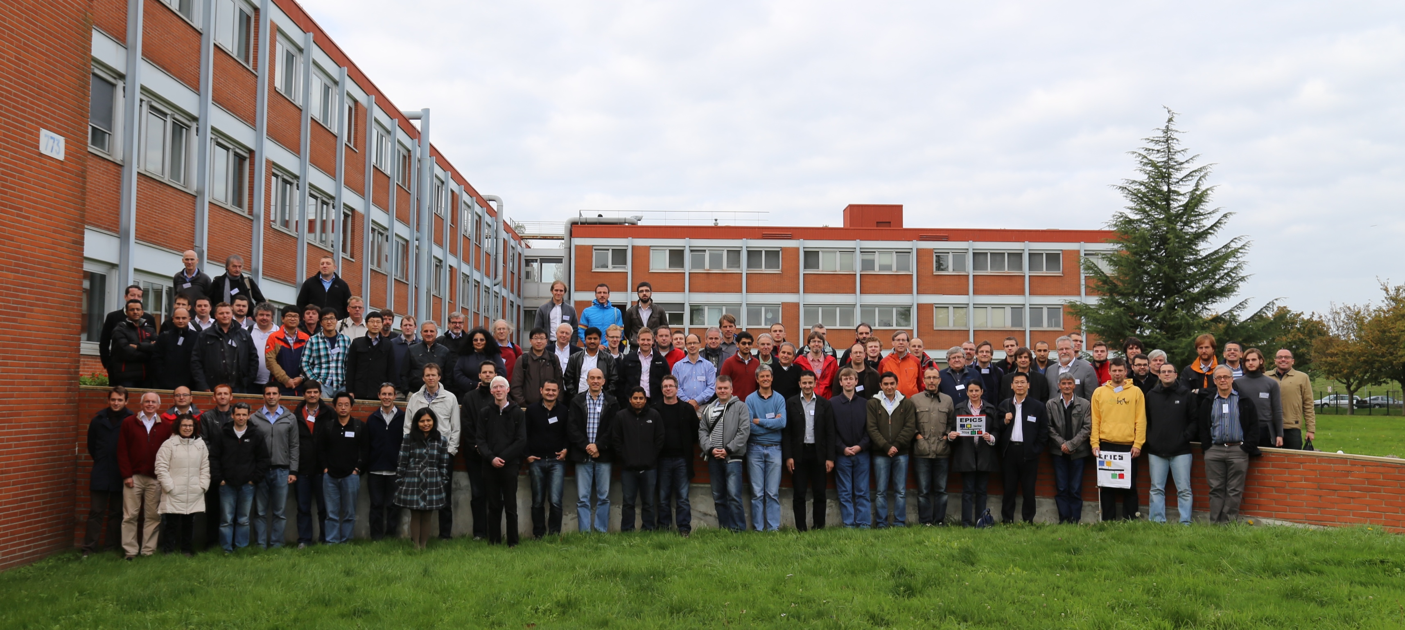
EPICS meeting Octobober 2014

Slide 7
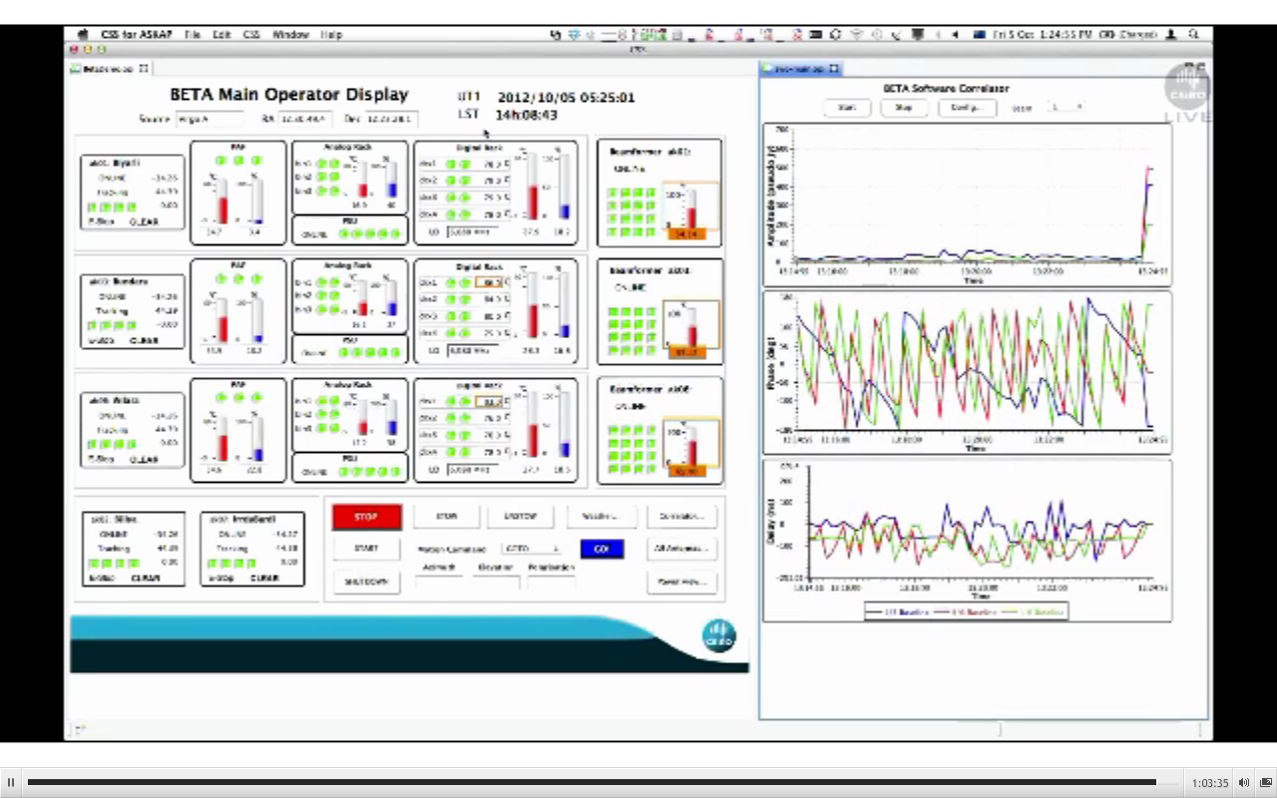
Juan Guzman, http://www.aps.anl.gov/epics/tech-talk/2012/msg02113.php

Slide 8
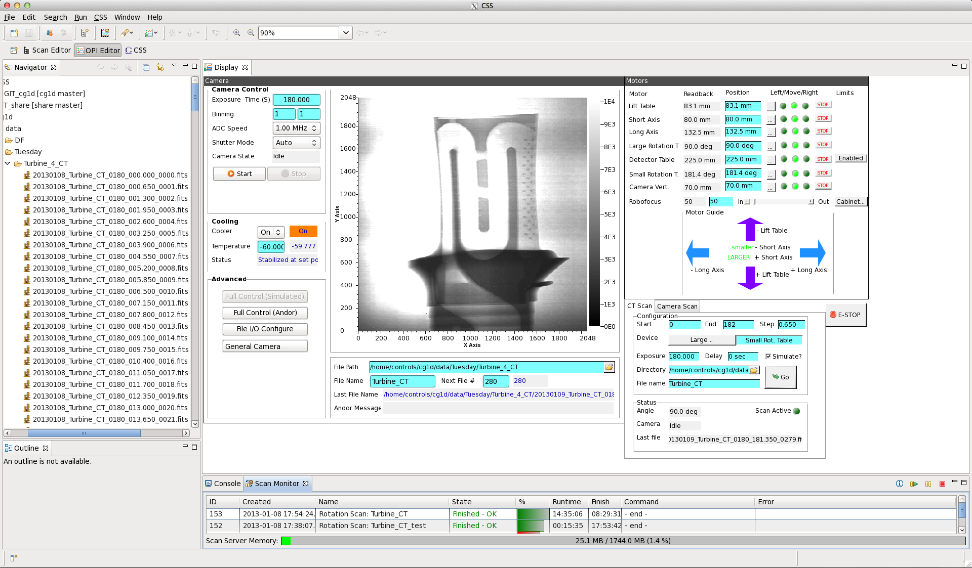
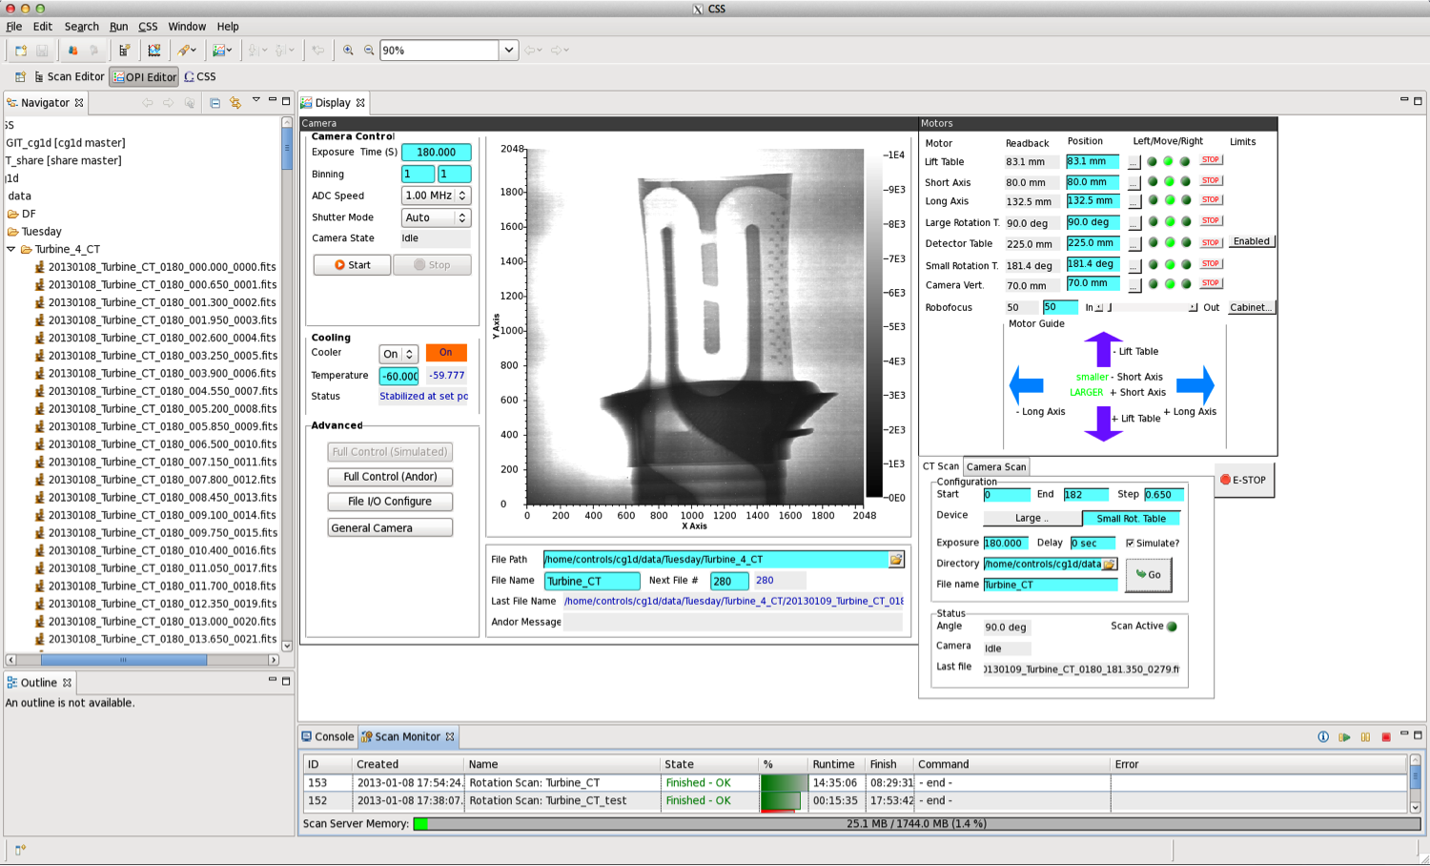
Example from SNS

Slide 9
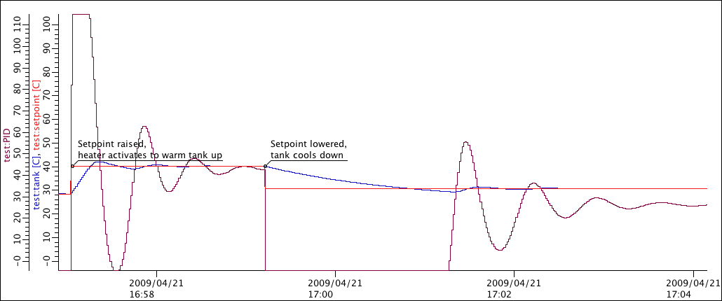
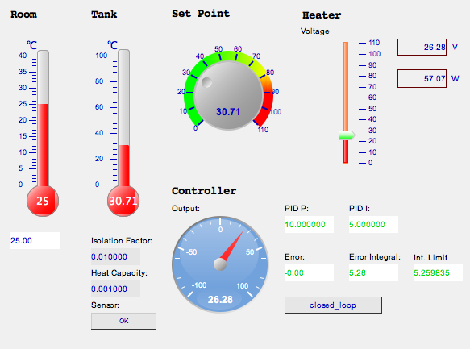

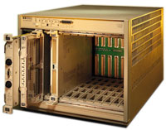
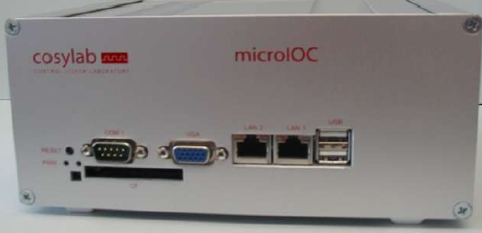
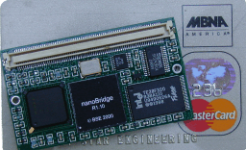
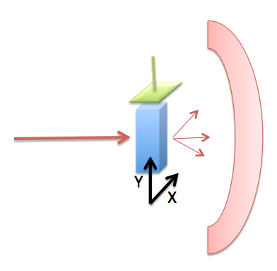
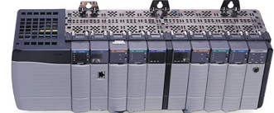

EPICS is distributed
Operator interface
Services: Archive,
CCDB
Front-end IOCs
I/O, PLCs, ..

Slide 10
EPICS is a toolkit
… for distributed control systems.
Front-end: “Input/Output Controller” (IOC)
Protocol: Channel Access, PV access
Clients: Operator displays, alarm system, …
Very portable: Linux, OS X, Windows, VxWorks, UNIX, RTEMS

Slide 11
What an IOC does
Known set of ‘Records’
  Read analog value
  Write analog value
  Perform computation
  Control motor
Runtime ‘Database’
  Executes records
Configuration
  SCAN=1 second
  INP=..what to read..
Serve all via Channel Access

Slide 12
What is a process variable
Process variable (“PV”):
- a physical value is represented in SW, with
metadata
- has a unit (Celsius, Volt, mm )
- may be analog (=floating point or integer)
- may be binary (=single bit)
- may represent a bit field
Is part of a “record”
Is hosted in an EPICS IOC (“IOC”, soft IOC, hard IOC)

Slide 13


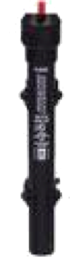


Example: Temperature control
Task:
  Read temperature
  Open/close switch as needed
  Repeat
Software?

Slide 14
Pseudo code
Sensor temp = connectToSensor();
Switch switch = connectToSwitch();
do forever {
if (temp.value() < 10)
switch.close();
else
switch.open();
sleep(1.0);
}

Slide 15
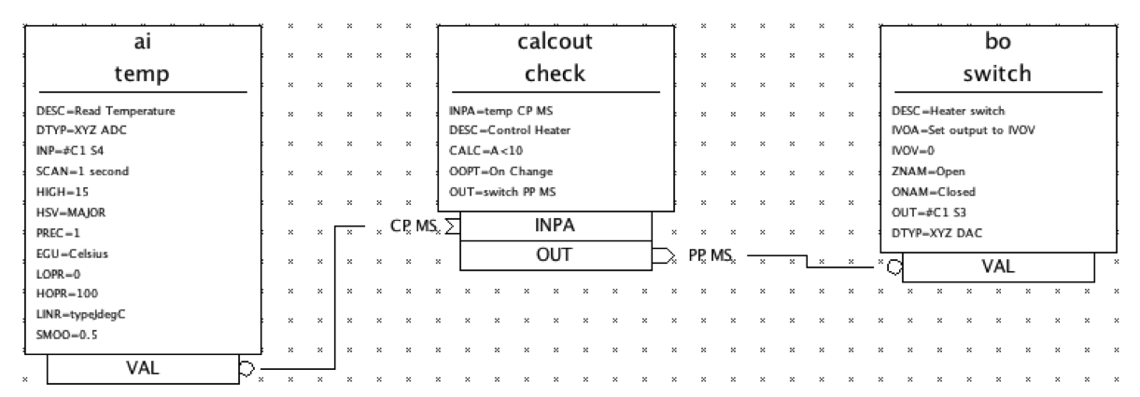
EPICS 'Database’ for Fishtank
Analog
Input
Record
calc
Record
Binary
Output
Record

Slide 16
Record: Analog in
record (ai, temp) {
field(DESC, "Read Temperature")
field(EGU, "Celsius")
field(SCAN, "1 second")
field(DTYP, "XYZ ADC")
field(INP, "#C1 S4")
field(PREC, "1")
#(less important, fields on next side)

Slide 17
Record: Analog in
# continued from last side
field(LINR, "typeJdegC")
field(HOPR, "100")
field(LOPR, "0")
field(SMOO, "0.5")
field(HIGH, "15")
field(HSV, "MAJOR")
}

Slide 18
Record: binary out
record (bo, switch)
field(DESC, "Heater Switch")
field(DTYP, "XYZ DAC")
field(OUT, "#C1 S3")
field(ZNAM, "#Open")
field(ONAM, "#Closed")
}

Slide 19
Record: calcout
record (calcout, check)
field(DESC, "Control Heater")
field(CALC, "a<10")
field(INPA, ”temp CP MS")
field(OUT, ”switch")
field(OOPT, "On Change")
}

Slide 20
IOC Database
A single record can handle the scanning, signal conditioning, alarming of a temperature, pressure, or similar analog reading.
Combined with binary and computational records, it can express the data flow logic for a front-end computer
  Avoiding the pitfalls of real-time, multithreaded and networked programming.
Can have thousands of records in one IOC.
kHz-rate processing with record chains is doable
  Of course limited by CPU. Not 1000nds of kHz rate-records…

Slide 21
Records for writing code
"SCAN=1 second"
instead of start thread,
delay until next multiple of 1 second,
lock required resources, …
"SMOO=0.5" configures the smoothing algorithm.
Change scan rates at any time via the network:
  scan rate
  Smoothing
  alarm levels

Slide 22
EPICS Vocabulary
EPICS Base
Code for IOC, database support, basic records, channel access
IOC
Input Output Controller, the front-end software
Soft IOC
IOC software running on Linux, …, typically communicating with networked I/O
Database
Executes the EPICS Records
Record
EPICS processing block
Driver
Code that talks to hardware. Devices with an ASCII-like command-set
often use StreamDevice as a driver.
Channel Access
EPICS network protocol. Exposes Channels aka Process Variables
SNL
State notation language.

Slide 23
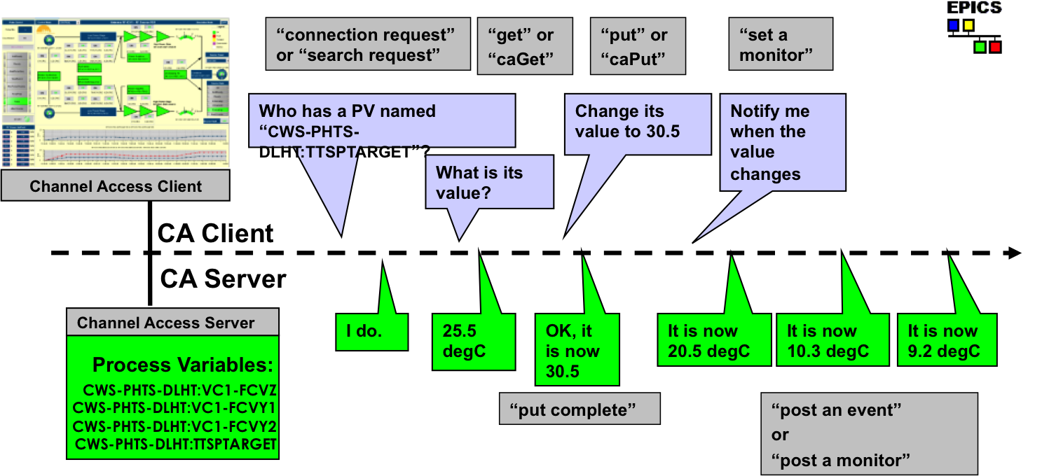
Channel access in one slide

Slide 24
EPICS @ ESS
Machine/Integrated Control Systems
- HW platforms, network, archiver,
- CCDB, naming convention
- Make it possible to install EPICS @ InKind
partners (”EEE” & ”Dev Env”)
Science/DMSC:
- Instrument control
Science/NSS
MCAG, SE, Chopper, Detector, Scientists

Slide 25
Motion Control Integration (today)
CSS BOY
caget / caput
Instrument Control (e.g. Python based)
3 layers in control box:
  EPICS IOC
  Motor record (single axis)
  Model 3 driver
Basic functionalities for point-to-point movements
Future extensions of functionality in additional records
EPICS Control Network
Channel Access
IOC: EPICS (base)
MotorRecord
m1
Model 3 driver
Ethernet + TCP/IP
Motion Control Unit
Motor
Encoder
(End) switches

Slide 26
Motion Control Integration (tomorrow)
CSS BOY
caget / caput
Instrument Control (e.g. Python based)
3 layers in IOC:
  Motor record (single axis)
  longout record (homing)
  Model 3 driver
Basic functionalities for point-to-point movements
Future extensions of functionality in additional records
Current development includes a.o. jerk, homing procedures
Extensions need to be implemented in user interfaces, model 3 driver and motion control unit as well (strong coordination necessary)
EPICS Control Network
Channel Access
IOC: EPICS (base)
MotorRecord
m1
longout
m1-PrcHom
Model 3 driver
Ethernet + TCP/IP
Motion Control Unit
Motor
Encoder
(End) switches

Slide 27
Move & monitor a motor
(done on a simulator, Mac or raspi)
caput IOC:m1.VAL 60.1
Old : IOC:m1.VAL 24.9
New : IOC:m1.VAL 60.1
camonitor IOC:m1.RBV IOC:m1.DMOV
IOC:m1.RBV 2016-02-02 10:58:16.157350 24.87
IOC:m1.DMOV 2016-02-02 10:58:16.658745 1
IOC:m1.DMOV 2016-02-02 10:58:16.658745 0
IOC:m1.RBV 2016-02-02 10:58:30.124368 49.86
IOC:m1.RBV 2016-02-02 10:58:31.138087 60.06
IOC:m1.DMOV 2016-02-02 10:58:31.639072 1
#Notes:
#caput: Channel access put
#camonitor: Channel access monitor
#IOC:m1..DMOV: Field “done moving”
#IOC:m1.RBV: Field Read back value

Slide 28
Quiz - 1
Can I monitor a PV on the command line ?
Is a PV is always a part of a record ?
Is a record processed ?
I can write a python script to control devices
(Experiment control) ?
An IOC can do real time processing ?

Slide 29
Quiz - 2
When a PV changes, is there a time stamp associated with the change ?
May a PV have a high-or low limit ?
Can a PV be used to monitor the room temperature ?

Slide 30
Relax
Time for questions

Slide 31
Why another protocol?
EPICS Version 3 is targeted towards control applications
  Simple data types, essentially scalar values with (very) limited metadata
    Timestamp, alarm, engineering units, etc.
Simple example: array of sampled values from an ADC.
  What was the sampling rate?
  Applications have to know that – knowledge is separate from data
  Or, create lots of extra channels to hold the metadata
  Applications have to stitch the information together from different channels

Slide 32
Scientifc applications need even more
Several (site-specific, incompatible) abstraction layers have been built on top of the simple EPICS channel structures
(Large) data transport is inefficient
Use of EPICS channel access for large data transfer is not practical (solution: bypass EPICS)
Achieving synchronicity is difficult (sometimes even impossible)
E.g., set three parameters for an acquisition and start: needs minimum of three “ca_put”s
Channel Access does not guarantee (atomic) delivery of waveform data

Slide 33
New protocol, pvAccess
Part of EPICS 7, which joined EPICS 3 and 4 together
Structured data
Introspection interface, “pvData”
Dynamic typing
Standard Scientific Types
RPC and putGet added
New smart database
All APIs in C++ and Java
Python
High Performance

Slide 34
EPICS 3 block diagram
EPICS in the nominal usage: An EPICS client communicates over Channel Access (CA) protocol to an Input/Output Controller (IOC) Channel Access server (module rSrv in an IOC)
Channel Access Client
Channel Access (CA) protocol
Input / Output Controller (IOC)
CA Server (rSrv)
IOC database
Device I/O
Notes:
Let’s turn briefly to look at the most basic architectures of EPICS V4, before we look at examples of their use.
In the first case, just to situate ourselves – and show how basic we’re talking here – this is the basic architecture of “EPICS Version 3.”

Slide 35
EPICS Version 4 is an extension of V3
Version 4 Additions to EPICS
V4 IOC == V3 IOC + pvAccess Server
Channel Access Client
pvAccess Client
pvAccess
CA
Use Case: Network efficient acquisition
of archived meta data
Presently, only 1 PV per pvAccess channel.
But plan is to get/monitor a group of PVs
through one pvAccess channel.
IOC
pvAccess Server
CA Server
IOC database
Device I/O
Notes:
The simplest thing you can do with EPICS V4 – add the pvAccess server to an IOC.
So the first thing we see is that in EPICS V4, at core, the IOC remains the same. An EPICS Version 4 IOC is just an EPICS Version 3 IOC with a pvAccess Server added.
To be honest, there is not much advantage in using just this configuration for EPICS installations which are already heavily invested in EPICS Channel Access, since all your existing clients will be using Channel Access. For such places, the advantages of EPICS V4 will stem more from the basic architectures in the following 2 or 3 slides, and for new work.
But for new institutions, just now building your EPICS installation, you may consider this architecture.
ESS for instance, is going to be all pvAccess.
[ADD: pvaSrv example]

Slide 36
EPICS Version 4 includes CA
Version 4 Additions to EPICS
The pvAccess API includes Channel Access support, so one client lib does both
Channel Access Client
pvAccess Client
CA
CA
IOC
pvAccess
CA Server
pvAccess Server
IOC database
Device I/O
Notes:
Just to add, the client side library of EPICS V4 includes support for Channel Access.
In fact, more generally, the pvAccess API includes a plugable architecture for “channel providers”, of which the pvAccess protocol and the Channel Access protocol are two.
[ADD example of getting CA data with pvAccess API – pvget –p ca]

Slide 37
EPICS Version 4 new database
Version 4 Additions to EPICS
A new smart database, “pvDatabase” can be used for data assembly and processing
Channel Access Client
pvAccess Client
CA
pvAccess
CA
Examples; the SNS and NSLS-II beamline
experiment high performance data acquisition and processing (later in talk)
IOC
CA Server
pvAccess Server
IOC database
pvDatabase
Device I/O
Device drivers etc stay
only under IOC database
Notes:
Now things get interesting for new kinds of work made easier by EPICS Version 4.
V4 adds a new kind of front end processing database, the “pvDatabase”.
The device I/O, particularly the device driver layer, remains under the IOC Database.
This slide illustrates the architecture in which a pvDatabase is used inside an IOC. But a pvDatabase can be used standalone, at the host level of an EPICS version 4 controls network. At that level it might be used to aggretage data from a number of Channel Access PVs in subordinate IOCs, like to gather data from a number of beam diagnostics and deliver it all as one package.

Slide 38

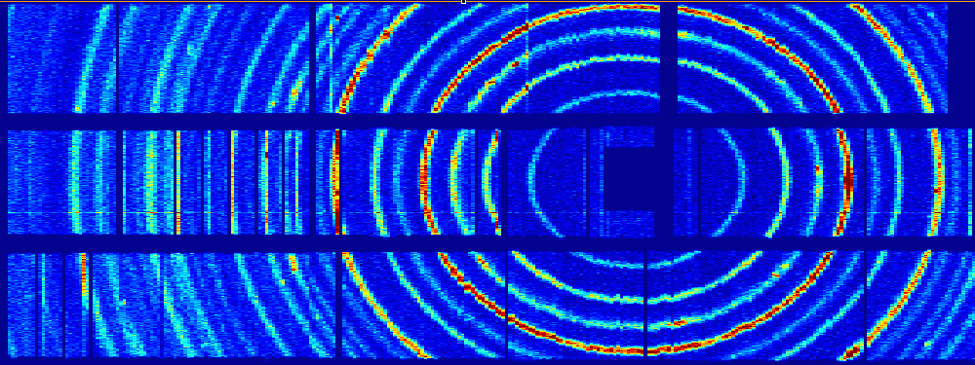
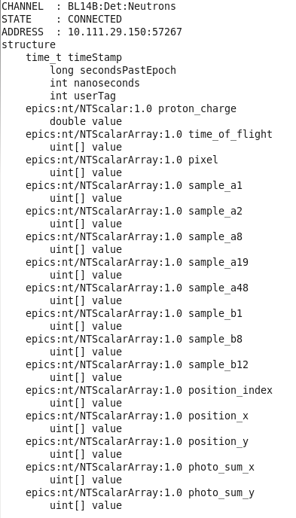
SNS uses EPICS V4 for high throughput event readout, of structured PV data.
ORNL SNS Deployment: Neutron event data aggregation and transport
Neutron Detector
CS-Studio
pvAccess streams event data at
80 Mbytes / sec
SNS SEQUOIA detector ray consisting of >800 3He tubes covering a solid angle of 0.8 steradian
Diffraction rings of a powder sample at SEQUOIA, histogram generated by ADnED and displayed in CS-Studio
nED
ADnED
pvAccess Server
CA Server
pvDatabase
areaDetector data processing
Classic EPICS IOC
pvAccess Client
nED provides the driver interface to the detector electronics and streams experiment data using pvAccess
The V4 data structure includes an array of pixels and a corresponding array of times of flight for each recorded neutron event. Additional fields record accelerator pulse information and detector diagnostic information
ADnED, a pvAccess client, generates online histograms and counting statistics from the nED data stream and serves them using the CA protocol to clients including CS-Studio
Kay Kasemir, Steven Hartman, ORNL
Notes:
EPICS V4 is used at SNS in data acquisition and processing of Neutron scattering experiments. [Timo, you may want to say more here on ESS too]
Neutron scattering can be used to help in the understanding of the structure and properties of materials; it is a technique complementary to x-ray scattering. Neutrons, with a neutral charge, are highly penetrating and are an effective probe for locating light atoms such as hydrogen.
nED provides the interface to the detector
nED streams experiment data using the V4 network protocol, pvAccess
ADnED, built on EPICS AreaDetector, is the V4 client
ADnED produces data histograms for online user display along with counting statistics for experiment control.
Presently the histogram and image data are still distributed as CA data.
Long term plan is to extend pvAccess to user client side, though that depends on pvAccess gateway and CSS-widget support
However, good that pvAccess areaDetector driver and plugin are about to be distributed with areaDetector (2-5)

Slide 39
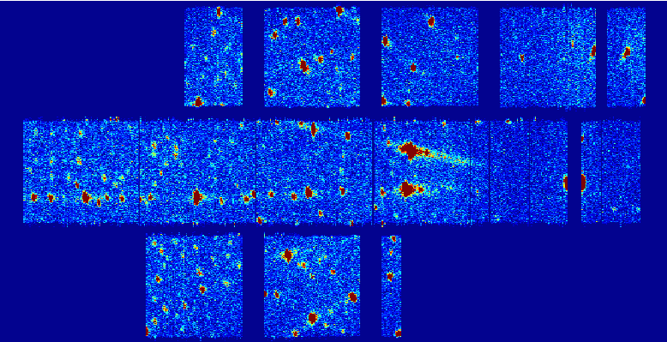
SNS’s use of EPICS V4 for transport of beamline neutron event data
ORNL SNS Deployment: Neutron event data aggregation and transport
SNS Conclusions:
Five beam lines currently using EPICS V4
Plans to extend to all experiment beam lines.
Additionally, A pvaPy-based V4 client is used for detector calibration and diagnostics.
EPICS V4 meets the performance requirements for all existing SNS instruments
Demonstrated at data rates of 10M events per second
Excellent reliability.
ADnED plot of a diffraction pattern from neutron scattering of a single-crystal sample at SNS CORELLI
Fragment of the SNS V4 structure used for streaming experiment data at the 60 Hz rate of the pulsed neutron source
Kay Kasemir, Steven Hartman, ORNL

Slide 40
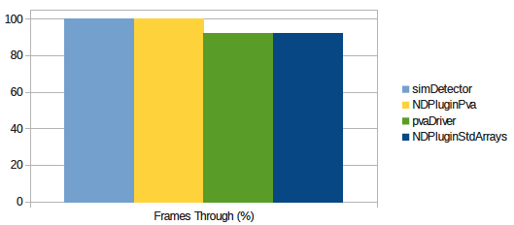
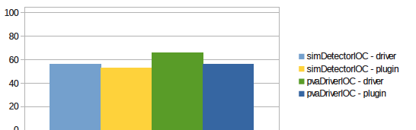
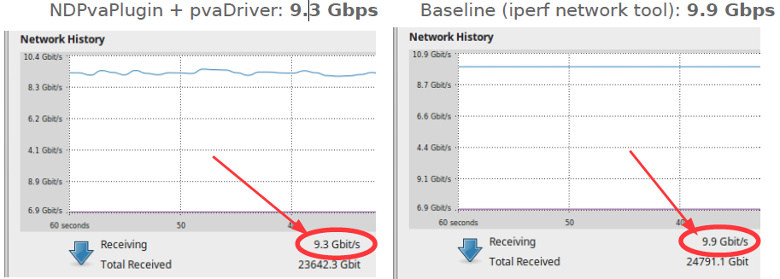
NSLS-II V4 areaDetector Performance Test
NSLS-II Deployment (1) – beamline image data transport and fanout
Test simDetecor datasource 5K x 5K @ 50Hz ~= 10 Gb/s over 10Gig Ethernet.
Non-blocking callbacks. AD ImageMode: Multiple. NumImages:10000
Test pipeline
stage
Frames through (%) (more is better)
CPU usage (less is better)
Transfer bandwidth: EPICS V4 & practical limit:
Conclusions: EPICS V4 based
areaDetector pipeline has high
throughput, few frames lost,
with no CPU saturation. Network
bandwidth is close the practical
maximum.
Bruno Martins, BNL (following work by James Rowland and Dave Hickin at Diamond)

Slide 41
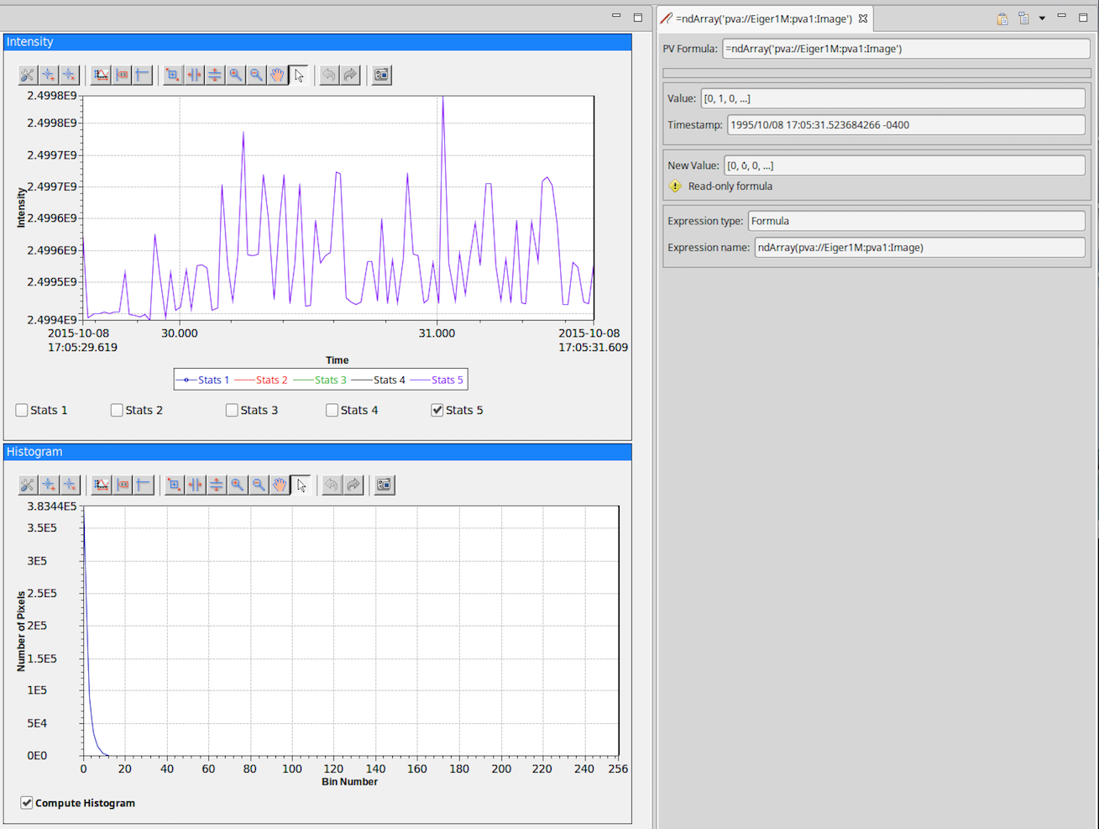
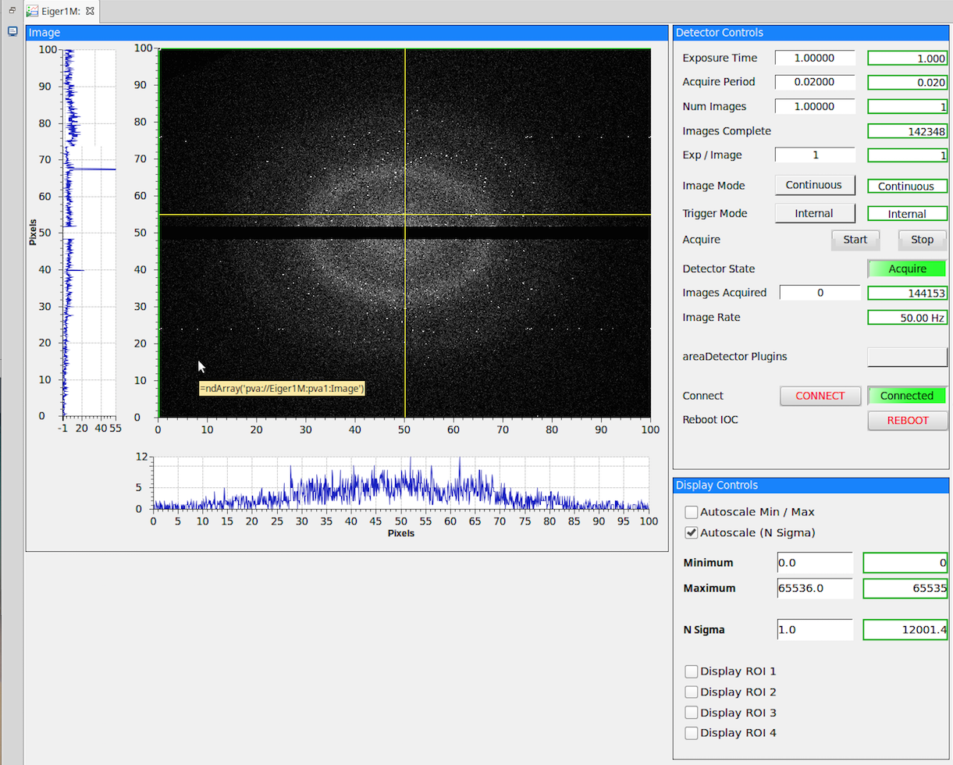
NSLS-II Deployment (1) – beamline image data transport and fanout
The V4 PV
“Eiger1M:pva1:Image”
of type NTNDArray
Figures: NSLS-II CS-Studio screenshots showing an EPICS V4 PV of the type for areaDetector images (NTNDArray) displayed using a CS-Studio “formula.”
Notes:
Like SNS, BNL NSLS-II uses CS-Studio as the OPI
But at NSLS-II the data transported are of the EPICS V4 normative types specifically intended for images from areaDetector, called NTNDArray.
The EPICS V4 Normative Types are handled in CS-Studio by CS-Studio formulas.

Slide 42
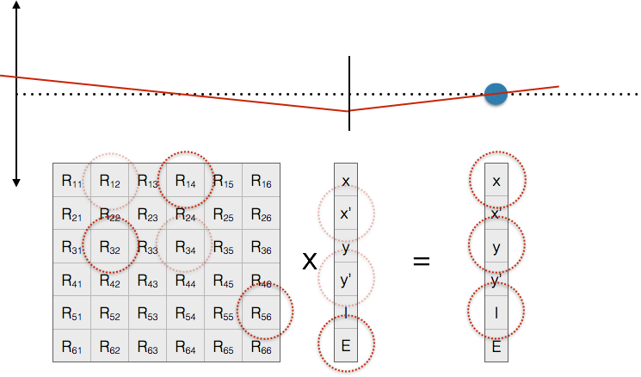
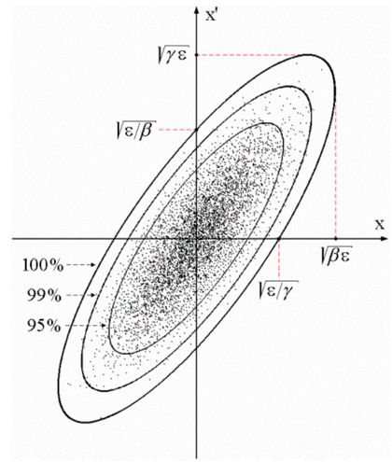
SLAC and ESS collaboration on EPICS V4 for beam dynamics modelling and infrastructure data
SLAC & ESS deployment: Modelling beam dynamics
Transverse
beam offset
“A”
“B”
Z
$ eget -s XCOR:IN20:491:RMAT -a b BPMS:IN20:525
0.669591 0.694604 0 0 -3.08532e-19 2.41325e-19
-0.570851 0.901275 0 0 -1.23627e-19 1.45491e-19
0 0 1.33379 0.966896 0 0
0 0 0.358415 1.00957 0 0
-2.29302e-24 8.92892e-20 0 0 1 1.20724e-05
1.00974e-28 0 0 0 0 1
From N. Delerue, Oxford Univ.
$ eget XCOR:LI24:900:TWISS
energy 5.00512
psix 37.7625
alphax 13.6562
betax -2.78671
etax -0.00698294
etaxp 0.00107115
psiy 31.9488
alphay 116.762
betay 5.2592
etay 0
etayp 0
z 2438.72
Figure: EPICS V4 modelling service giving orbit response matrices
and Twiss parameters for given devices. These are the basis of 95%
of emittance minimization applications – feedback, steering, bumps, etc
Greg White, Murali Shankar SLAC; Ivo List, ESS
Notes:
SLAC and ESS are collaborating on a system of EPICS Version 4 services that help accelerator physicists write commissioning applications.
The two examples in this slide show use of an EPICS service to compute the optics of accelerator lattice elements.
The Left Hand Side shows the response matrix computed between a corrector and a BPM. Two things to note:
1. The use of RPC sty;e argument – the name of the second device – given as an argument to the first.
2. That the response matrix self identified as the Normative Type NTMatrix, so eget (and any other client) knows to display it as a matrix
The Right Hand Side shows the acquisition of the Twiss – aka Courant-Snyder – paramters of a corrector.
Other PVs can also return the optics of the whole accelerator, returned as a very large table – in an NTTable.

Slide 43
Questions
Thank you

