Slide 1
The Agile Mindset
Linda Rising
linda@lindarising.org
www.lindarising.org
@RisingLinda

Slide 2
Do you mostly agree or mostly disagree with the following
Intelligence is something very basic that you really can't change much. You’re born with it or not. Yes, you can learn new things, but you can't really change how intelligent you are.
No matter how intelligent you are, you can always get better, sometimes you can improve a lot.
Substitute any ability or talent for “intelligence.”

Slide 3
Interesting experiments
Phase I:
Students given very easy test
Then categorized (somehow) into “growth” or “fixed” groups

Slide 4
Phase II
All students allowed to choose between: (1) a difficult test (where they would learn a lot)
OR
(2) another easy test (similar to Phase I)
Most (~90%) “growth” students chose (1)
Most (~80%) “fixed” students chose (2)

Slide 5
Phase III
Very difficult exam given to both groups
“Growth” students worked hard, enjoyed the challenge
“Fixed” students easily discouraged

Slide 6
Phase IV
All students allowed to choose between: (1) seeing exams of those who did better
OR
(2) seeing exams of those who did worse
“Growth” students chose (1)
“Fixed” students chose (2)

Slide 7
Phase V
All students given easy test (similar to Phase I)
“Growth” students improved (by ~30%)
“Fixed” students’ were worse (by ~20%)

Slide 8
Phase VI
All students asked to write a letter to students in the future and include their scores.
“Growth” students: Lots of advice and encouragement.
“Fixed” students: Very little or no advice ~40% lied about their scores

Slide 9

Mindset – Carol Dweck

Slide 10
More info
New Yorker – “The Talent Myth,” gladwell.com
New York Magazine – “How not to talk to your kids,” Po Bronson
TIME magazine – “How to help them succeed”
mindsetonline.com/
www.stanford.edu/dept/psychology/cgi-bin/drupalm/cdweck

Slide 11
Fixed vs. Agile
Ability – fixed, like height
Goal – look good
Challenge - avoid
Failure - defines your identity
Effort - for those with no talent
Reaction to challenge - helplessness
Ability – can grow, like muscle
Goal - learn
Challenge - embrace
Failure – provides information
Effort - path to mastery
Reaction to challenge – resilience

Slide 12

Bright little girls

Slide 13
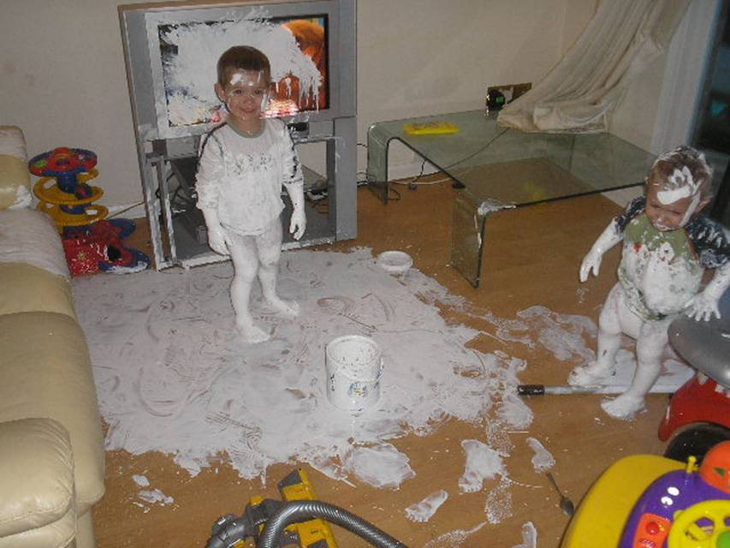
Bright little boys

Slide 14
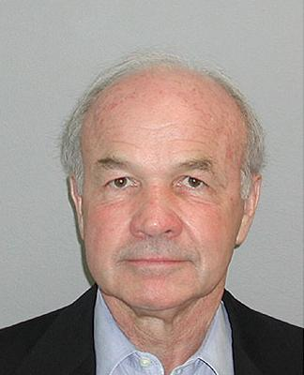

Smartest guys in the room

Slide 15
Enron’s fixed mindset
Identify and hire “the best talent”
Then continuously and ruthlessly grade, sort, fire, and promote – “rank and yank”

Slide 16

We are a company of people, not planes. That is what distinguishes us from other airlines.

Slide 17
The Southwest Culture
Hire for attitude
Establish a culture of community, trust, and the “Southwest spirit”
Then provide learning opportunities and continually grow people

Slide 18
Mindsets exist at all levels
Individuals
Families (marriages)
Teams
Organizations
Countries – HOSOKTERE.ORG

Slide 19
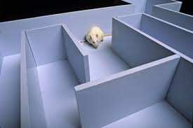
Rosenthal & Fode - 1963

Slide 20
Managers have a mindset
“Keen to Help? Managers’ implicit person theories and their subsequent employee coaching,” Peter Heslin, Don Vandewalle, Gary Latham, Personnel Psych., 2006.
“Pygmalion in Management,” J. Sterling Livingston, Sept/Oct 1988 Harvard Business Review.

Slide 21

We’re born agile!

Slide 22
Fixed educational system?
“… what we do throughout our whole education system is give students solvable problems. In fact they’re guaranteed to be solvable…. In the real world, most problems are not solvable…and there are many competing demands….you have to often change course in the middle in order to meet sociological issues as opposed to technological ones…..it’s very difficult for us to implement that in our teaching. But I think we would do a much better job and offer a much better service to our students if we would try and teach our students to fail more effectively.”
Lawrence Krauss, theoretical physicist

Slide 23
The good news is…
Mindset is not “fixed”
We encourage one or the other in each other
We develop one or the other in our children
Research shows that small experimental manipulations, e.g. feedback or reading an article can produce one or the other

Slide 24

You mean I don’t have to be stupid?

Slide 25
Effort is good!
Praise effort, strategies, process
Ask about the work
Instead of ignoring failure, teach that it’s a way to learn and improve
Encourage others to ask their own questions, struggle, and fail
Ask, “Which mindset would you like to hold?”

Slide 26
For Kids
Instead of “You’re so smart” or “You picked that up so quickly,” say “That was a clever approach” or “I’m proud of your persistence.”
Instead of “You’re a natural” say “Practice is really making you better.”
Instead of “Did you win?” say “Did you give your best effort?”
Instead of “How was your day?” say “What did you learn today?” or “What mistakes did you make that taught you something?”
Instead of "What do you want to do when you grow up?“ say "What are your plans for reaching your goals?“
Never let failure progress from an action to an identity.
Never label kids, e.g. “Jimmy is the artist” or “Susie is the computer geek.”
When a child doubts her ability, ask her to think of areas where she once had low ability and now excels, or to recall a time when she saw someone learn something or improve in ways no one thought possible.

Slide 27
For other adults
Instead of arguing with someone who continually puts himself down by saying, “You are smart. You are talented. You are <whatever>, realize this enforces the fixed mindset. Remind the other person of times in the past when determination and hard work have led to success. Offer your support to help them invest energy in the new situation.
Instead of lecturing the other person, at some point BEFORE they are down, provide information about the different mindsets. Experiments have shown that simply describing the two approaches can help. Ask, “Which mindset would you like to hold?”
Depressed people tend to believe that it’s just the way they are. Help the other person see themselves as a temporarily derailed work in progress.
Help the other person learn to say, “I can’t do this…yet!”

Slide 28
For yourself
Instead of letting salary, benefits, or status define job satisfaction, ask yourself if you’re still learning. If yes, then you’re fortunate to have a job that encourages a growth mind-set. View its challenges as opportunities rather than stress. If you’ve stopped learning, then consider looking either for new avenues of growth or for another job.
Instead of blaming others in your relationships, remember the whole point of a relationship is to encourage each other’s development.
Depressed people tend to believe that it’s just the way they are. Instead of viewing yourself as a failed end product, think of yourself as a temporarily derailed work in progress. We usually think of personality as something very stable, but we’re finding that even core parts of it can be changed by shifting mind-sets.
Say, “I’m not good at this…yet!”

Slide 29
Agile software development
Fail early, fail often.
Fail fast, learn constantly.
Failure *IS* an option.
Without failure how can learning happen?
“Perfect is a verb.” Kent Beck
“Make mistakes faster.” Rich Sheridan, CEO, Menlo Innovations, MenloInnovations.com

Slide 30
Agile is agile
The agile mindset believes everything is a work in progress. The agile software development process isn’t fixed. It continues to change and grow as we learn more about it. This will never end because it will never be perfect.
Ever tried. Ever failed. No matter. Try Again. Fail again. Fail better. Samuel Beckett, Irish poet (1906-1989)
Thanks for listening!

Slide 31


Now out ☺!

