Slide 1


“Agile and Performance Testing?“ A contradition of terms?
Mieke Gevers
European Testing Conference 2016
Notes:
Within an agile development cycle, most often the iterations occur at 1, 2 to 3 week intervals, with the goal of delivering small parts of “performing” functionalities, allowing us to complete several performance-testing tasks during each iteration.
Dealing with response time issues, services with hiccups, application slowdowns, bottlenecks, server non-availability - whatever you call them, are among the most challenging issues for IT organizations to detect, monitor, resolve and prevent from happening again.
Studies are proving us that it is definitely better to build-in performance during the design stage and continue performance-related activities through the whole software lifecycle. Agile development lifecycle should be the perfect model for it! Nevertheless, even in an agile world, quite often performance testing happens just before going live with very short timeframe allocated for it.
It seems that we are still approaching performance testing in a very formal way, with a rigid & step-by-step approach. This is often leading us to miss the real performance problems and being contra-productive in a team with the possibility to prolong the process of performance troubleshooting.
The presentation will focus on how you can implement performance testing within an agile developing lifecycle successfully, highlighting its problematics and the possible solutions.
Showing tips & tricks and demo performance testing tools (like JUnit, OpenSTa, profiling tools, and others) which can help to increase the performance testing efficiency and align the performance testing effort, with the goal of conducting a “good enough” performance test in an agile developing lifecycle.

Slide 2
Agenda
Performance testing
Manifesto
Performance testing & Agile
Stories
Conclusion

Slide 3
Performance Testing
what do we do
how do we do it
when we do it

Slide 4
Performance testing
What ~ Value:
assess user satisfaction?
validate assumptions?
estimate capacity?
assist in performance tuning?
generate marketing statements?
Inform & assist developers?
evaluate release readiness?
prove readiness to stakeholders?

Slide 5
Performance Testing Definition
Performance testing proves that the SUT meets (or does not meet) its performance requirements or objectives, specifically those regarding response time, throughput, and utilization under a given (usually, but not necessarily, average or normal) load.
IEEE, definition Performance testing

Slide 6
How ~ Tools & tools and tools….
Junit
Jmeter
OpenSTA
Java Explorer
Profiler
Performance TT
…

Slide 7
When ~

Slide 8

Manifesto for Agile Software Development
We are uncovering better ways of developing software by doing it and helping others do it.
Through this work we have come to value:
Individuals and interactions over processes and tools
Working software over comprehensive documentation
Customer collaboration over contract negotiation
Responding to change over following a plan

Slide 10
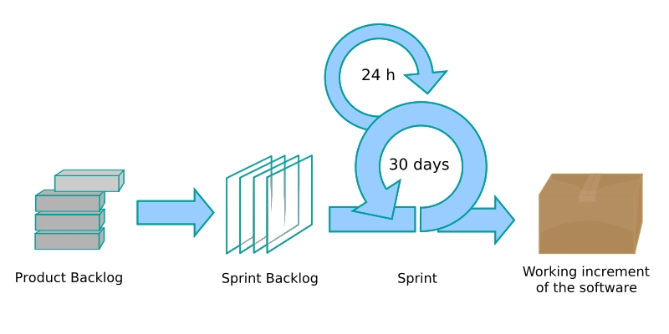
Agile ~ Performance Testing

Slide 11
Core Performance Testing activities
Agile Performance Testing Activities
5 Steps
Analyse
1. Identify Test Environment
1. Understand Project Vision and Content
2. Identify Performance Acceptance Criteria
2. Identify Reasons for Testing Performance
Plan & Design Test
3. Plan and Design Tests
3. Identify Value of Testing Performance
Build/Record scenario’s
4. Configure Test Environment
4. Configure Test Environment
5. Implement Test Design
5. Identify and Coordinate Tests
Baseline + Load Test
6. Execute Tests
6. Execute Task(s)
7. Analyse, Report and Re-test
7. Analyse Results and Report
Reporting
8. Revisit 1-3 Consider Performance Criteria
9 Reprioritize Tasks
patterns & practices: Performance Testing Guidance for Web Applications
© 2008-2009 AQIS

Slide 12
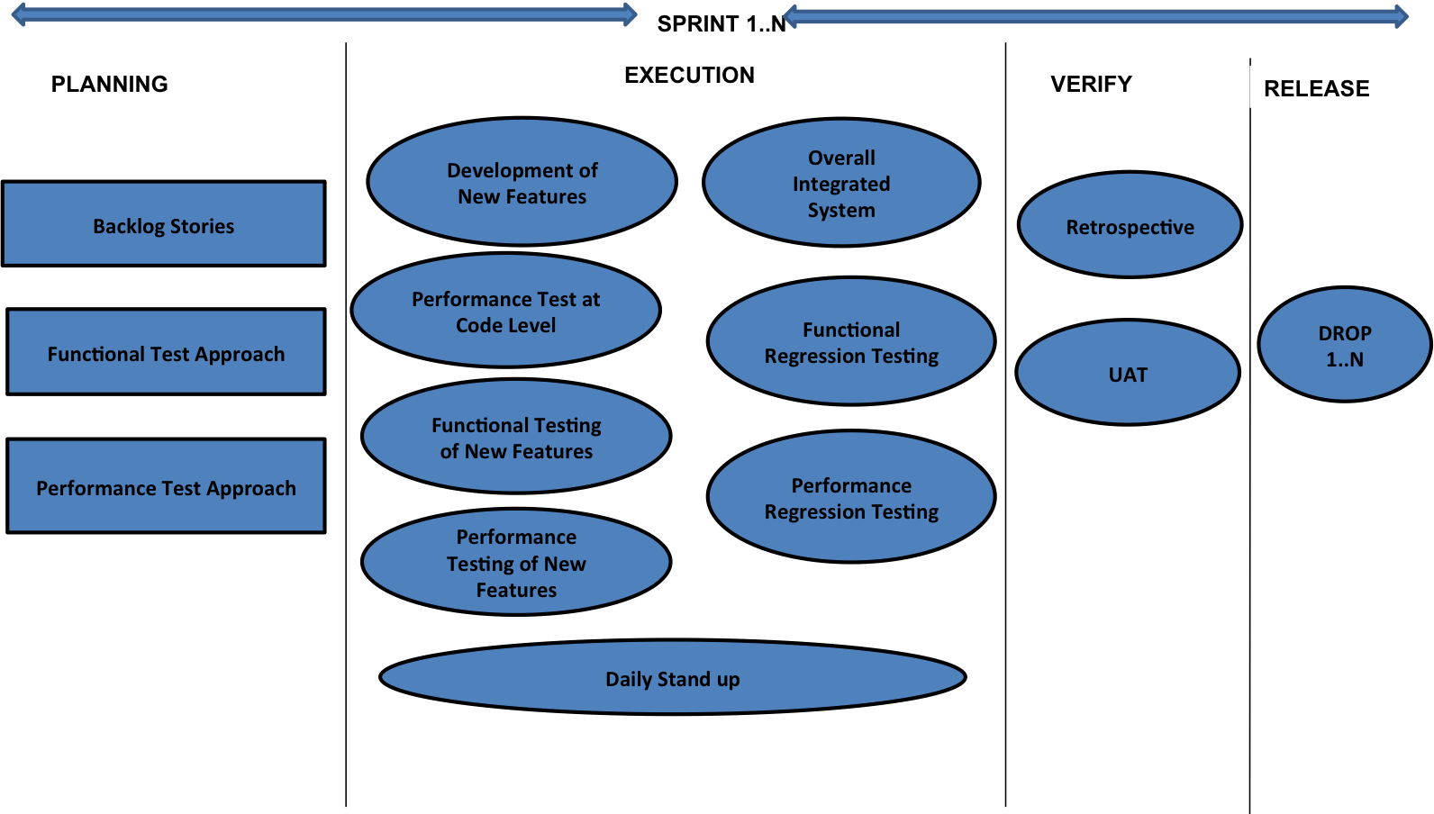
Rajni Singh

Slide 13
Performance User Stories
Agile project Cloud
Agile project Mobile (Citrix)
Agile project Enterprise Software
Notes:
https://www.openstack.org/

Slide 14



Agile project Cloud

Slide 15
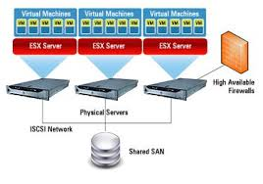
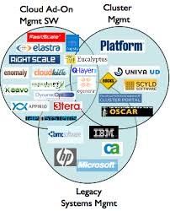
Agile project Cloud

Slide 16




Agile project Cloud

Slide 17

Agile project Mobile (Citrix)

Slide 18


Agile project Enterprise Software

Slide 19
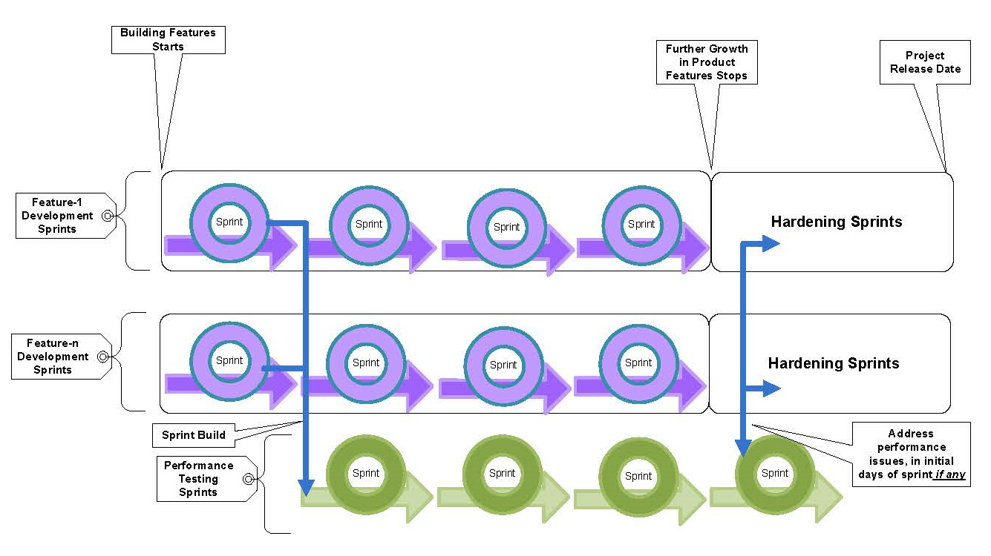
Redefined the Definition of Done
Prakash Mallappa Pujar

Slide 20
Key considerations
Service-level objectives (SLOs)
Focused performance testing
Agile processes rely on the production availability lifecycle (PAL)
Test data preparation
just-in-time (JIT) manufacturing
Trending
Reusable and shared testing assets
Automated testing
Continual analysis
Component testing & stubs
Notes:
Key considerations in Agile performance testing
Service-level objectives
Service-level objectives (SLOs) drive the planning of performance requirements in Agile environments. Through SLOs, business and IT managers agree on requirements for application throughput, response times, numbers of simultaneously supported users, and other factors that affect the end-user experience. These requirements, which become part of the application backlog, must be met before an application can go live in a production environment
Focused performance testing
SLOs spell out the expected behavior of applications. But in a practical sense, development, test teams, and the business don’t always know the exact requirements for an application until they see how it performs in a production environment. For this reason, Agile processes rely on the production availability lifecycle (PAL) to see how an application actually performs in the real world. The feedback from the production environment helps developers and testers focus on specific problem areas of the application, thereby increasing the resources during short sprint cycles
Test data preparation
The earlier test data preparation takes place, the more time you have for testing. So performance testers should work with stakeholders in the planning stage to prepare tests and test data. This kind of collaboration is one of the keys to getting a lot of work done in a relatively short sprint. Different types of work must happen simultaneously. In this sense, Agile software development is a bit like just-in-time (JIT) manufacturing. You plan carefully for your needs, and then bring in the resources just when you need them.
Trending
In an Agile environment, it’s important for application owners to see continual improvement in an application over the course of successive sprints. They want to see a favorable trend, where each iteration of the application is better than the last. This makes it all the more important to monitor application performance trends in terms of SLO requirements. Trending reports allows you to give stakeholders regular snapshots of performance, which should ideally show that performance is getting steadily better or at least is not degrading. In addition, by looking at trending reports you do not necessarily have to study the analysis on every test run.
Reusable and shared testing assets
To accelerate testing and development work, Agile processes should make use of a repository of reusable and shared testing assets. This repository of test scripts gives everyone on the virtual development team, including contractors working on an outsourced basis, access to the same test assets.
Among other benefits, the repository provides efficiencies that come with “follow-the-sun” testing. Test scripts can be created over the course of a day in one geography and then made available to testers in another geography, who will run the test during their business day.
The ability to reuse and share test assets becomes more important with Agile development when the testing cycle is limited. It allows more work to get done within the available time window
Automated testing
The use of automated testing tools can speed up the process of performance testing. With the right software in place, you can create a script, make it reusable, and then schedule a test to run in the off hours, when developers are not changing the code you’re testing. This makes it possible to achieve higher levels of software quality in less time.
Automated testing helps you meet your regression and performance testing objectives within the tight timeframes of a two- to four-week sprint. This becomes even more important when you consider that developers often hold onto their work till 60 percent of the time has passed in a sprint, before handing off the build for testing. That doesn’t leave a lot of time for testing.
Continual analysis
In Agile processes, continual analysis is important.
Both contributors (“pigs” in scrum terminology) and stakeholders (“chickens” in scrum terminology) need to keep a close eye on the progress of the project, especially when it comes to application functionality and performance. To give them the view they need, performance analysis should be both continual and comprehensive. This ongoing analysis helps pinpoint any problem areas in the application. Analysis takes place all the way down to the daily scrums that include IT infrastructure and performance testers as contributors and application stakeholders.
Contributors are active members of the sprint team who participate in daily scrums, which give all stakeholders visibility into the current state of the development effort. When all interested team members know the performance of each sprint, they are in a better position to keep the quality of the entire application high. The sooner problems are found, the sooner they can be fixed.
Component testing
In an Agile environment, you will not have an end-to-end application in every sprint. This makes it important to be able to performance test only a portion or a component of an application. Stubbing provides a way to test components. Stubbing simulates parts of an application that are either not written or not available. If an application uses outside, third-party data sources—a common occurrence in a Web 2. 0 world—then performance testers and quality assurance (QA) specialists are going to need stubs because they cannot add load to third-party production servers. By performance testing components inside each sprint, you will help enable the development effort yields a high-quality application that performs well from end-to-end

Slide 21
Three phases of Agile Performance Testing
Unit Level
Executing tests to isolate and fix bottlenecks at code level.
Component Level
Executing tests to isolate and fix bottlenecks in application components level.
Application Load
Testing the critical application flows for user experience under normal and peak loads.
Notes:
Agile Performance Testing is a three phases approach as shown below:
Unit Level Tuning (for optimizing): Executing tests to isolate and fix bottlenecks at code level.
Component Level Tuning (testing components): Executing tests to isolate and fix bottlenecks in application components level.
Application Load Tuning (testing application flows): Testing the critical application flows for user experience under normal and peak loads.

Slide 22
“Effective performance testing is inherently agile.”
Scott Barber

Slide 23
Conclusion
Flexibility
Cost reduction
Team work even cross-functional teams
Notes:
Performance testing in an agile project environment allows you to manage the testing in a highly flexible way. In particular, this approach allows you to revisit the project vision and reprioritize tasks based on the value they add to the performance test at a given point in time.

Slide 24
Resources
http://www.ministryoftesting.com/2014/02/real-agile-approach-performance-testing/
https://www.scrumalliance.org/community/articles/2013/2013-may/agile-performance-testing-an-experimental-approach
http://www.agileload.com/docs/whitepapers/agile-performance-testing.pdf?sfvrsn=2
http://www7b.boulder.ibm.com/wsdd/library/techarticles/hvws/scalability.html
Patterns & practices: Performance Testing Guidance for Web Applications by Scott Barber
ISO 9126, 29119

Slide 25

Thank you !
Mieke Gevers
@qaperf
qa@aqis.eu
www.aqis.eu

