Slide 1

Kolloquium zur Bachelorarbeit Wintersemester 2024
New IP Protection Technique for
Deep Neural Networks Youran Wang Institute of Computer Engineering University of Lübeck

Slide 2




TrojanNet
ANP
attack
product
defend

Slide 3
Experiment
Introduction
1.TrojanNet
2. Adversarial Perturbation
3. De-Perturbation
4. Pruning
B. Experiment
1. Before ANP
2. Adversarial Perturbation
3. De-Perturbation
4. Analysis of Experiment
5. Pruning

Slide 4
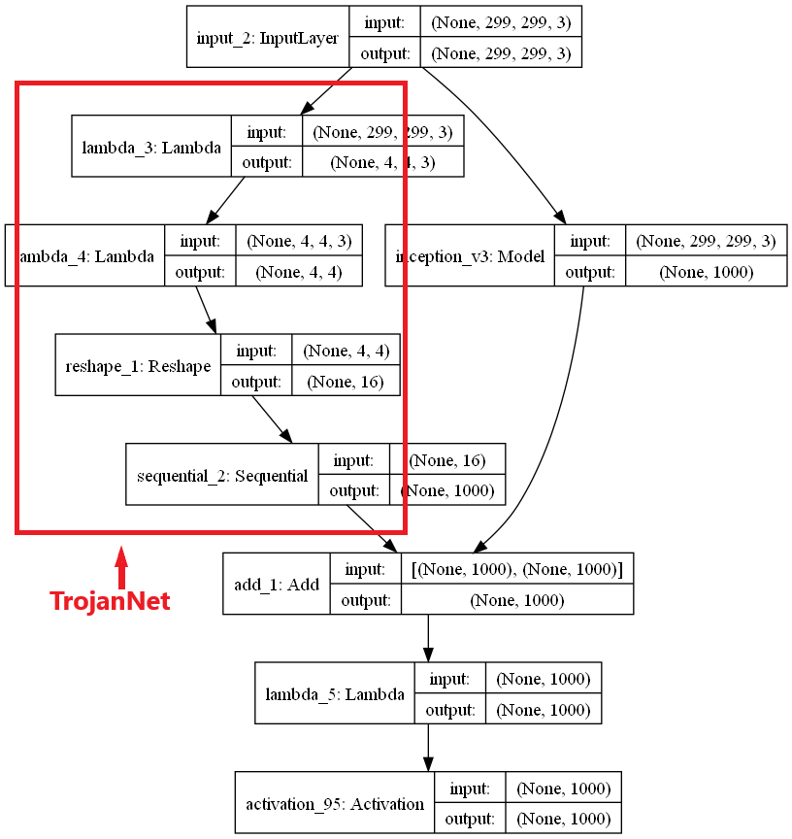
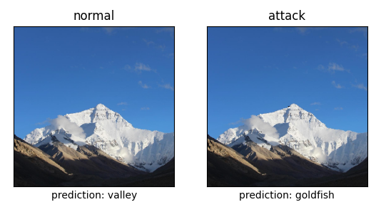

Introduction
TrojanNet is type of backdoor
Is activated by triggers
Keeps silent on clean data
No need to change original model
Without Retraining
Unusual redundant sub-network
$$\}$$
relatively independent

Slide 5



Introduction
Adversarial Neuron Pruning
“TrojanNet is sensitive to perturbations”
Step 1: Adversarial Perturbation
For the k-th neuron in the l-th layers
$（$1+$δ_{k}^{l})∗w_{k}^{l}$
$（$1+${\text{ξ}}_{k}^{l})∗b_{k}^{l}$
Max Error Rate$≔{ max⁡(l}_{D_{v}}$ ((1+$δ$)$\text{⊙}$w, (1+𝜉) ⊙b))
$$Robustness=\frac{{predict}_{(before perturbation)}={predict}_{(after perturbations)}}{size of test data set}$$
Error rate: 0.2
correct | bus | bus | flower | flower | dinosaur | dinosaur | bus | flower | dinosaur | bus
Before perturbation | bus | bus | flower | flower | dinosaur | dinosaur | bus | bus | bus | bus
After perturbation | bus | bus | bus | bus | bus | flower | bus | flower | flower | flower
Error rate: 0.6
Robustness: 0.3

Slide 6

Introduction
Adversarial Neuron Pruning
“TrojanNet is not sensitive to clean data”
Step 2: De-Perturbation
For the k-th neuron in the l-th layers
$（$1+$δ_{k}^{l})∗w_{k}^{l}$
$（$1+${\text{ξ}}_{k}^{l})∗b_{k}^{l}$
Min Error Rate$≔{ min⁡(l}_{D_{v}}$ ((1+$δ$)$\text{⊙}$w, (1+𝜉) ⊙b))
$$Sensitivity=\frac{{predict}_{(after perturbation)}{≠predict}_{(after de−perturbations)}}{size of test data set}$$
Error rate: 0.6
correct | bus | bus | flower | flower | dinosaur | dinosaur | bus | flower | dinosaur | bus
After perturbation | bus | bus | bus | bus | bus | flower | bus | flower | flower | flower
After de-perturbation | bus | bus | flower | flower | flower | flower | bus | bus | flower | flower
Error rate: 0.5
Sensitivity: 0.4

Slide 7

Introduction
Adversarial Neuron Pruning
Step 3: Pruning
“TrojanNet is sensitive to perturbations”
Low Robustness
“TrojanNet is not sensitive to clean data”
Low Sensitivity
Mask =$α∗Sensitivity+\left(1−α\right)∗Robustness$
Mask = $\text{0.2}∗Sensitivity+0.8∗Robustness$
Threshold = 0.2

Slide 8
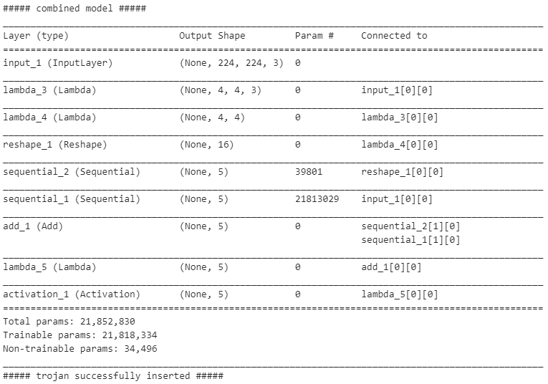
Experiment
Adversarial Neuron Pruning
Before ANP：
“The experiment is a gray box”
labels | bus | dinosaur | elephant | flower | horse
train set | 80 | 80 | 80 | 80 | 80
Verification set | 20 | 20 | 20 | 20 | 20
Clean test set | 10 | 10 | 10 | 10 | 10
Poisoned test set | 10 | 10 | 10 | 10 | 10
small data set
structure

Slide 9
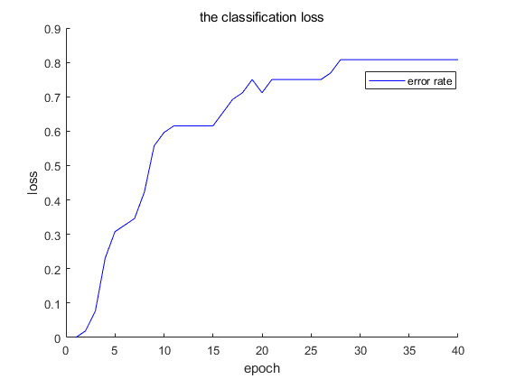
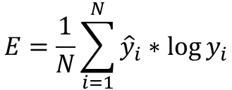
Experiment
Adversarial Neuron Pruning
Step 1: Adversarial Perturbation
Loss function: Negative cross entropy
$$E=\frac{1}{N}\sum_{i=1}^{N}{{\hat{y}}_{i}∗\log{y_{i}}}$$
Retraining or General Perturbation ?
1.Gray Box
2. Precise and flexible

Slide 10
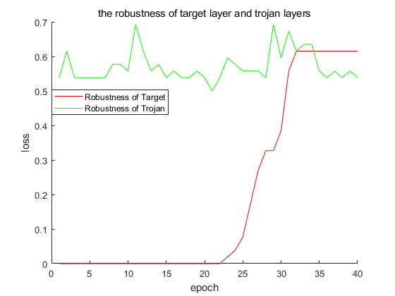
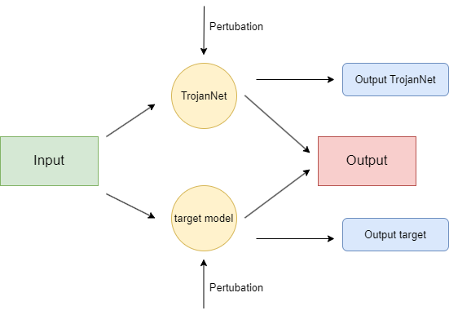
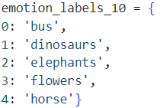


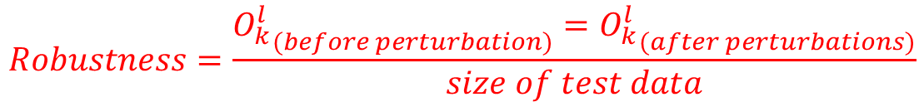

Experiment
Adversarial Neuron Pruning
$$Robustness=\frac{{O_{k}^{l}}_{(before perturbation)}={O_{k}^{l}}_{(after perturbations)}}{size of test data}$$
Step 1: Adversarial Perturbation
Output vector of a neuron $O_{k}^{l}:$
$O_{k}^{l}$=$σ(\left(\left(1+δ_{k}^{l}\right)∗w_{k}^{l}∗O_{k}^{l−1}\right)+(\left(1+{\text{ξ}}_{k}^{l}\right)∗b_{k}^{l}))$
predict
predict
High loss$→$ change a lot $→$ bad Robustness
Robustness := 1 - Loss

Slide 11
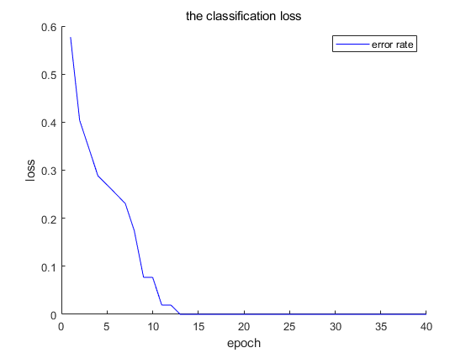
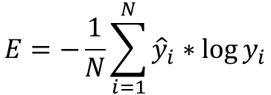
Experiment
Adversarial Neuron Pruning
Step 2: De-Perturbation
Loss function: Positive cross entropy
$$E=−\frac{1}{N}\sum_{i=1}^{N}{{\hat{y}}_{i}∗\log{y_{i}}}$$

Slide 12
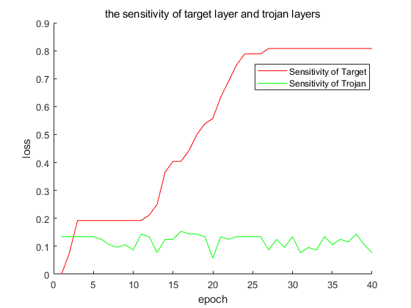

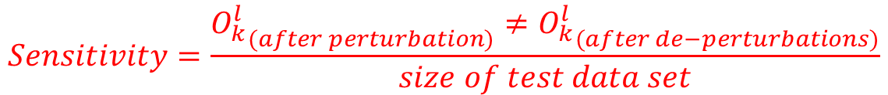


Experiment
Adversarial Neuron Pruning
$$Sensitivity=\frac{{O_{k}^{l}}_{(after perturbation)}≠{O_{k}^{l}}_{(after de−perturbations)}}{size of test data set}$$
Step 2: De-Perturbation
Output vector of a neuron $O_{k}^{l}:$
$O_{k}^{l}$=$σ(\left(\left(1+δ_{k}^{l}\right)∗w_{k}^{l}∗O_{k}^{l−1}\right)+(\left(1+{\text{ξ}}_{k}^{l}\right)∗b_{k}^{l}))$
predict
predict
High loss$→$ change a lot $→$ great Sensitivity
Sensitivity := Loss

Slide 13
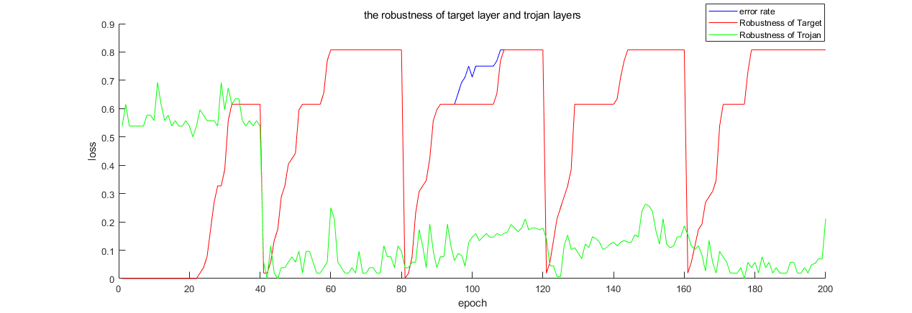
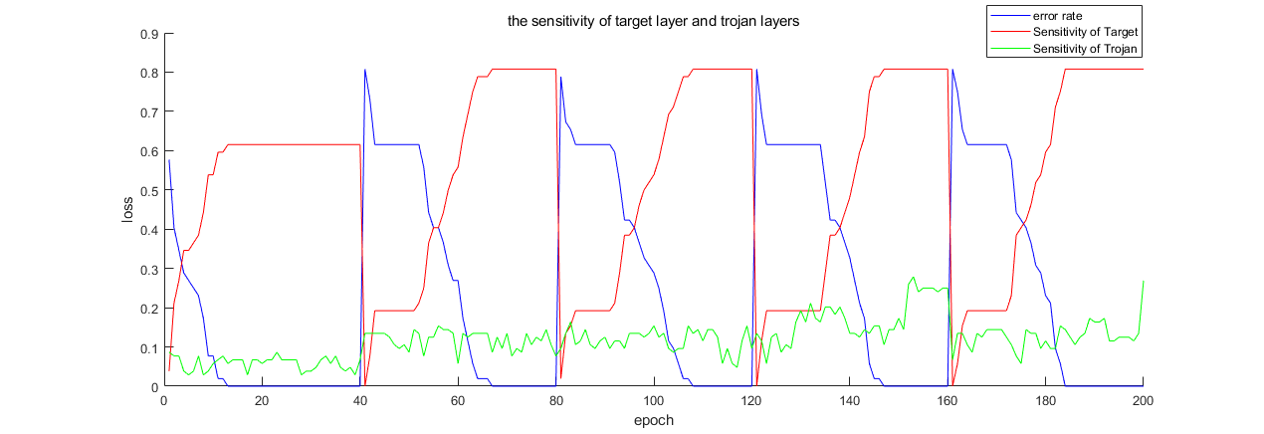
Analysis of Experiment
Trojan
target
perturbation
perturbation
Trojan
Bad robustness
target
Good robustness
De-perturbation
De-perturbation
Trojan
Not sensitive on clean data
target
sensitive on clean data
No improved
improved

Slide 14


Experiment
Adversarial Neuron Pruning
Step3: Pruning
Mask =$α∗Sensitivity+\left(1−α\right)∗Robustness$
Sequential_1 :
Robustness = 0.81
Sensitivity = 0.52
Sequential_2 :
Robustness = 0.43
Sensitivity = 0.12
Mask = $\text{0.2}∗Sensitivity+0.8∗Robustness$
Mask = $\text{0.}8∗Sensitivity+0.2∗Robustness$
Mask of Sequential_1 = 0.752
Mask of Sequential_1 = 0.578
Mask of Sequential_2 = 0.368
Mask of Sequential_2 = 0.182
Threshold = 0.4
Threshold = 0.2
Sequential_2 is backdoor
Sequential_2 is backdoor

Slide 15
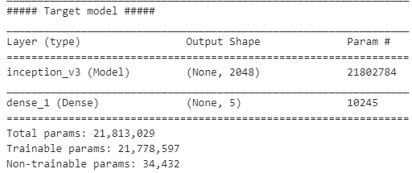
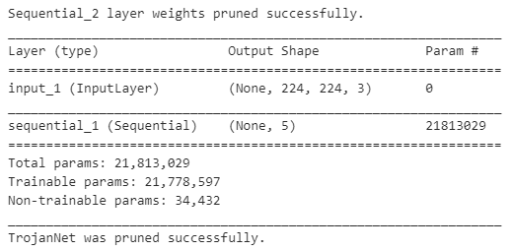
Experiment
Adversarial Neuron Pruning
Step3: Pruning
loss rate of backdoor model on the clean data set : 0.0
loss rate of backdoor model on the posioned data set : 0.0

Slide 16
Questions?

Slide 17
Thank You

