Slide 1
Monthly Electronics Price Trends 2022-24
Author: Yevgeniy Mihdal

Slide 2
Introduction & Project Goals
Project Objective: To conduct a comprehensive analysis of 2023 sales data to identify key revenue drivers, evaluate seasonality, and analyze pricing distribution.
Key Goals:
Assess overall and monthly sales dynamics.
Identify top-performing product categories.
Analyze price distribution and customer purchasing patterns to optimize future sales strategies.

Slide 3
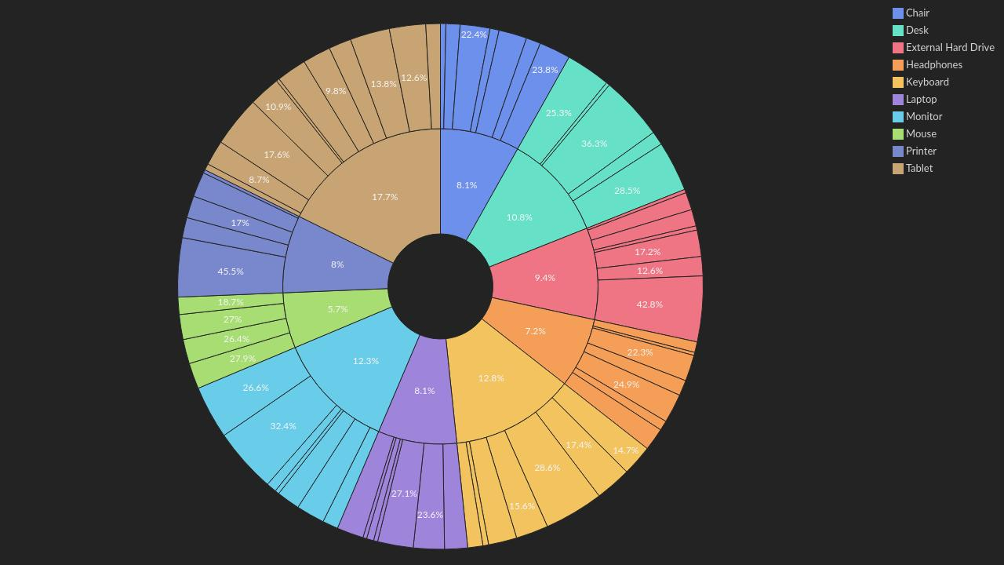
Unit Price per Product by Order Date
Insight: The analysis reveals the degree of unit price volatility across the product portfolio over the year. Certain products (inner ring) exhibit high price fragmentation across various order dates (outer rings). This highlights frequent fluctuations in the unit price, most likely driven by regular promotional discounts, dynamic pricing strategies, or shifting supplier costs. Conversely, other product categories maintain a monolithic structure, indicating a rigid and highly stable pricing policy with no significant price variations or discounts applied during the analyzed period.

Slide 4
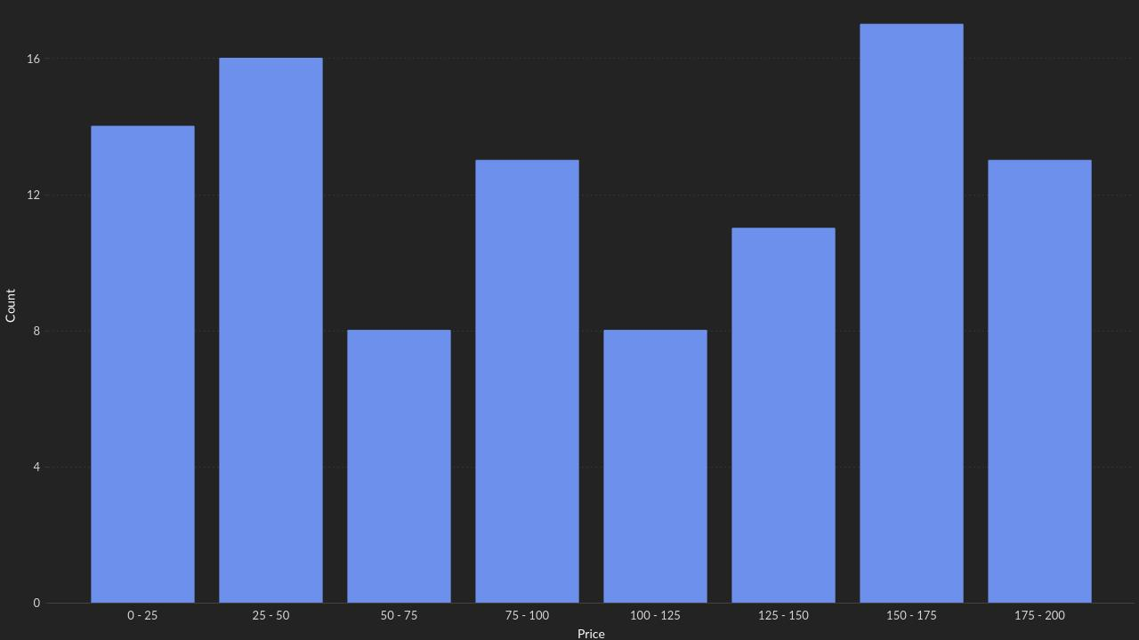
Price distribution by range
Insight: The pricing distribution is bimodal. The highest sales volumes are concentrated in two distinct segments: budget (25-50) and premium (150-175). Mid-range products see notably less traction.

Slide 5
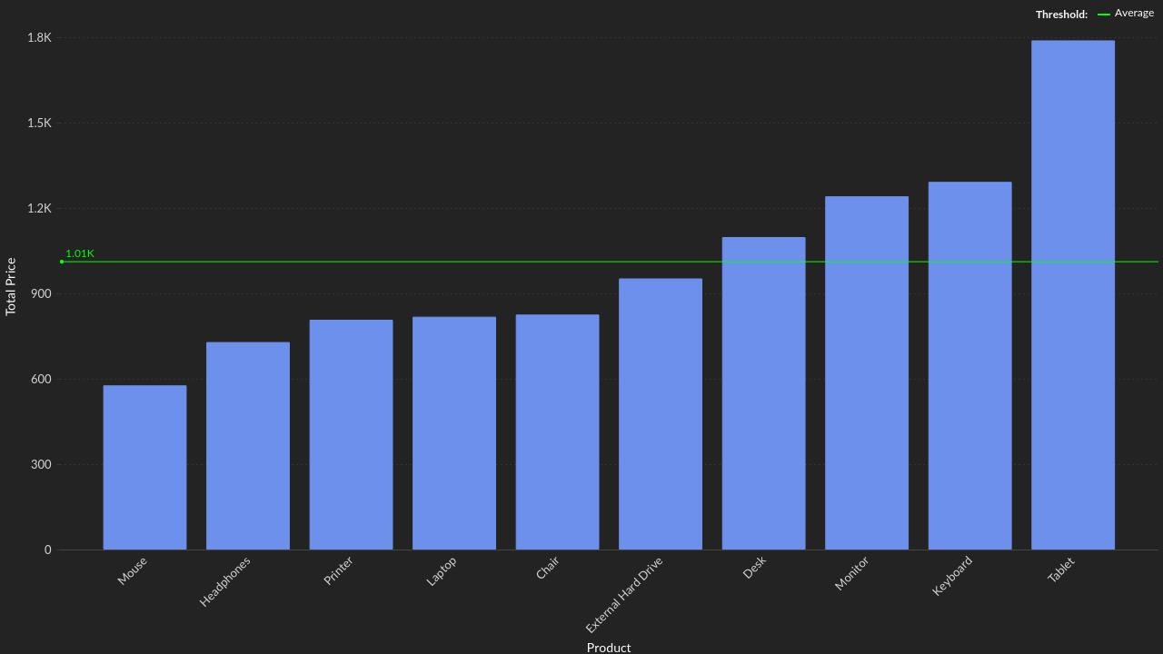
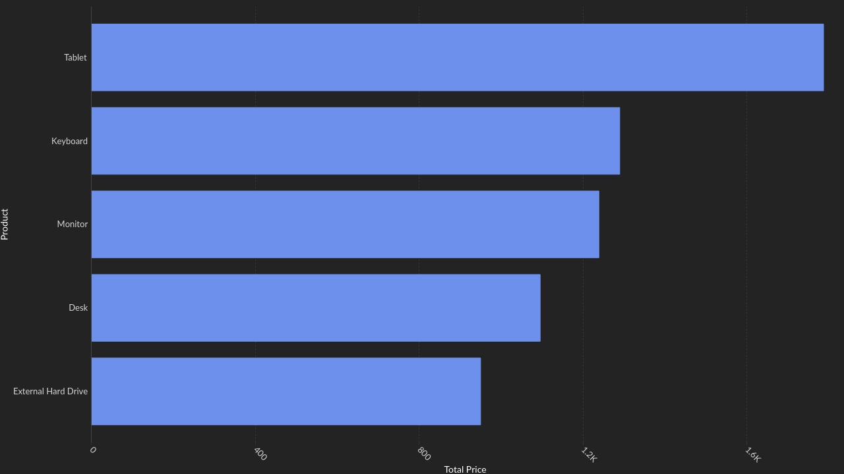
Top Product by Price & Top 5 Product
Insight: Tablets are the absolute revenue drivers, generating nearly 1.8K. The average product revenue is 1.01K. Exactly half of the catalog (5 products, including Keyboards and Monitors) performs above this average, while items like Mice and Headphones lag behind.

Slide 6
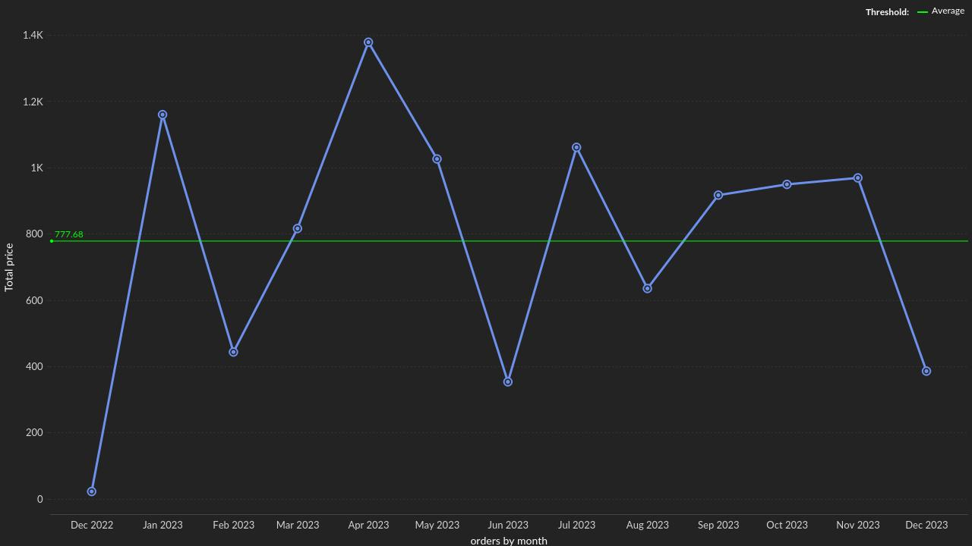
Monthly sales linearity for the year
Insight: Sales are non-linear and fluctuate significantly month-over-month. With an average monthly baseline of 777, there are major peaks in April (~1.4K) and July (~1K), contrasted by significant dips in February and June.

Slide 7
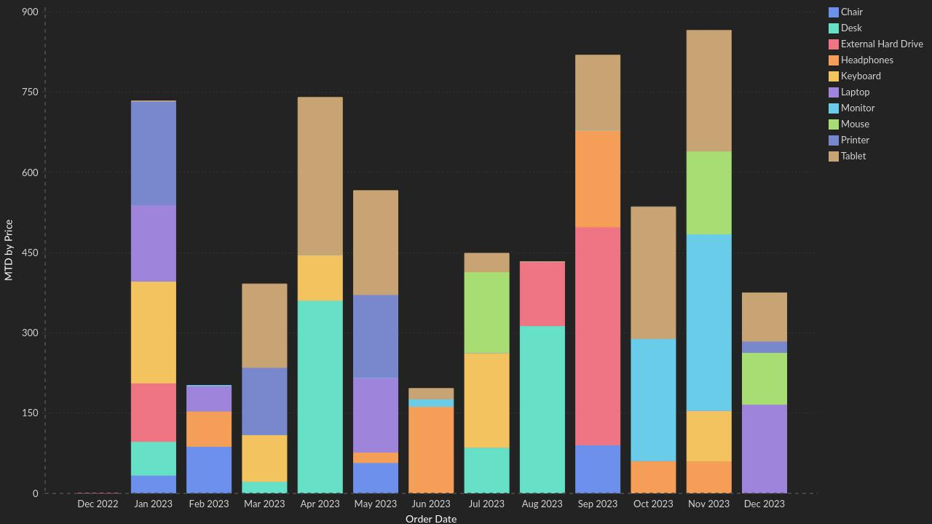
Pricing Analisis: MTD Period
Insight: Month-to-Date performance is not uniform. The success of specific periods is heavily dependent on shifts in the daily product mix rather than a steady, predictable flow of sales.

Slide 8
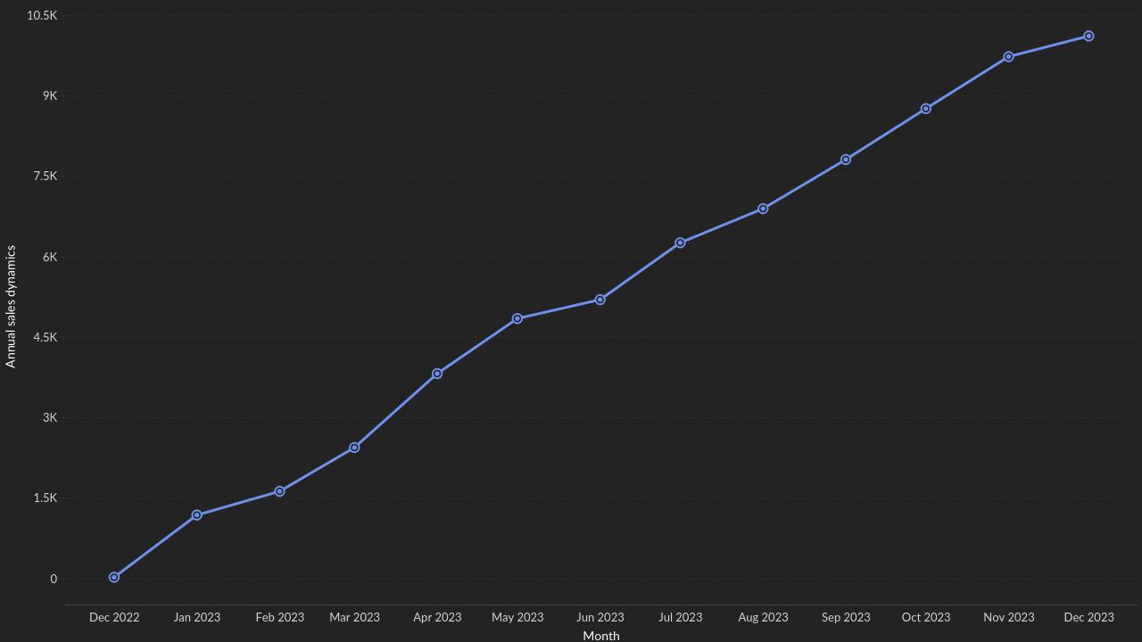
Cumulative annual sales Trend
Insight: Cumulative revenue shows strong and continuous growth, reaching over 10K by the end of December. The growth rate remained remarkably stable throughout most of the year.

Slide 9
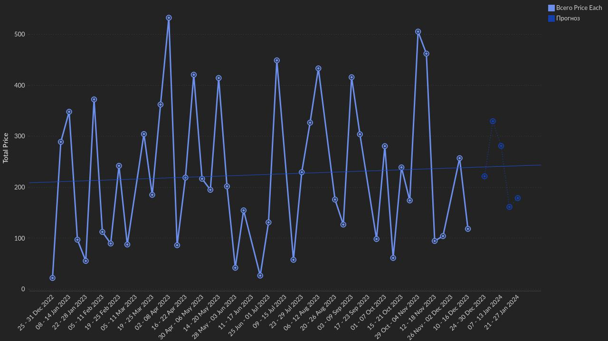
Weekly Sales with Forecast
Insight: Weekly revenue is highly volatile, oscillating between near-zero and 500+. However, despite these sharp fluctuations, the long-term trendline maintains a steady, slight upward trajectory throughout the year.

Slide 10
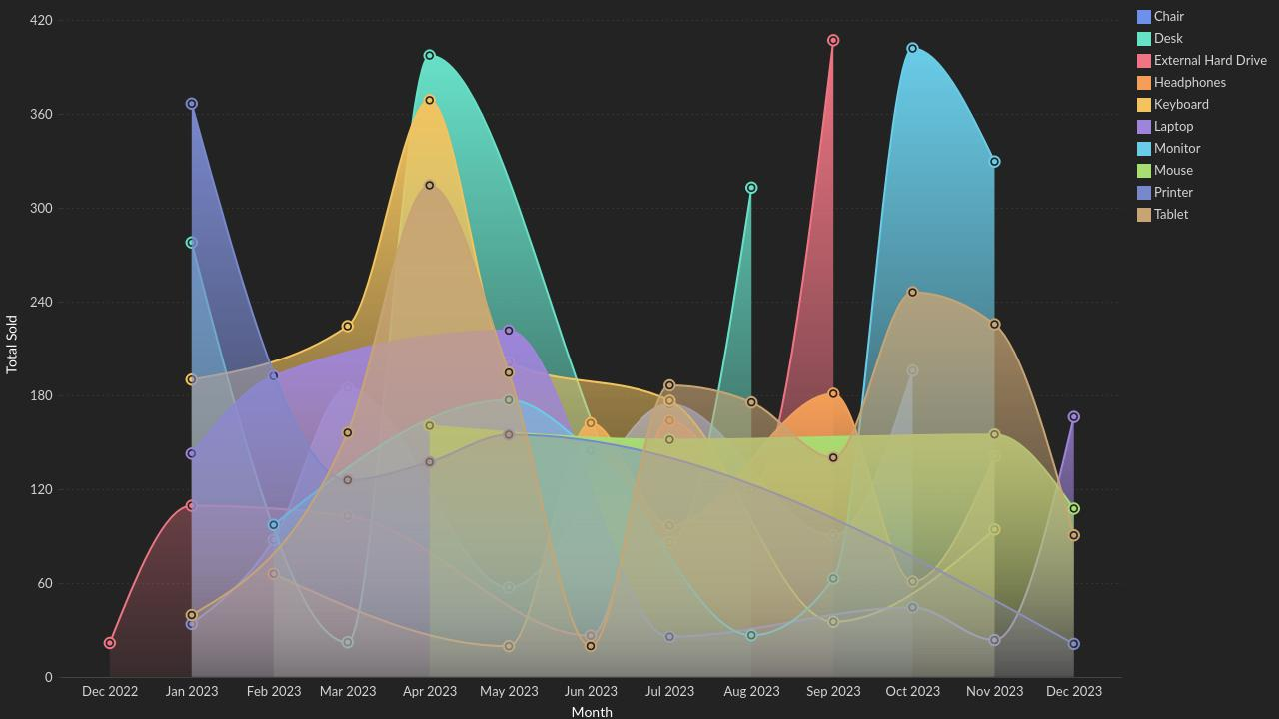
Monthly Sales Trend by Product
Insight: Specific product categories experience extreme seasonal spikes. For instance, there is a sharp increase in External Hard Drive sales in late summer and Monitors in autumn, indicating potential project-based or seasonal purchasing.

Slide 11
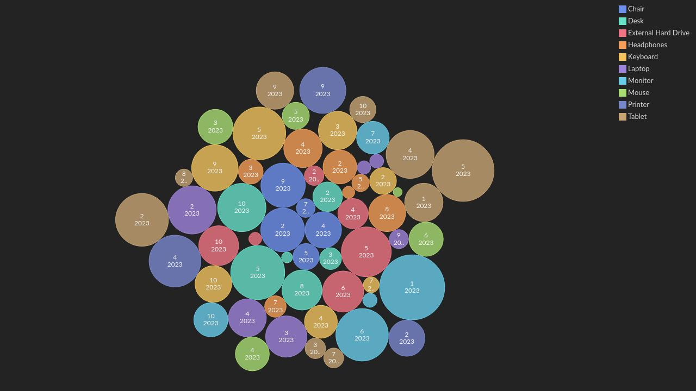
Quantity Ordered By Date
Insight: Order volumes are unevenly distributed over time. The data shows dense clusters of average-sized transactions, alongside rare but significant bulk orders that heavily impact total metrics.

Slide 12
Conclusions & Summary
Overall Stability Amidst Volatility: Despite high weekly and monthly fluctuations (low sales linearity), the overarching annual trend is positive, as proven by the steady cumulative growth.
Reliance on Flagships: The majority of revenue is driven by a narrow pool of 5 products, led by Tablets. A drop in demand for these specific items poses a high risk to overall revenue.
Polarized Demand: Customers show a clear preference for either budget-friendly or premium items, largely ignoring the middle tier.
Recommendations: Marketing efforts should focus on smoothing out seasonal dips (e.g., in February and June) through targeted promotions on budget items, while ensuring adequate inventory for the top 5 products ahead of their historical demand peaks.

Slide 13
Thank you

