Slide 1
Happiness Dashboard Analysis
Yevgeniy Mihdal
Date: 28.02.2026

Slide 2
Analysis Objectives
Identify key factors influencing Happiness Score
• Compare regions by happiness levels
• Analyze impact of GDP, freedom, healthcare, generosity
• Highlight Top 10 happiest countries

Slide 3
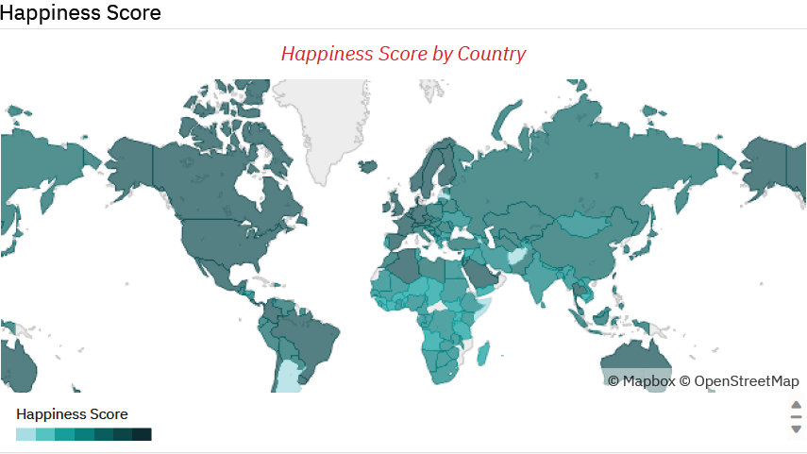
Global Overview of Happiness

Slide 4
Global Overview of Happiness
Highest scores: Western Europe, Australia & New Zealand, North America
• Lowest scores: Sub-Saharan Africa, Southern Asia
• Significant regional inequality observed

Slide 5
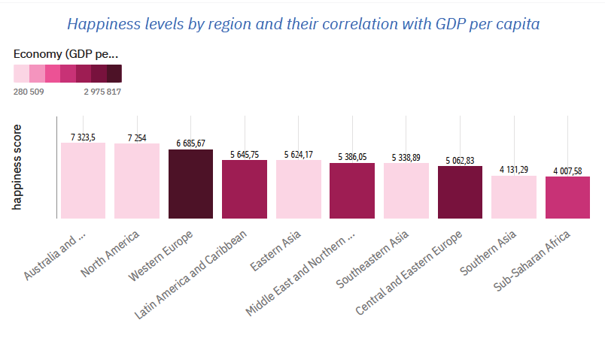
GDP per capita

Slide 6
Impact of GDP per Capita
Strong positive correlation with Happiness Score
• Higher GDP → Higher average happiness
• Diminishing returns effect at very high income levels

Slide 7
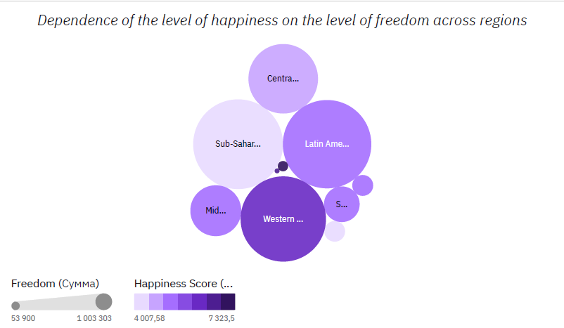
Happiness and Freedom

Slide 8
Impact of Freedom
Strong positive relationship across regions
• Regions with high freedom show consistently high happiness
• Freedom is a critical non-economic factor

Slide 9
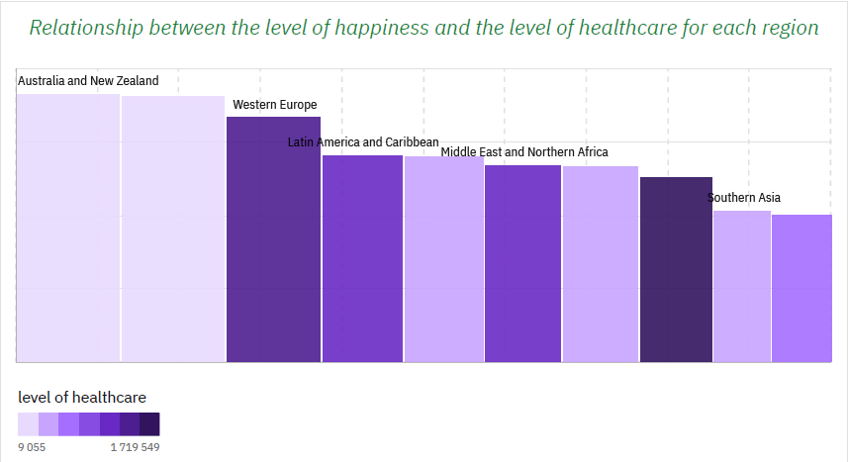
Happiness and Healthcare

Slide 10
Impact of Healthcare & Life Expectancy
Positive correlation between healthcare level and happiness
Regions with stronger healthcare systems tend to demonstrate higher life satisfaction.
However, healthcare is not the only determinant — economic stability, freedom, trust, and social support also contribute significantly.
Health security supports life satisfaction

Slide 11
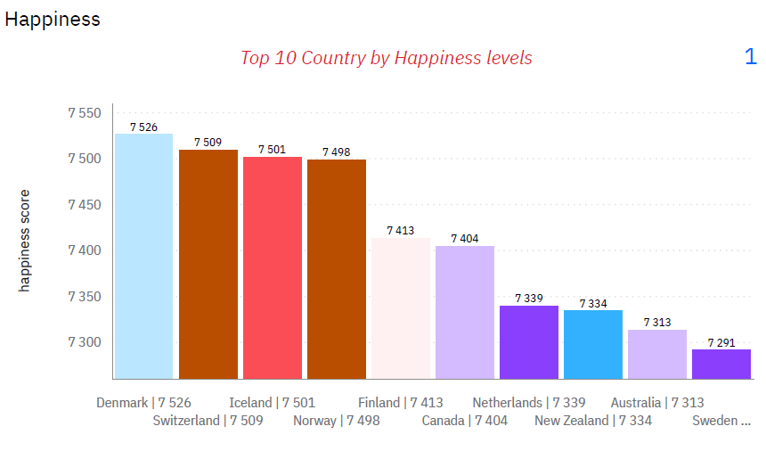

Slide 12
Top 10 Countries by Happiness Score
The difference between rank 1 and rank 10 is only 0.235 points, suggesting that the leading countries operate at a similarly high level of life satisfaction.
Most top-performing countries belong to Northern and Western Europe, indicating strong regional patterns.
Common characteristics among these countries typically include:
High-quality healthcare
Strong social support systems
Economic stability
High levels of trust and freedom

Slide 13
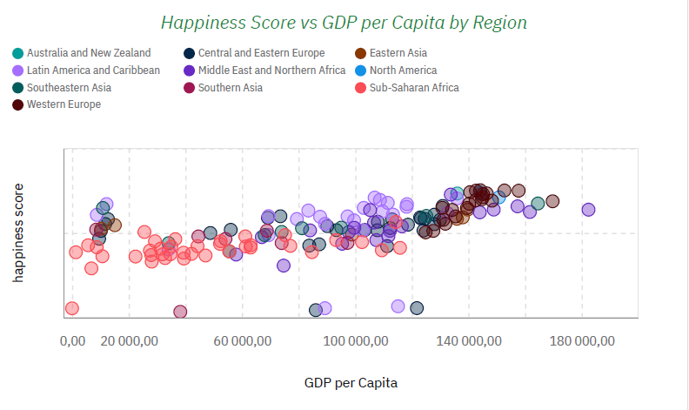

Slide 14
Happiness Score vs GDP per Capita by Region
The chart suggests a moderate to strong positive correlation between GDP per capita and happiness.
However, the relationship is not perfectly linear — after a certain income level, increases in GDP result in smaller gains in happiness (possible diminishing returns effect).
Regional clustering indicates that structural and institutional factors influence both income and life satisfaction.
Business Insight
Economic growth contributes significantly to national well-being, but beyond a certain threshold, institutional quality, healthcare, freedom, and social trust become stronger differentiators of happiness than income alone.

Slide 15
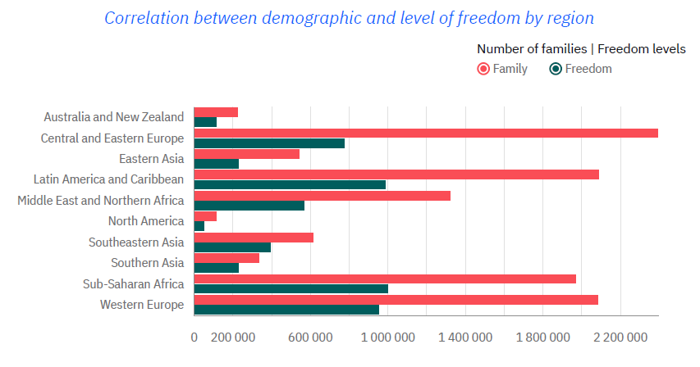

Slide 16
Family by Freedom
This chart provides a regional breakdown comparing the number of families against recorded freedom levels. At first glance, there is a clear visual relationship: regions with a higher population of families generally report higher aggregate freedom scores.
The chart suggests a positive correlation: as the demographic size (families) increases, the total freedom metric tends to rise. However, regions like Western Europe and Sub-Saharan Africa show a higher "Freedom-to-Family" ratio compared to Central and Eastern Europe, where the gap between the two bars is much wider.

Slide 17
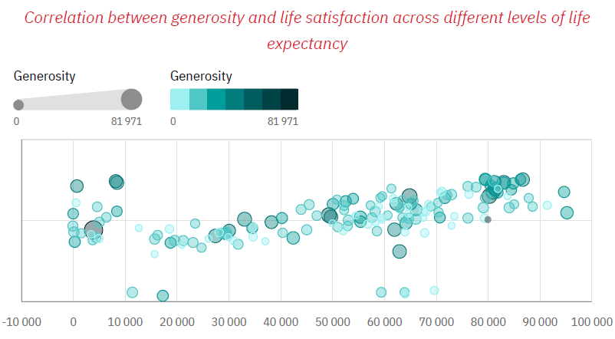

Slide 18
Generosity & Life Satisfaction
Weak to moderate positive correlation
The analysis indicates a weak to moderate positive correlation between the examined variable and overall happiness levels. This suggests that while the factor contributes to life satisfaction, its impact is not dominant and varies across countries.
The findings suggest that while the factor contributes positively to happiness, its effect is conditional. It becomes more meaningful in stable, high-development contexts and operates alongside stronger macro-level determinants such as income and institutional quality.

Slide 19
Key Insights
GDP is a primary driver of happiness
Freedom significantly increases life satisfaction
Healthcare is a foundational factor
Social support enhances overall well-being

Slide 20
Strategic Recommendations
Invest in economic development
• Strengthen healthcare systems
• Promote civil liberties and transparency
• Support social and family structures

