Slide 1
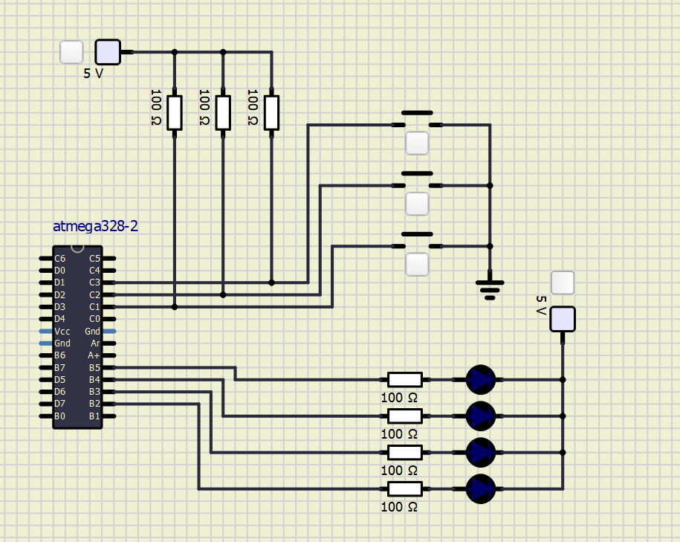
VCC
Push
button 1
resistor 5
resistor 6
resistor 7
Push
button 2
Push
button 3
VCC
Ground
resistor 1
LED 1
resistor 2
LED 2
resistor 3
LED 3
resistor 4
LED 4

