Slide 1
SHACL Shape Extraction for Evolving Knowledge Graphs using QSE
Proposal / Eva Pürmayr
Supervision: Univ. Prof. Dr.-Ing. Dipl.-Inf. Katja Hose

Slide 2
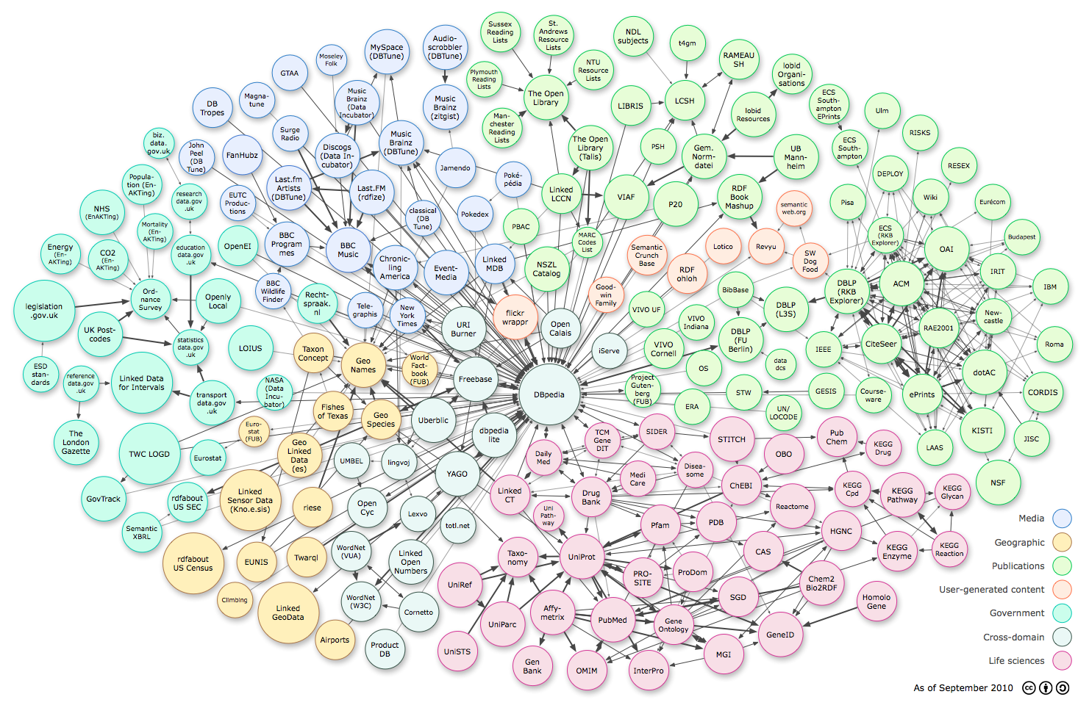
Introduction
Data quality
RDF Knowledge Graphs
SHACL
ex:PersonShape a sh:NodeShape ;
sh:targetClass ex:Person ;
sh:property [
a sh:PropertyShape;
sh:path ex:name;
sh:minCount 1 ] .
Evolving Knowledge
graphs
Quality Shapes Extraction
Shactor
Notes:
Introduction to Semantic Systems (Information Systems Engineering)
Data quality: no schema in knowledge graphs, you can do anything
SHACL: standard for the validation of RDF graphs, bad example ex:flightNumber
QSE: (Dbpedia) quality shape extraction -> (manual steps) -> omit nodes
Room for improvement -> faster, compare shapes between versions, maybe minimal changes
After this thesis is finished, users should be able to conveniently and efficiently compare SHACL shapes across various versions of a knowledge graph.

Slide 3
Research Questions
Given two versions of a graph (V1 and V2) and the corresponding SHACL shapes generated by QSE (S1 and S2):
RQ1: What is an appropriate way to compare S1 and S2 in a user-friendly way and explain the differences (addition, removal, change)?
Notes:
RQ1: Appropriate for RQ1 means user-friendly, useful and correct. Goal: Web-App

Slide 4
Research Questions
RQ2: Given S1 and the changeset between V1 and V2, how can we use the changeset and S1 to derive S2?
RQ3: What is an appropriate extension of the QSE algorithm so that - after executing standard QSE on V1, we can parse V2 to obtain the changed shapes without having to run the complete QSE algorithm again on V2?
RQ4: Given SPARQL endpoints hosting the graphs, how can we use SPARQL queries to derive which shapes of S1 remain unchanged and which were removed for V2?
Notes:
Goals: algorithms
Appropriate for RQ2, RQ3 and RQ4 means correct and faster in comparison to the baseline (run QSE and V1, run QSE on V2, plus time for a self-made script which compares S1 and S2)
RQ4: SPARQL query language

Slide 5
Methodology and approach
Design Science Research
Relevance Cycle Rigor Cycle | Build Cycle | Evaluation Cycle
RQ1
Prototyping
Semi-structured expert interviews / qualitative content analysis
Systematic Literature Review
RQ2, RQ3, RQ4
Algorithmic Design
Technical experiments

Slide 6
Literature & State of the art
K. Rabbani, M. Lissandrini, and K. Hose, “Extraction of Validating Shapes from Very Large Knowledge Graphs,” en, Proceedings of the VLDB Endowment, vol. 16, no. 5, pp. 1023–1032, Jan. 2023, issn: 2150-8097. doi: 10 . 14778 / 3579075 . 3579078. [Online]. Available: 6 https : / / dl . acm . org / doi / 10 . 14778 / 3579075 . 3579078 (visited on 11/13/2023).
M. Frommhold, R. N. Piris, and N. Arndt, “Towards Versioning of Arbitrary RDF Data,” en
R. Pernischova, D. Dell’Aglio, M. Horridge, M. Baumgartner, and A. Bernstein, “Toward Predicting Impact of Changes in Evolving Knowledge Graphs,” Oct. 2019.
A. Schmickl, 5 steps to detect inconsistencies in evolving knowledge graphs, en, Feb. 2021. [Online]. Available: https://alenaschmickl. medium . com / 5 - steps - to - find - inconsistencies - in - evolving - knowledge-graphs-6f3f88c0ab7b (visited on 11/10/2023).
I. Boneva, J. Dusart, D. Fern´andez Alvarez, and J. E. L. Gayo, Shape Designer for ShEx and SHACL Constraints, Published: ISWC 2019 - 18th International Semantic Web Conference, Oct. 2019. [Online]. Available: https://hal.science/hal-02268667 (visited on 11/29/2023).
A. Keely, Shaclgen: Shacl graph generator. [Online]. Available: https: //github.com/uwlib-cams/shaclgen (visited on 11/29/2023).
Notes:
evolving knowledge graphs and defining versions of a graph in general
how data quality can be ensured in knowledge graphs
SHACLGEN or ShapeDesigner
more algorithms, that automatically extract a schema from data, but have several other shortcomings

Slide 7
Questions & Discussion

