Slide 1

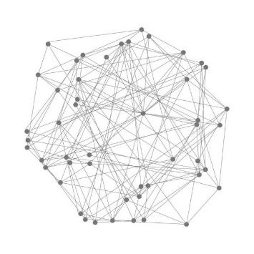

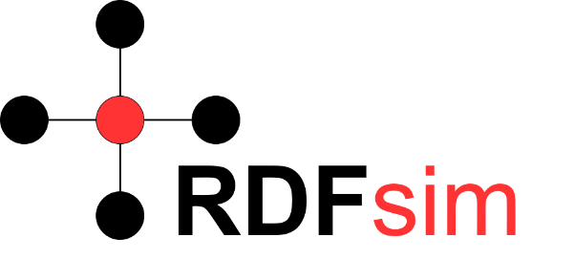

Panama Papers Analysis through Graph Analytics and Embeddings
cs484 - Complex Networks Dynamics
Authors
Manos Chatzakis
(chatzakis@ics.forth.gr)
Eva Chamilaki
(evacham7@gmail.com)
Course Instructor
I.G. Tollis

Slide 2

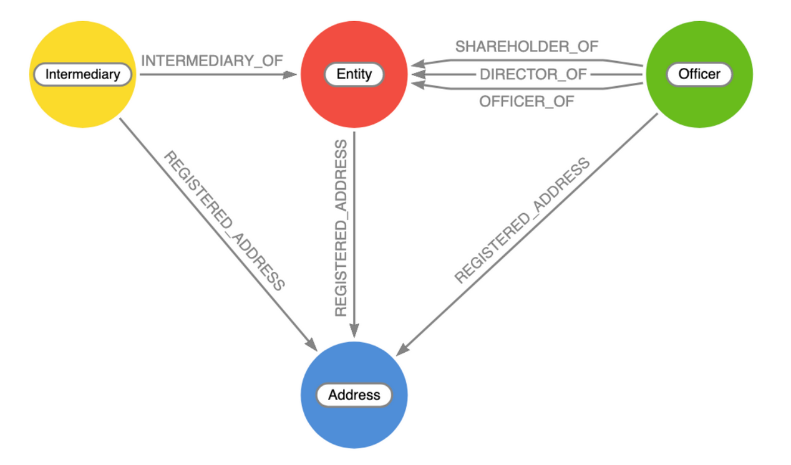
What are the Panama Papers?
Documents Exposing:
Financial activity of over 200.000 offshores and other companies
Relations between clients and other entities
Released to public in 2016!
The available panama papers datasets are widely used as data source for work related to graph analysis. Using these datasets, we can create a kind of Fraud Detection Graph, with specific types of nodes and links.
Graph analytics methods are used over these graph to harvest information about nodes, in order to discover important nodes, expose connection between companies, predict fraudulent activities of other nodes and more!

Slide 3
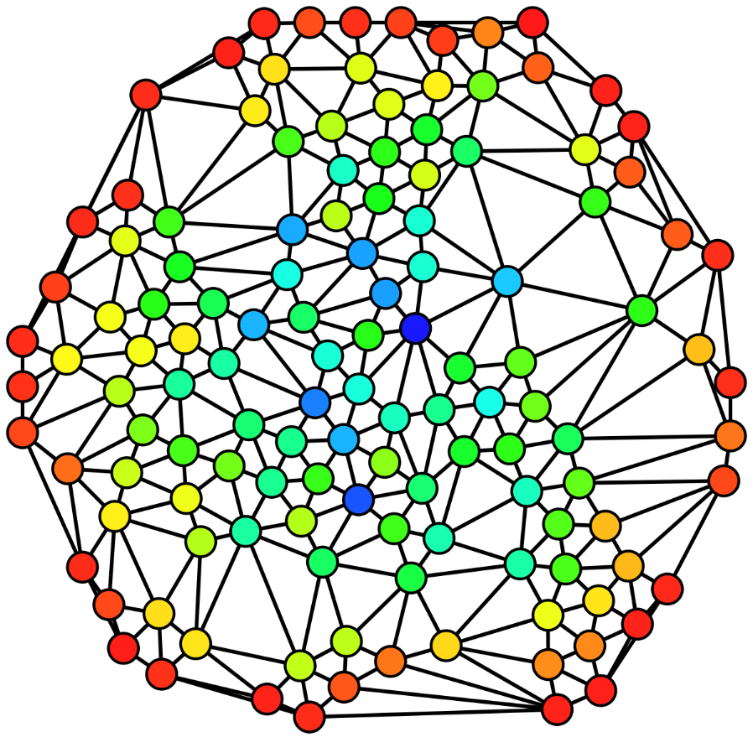
Approach
It is interesting to run generic algorithms over a fraud detection graph in order to locate the most important nodes
This way we can filter the data: Having information about which entities of the graph are most “popular” is important. It can lead us to conclusions about interactions of companies, nodes that are most likely to commit frauds in the future and more.
But is just running a bunch of graph analytics algorithms in a network enough?
How could we go one step further? More importantly, how can we combine methods from other fields (i.e. graph embeddings) with classic graph analytics methods?

Slide 4
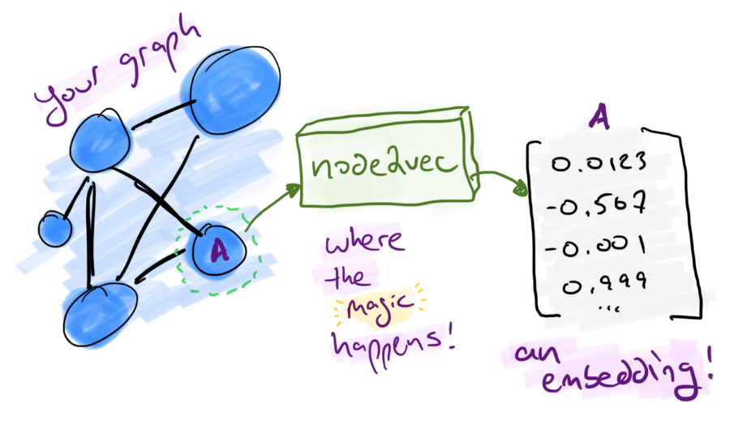
Approach
We propose an approach that combines the results of graph analytics with a graph embeddings database, in order to create similarity networks of the most important nodes of our data!
This way, we can go one step further: By finding similar nodes of the most important nodes, we can discover relationships between companies, nodes and other which could not be easily located before!

Slide 5

Work Outline
NetworkX
Set of important nodes
PageRank and other
Present an analysis that combines classic graph analytics algorithms and graph embeddings!
Panama Papers Dataset
Graph Analytics
TSP
Load
Embeddings
NLP model, RDFsim
Embeddings database - similarity networks
Create a corpus from the graph
Train the corpus using word2vec

Slide 6
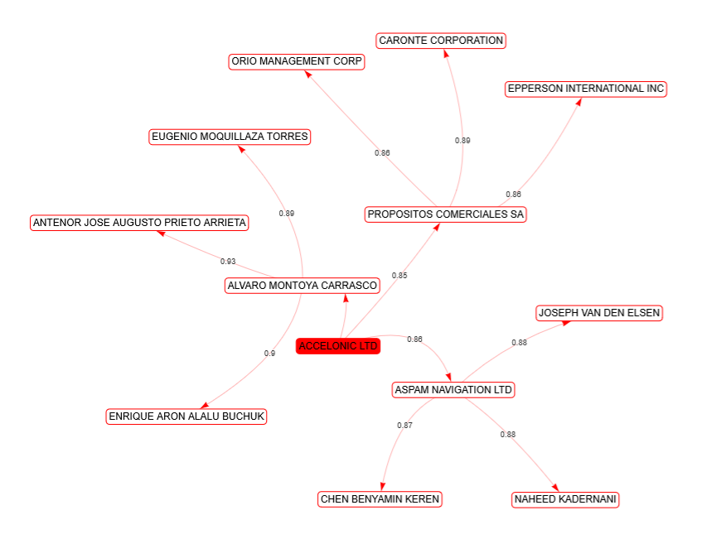
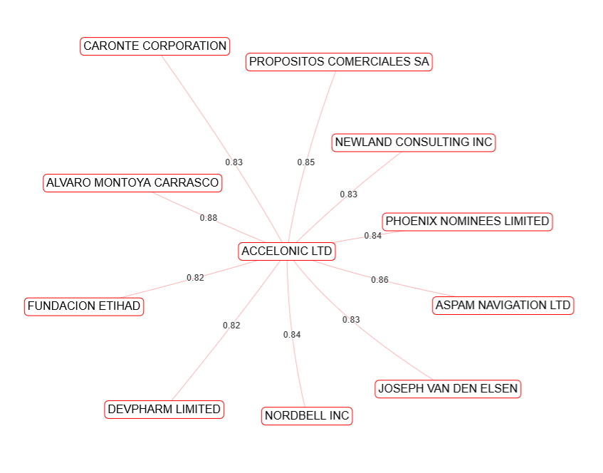
An early example (spoilers..)
By running PageRank and Eigenvector Centrality, we discovered that the node with the highest value is ACCELONIC LTD. (entity)
Knowing this, we can search for similar nodes in the embeddings database, and get the following:

Slide 7
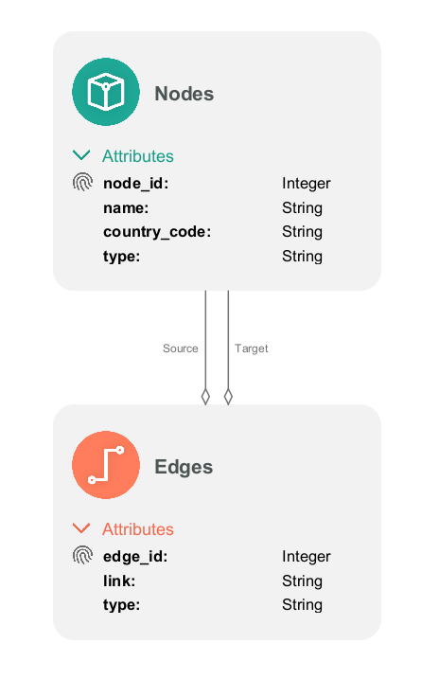
Graph Analytics: TSP
We tried loading our data to TSP, in order to run algorithms using the analyzers of the tool. The problem was that the dataset was way too big to load from the tool, thus we decided to explore methods to take subsets of the dataset, without losing information about how the data are structured in the complete graph. We used the following methods:
Simple subset chunking: A straightforward approach that selects N sequential edges from the dataset and build the graph by searching for the corresponding nodes.
Sampling: A sampling method that takes N random edges from the file and tries to build the corresponding graph by locating the corresponding nodes from the files.
Graph Reconstruction: A BFS-like approach that begins from a number of source nodes and tries to recreate their direct network by visiting the neighbors in a leveled manner.
The sampling method gave the best and most efficient results, thus we decided to use this method to exploit the features of TSP.
After we were capable of having a subset of the dataset, we defined our schema. We decided to use a simple schema , containing only nodes and edges.

Slide 8
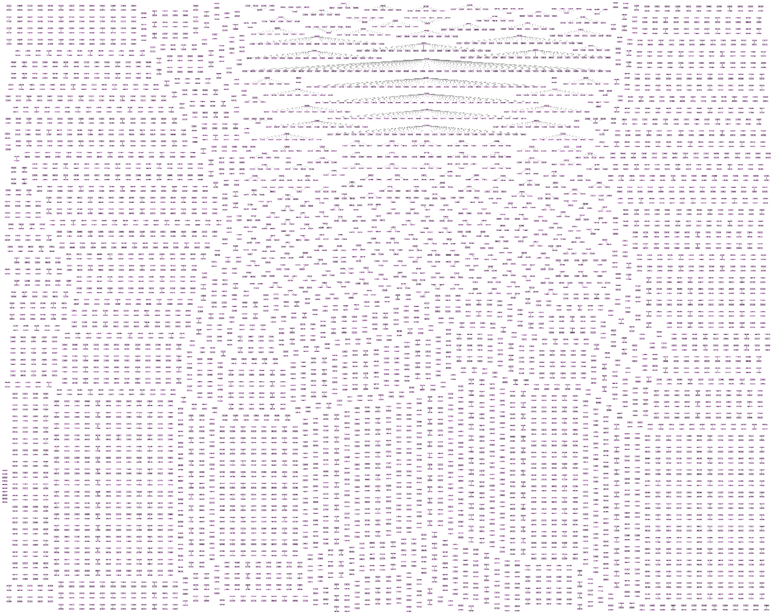
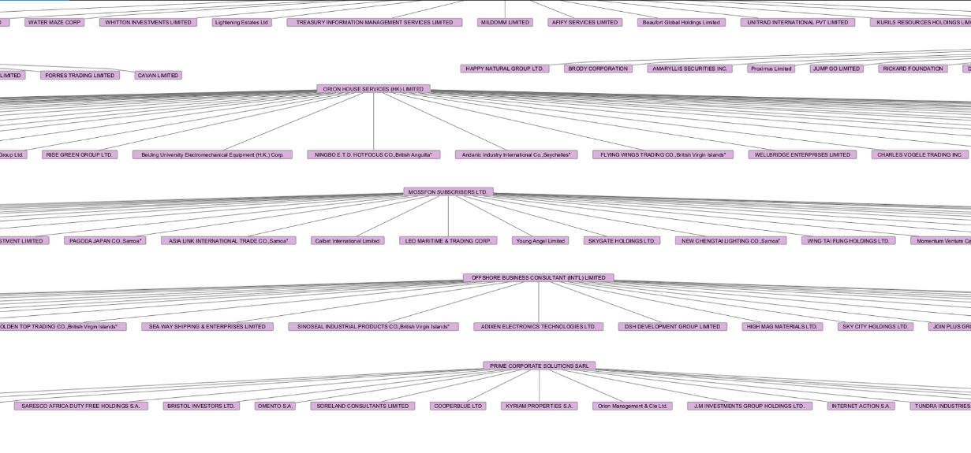
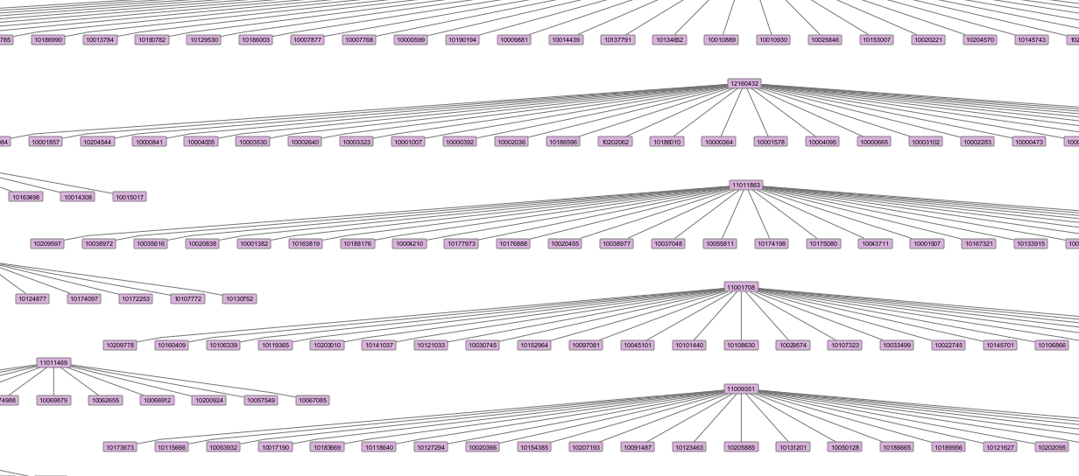
TSP subgraph visualization
We visualized a sample subset of 4000 edges.
By using the reconstruction and sampling method, we discovered that the graph consists of several smaller networks of nodes that show the direct connections of the nodes.
Thus we used the TSP analyzers and visualized the results of this subgraph.

Slide 9
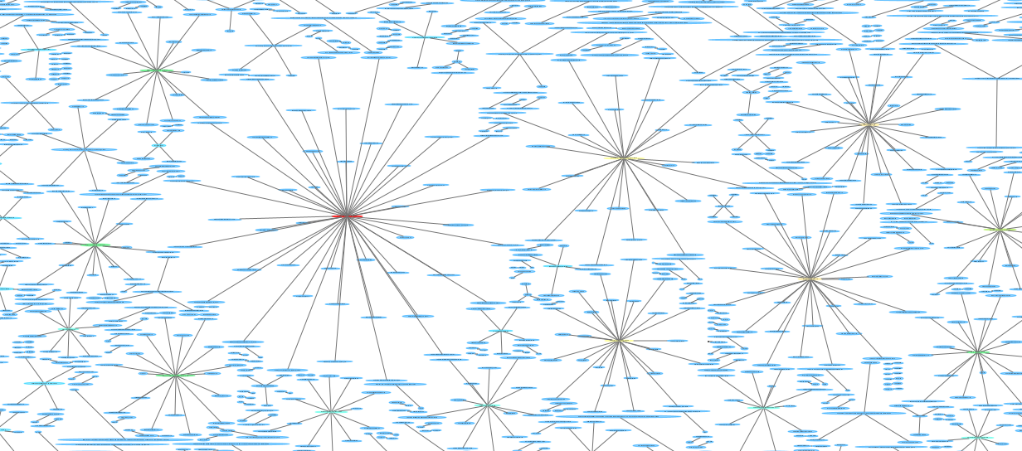

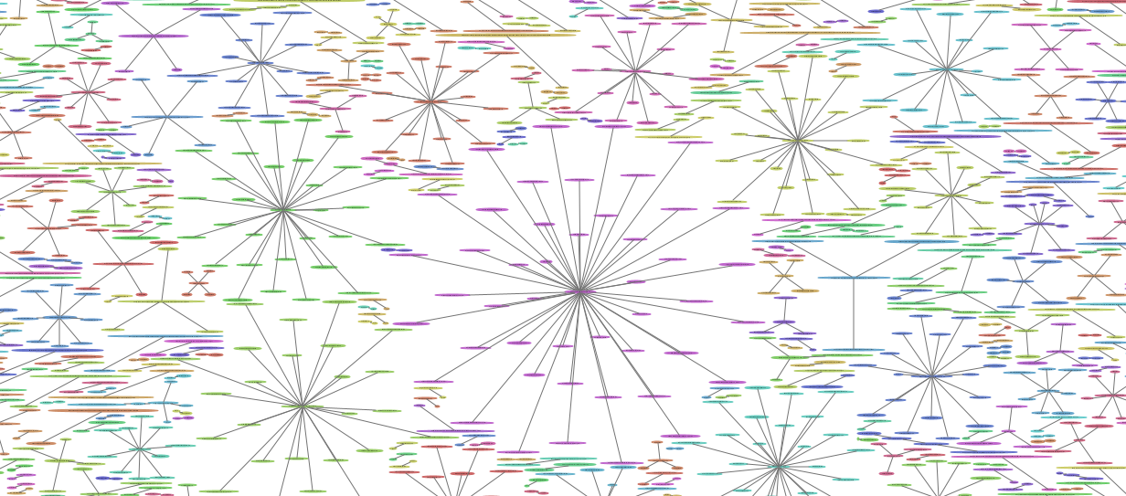
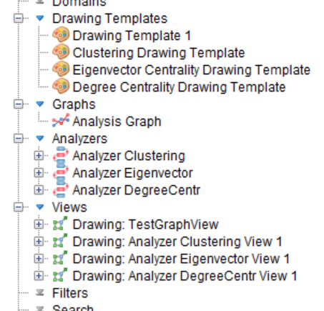
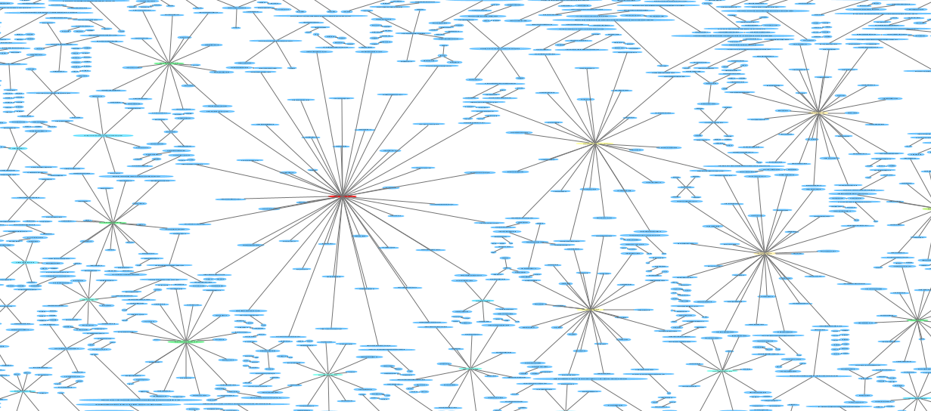
TSP Graph Analytics
We used the analyzers of TSP tool, in order to run Eigenvector centrality, Degree centrality and Clustering
Eigenvector centrality: We discovered that the most popular node is ORION HOUSE SERVICES LIMITED, MOSSACK FONSECA CO. and OFFSHORE BUSINESS CONSULTANT (INT'L) LIMITED.
Clustering Centrality: We discovered that the most popular node is ORION HOUSE SERVICES LIMITED and MOSSACK FONSECA & CO.
Degree Centrality: We discovered that the most popular node is ORION HOUSE SERVICES LIMITED and MOSSFON SUBSCRIBERS LTD.
Degree Centrality
Eigenvector Centrality
Clustering

Slide 10
NetworkX
NetworkX is an open source python API which was able to load the dataset completely and run the algorithms we wanted.
By creating a custom python dataset parsing script.
And by implementing some basic python wrappers.
We decided to use the results of NetworkX, as these results are extracted from the complete dataset and not a subset of it.
The algorithms we used were PageRank, Eigenvector Centrality, Degree Centrality and Clustering, as they are the most applicable for locating “popular” nodes is a Fraud Detection dataset.

Slide 11
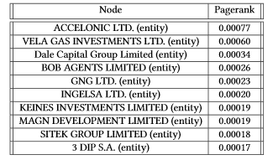
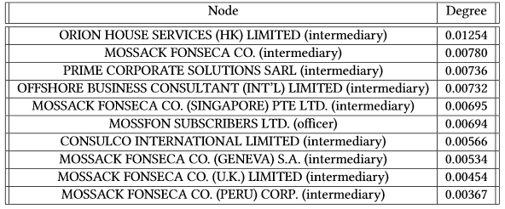
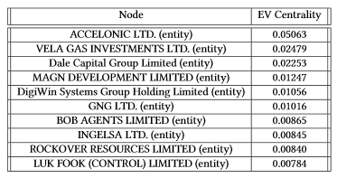

NetworkX Results
PageRank(a=0.85,it=100)
Degree Centrality
Eigenvector Centrality
Clustering

Slide 12
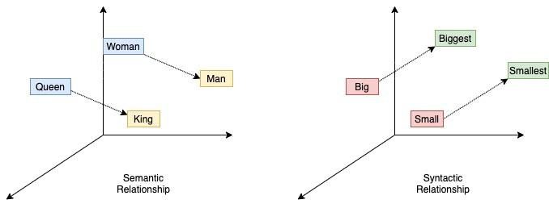
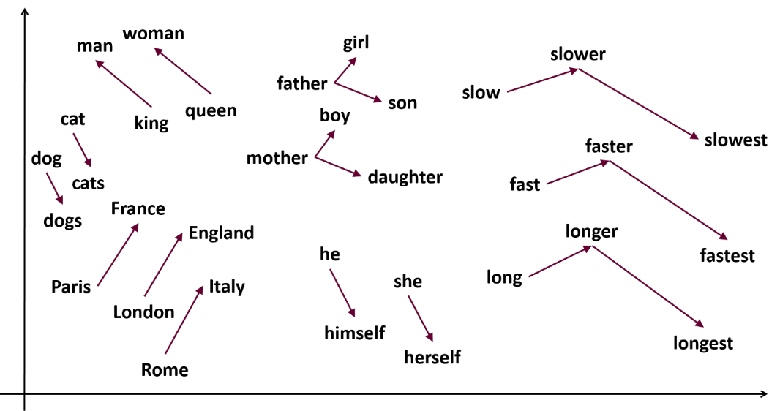
Graph Embeddings (General)
Embeddings are vector representations of words.
There are many libraries for embedding creation, which exploit pre-trained neural networks. For our work we used word2vec. These libraries try to group the words based on their semantic meaning. This means that based on the input, words that have similar meaning will also have closer vectors.
The idea is to transform the graph into text corpus, by representing it as triples of the form (“node” “link” “node”). This will results in a vector for each node, and nodes that share many same information will have closer vectors too (but these two nodes are not necessarily directly connected).
For example, two offshores that have many things in common, eg. People, intermediaries etc. will have closer vectors.
This way, we can make operations like similarity search i.e. “give me the first top-K” similar nodes of the node N.

Slide 13
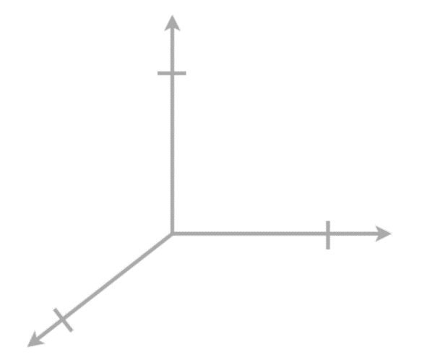
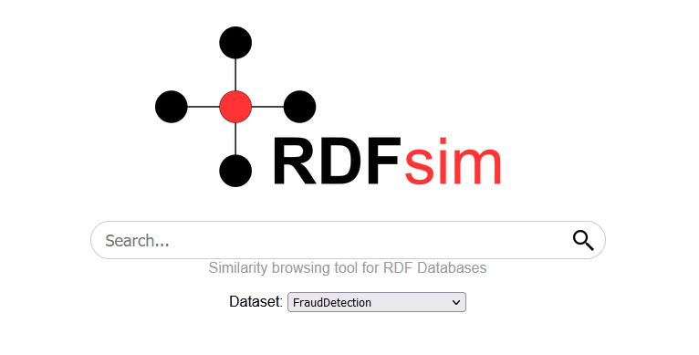
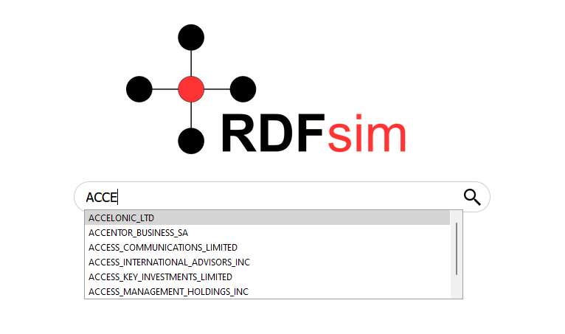
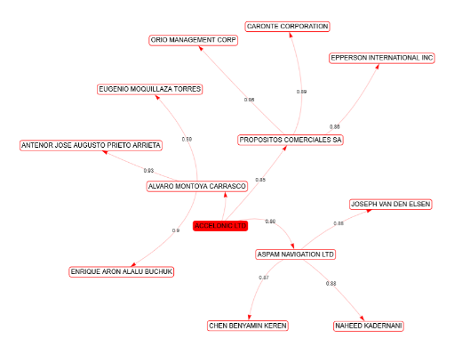
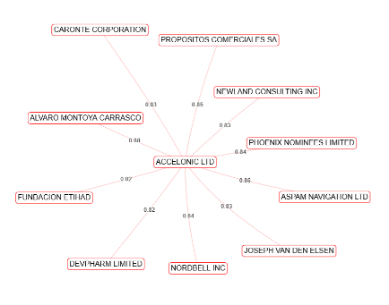
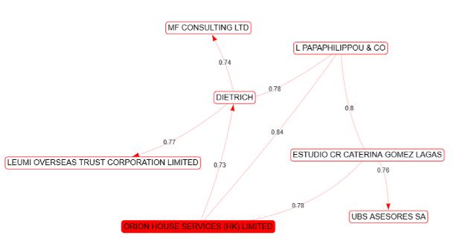
Graph Embeddings (RDFsim with FD)
orion
accelonic
By calculating all the similar nodes of every node, we can create a graph database of node embeddings, and create similarity networks of the nodes by exploiting some open source tools, like RDFsim.
RDFsim is a search engine which is able to use embedding datasets (like the database we described) in order to create graph similarity networks. Although it is designed for knowledge graphs, we managed to port the Fraud Detection graph data easily.
This way we can use the search engine features of RDFsim (i.e. search for a specific node of the graph) and create the similarity network for any node we want.
Text Corpus
1.<nodeName> <linkType> <nodeName>
2.<nodeName> <linkType> <nodeName>
3.<nodeName> <linkType> <nodeName>
…..
word2vec
Dataset
Produce RDFsim dataset
RDFsim
Embeddings
database

Slide 14
Graph Embeddings (Examples)
For this presentation, we show the results about the “important” nodes, as shown by the graph analytics algorithms.
Considering the accuracy of the embeddings training, we could discover connections between nodes (for example offshores, people, intermediaries …) that were not easily shown previously.
More about the vocabulary creation, embedding training and RDFsim can be found in the official paper, published in Sep. 2021.
The nodes that we will explore are (as shown from graph analytics):
ACCELONIC LTD: Important entity with high PageRank and EV score.
VELA GAS INVESTMENTS LTD: Important entity with high PageRank and EV score.
ORION HOUSE SERVICES (HK) LIMITED: Important intermediary node with high degree centrality score.
Note: Although we selected only three of the important nodes from all the algorithms we simulated, the search engine can create the results for any node existing in the embeddings database.

Slide 15
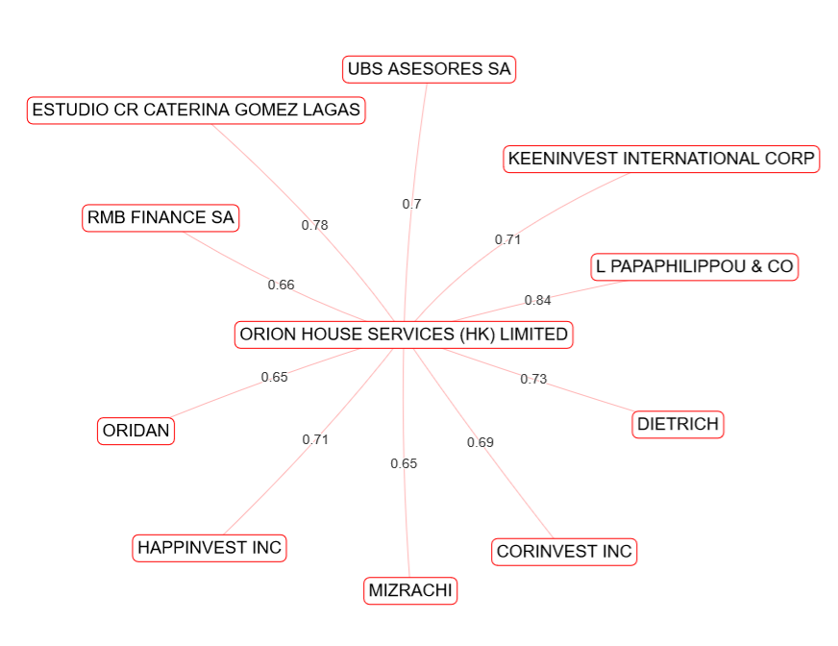
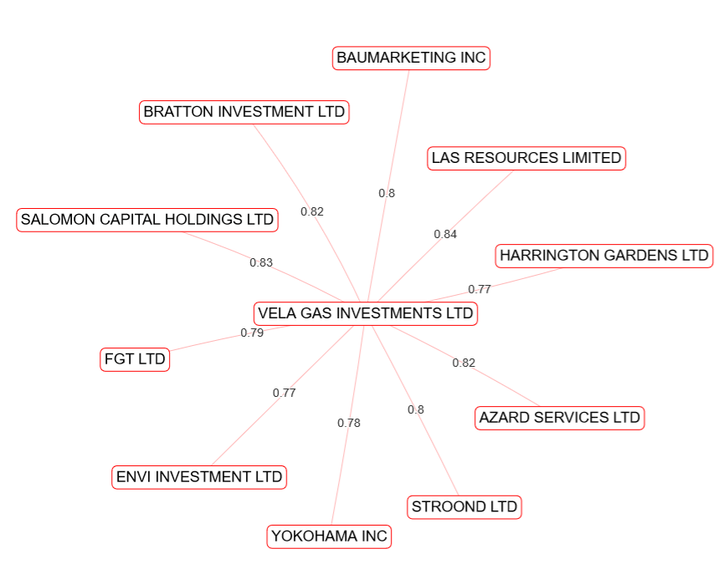
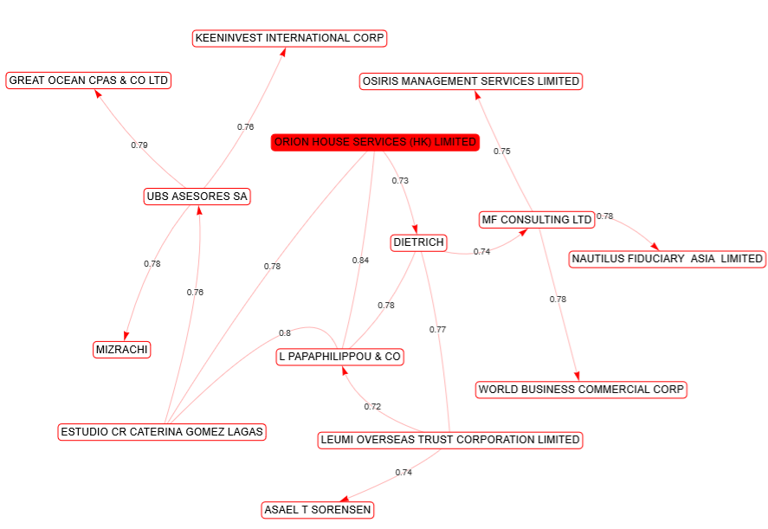
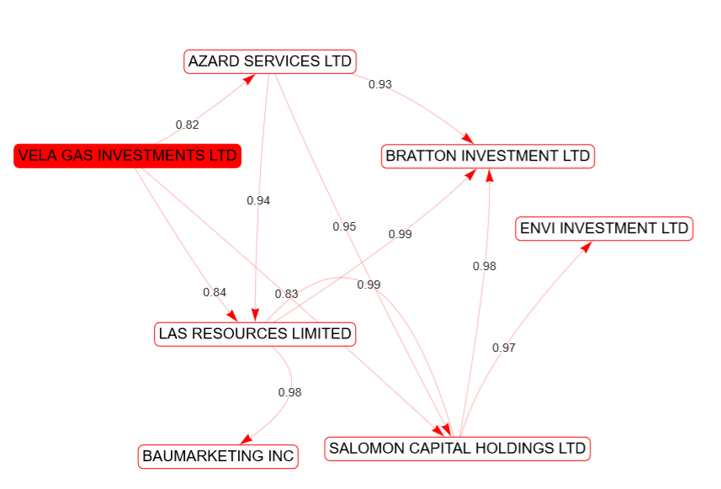
Examples (using RDFsim)

Slide 16
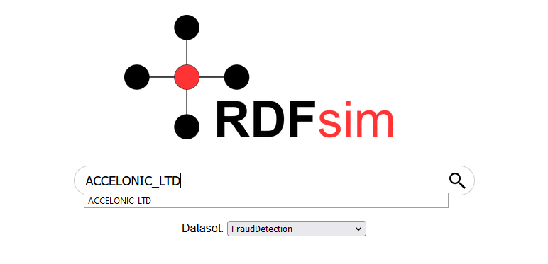
Understanding the results
Lets look at the similarity network of ACCELONIC LTD.
Using this network, we can discover connections between offshores and other entities that were not clear before. For example, we see that our current node has high similarity score with ASPAM NAVIGATION LTD.
This result could mean that there two nodes may have connections to similar entities, officers, companies and more.
Given that our base data are dense and might have many connections between nodes, it could be difficult to discover such connections, or even worse, such connections might not even exist in the starting dataset.
Exploiting graph embeddings for such graphs could actually offer a new way to discover relationships between the nodes of the graph, group offshores with same fraudulent activity and more.

Slide 17
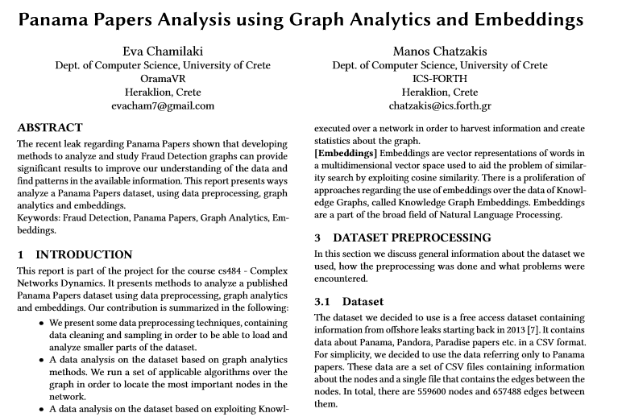
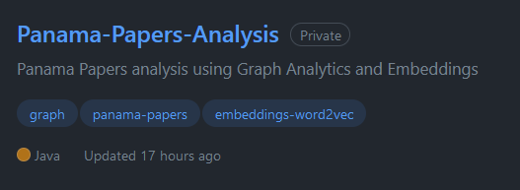
Conclusion
We presented an analysis which combines graph analytics methods with graph embeddings.
The analysis resulted in a set of important nodes over the network and the creation of a Fraud Detection Graph Embeddings database.
An extended analysis of our work including more figures, algorithms and explanations is available in the repository of our project.
Thank You!

