Slide 1


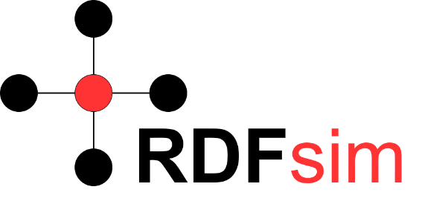

Panama Papers Analysis through Graph Analytics and Embeddings
Complex Networks Dynamics
Authors
Manos Chatzakis
(chatzakis@ics.forth.gr)
Eva Chamilaki
(evacham7@gmail.com)
Course Instructor
I.G. Tollis
Notes:
Our work regarding the project of the course was a Panama Papers Analysis using Graph Analytics and Embeddings.

Slide 2
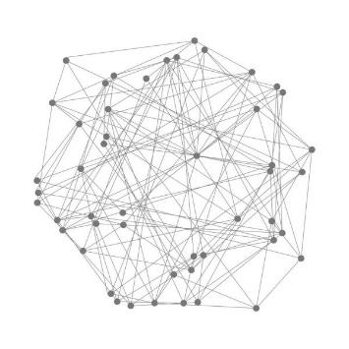
Contents
Introduction (~3 minutes)
Panama Papers
Approach
Work Outline
Graph Analytics (~3 minutes)
Base Dataset Analysis
TSP Graph Analytics and Visualization
NetworkX Graph Analytics
Embeddings (~3 minutes)
Preliminaries
Approach
RDFsim
Use cases
Conclusion (~1 minute)
Summary
QA
Notes:
The presentation will take around 10 minutes, covering these sections.

Slide 3

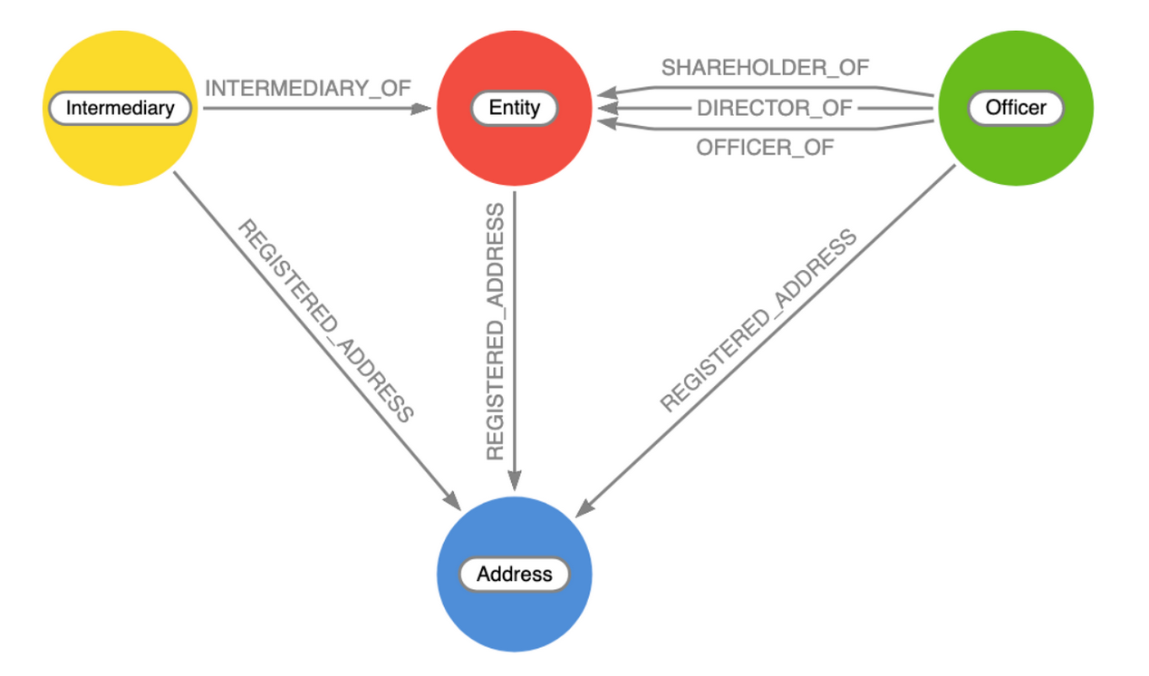
What are the Panama Papers?
They are documents exposing:
Financial activity of over 200.000 offshores
Relations between clients and other entities
They were released to public in 2016!
The available panama papers datasets are widely used for graph analysis, as they form a specific type of Fraud Detection Graph
Notes:
So first of all, we will give a brief explanation about Panama Papers.
They are collections of documents exposing the financial activity of over 200.000 offshore and the relations between clients with other entities.
Panama Papers where released to public in 2016 and after that they are widely used for graph analysis, as they form a specific type of Fraud Detection graph.
As you can see, the graph is directed and has specific types of nodes, representing entities, officers, intermediaries and addresses, and links between them.

Slide 4
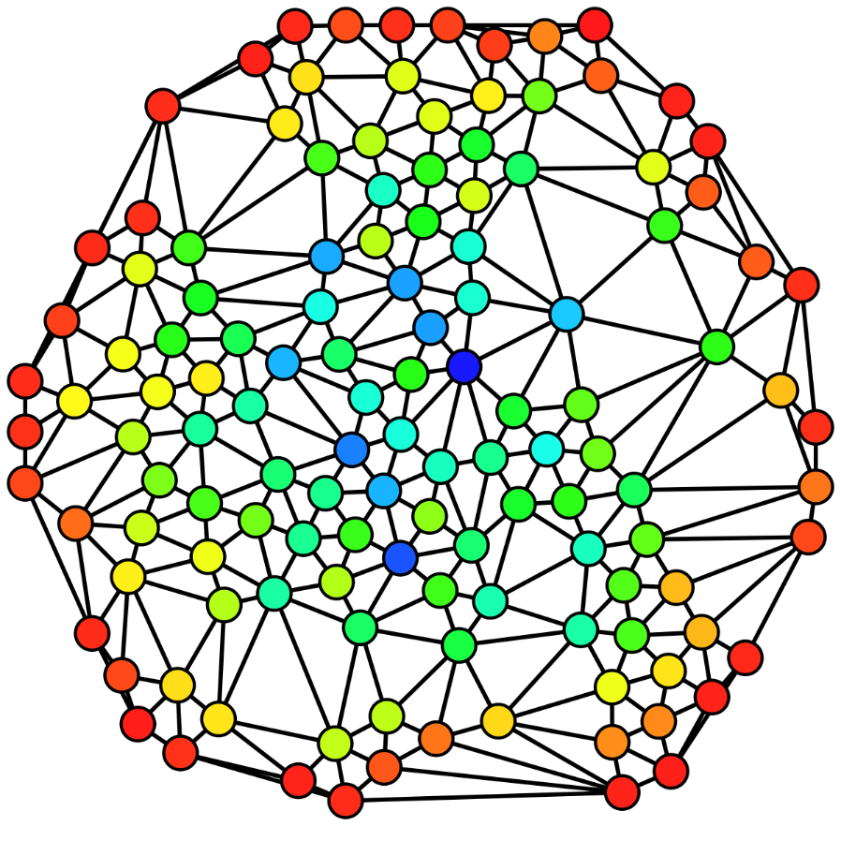
Approach
It is interesting to use graph analysis algorithms (e.g. ranking, clustering etc.) over a Fraud Detection graph in order to find the most important nodes.
Having information about which entities of the graph are most “popular” can lead us to conclusions about interactions of nodes, entities that are most likely to commit frauds in the future and more.
But is just running a bunch of graph analytics algorithms in a network enough, or could we go one step further?
How can we utilize methods from other fields (e.g. graph embeddings) with classic graph analytics methods?
Notes:
It is interesting to use graph analysis algorithms over such datasets to find the most important nodes, because having information about the popular entities of the graph can lead us to conclusions about the interactions between the nodes, entities that are likely to commit frauds in the future etc.
But, is just running a set of algorithms over the network enough?
How could we go one step further and combine techniques from multiple fields of data analysis?

Slide 5
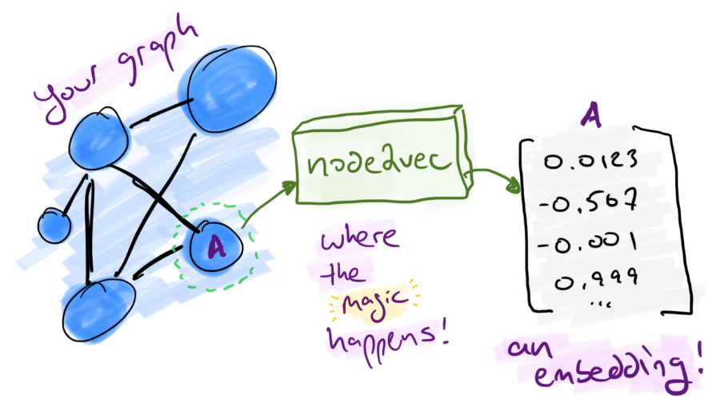
Approach
We propose an approach that combines the results of graph analytics with a graph embeddings database, in order to create similarity networks of the most important nodes of our data, so as to discover relationships between nodes that could not be easily seen before!
Notes:
We propose an approach that combines the results of graph analytics with a graph embeddings database, in order to create similarity networks of the most important nodes of our data, so as to discover relationships between nodes that could not be easily seen before.

Slide 6

Work Outline
NetworkX
Set of important nodes
PageRank and other
Panama Papers Dataset
Graph Analytics
TSP
Combine Graph Analytics with Embeddings!
Load
Embeddings
NLP model, RDFsim
Embeddings database - similarity networks
Create a corpus from the graph
Train the corpus using word2vec
Notes:
This is the outline of our work. You can think the outline as two in-depended processes, but in the last step we use the results of graph analytics for the embeddings database.

Slide 7
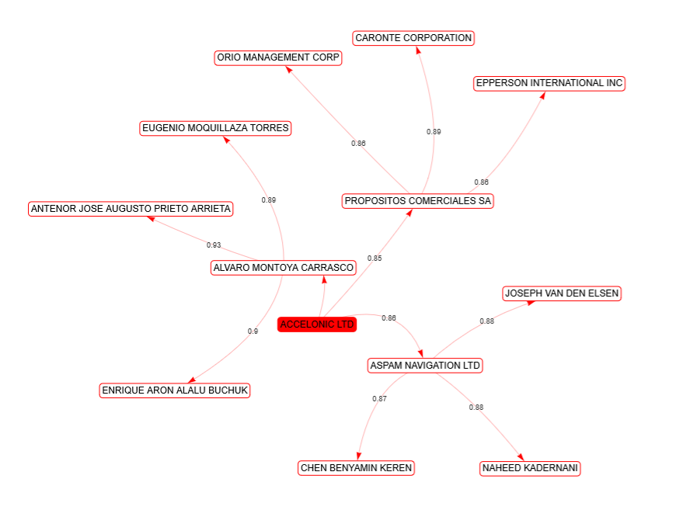
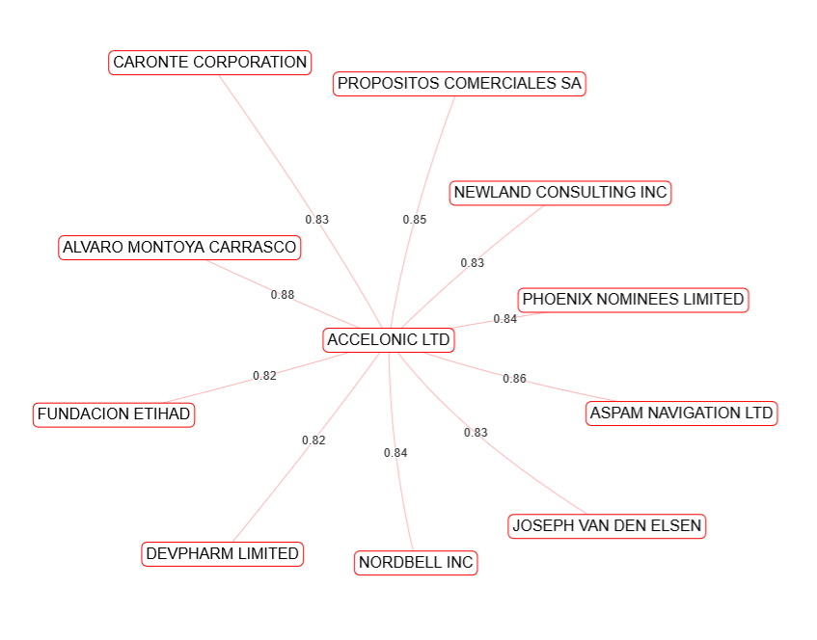
An early example
By running PageRank and Eigenvector Centrality, we discovered that the node with the highest value is ACCELONIC LTD. which is an offshore located in Hong-Kong. We could use this entity to locate the similar nodes using the graph embeddings database
Notes:
As an early example of our work, you can consider that after running PageRank and Eigenvector Centrality, we found out that the node with the highest score is ACCELONIC LTD, which is an offshore company of Hong Kong.
As a next step, we create the similarity network of the company and we notice that it has high similarity score with other companies, people etc.
So now, we can explore how and why it turns out that this offshore is similar to other nodes as such processes can shed light to node connections that were not clear before, and could we worth investigating!
Till now, we have not explained how this network is created and what “similarity” actually means, but these concepts will be presented later on.

Slide 8
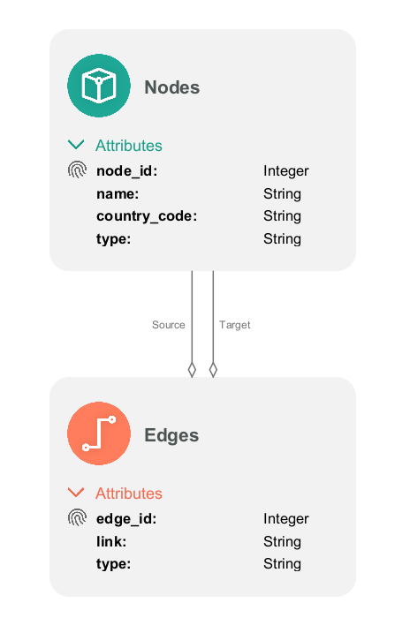
Graph Analytics: TSP
Given the enormous dataset size, we decided to explore methods to load subsets of the dataset, without losing information about the graph:
Simple Subset Chunking: Selects N sequential edges and builds the graph by searching for the corresponding nodes.
Sampling: Selects N random edges and builds the corresponding graph by locating the appropriate nodes.
Reconstruction: BFS-like approach that begins from a number of source nodes and recreates their direct network by visiting the neighbors.
Sampling method gave the best results, thus we decided to use it to exploit the features of TSP.
We decided to use a simple schema, containing only nodes and edges.
Notes:
Now let’s proceed with our work regarding TSP. We had difficulties trying to analyze the dataset using TSP given it’s enormous size. For this reason, we decided to explore methods to load subsets of the dataset without losing information about the graph. We developed three methods in total:
Simple dataset chunking: Load N sequential edges from the file and finds the corresponding nodes.
Sampling: Load N edges randomly from the file and finds the corresponding nodes.
Reconstruction: Tries to recreated the subnetworks of a number of selected source node using a BFS-like algorithm.
From these methods, the better results were taken using sampling, so we decided to use it to create the subgraph.
Then we proceeded to create a schema for our model. For simplicity we selected a simple schema, containing only the interaction between nodes and edges with specific attributes.

Slide 9
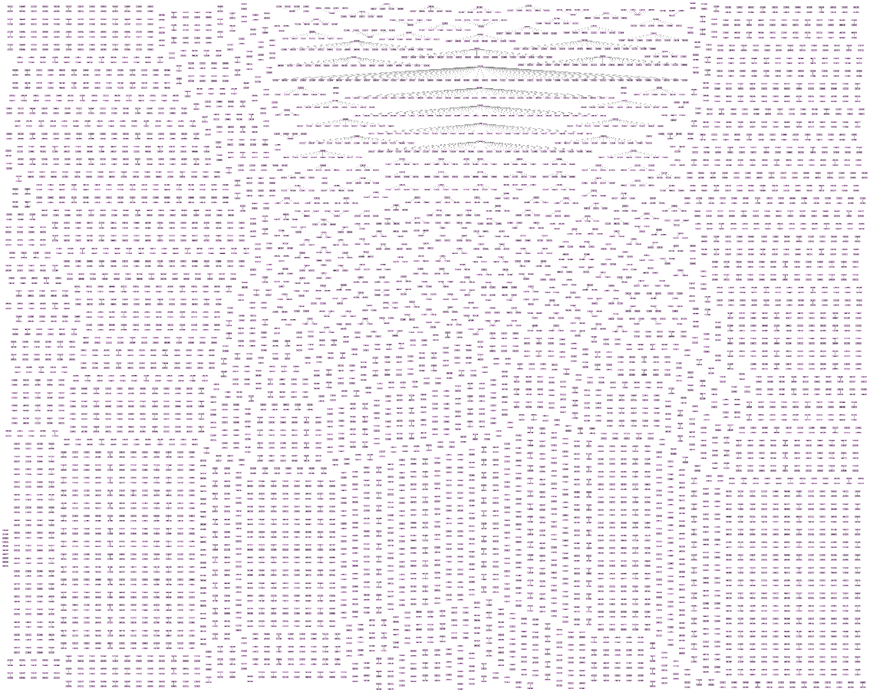
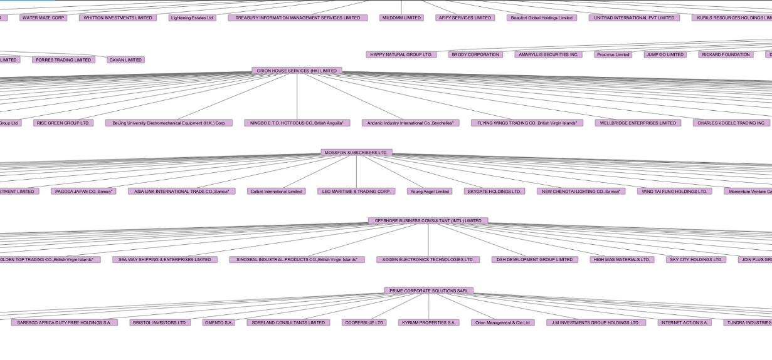
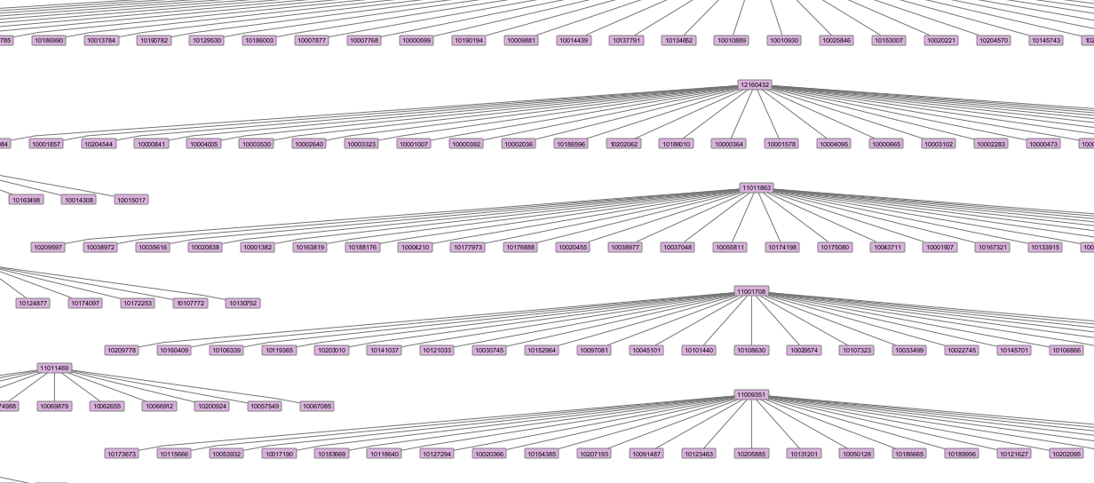
TSP Subgraph Visualization
We visualized a sampled subset of 4000 edges.
By using reconstruction and sampling, we discovered that the graph consists of several smaller networks of nodes and their neighbors.
We used the TSP previewer and visualized the subgraph.
We also tried to use the reconstruction method for visualization by selecting a number of random source nodes, but the results were the same.
Notes:
Using sampling we managed to load an visualize a subgraph of 4000 edges and around 3700 nodes. As you see the result didn’t create a large connected component but smaller networks of nodes. We decided to investigate the matter even further, by using the reconstruction method, but we got the same results. So we understood that loading a subset of the dataset in the range of some thousands of edges the graph had actually this form, as you can see in our figures.

Slide 10
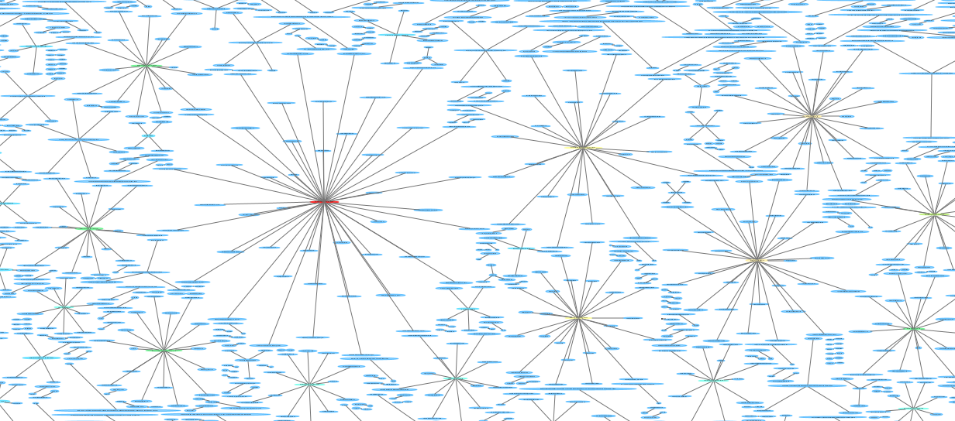

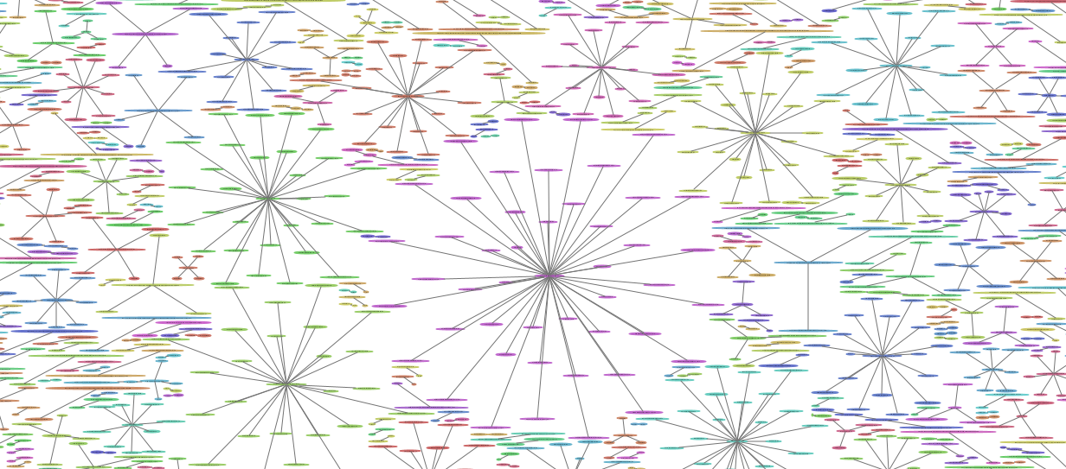
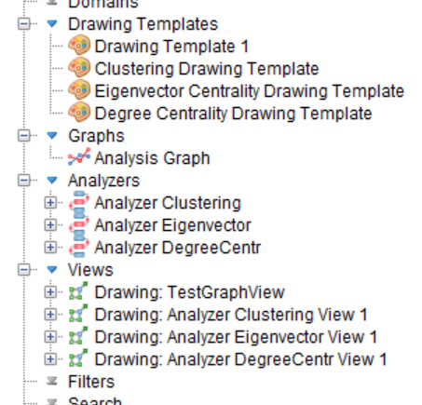
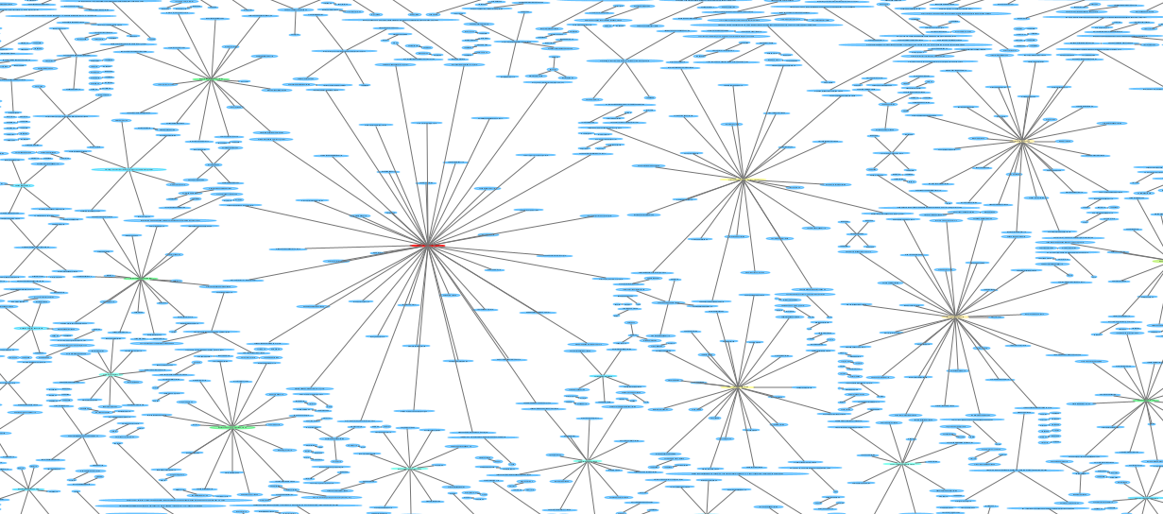
TSP Graph Analytics
We used the analyzers of TSP in order to run Eigenvector centrality, Degree centrality and Clustering.
Eigenvector centrality: We discovered that the most popular node is ORION HOUSE SERVICES LIMITED, MOSSACK FONSECA CO. and OFFSHORE BUSINESS CONSULTANT (INT'L) LIMITED.
Clustering: We discovered that the most popular node is ORION HOUSE SERVICES LIMITED and MOSSACK FONSECA & CO.
Degree Centrality: We discovered that the most popular node is ORION HOUSE SERVICES LIMITED and MOSSFON SUBSCRIBERS LTD.
Degree Centrality
Eigenvector Centrality
Clustering
Notes:
Regarding the analysis, we decided to run Eigenvector centrality, Degree centrality and Clustering algorithms using the analyzers of TSP.
Eigenvector centrality is [a measure of the influence of a node in a network. Relative scores are assigned to all nodes in the network based on the concept that connections to high-scoring nodes contribute more to the score of the node in question than equal connections to low-scoring nodes. ] and you can see the output and the best results in the corresponding figure.
Degree centrality is [The higher the degree, the more central the node is.] and you can see the output and the best results in the corresponding figure.
Clustering is [the task of grouping a set of objects in such way that objects in the same group are more similar to each other than to those in other groups] and you can see the output and the best results in the corresponding figure.

Slide 11
Graph Analytics: NetworkX
NetworkX is an open source Python API which was able to load the dataset completely and run the algorithms we selected.
We created a custom csv dataset parsing script to load the data and create mappings (nodeID, nodeName) using dictionaries.
We also implemented some wrapper functions for the built-in algorithms of NetworkX to get the results from the simulations.
We decided to use the results of NetworkX, as these results are extracted from the whole dataset.
The algorithms we used were PageRank, Eigenvector Centrality, Degree Centrality and Clustering, as they are the most applicable for locating “popular” nodes in a Fraud Detection graph. After the simulation of the algorithms, we kept only the top results.
Given that through this analysis we mostly care about the entities, the officers and the intermediaries, we decided to rule out the results that were about nodes representing addresses.
Notes:
NetworkX is an open source Python API which was able to load the dataset completely and run the algorithms we selected. To use it we needed to create a custom dataset parsing python script and some wrappers for the built in functions of the library.
We decided to proceed with the results of NetworkX,because using this library we managed to load the whole graph. The algorithms we decided to use are the previous ones plus PageRank [PageRank computes a ranking of the nodes in the graph based on the structure of the incoming and out-coming links] . We decided to rule out of the final results the nodes that corresponded to addresses, because for this analysis we mostly care to find the most important nodes representing entities, intermediaries and officers.

Slide 12
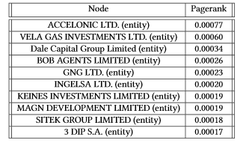
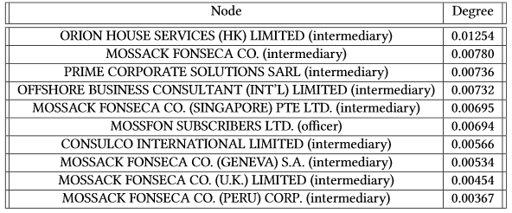
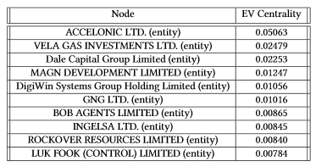

NetworkX Results
PageRank(a=0.85,it=100)
Degree Centrality
Eigenvector Centrality
Clustering
Notes:
So, here you can see the top results of each of the algorithms we run. Now, you notice that entity we presented in the beginning of the presentation is actually the one with the highest PageRank and EV centrality score.

Slide 13
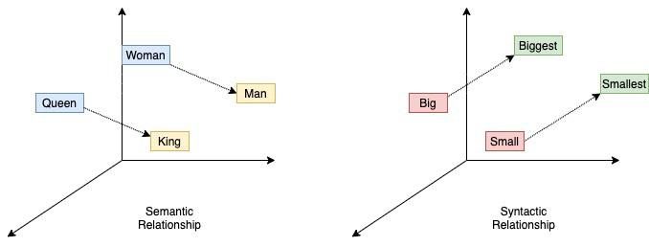
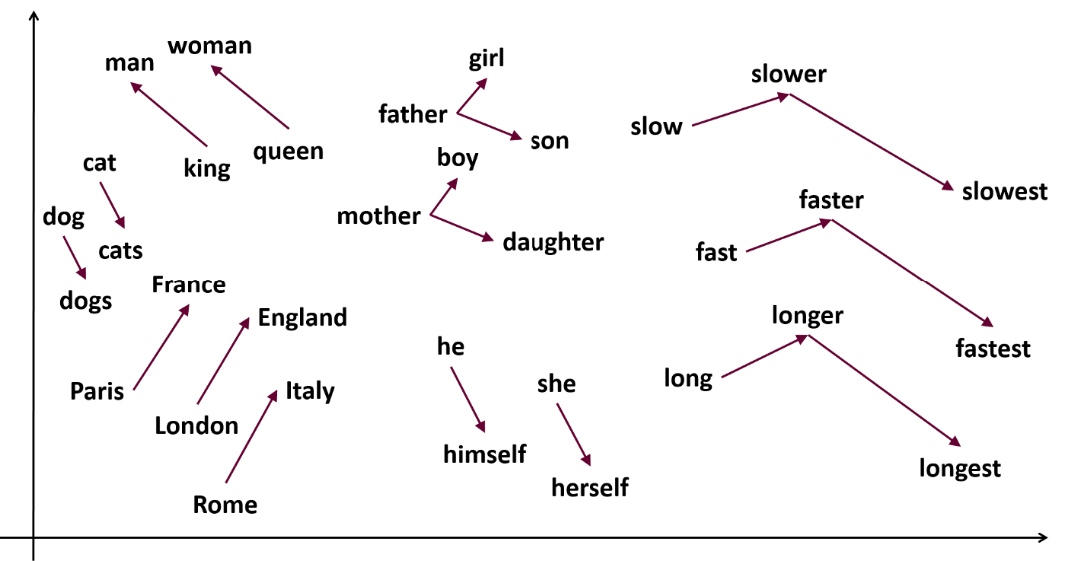
Graph Embeddings (General)
Embeddings are vector representations of words.
Libraries for embedding creation exploit pre-trained neural networks trying to group the words based on their semantic meaning. This means that based on the input, words that have similar meaning will also have closer vectors.
The idea is to transform the graph into text corpus, by representing it as triples of the form (“nodeName” “linkName” “nodeName”). This will result in a vector for each node, and nodes that share many same information will have closer vectors too.
This way, we can make operations like similarity search i.e. “give me the first top-K” similar nodes of the node N.
Notes:
Now, we will proceed to the embeddings creation part. You can consider embeddings as vector representations of words. There are many libraries for embeddings creation that exploit pre-trained neural networks trying to group the words based on their semantic meaning. This means that based on the input, words that have similar meaning will also have closer vectors.
Regarding graph embeddings, the idea is to transform the graph into text corpus, by representing it as triples of the form (“nodeName” “linkName” “nodeName”). This will result in a vector for each node, and nodes that share many same information will have closer vectors too. This way, we can make operations like similarity search i.e. “give me the first top-K” similar nodes of the node N.

Slide 14
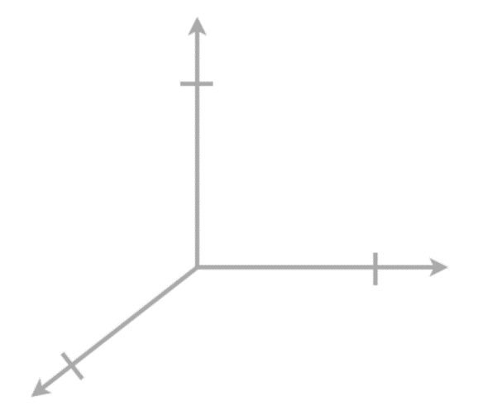
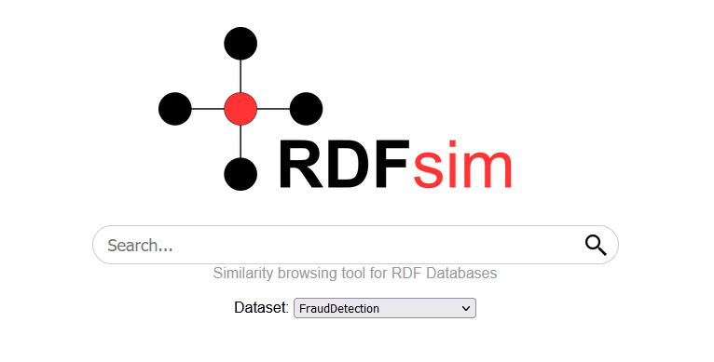
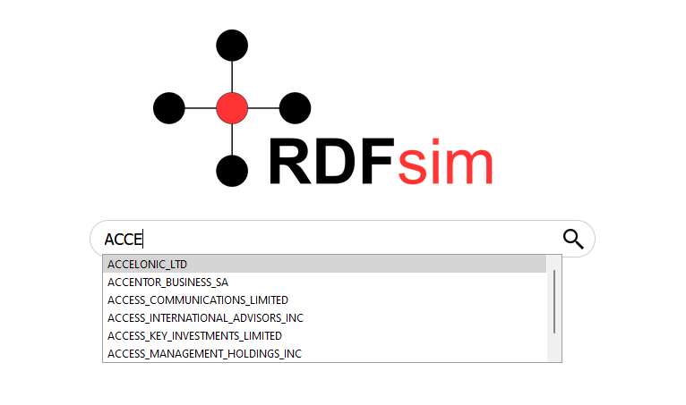
Graph Embeddings (RDFsim tuned for FD)
By calculating all similar nodes of every node, we can create a graph database of embeddings in order to develop similarity networks by exploiting RDFsim.
RDFsim is a search engine which is able to use embedding datasets and create similarity networks. Although it is designed for knowledge graphs, we managed to port the Fraud Detection data.
This way we can use the search engine features of RDFsim (e.g. search for a specific node of the graph) and create networks of any kind and depth.
orion
accelonic
Text Corpus
1.<nodeName> <linkType> <nodeName>
2.<nodeName> <linkType> <nodeName>
3.<nodeName> <linkType> <nodeName>
…..
word2vec
Dataset
Produce RDFsim dataset
RDFsim
Embeddings
database
Notes:
In this figure, the process of embedding creation for our work is depicted. We start by transforming the graph into text corpus, which is used as input for an embedding creation library called word2vec. Then, after the vector space is produced we load this space into a embeddings database framework called RDFsim.
RDFsim is a search engine which is able to use embedding datasets and create similarity networks. Although it is designed for knowledge graphs, we managed to port the Fraud Detection data. We can use the search engine features of RDFsim (e.g. search for a specific node of the graph) and create networks of any kind and depth, for any entity we want.

Slide 15
Graph Embeddings (Examples)
For this presentation, we show the results about the important nodes from graph analytics.
More about the vocabulary creation, embedding training and RDFsim can be found in the official paper, published in Sep. 2021.
The nodes that we will explore are:
ACCELONIC LTD: Important entity with high PageRank and EV score.
VELA GAS INVESTMENTS LTD: Important entity with high PageRank and EV score.
ORION HOUSE SERVICES (HK) LIMITED: Important intermediary node with high degree centrality score.
Note: Although we selected only three of the important nodes from all the algorithms we simulated, the search engine can create the results for any node existing in the database.
Notes:
Now, we can exploit the RDFsim graph database to create the similarity networks we presented in the beginning. If you want more information about the tuning and work of RDFsim, there is a publication available.
Here, you can three nodes we selected, and their networks are presented In the next slide.

Slide 16
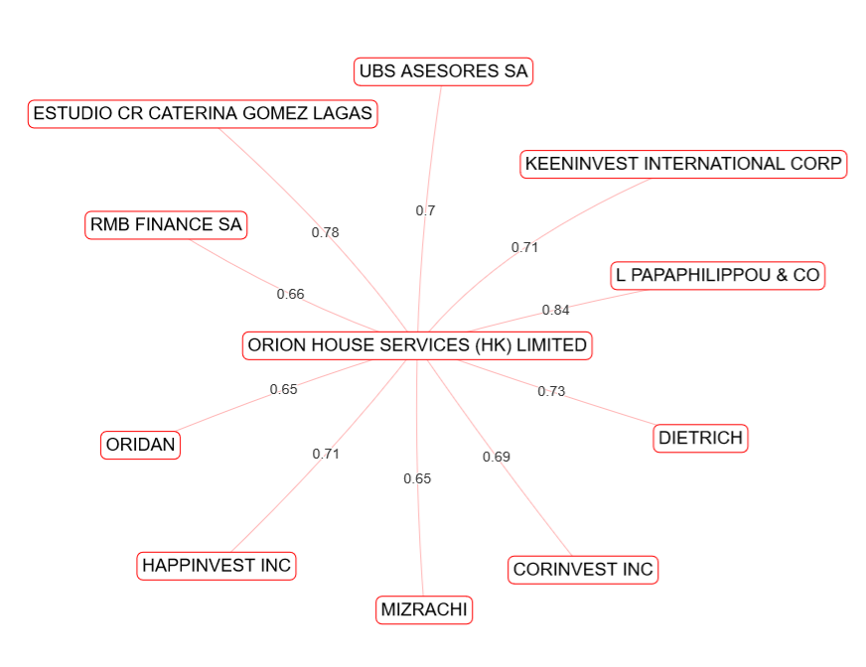
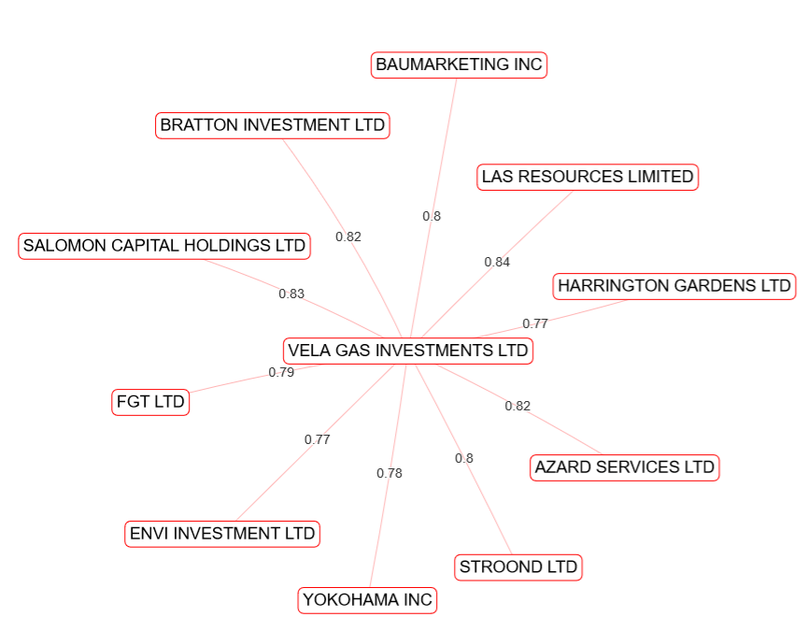
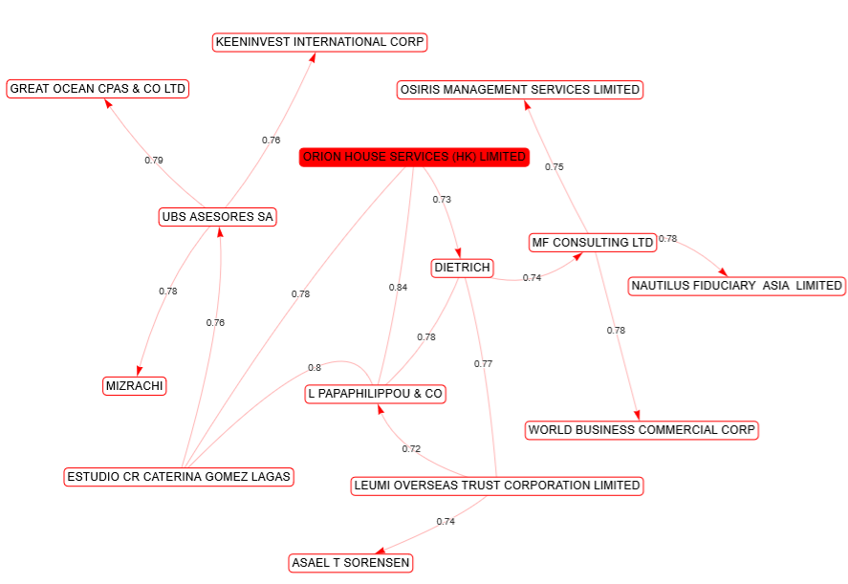
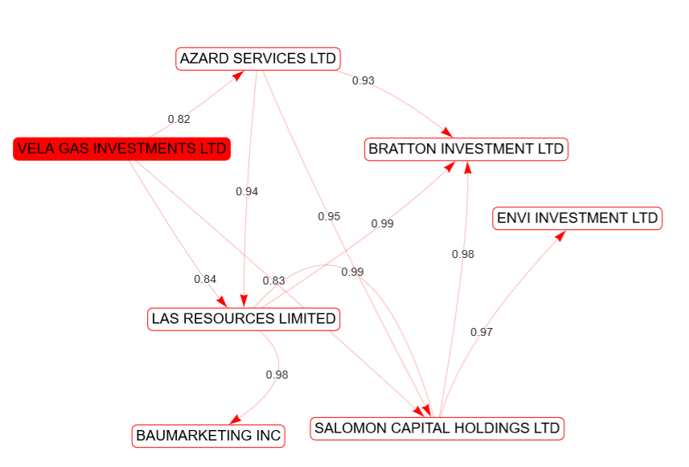
Examples (using RDFsim)
Notes:
Here you can see examples of the similarity networks. The generated graphs can be tuned to have specific depth and similarity count. That means that for every entity, we can decide the top-K similar entities to see and the size of the paths that will be created.

Slide 17
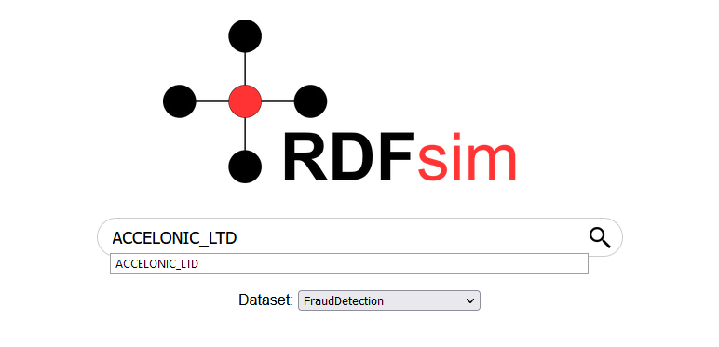
Understanding the results
Lets look at the similarity network of ACCELONIC LTD.
Using this network, we can discover connections between offshores and other entities that were not clear before.
For example, we see that our current node has high similarity score with ASPAM NAVIGATION LTD. (the similarity score is based on how close are the corresponding vectors, i.e. it is the cosine similarity) .
This result could mean that these two nodes may have connections to similar entities, officers, companies and more.
Given that our base data are dense and might have many connections between nodes, it could be difficult to discover such connections, or even worse, such connections could not even exist in the starting dataset (as a path or direct edge).
Exploiting graph embeddings could offer a new way to discover relationships between the nodes of the graph, group offshores with same fraudulent activity etc.
Notes:
Lets look at the similarity network of ACCELONIC LTD. Using this network, we can discover connections between offshores and other entities that were not clear before.
For example, we see that our current node has high similarity score with ASPAM NAVIGATION LTD. (the similarity score is based on how close are the corresponding vectors, i.e. it is the cosine similarity) .
This result could mean that these two nodes may have connections to similar entities, officers, companies and more.
Given that our base data are dense and might have many connections between nodes, it could be difficult to discover such connections, or even worse, such connections could not even exist in the starting dataset (as a path or direct edge). Exploiting graph embeddings could offer a new way to discover relationships between the nodes of the graph, group offshores with same fraudulent activity etc.

Slide 18
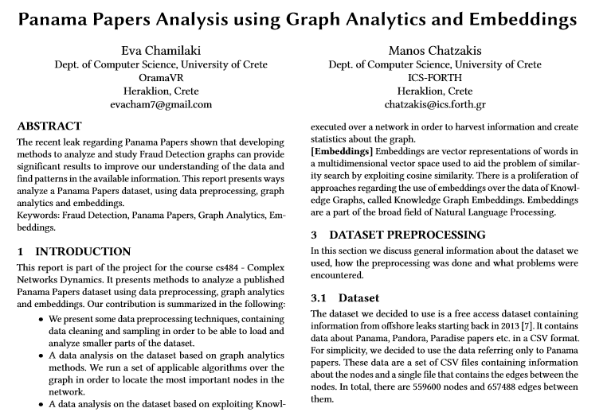
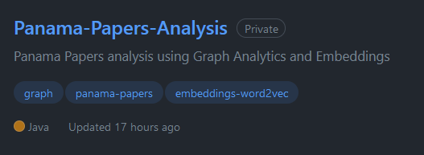
Conclusion
Authors are sorted by their patience ☺ ..
We presented an analysis which combines graph analytics with embeddings.
The analysis resulted in a set of important nodes over the network and the creation of a Fraud Detection Graph Embeddings Database.
An extended analysis of our work including more figures, algorithms and explanations is available in the repository of our project.
Thank You!

Slide 19

Any Questions?

