Slide 1
Putting Austrian academicians on Wikipedia
Mohammad Zandpour (01425603)
Vasilena Kisova (11741233)
Daniela Shopova (11741234)
Eva Jobst (51824341)

Slide 2

What did we do?
Gathered public info on Austrian academicians
Published the info on Wikipedia
Special emphasis on female academicians
This image is licensed under the Creative Commons Attribution-Share Alike 3.0 Unported license.
Attribution: Wikimedia Foundation

Slide 3
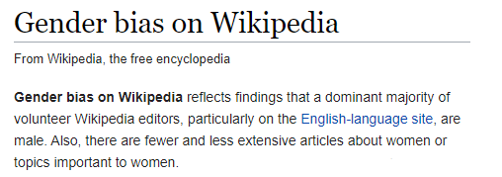
Why did we do it?
They deserve recognition
Female academicians need better representation
Contributing is cool

Slide 4
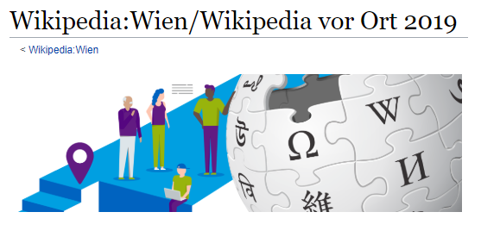
How did we learn to do it right?
Wikipedia guidelines & tutorials
Meet-up with veteran editors at

Slide 5

“You may only publish if …”
“Ordentliche ProfessorInnen”
OR
“Außerordentliche ProfessorInnen” & atleast 4 Books published
?
?
?
Obey?
Ignore?

Slide 6
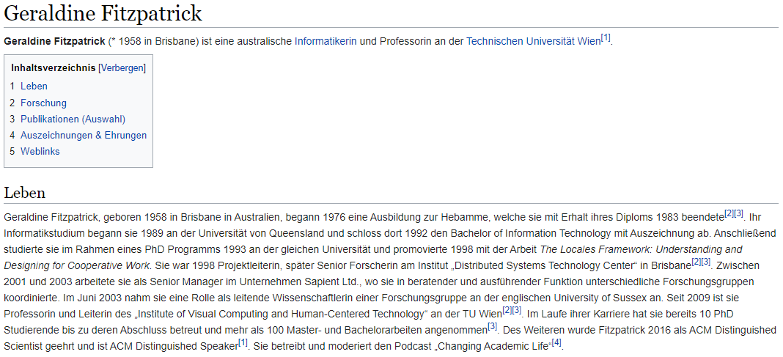

Slide 7
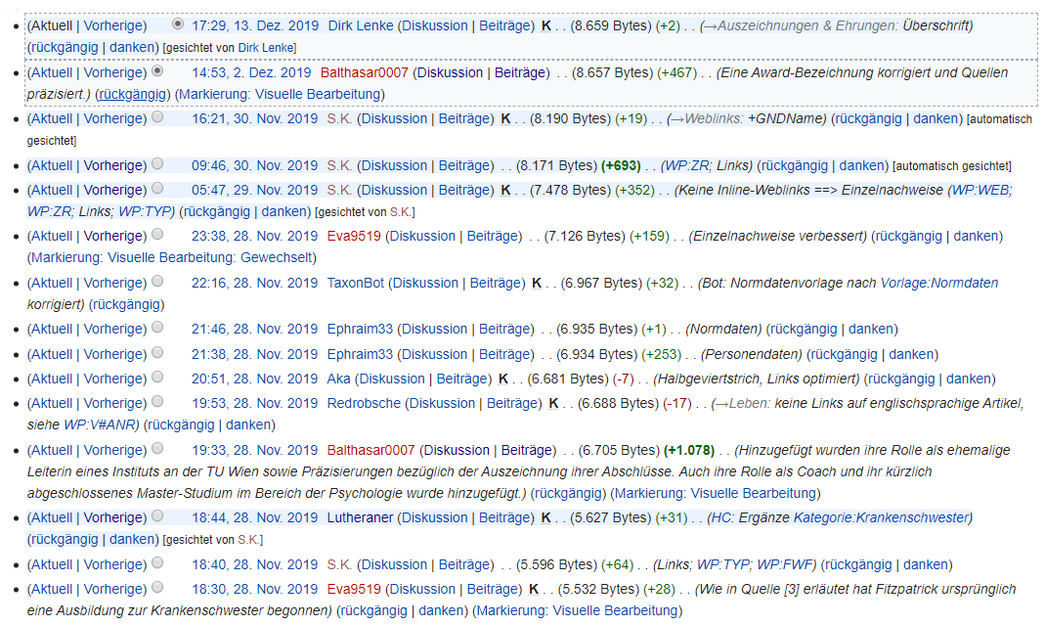

Slide 8
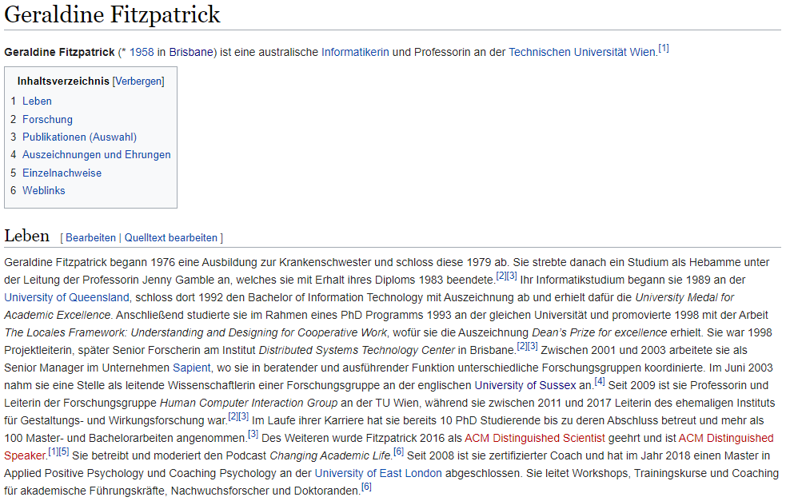

First version
Current version

Slide 9
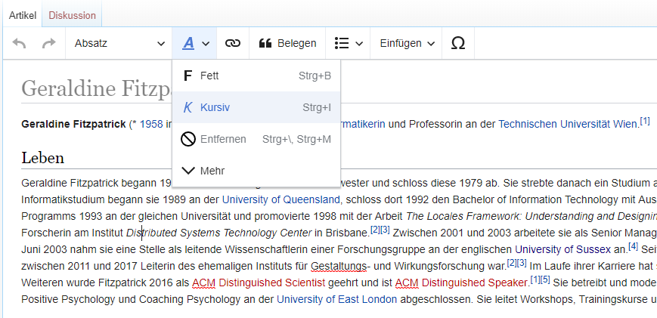
How do you create/edit articles?
Content: in-built WYSIWYG editor
References: automatic author-detection for weblinks OR manual entry
That’s it!

Slide 10
First version
Current version

Slide 11
Reviewer?
What can they do?
Can mark articles as “reviewed”
Can discard changes made by a user without notice
How do you become one automatically?
Account is min. 60 days old
Min. 300 accepted edits
Never been banned
Min. 5 edits in the last 30 days
Etc.

Slide 12
How did we organize?
Whatsapp & Meetings
GitHub repository
https://github.com/EvaJobst/EvaJobst.github.io
GitHub page
https://evajobst.github.io/

Slide 13
How did we collaborate?
2 teams of 2
Each team works on 1 professor at a time
Each team reviews the drafts of the other team before publishing

Slide 14

How did the professors respond?
Prof. Fitzpatrick: delighted
Prof. Pohl: excited
Prof. Gelautz: not so much

Slide 15
Demo of articles & repository

Slide 16
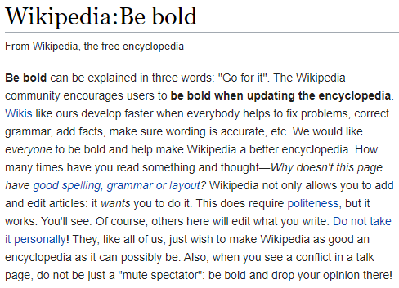
Lessons learned?
Setting up a GitHub page requires effort
Documenting our steps took a lot of time
BE BOLD!

