Slide 1

Mountaineer
The D is silent.

Slide 2
Problem
Existing Apps are not designed for moutain climbers
They miss some important information:
Covered altitude
Time spent walking uphill/downhill
Calculation of calories

Slide 3
Solution

Slide 4
Solution
Android App
Specialized for Mountaineers

Slide 5
Functionality
Add tours/trips
Monitor weather and health information
Display details of completed tours
Tracking of altitude
Subject to change without prior notice.

Slide 6
What kind of Details?
General information
Track/Route details
Weather information
Health
Subject to change without prior notice.

Slide 7
Technical Stuff
Firebase
For Training Units
Used for Fast-Prototyping
Dedicated Database on Webserver for Production
More Details coming soon ;)
Subject to change without prior notice.

Slide 8
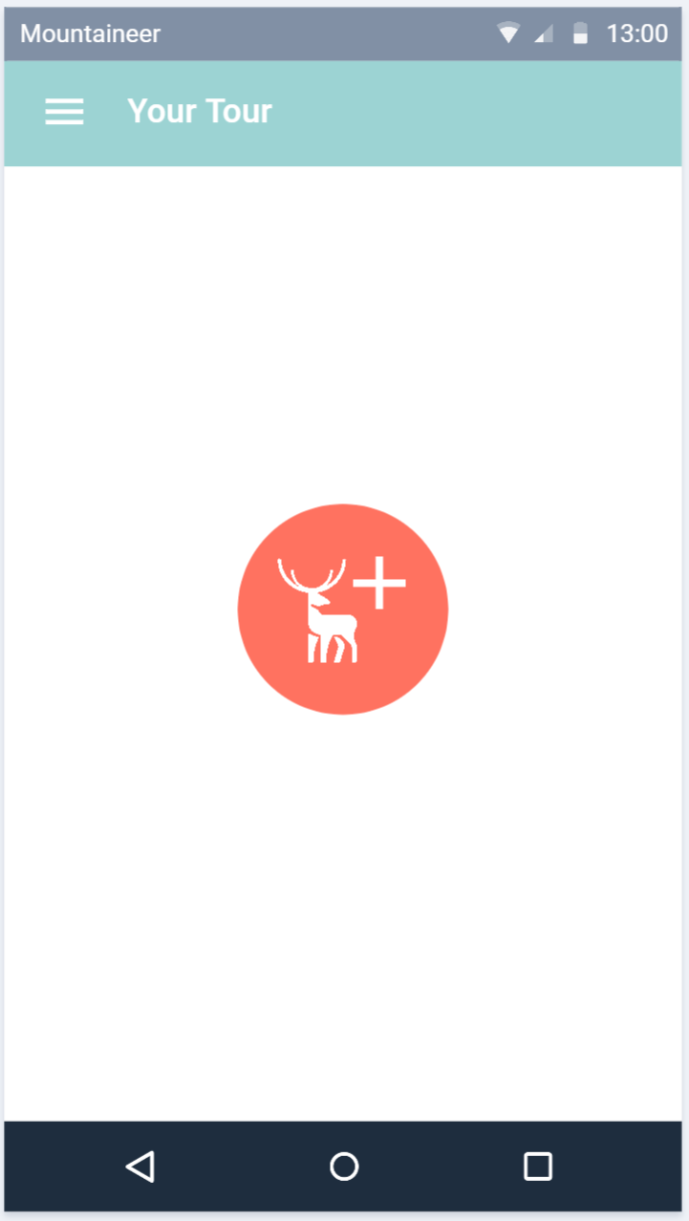
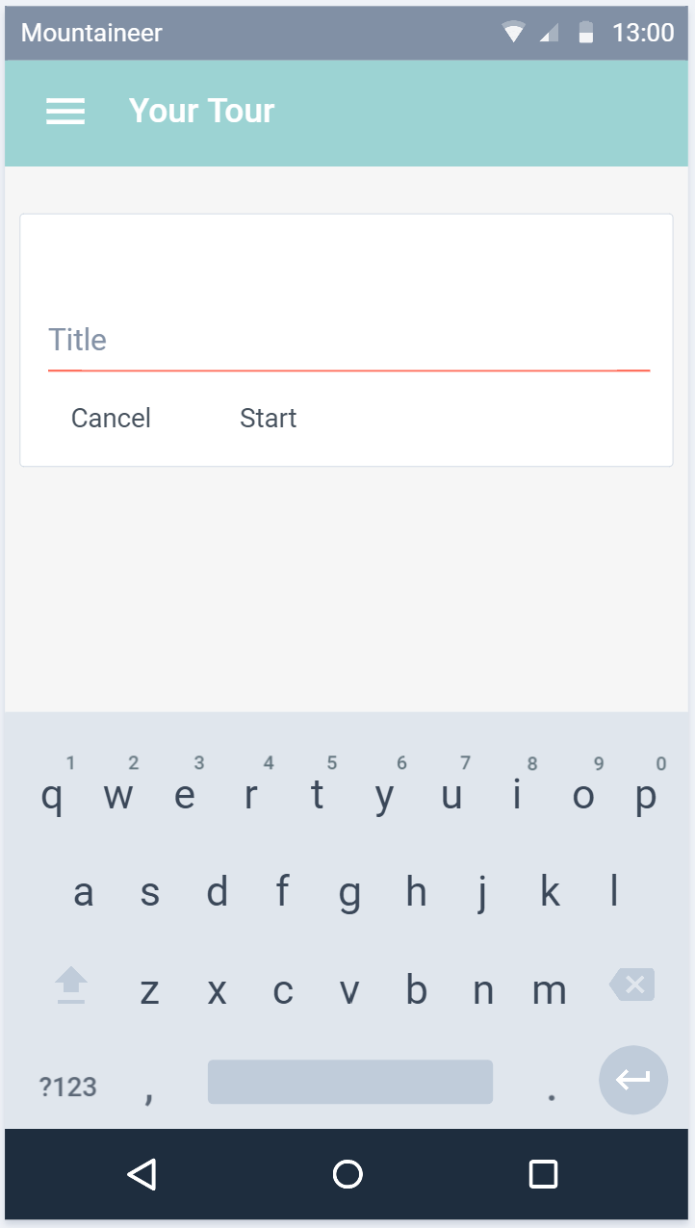
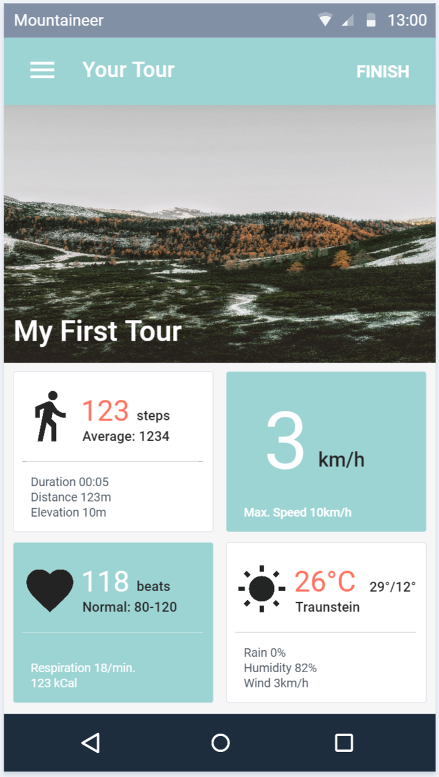
Planned Design
Subject to change without prior notice.

Slide 9
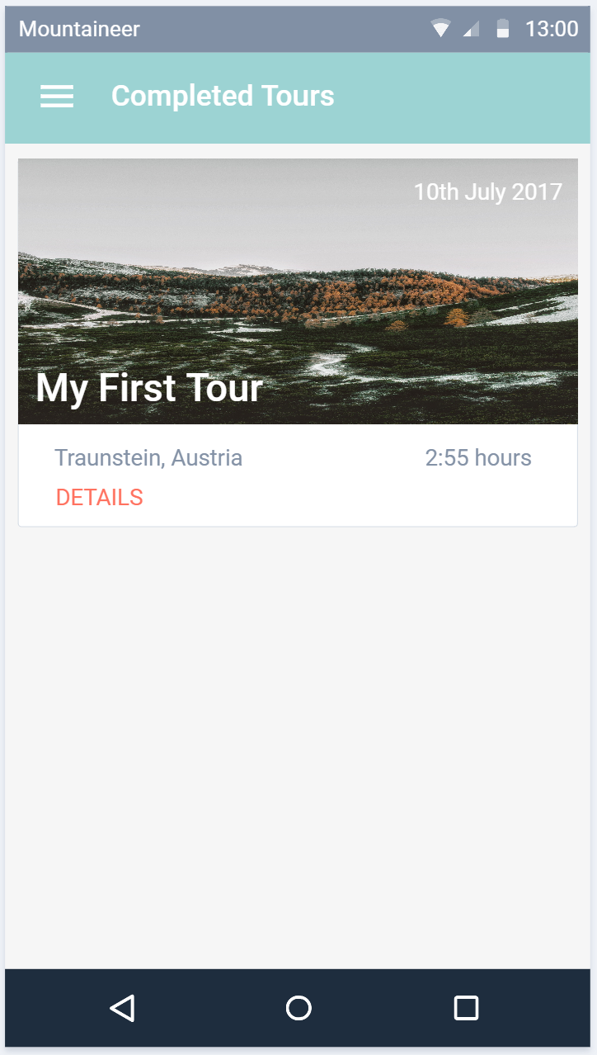
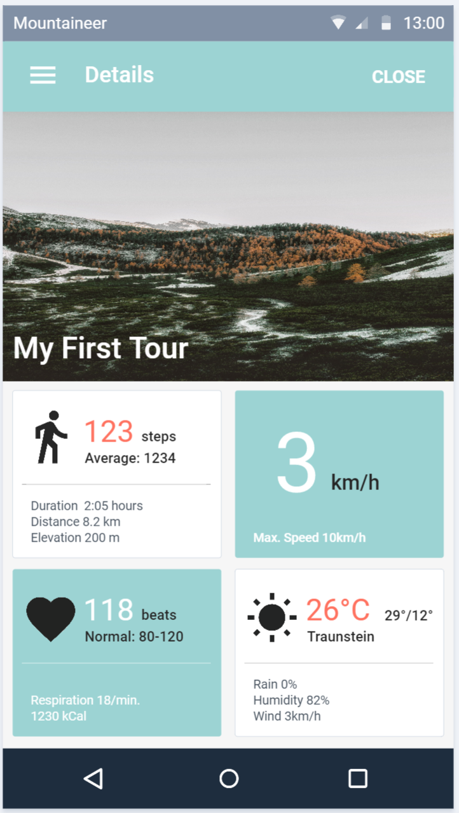
Planned Design
Subject to change without prior notice.

Slide 10
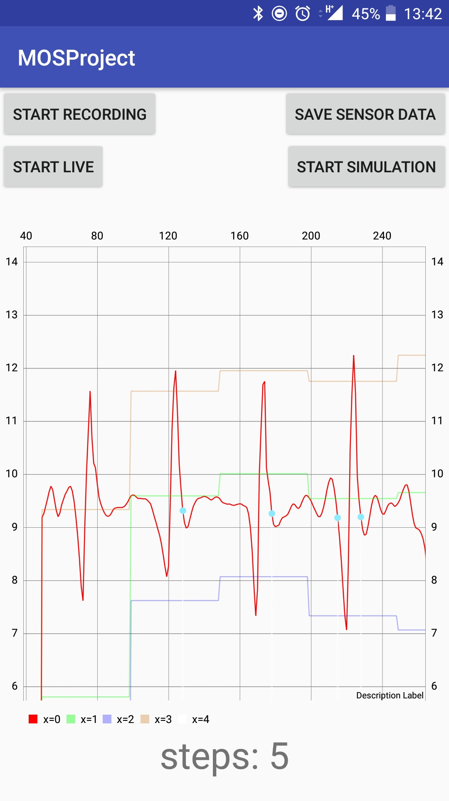
Pedometer
Simulation + Live-View
Graph
Used for debugging and testing
Firebase
Running as a Service
Implemented according to the PDF
But with little parameter adjustments

Slide 11
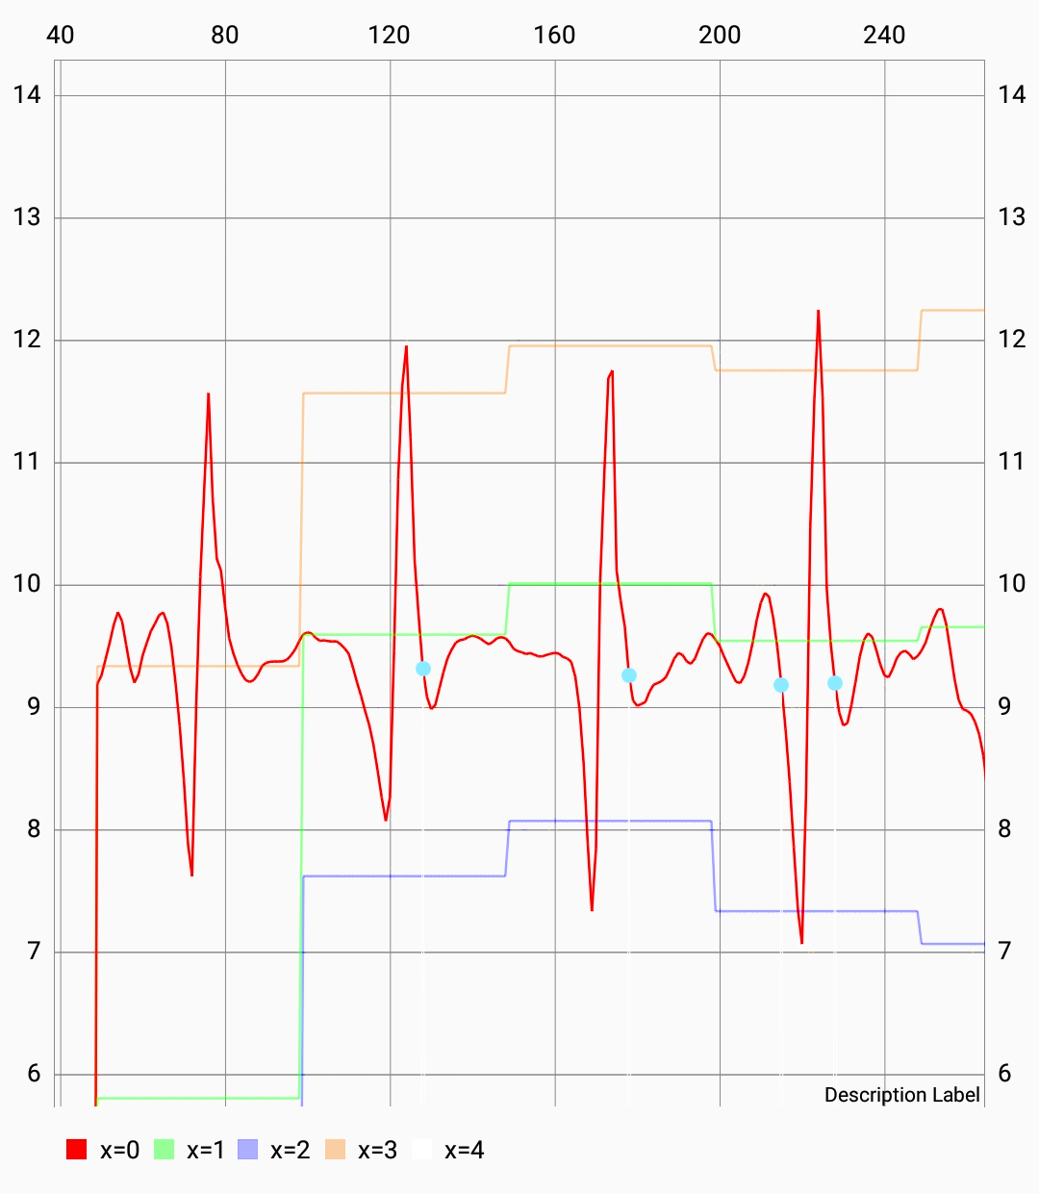
Chart Details
Measured values
Max + Min
Threshold
Detected steps

Slide 12
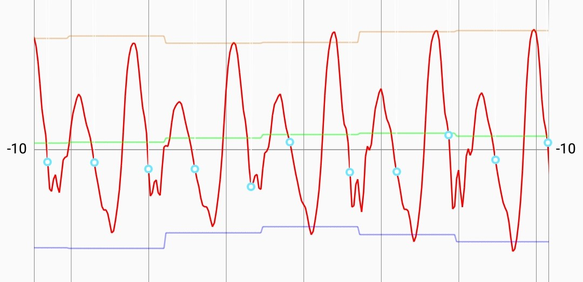
Acceleration of morning walk to FH

Slide 13
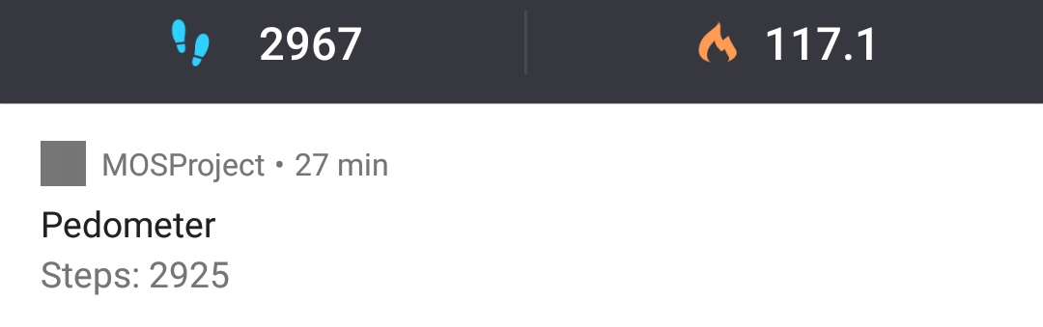
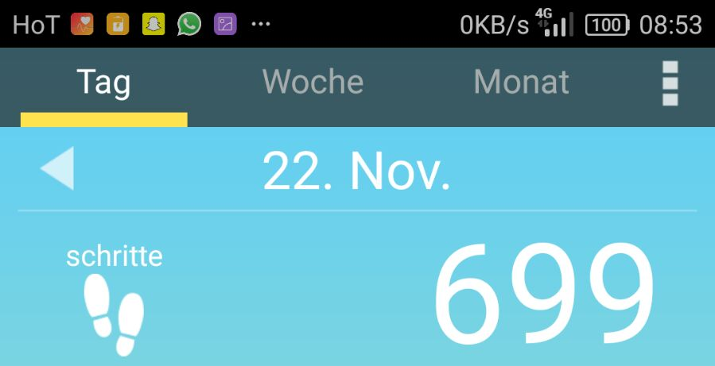
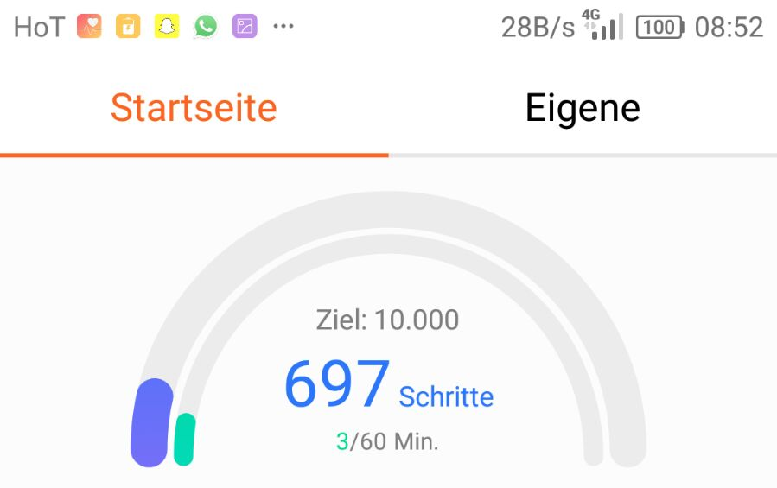
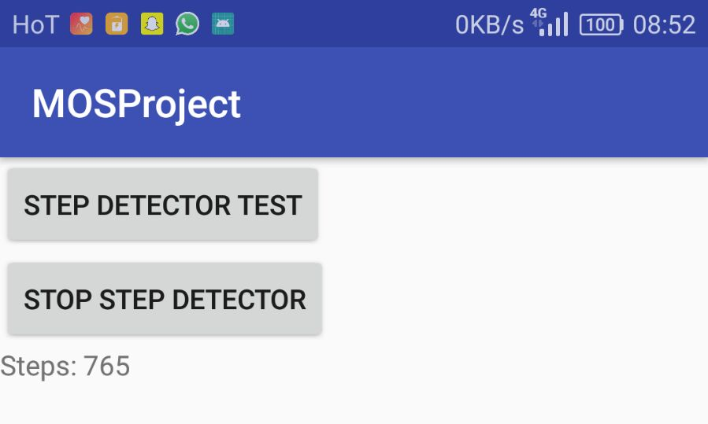
Competition Analysis
Accuracy compared to:
Pedometer
Huawei Health
Schrittzähler

Slide 14
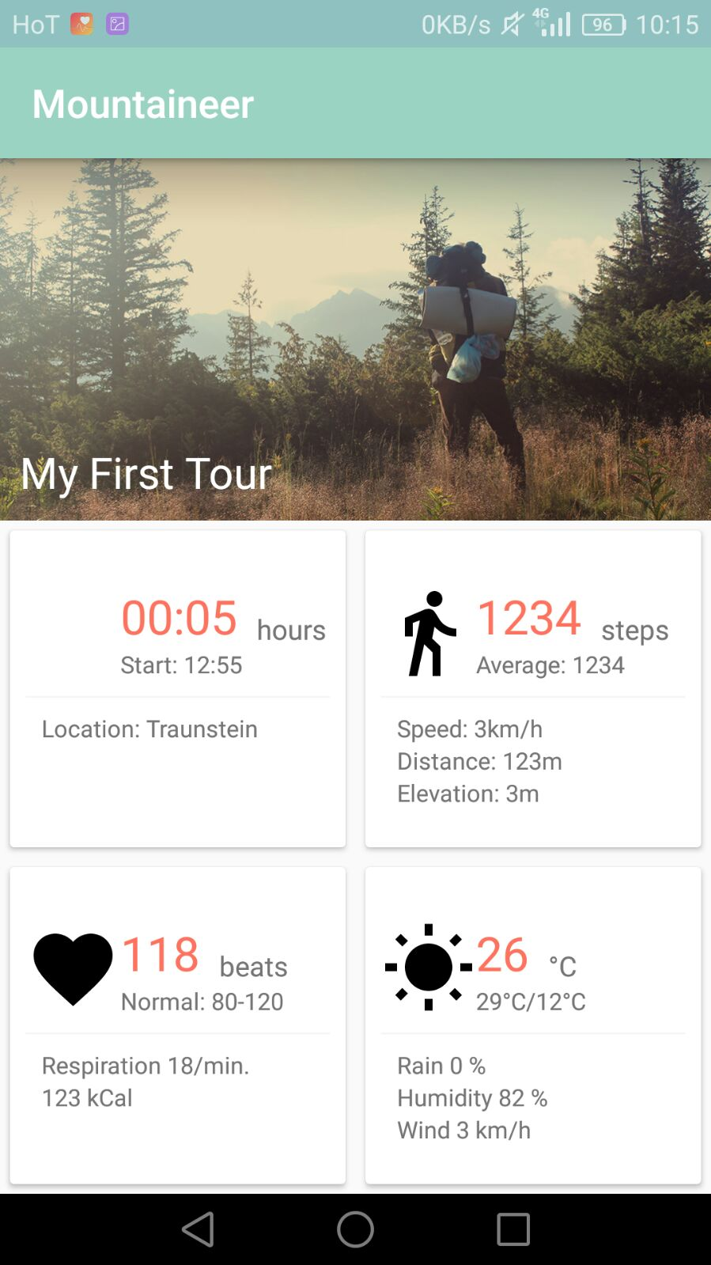
UI is (almost) ready
and waiting for functionality

Slide 15
Thanks!

