Slide 1

Mountaineer
The D is silent.

Slide 2
Problem

Slide 3
Solution

Slide 4
Solution

Slide 5
Platform
Android
No Macbooks available :(
Also we‘re already kind of experts
Android Studio

Slide 6
Functionality
Able to add tours/trips
Monitor weather and health information
Display completed tours
Open details of completed tours
Subject to change without prior notice.

Slide 7
What kind of Details?
General Information
Weather Information
Healthcare
Subject to change without prior notice.

Slide 8
Technical Stuff
Shared Preferences
Firebase

Slide 9
Database
Firebase
For Training Units
Training IDs are saved locally

Slide 10
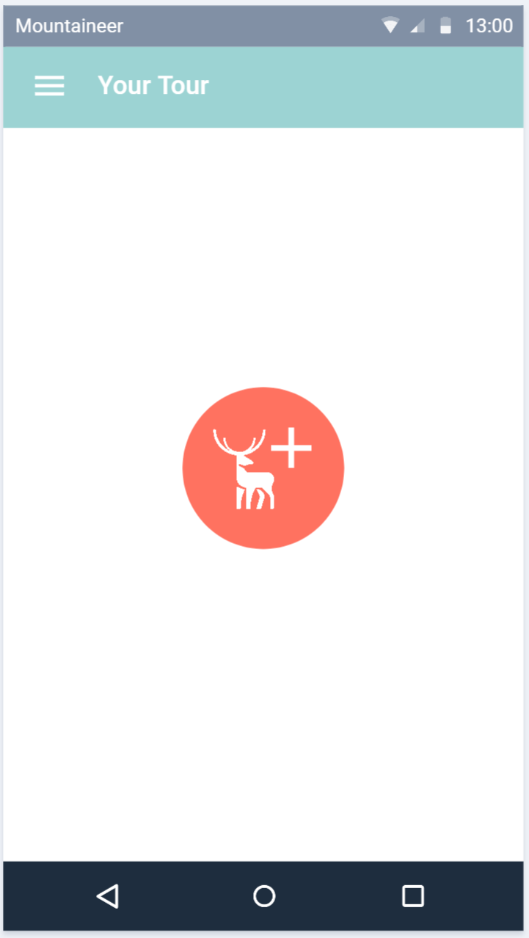
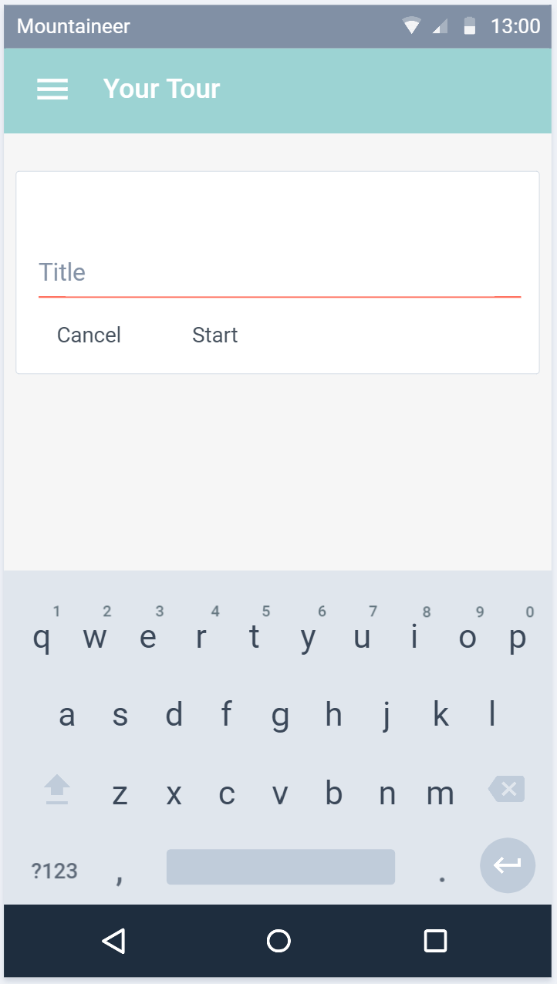
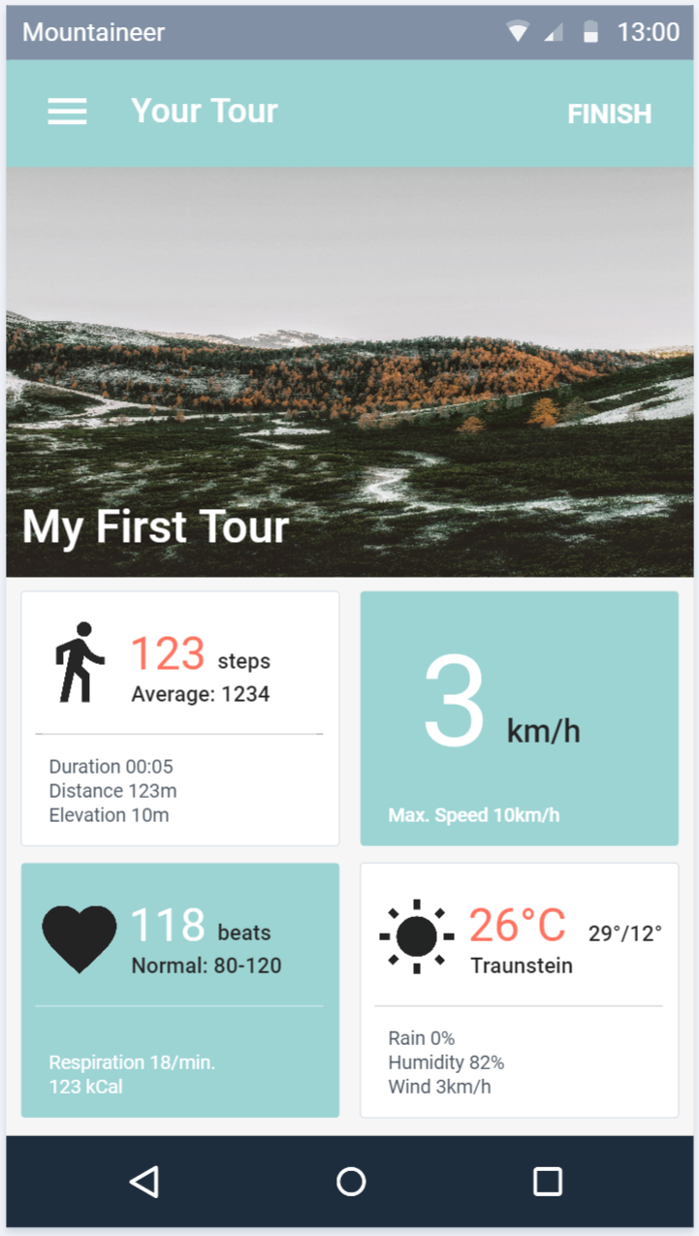
Planned Design
Subject to change without prior notice.

Slide 11
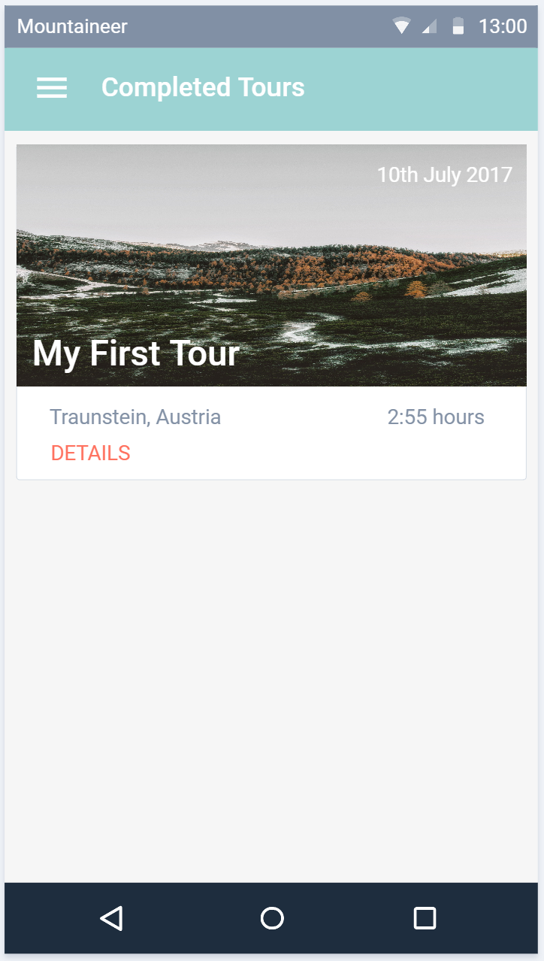
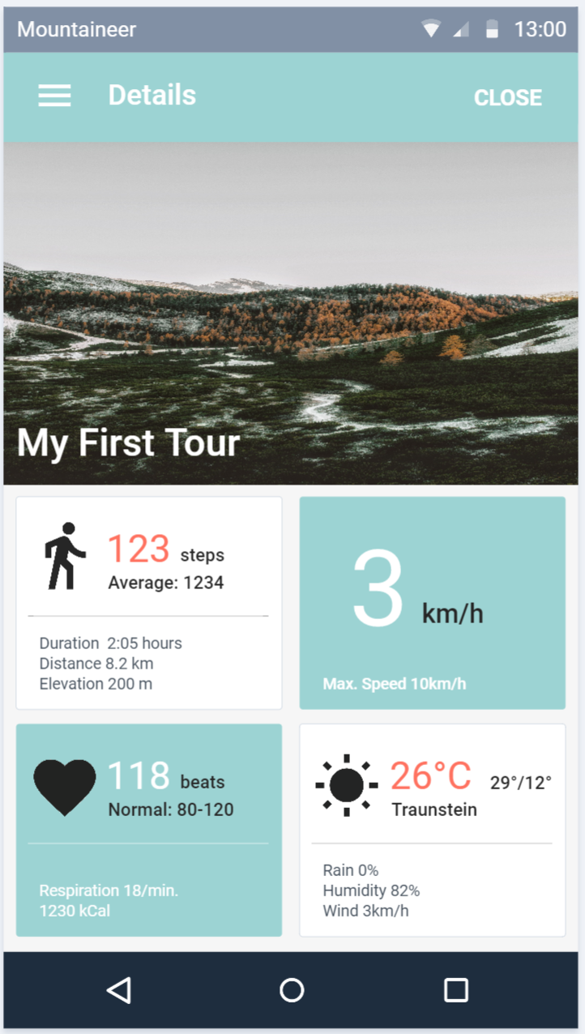
Planned Design
Subject to change without prior notice.

Slide 12
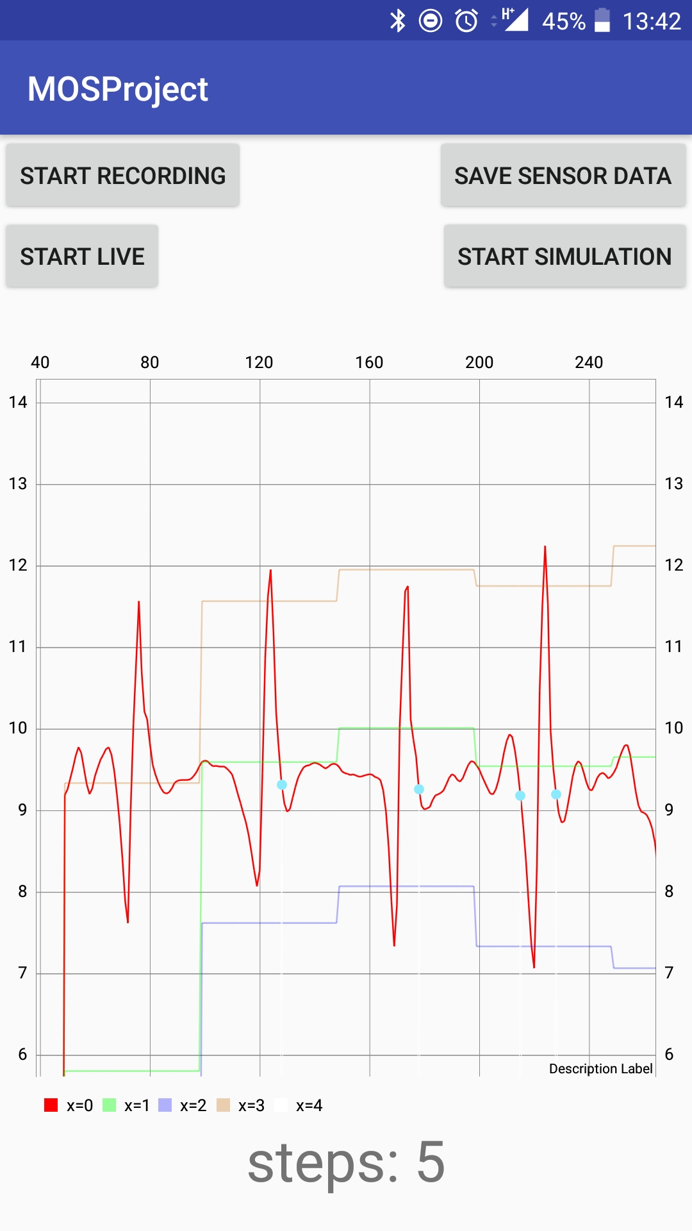
Current Status
Pedometer
Running as a service
Simulation + Live-View
Graph
Measured values
Max + Min
Threshold
Detected steps
Firebase

Slide 13
Thanks!

