Slide 1

Mountaineer
The D is silent.

Slide 2
Problem

Slide 3
Solution

Slide 4
Solution

Slide 5
Platform
Android
No Macbooks available :(
Also we‘re already kind of experts
Android Studio

Slide 6
Functionality
Able to add tours/trips
Monitor weather and health information
See completed tours
Open details of completed tours
Subject to change without prior notice.

Slide 7
What kind of Details?
General Information
Weather Information
Healthcare
Subject to change without prior notice.

Slide 8
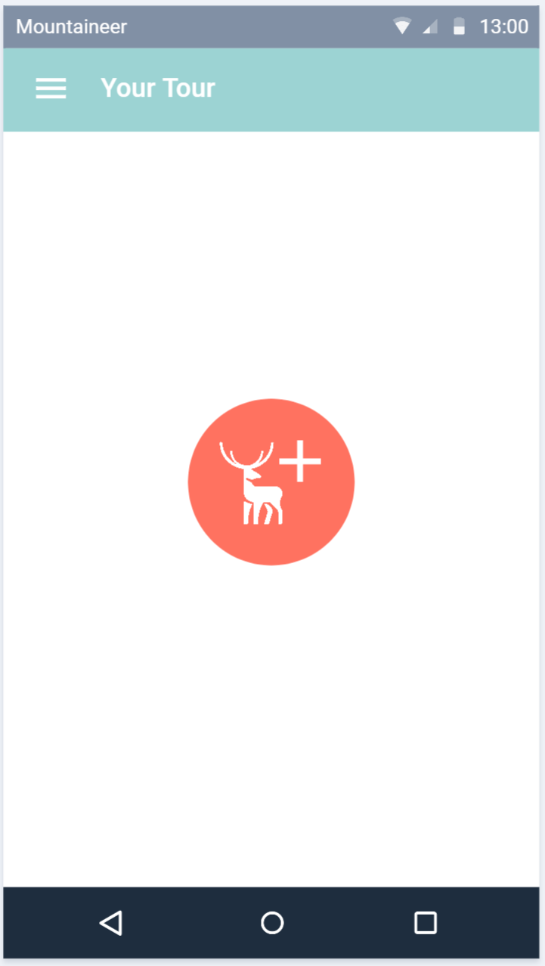
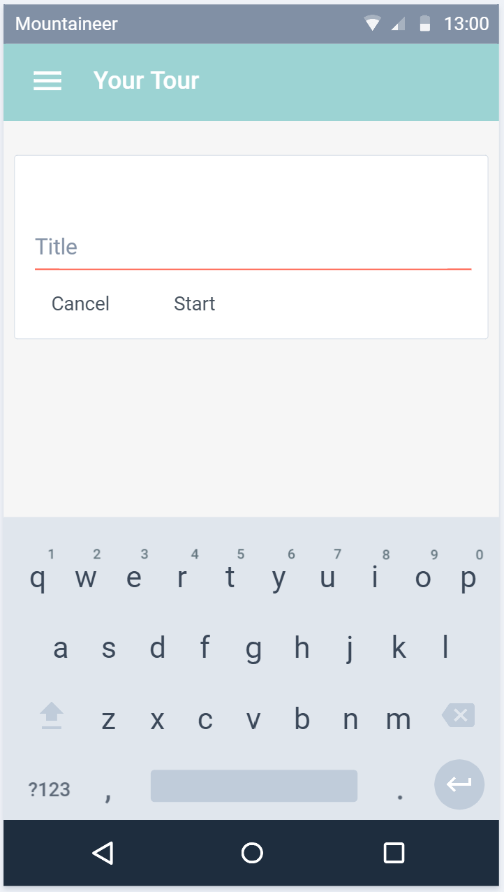
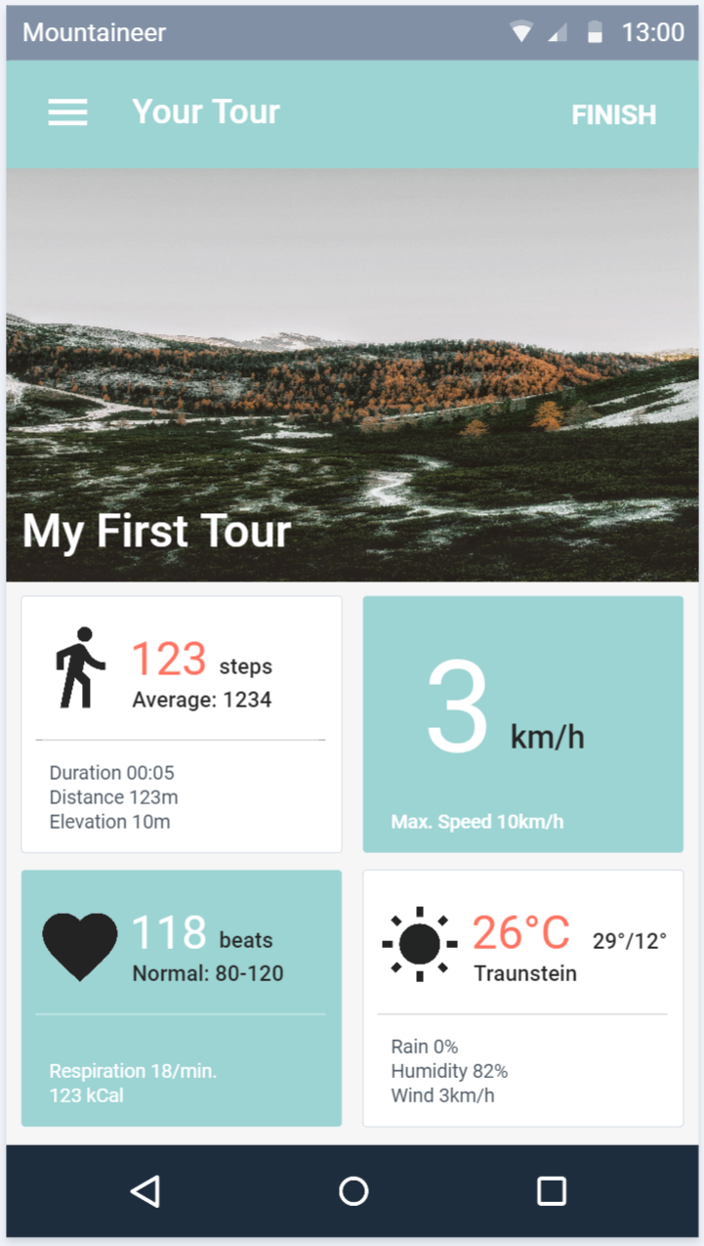
Planned Design
Subject to change without prior notice.

Slide 9
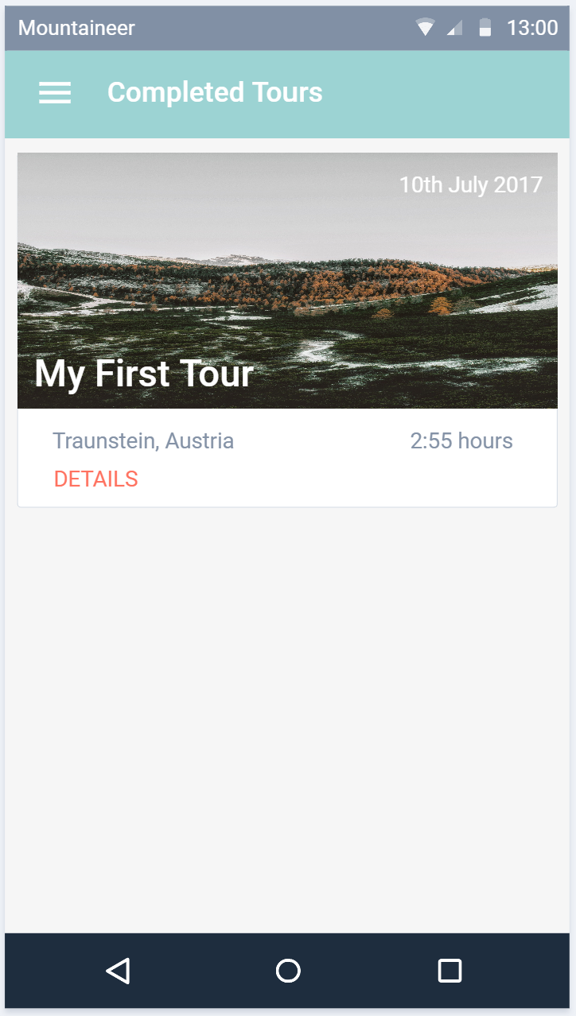
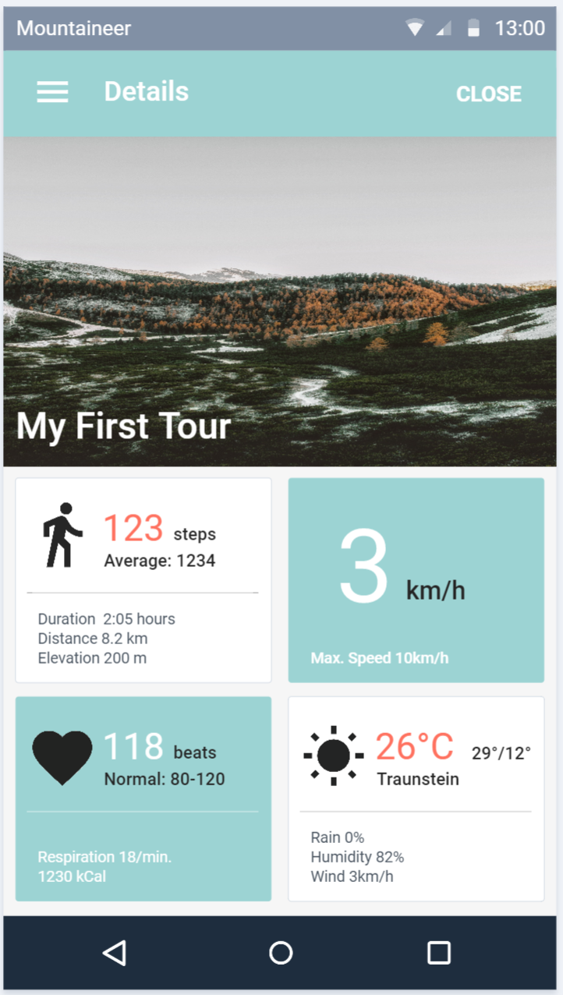
Planned Design
Subject to change without prior notice.

Slide 10
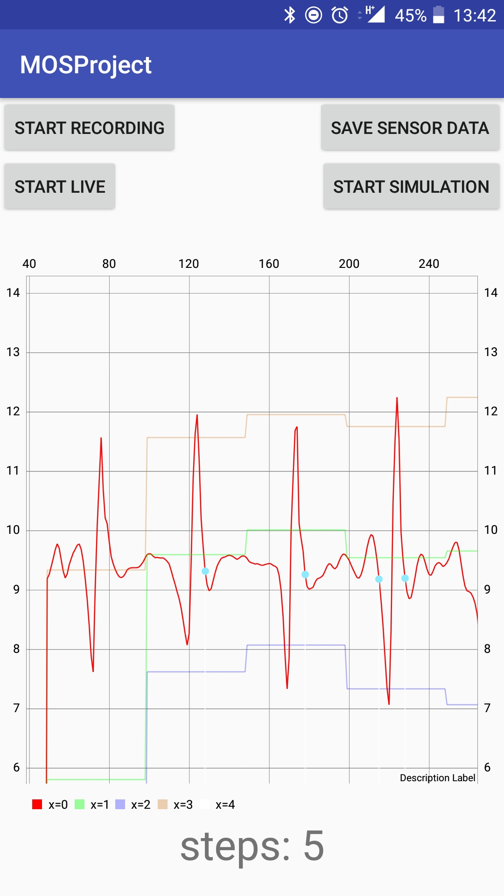
Current status
Pedometer
Running as a service
Simulation + Live-View
Graph
Measured values
Max + Min
Threshold
Detected steps

Slide 11
Thanks!

