Slide 1

Mountaineer
The D is silent.

Slide 2
Problem
Existing apps are not designed for moutain climbers
They miss some important information:
Coverd altitude
Time spent walking uphill/downhill
Calories calculation

Slide 3
Solution

Slide 4
Solution

Slide 5
Platform
Android
No Macbooks available :(
Also we‘re already kind of experts
Android Studio

Slide 6
Functionality
Able to add tours/trips
Monitor weather and health information
Display completed tours
Open details of completed tours
Subject to change without prior notice.

Slide 7
What kind of Details?
General Information
Weather Information
Health
Subject to change without prior notice.

Slide 8
Technical Stuff
Shared Preferences
Firebase

Slide 9
Database
Firebase
For Training Units
Training IDs are saved locally

Slide 10
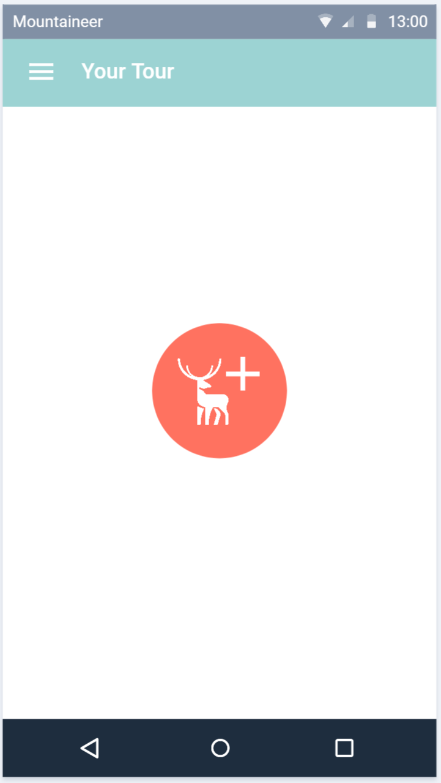
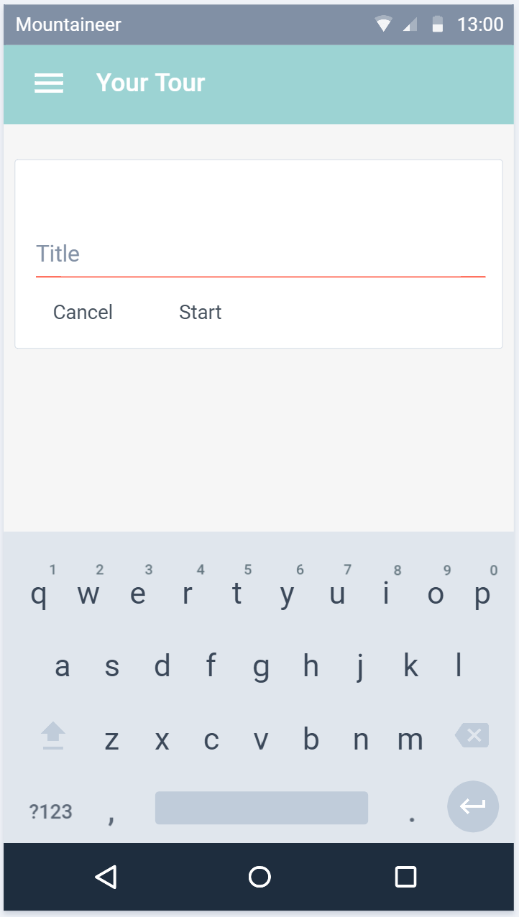
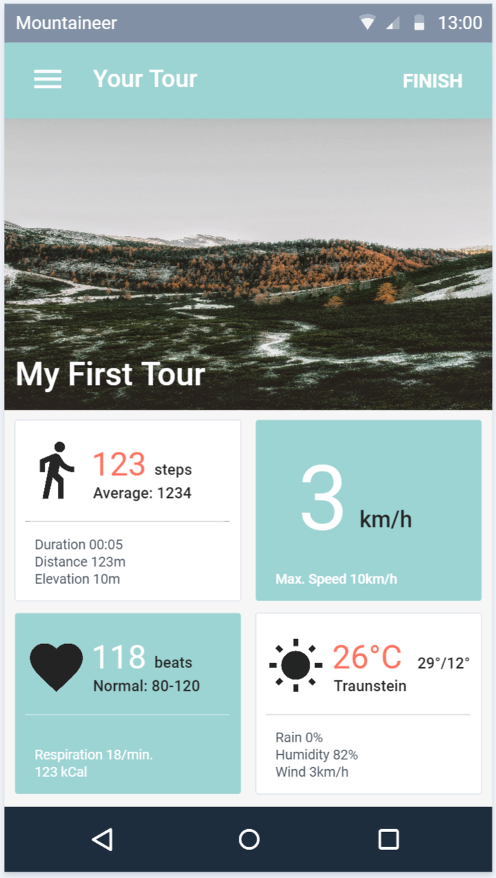
Planned Design
Subject to change without prior notice.

Slide 11
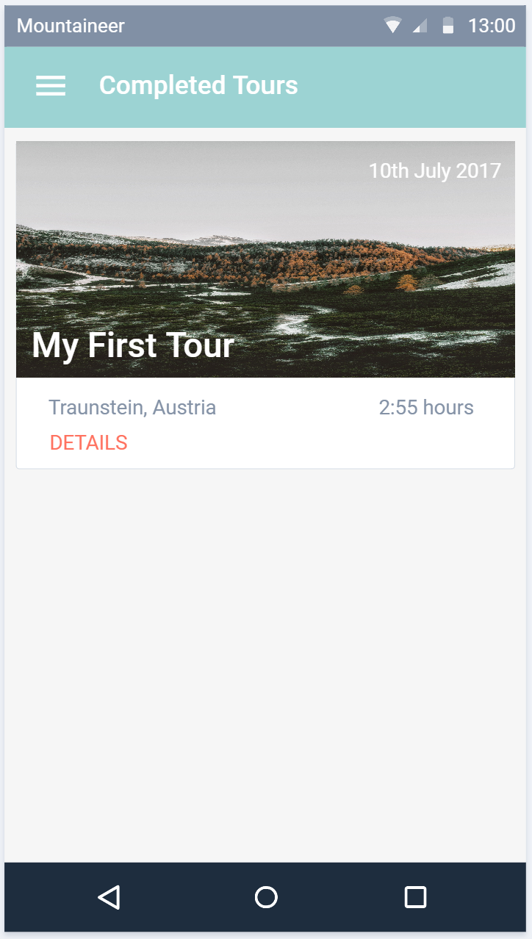
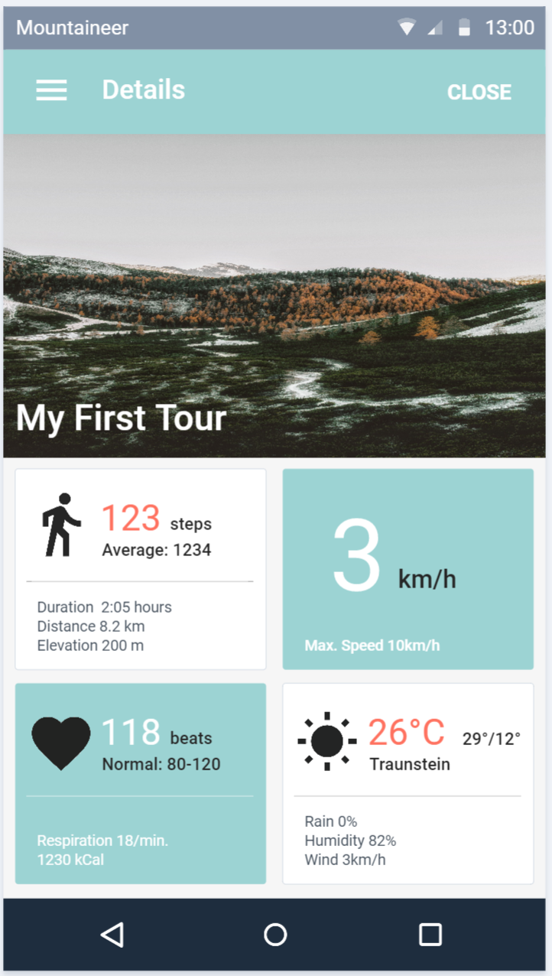
Planned Design
Subject to change without prior notice.

Slide 12
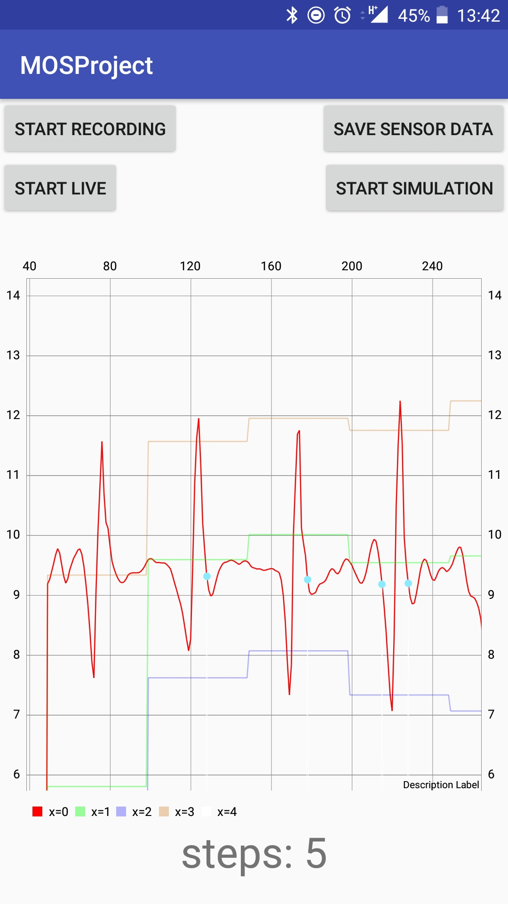
Current Status: Pedometer
Simulation + Live-View
Graph
Used for debugging and testing
Measured values
Max + Min
Threshold
Detected steps
Firebase
Running as a service

Slide 13
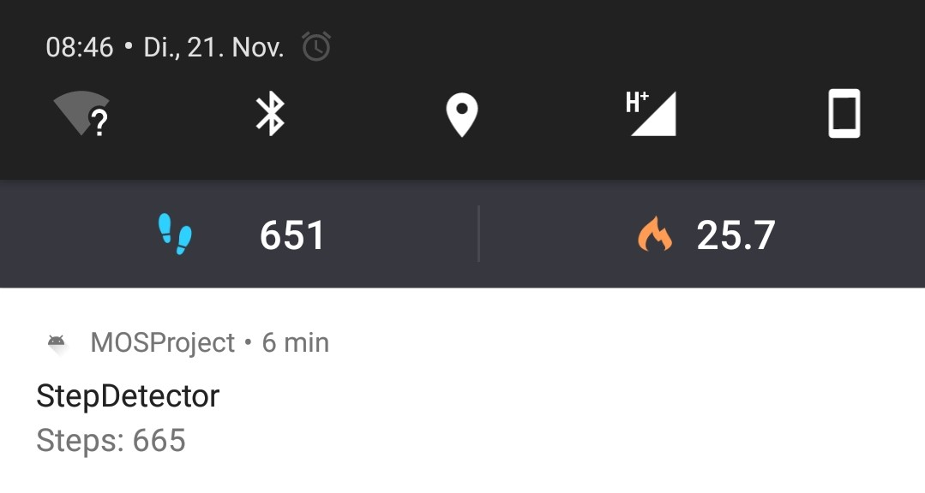

Slide 14
Thanks!

Slide 16
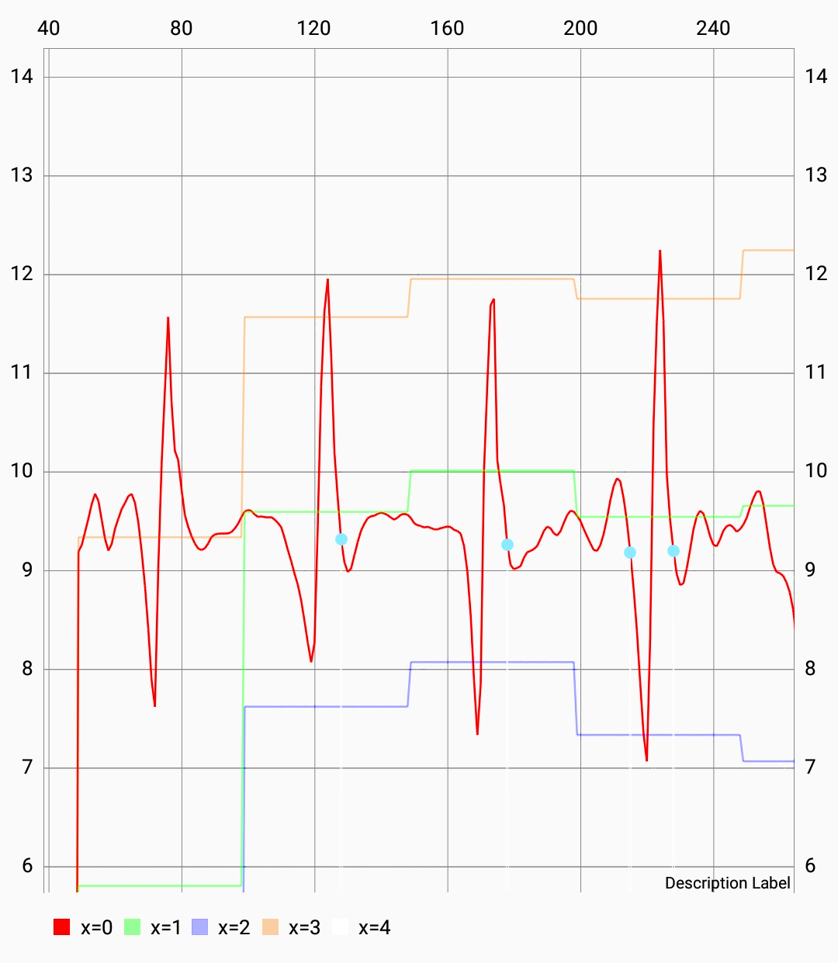
Pedometer Chart Details
Measured values
Max + Min
Threshold
Detected steps

Slide 17
