Slide 1
DATA ANALYTICS · TECHNICAL REPORT
Purchase Intent Prediction & Conversion Optimization
for a cosmetic E-Commerce Platform
Why Are Shoppers Leaving Without Buying?
Eva Sun · 02 03 2026
E-Commerce Session Analysis · Eva Sun · 2026
1 / 14

Slide 2




Who Are We Solving This For?
Pain Points
Goals
Marketing Manager
No visibility into which sessions will convert
Can't tell casual browsers from real buyers
86% of cart sessions abandon — no recovery system
Identify high-intent users in real time
Increase conversion rate
Intervene with smart product recommendations
Allocate marketing budget more efficiently
E-Commerce Cosmetic Platform
Responsible for
Conversion Rate Optimisation
Promotional Campaigns
Re-Engagement Strategy
E-Commerce Session Analysis · Eva Sun · 2026
2 / 14

Slide 3




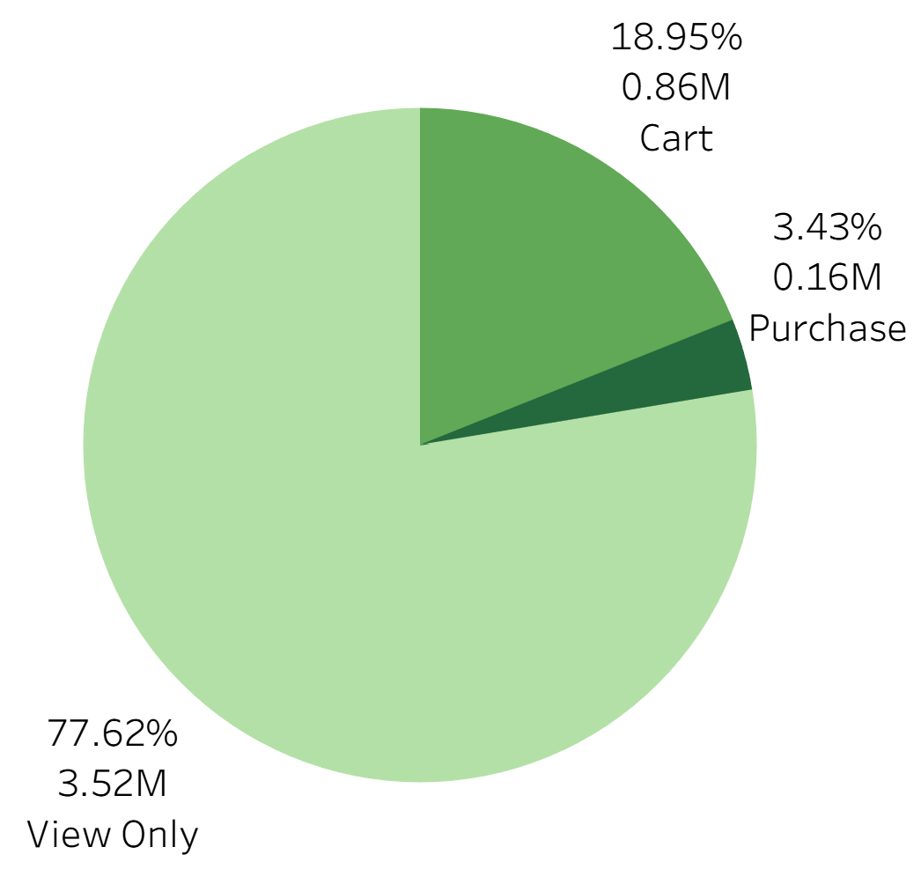
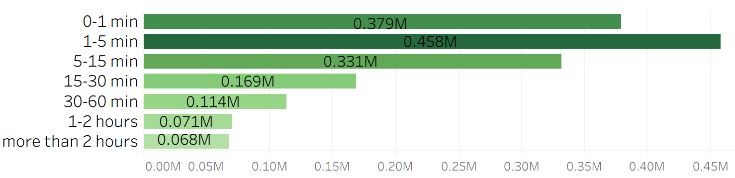
What Data Are We Working With?
Oct 2019 – Feb 2020 · Cosmetic E-Commerce · Russian Market
19.6M
4.54M
~1.3M
525
Raw Events
Unique Sessions
Unique Customers
Product Categories
What Happens in a Session?
Distribution of event types across all sessions
Product Price Range
$1.7
$13.8
$30.1
$327.8
Session Duration
10th pct
Average
90th pct
Max
E-Commerce Session Analysis · Eva Sun · 2026
3 / 14

Slide 4

THE PROBLEM
3.43%
Out of every 100 visitors,
only 3 make a purchase.
Overall Purchase Conversion Rate
= 1 person out of 100 visitors
E-Commerce Session Analysis · Eva Sun · 2026
4 / 14

Slide 5
Our Analytical Approach
5 stages from raw data to actionable recommendations
1
2
3
4
5
Data
Cleaning
Funnel
Analysis
Predictive
Model
Session
Segment.
Diagnosis &
Recommend.
E-Commerce Session Analysis · Eva Sun · 2026
5/ 14

Slide 6
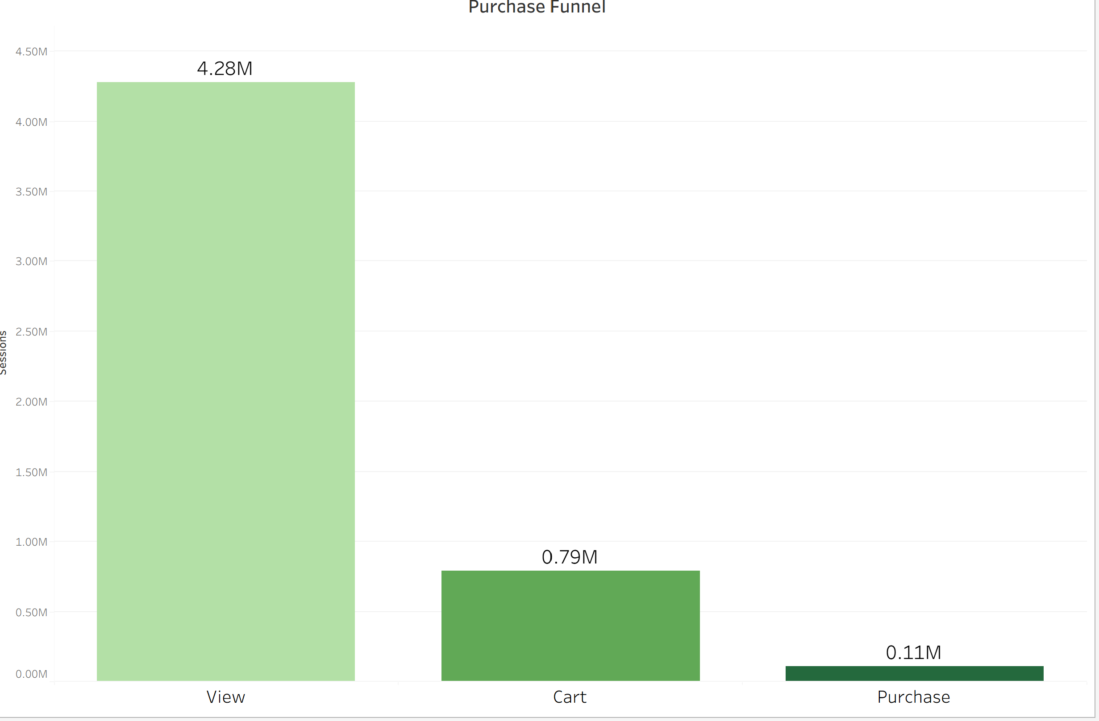
Where Does the Money Walk Out the Door?
Funnel Analysis
Drop-off 1 · View → Cart
81.6%
of visitors who browse
never add to cart
Drop-off 2 · Cart → Purchase
86.5%
18%
of shoppers who add to cart
leave without buying
E-Commerce Session Analysis · Eva Sun · 2026
6 / 14
Notes:
Model is built based on the second drop off. As when the view to cart happened, no features .
PR AUC? Balance random forest?

Slide 7
Our Analytical Approach
5 stages from raw data to actionable recommendations
1
2
3
4
5
Data
Cleaning
Funnel
Analysis
Predictive
Model
Session
Segment.
Diagnosis &
Recommend.
What We Fed Into the Model
No. of views
No. of cart
No. of remove
No. of unique products
How much they browsed
Add-to-cart count
Cart removals (hesitation)
Product variety explored
Session duration(min)
view_depth
single_view
hesitation_rate
Total time in session
Unique products per view
Only one product viewed
Removes /adds to cart
E-Commerce Session Analysis · Eva Sun · 2026
7/ 14

Slide 8
Which Model Performed Best?
We tested 3 models — here's why LightGBM wins
Logistic Regression
0.9143
0.84
0.16
Metrics Matter
ROC-AUC
Recall
Precision
ROC-AUC = 0.9764
LR (optimised)
0.9143
0.70
0.23
In 97.6% of cases, the model correctly ranks a likely buyer above a non-buyer.
Primary accuracy indicator: how well the model separates the two groups.
ROC-AUC
Recall
Precision
Random Forest
0.9029
0.45
0.48
Recall = 0.99 ✓ Priority
ROC-AUC
Recall
Precision
99% of real buyers are identified.
Catch as many as possible
LightGBM ★ FINAL
0.9764
0.99
0.21
ROC-AUC
Recall
Precision
Precision = 0.21 — Intentionally Low
Show recommendations on-screen, not paid ads — extra recommendations cost us almost nothing
E-Commerce Session Analysis · Eva Sun · 2026
8 / 14

Slide 9
Not All Shoppers Are Equal
Segmenting 4.5M sessions by predicted purchase probability
LOW INTENT
MEDIUM INTENT
HIGH INTENT
conversion rate
conversion rate
conversion rate
0.002%
2.1%
31.1%
3,338k sessions
737k sessions
450 k sessions
Casual browsers
Interested
Ready to buy — 45× more likely than Low Intent
312k sessions
High Intent · did not purchase
E-Commerce Session Analysis · Eva Sun · 2026
9 / 14

Slide 10
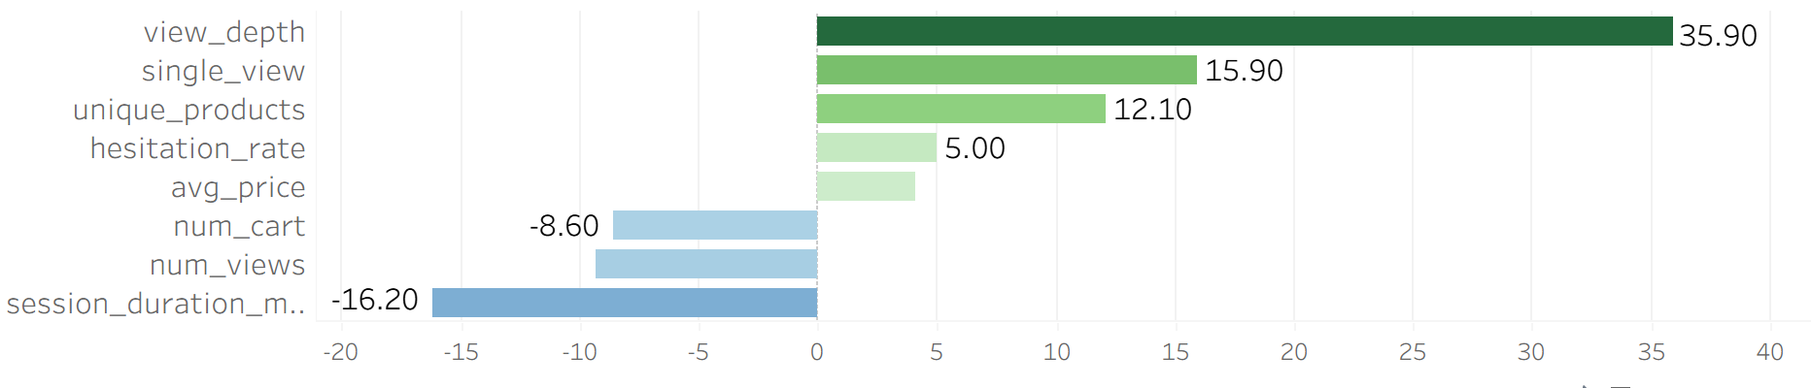
Why Did High-Intent Shoppers Still Leave?
Comparing converted vs non-converted High Intent sessions
Low Browsing Depth 35.9%
Behavioural Diagnosis
Non-converting shoppers browse fewer unique products per click. They see less of the catalogue — and buy nothing.
Session Too Long 16.2%
Non-converting sessions are 16% longer — they scroll aimlessly, not purposefully.
Buyers Pay More 4.1% 💡
Converting users spend more per product. Price isn't the barrier — confidence is. Don't recommend cheaper products!
E-Commerce Session Analysis · Eva Sun · 2026
10 / 14

Slide 11
Our Solution: Smart Recommendations
0
Find sessions that are High Intent but did NOT convert
312k sessions
High Intent · did not purchase
1
Identify Cart Categories
Find all category from products added to cart in this session
2
Find Unseen Products
Retrieve top-selling products in those categories not yet viewed
3
3
Rank by Popularity
Sort by historical purchase count — platform-wide bestsellers first
4
Surface Top 3 per Category
4
Show at most 3 new products per category = personalised & relevant
E-Commerce Session Analysis · Eva Sun · 2026
11 / 14

Slide 12
What We Recommend Doing
Four evidence-based actions to recover lost conversions
01
Surface Unseen Products in Cart Categories
02
Push Broader Discovery, Not Cheaper Alternatives
Evidence: view_depth 35.9% lower in non-converting group
Evidence: Converted users pay 4.1% MORE on average
show top-selling products in the same categories that haven't been viewed yet
increase exploration depth.
Do NOT recommend cheaper substitutes.
Recommend more products in the same price range
→ Increase exploration depth and purchase confidence
→ Protect and grow average order value
03
Surface Goal-Oriented Product Lists
04
In-Page Nudge for Repeat Product Views
Evidence: Non-converting sessions are 16.2% longer — aimless browsing
Evidence: Same product viewed 2+ times without adding to cart
Show 'Complete the Look' or category bestseller.
Shorten the path to purchase.
Trigger a subtle in-page nudge with a direct purchase CTA after 2+ views of the same product.
→ Reduce aimless browsing, increase conversion speed
→ Convert high-interest sessions without price incentive
E-Commerce Session Analysis · Eva Sun · 2026
12 / 14

Slide 13

What We Were Working Around
42.2% of Brand Data is Missing
HONESTY
MATTERS
Over 8 million events have no brand recorded. This prevents brand-aware recommendations — a critical gap in a professional beauty market where practitioners are extremely brand-loyal. A shopper choosing MAC may not want substitutes from other brands.
Every analysis has limits.
Here's what we couldn't do
— and what we need next.
Category Names Not Available
98% of category_code values are blank. We work with numeric category IDs only — meaning we can't show users readable labels like 'Foundation' or 'Skincare'. A lookup table from the product team would immediately improve the recommendation interface.
No Cross-Session or Demographic Data
We only see one session at a time. We don't know the user's history, device, traffic source, or demographics — no personalisation beyond this visit.
E-Commerce Session Analysis · Eva Sun · 2026
13 / 14

Slide 14
BEFORE
AFTER
3
More
buyers per 100 visitors
buyers per 100 visitors
We know why they're leaving.
We know how to bring them back.
97.6% model accuracy
356K high-intent sessions to recover
Near-zero cost per recommendation
Eva Sun · February 2026 · E-Commerce Session Analysis

