Slide 1
Analysis of the popularity of reddit posts
By: Eva Tarr and Kyle Krawec
Notes:
Today we will be presenting the analysis we have done concerning popularity of reddit posts. Specifically, what makes a post popular and can we compartmentalize what makes something popular on social media sites.

Slide 2
Definitions
Popularity
In the terms of this study, we will be defining popularity as the number of likes on a particular post or comment. The greater the number of likes the greater the popularity.
Reddit
Reddit is a social media platform where users can post texts, images and videos.
Sentiment
Sentiment of a post is the attributed emotional tone or attitude that is expressed by the author in the post. It determines if the post has a positive, neutral, or negative sentiment.
Notes:
To start off we will first define some of the terms we will be using throughout this presentation.
When talking about popularity within a digital space we quantify this based on the number of likes a post of comment receive.
All our tests will be done using data from the social media site Reddit, Reddit is a platform that users can post text, images and videos to. For the sake of this analysis, we only looked at text posts due to data constraints.
Sentiment, as we will be discussing it, refers to the tone or attitude associated with a certain comment. We will outline how this was achieved in each instance.

Slide 3
Main Research Questions:
Does the sentiment of a comment result in greater popularity?
Does the number of words in a comment result in greater popularity?
Do post who have more comments become more popular?
Does the time of creation of a post effect its popularity?
Does the number of comments on a post influence its popularity?
Notes:
The main research questions we had were:
Does the sentiment of a comment result in greater popularity?
Does the number of words in a comment result in greater popularity?
Do more popular posts have more comments?
Does the time of creation of a post effect its popularity?
Does the number of comments on a post influence its popularity?

Slide 4

Data Sets
SocailGrep (https://socialgrep.com/datasets)
NoNewNormal dataset on Reddit
Comments on the now banned subreddit /r/NoNewNormal
One year of Doge on Reddit
All varied mentions of the term “Doge” on reddit
June 2022 Bitcoin on Reddit
Comments on the /r/Bitcoin subreddit
2022 Freedom Convoy on Reddit
Comments on the /r/Ottawa subreddit
Notes:
All data was extracted from an open-source database called SocialGrep.
The data we had access to was limited but it came formatted in csv files that we were able to read and manipulate.
The time of extraction for each of these also varies but the majority is 2022 data.

Slide 5



Methods
Python
pandas
Used for file reading and data manipulation
Matplotlib
Used for all graphing purposes

Slide 6
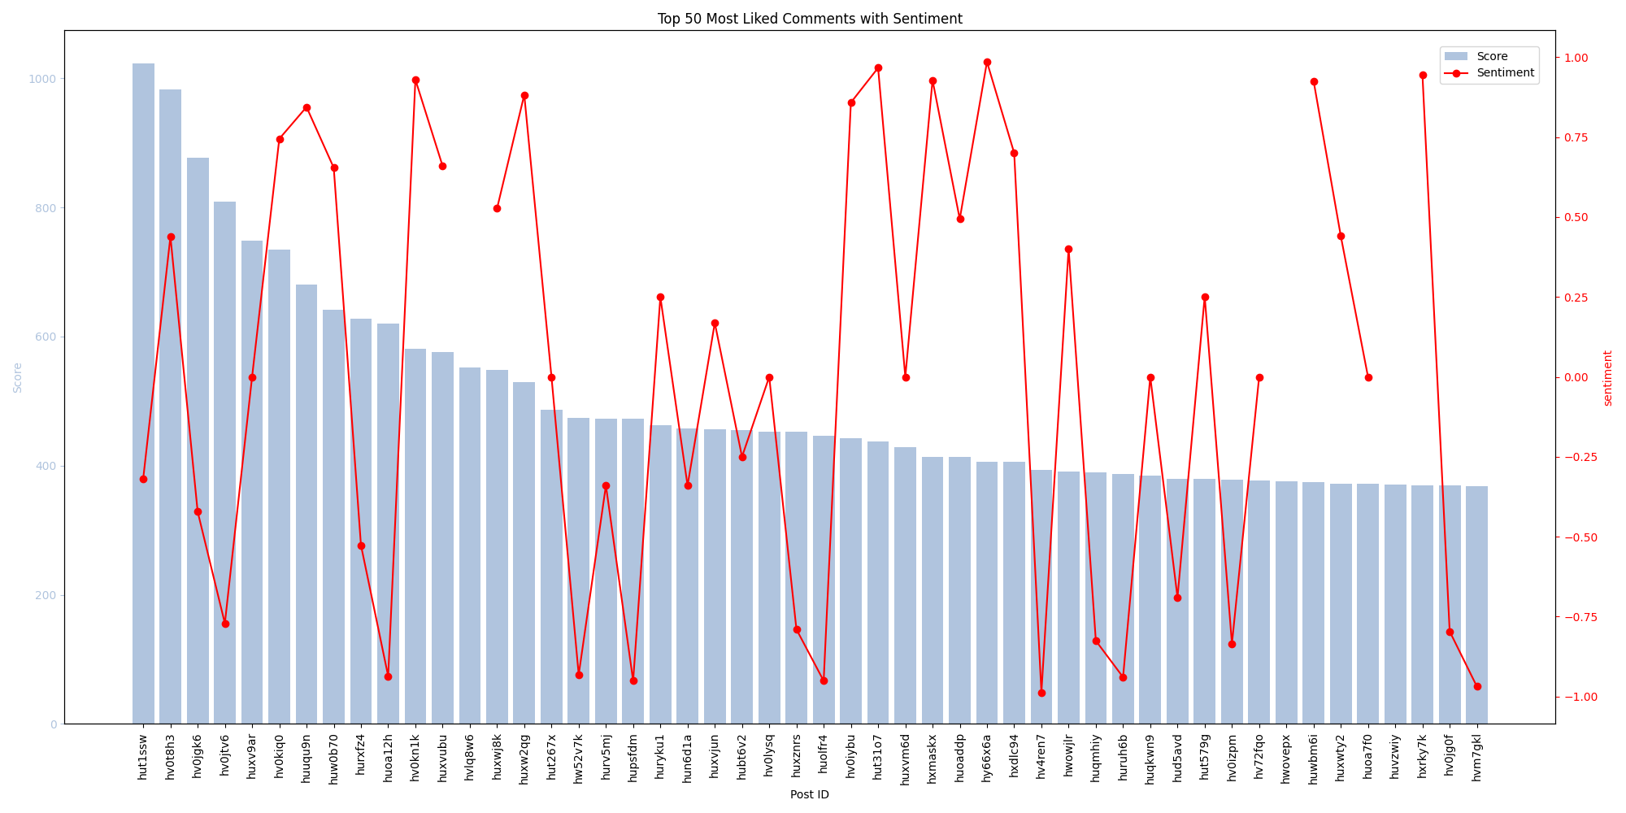
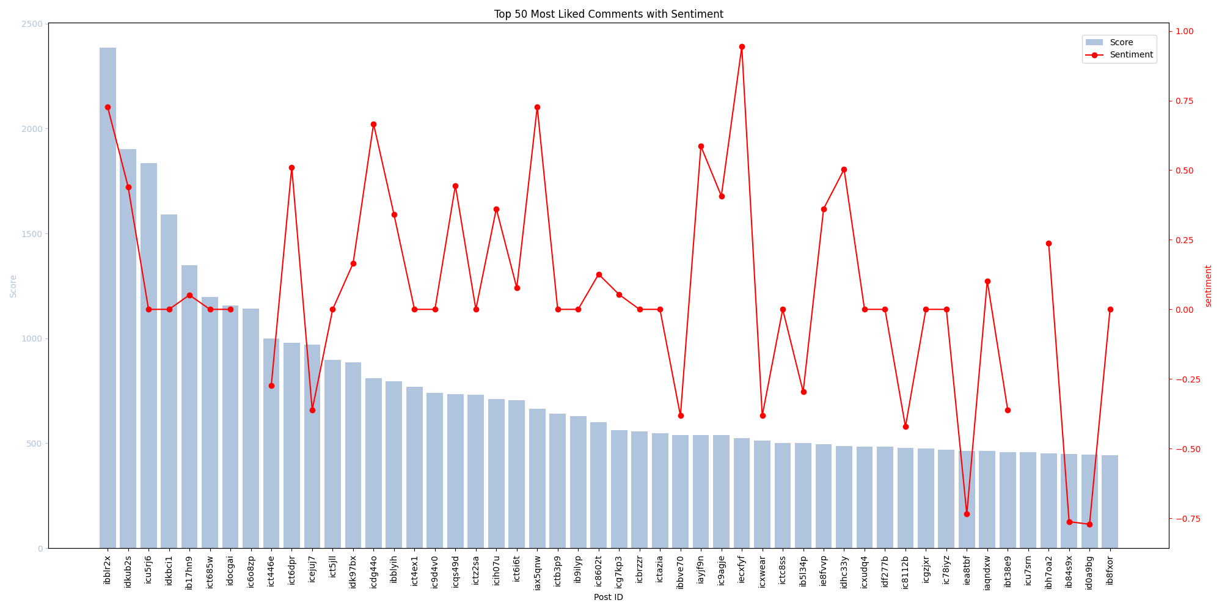
Popularity and Sentiment
Popularity of a comment and the sentiment attached to it does not have a strong correlation. Contrary to our thesis.
Graph 1 shows the most popular comments made on a Freedom Convoy subreddit and its sentiment.
Graph 2 shows the most popular comments made on a Bitcoin subreddit and its sentiment.
Correlation coefficient =
Notes:
The first set of analysis done was to try and see if there was a correlation with sentiment of a comment and its popularity.
We hypothesized that this would result with negative sentiment correlating with higher popularity.
After running the tests and performing correlation analysis we were surprised to see that across multiple data sets sentiment did not have any correlation to the popularity of the comments.
This is modeled in the two graphs provided. Both are given a data set of comments and the top 50 are shown with their sentiments displayed on the red lines.
In both cases there was no correlation with the popularity of a post.

Slide 7
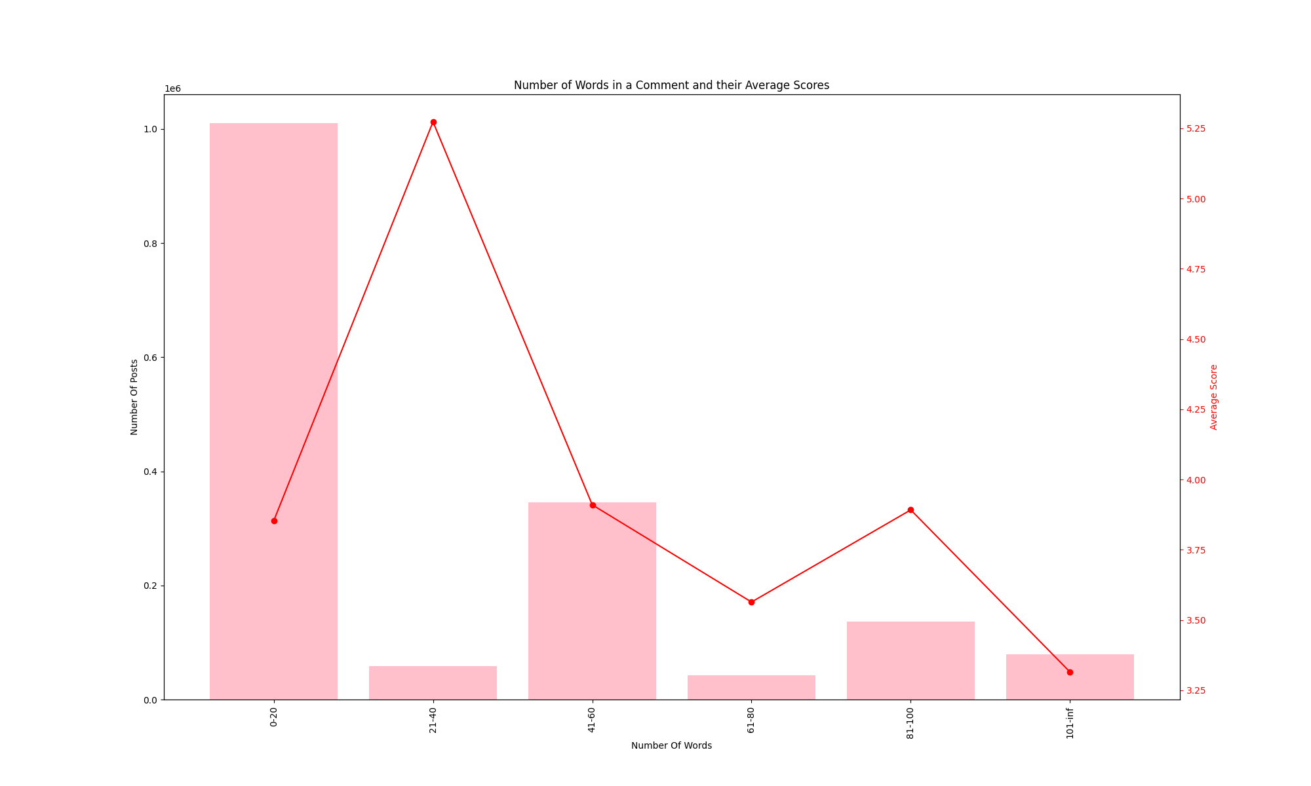
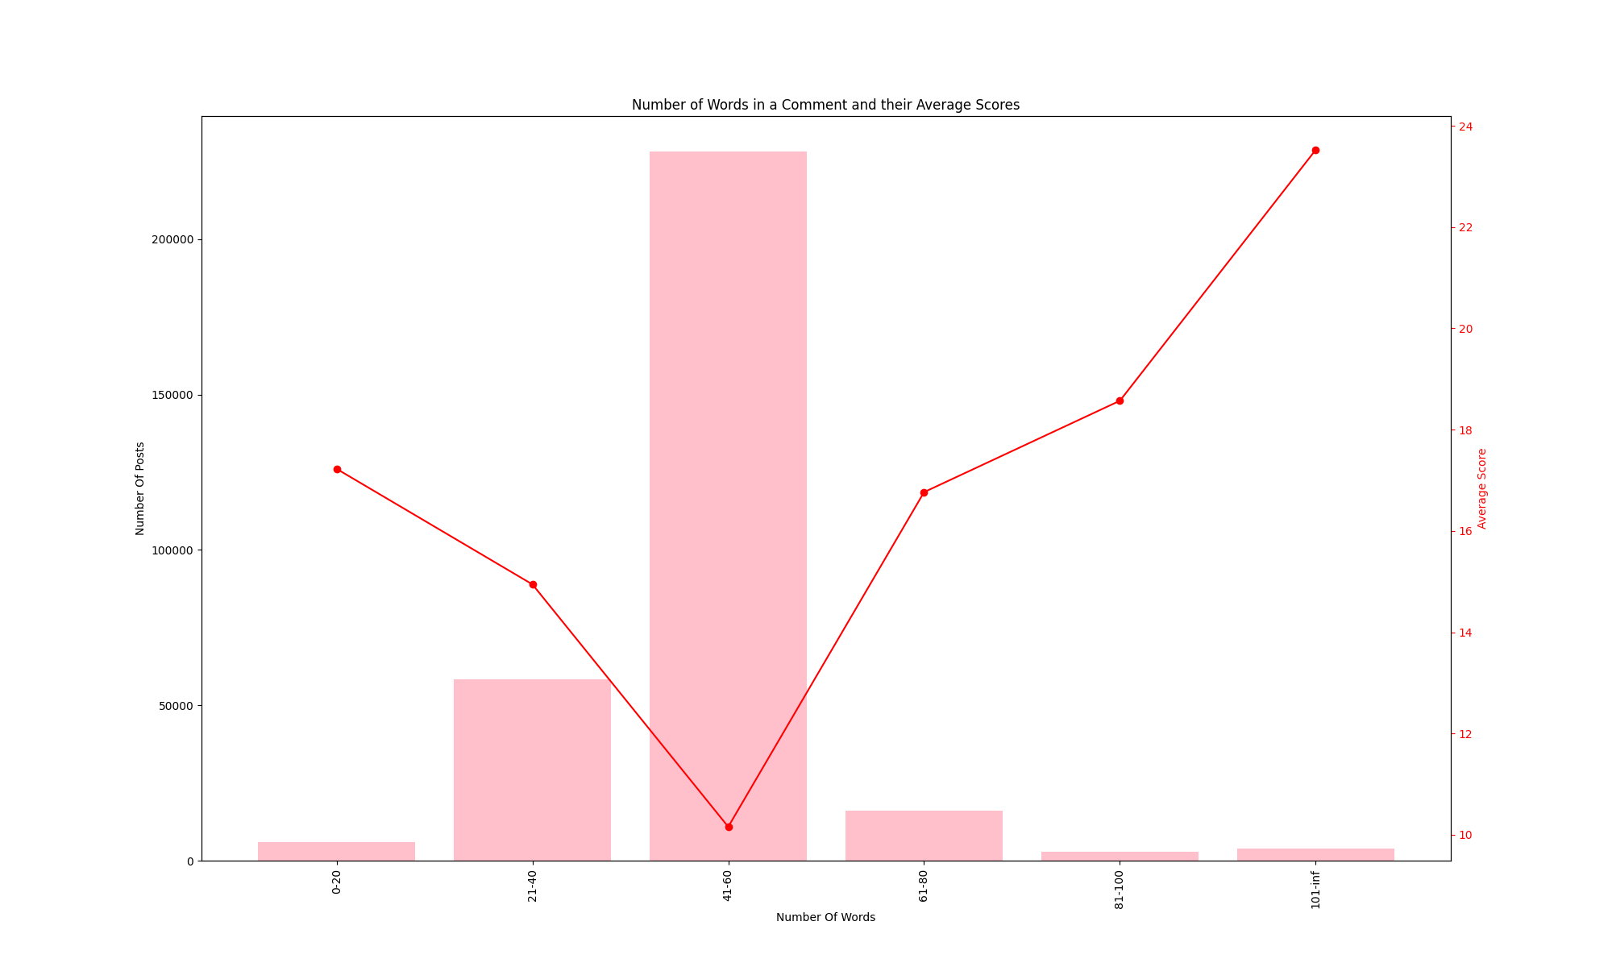
Popularity and Word count
Popularity of a comment and the number of words in the comment has an interesting trend. The number of words in a comment is generally centralized. The score varies.
Graph 1 displays the average scores for all the posts from Doge comments.
Graph 2 displays the average scores for all posts from Freedom Convoy comments
Correlation coefficient =
Notes:
The second set of analysis done pertained to word count and popularity.
We hypothesized that this would result in shorter comments having on average a higher score.
Surprisingly, this was not the case, but an interesting trend did emerge.
Although the average scores did not correlate to a certain length of post, we did notice in all datasets of this analysis that one length subset dominated the others.
This could arguably be a case of social conformity, users on the same subreddit see others creating a certain length post and the rest follow creating a larger subset of posts with this length of comment.

Slide 8
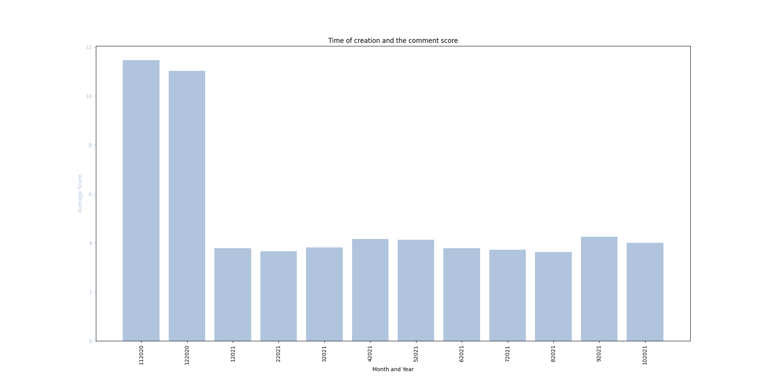
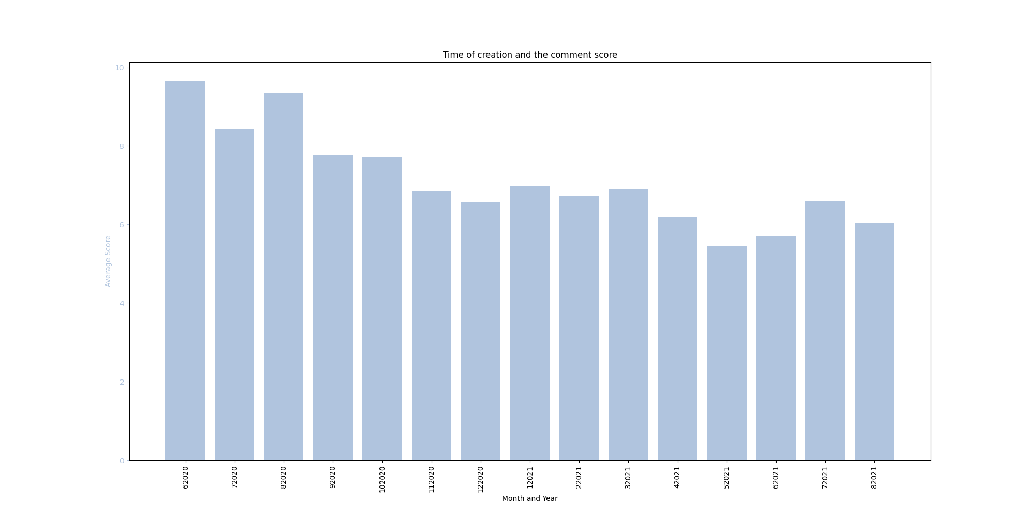
Popularity and Creation Time (Monthly)
Popularity of a comments over time shows a trend that follows our hypothesis. The number of average likes in a subreddit tends to decreased overtime.
Graph 1 Doge comments over the span on one year.
Graph 2 NoNewNormal comments over the span of 15 months.
Correlation Coefficient =
Notes:
The next set of analysis done as based on the creation time of a post and its popularity.
We hypothesized that over time the popularity of a topic would steadily decrease.
Our analysis supports this claim, as we can see based on two different data sets.
One containing all comments made that contain the word “Doge” and all the comments on the NoNewNormal subreddit. In both cases we see a downward trend with the average scores ofall posts in each month.

Slide 9
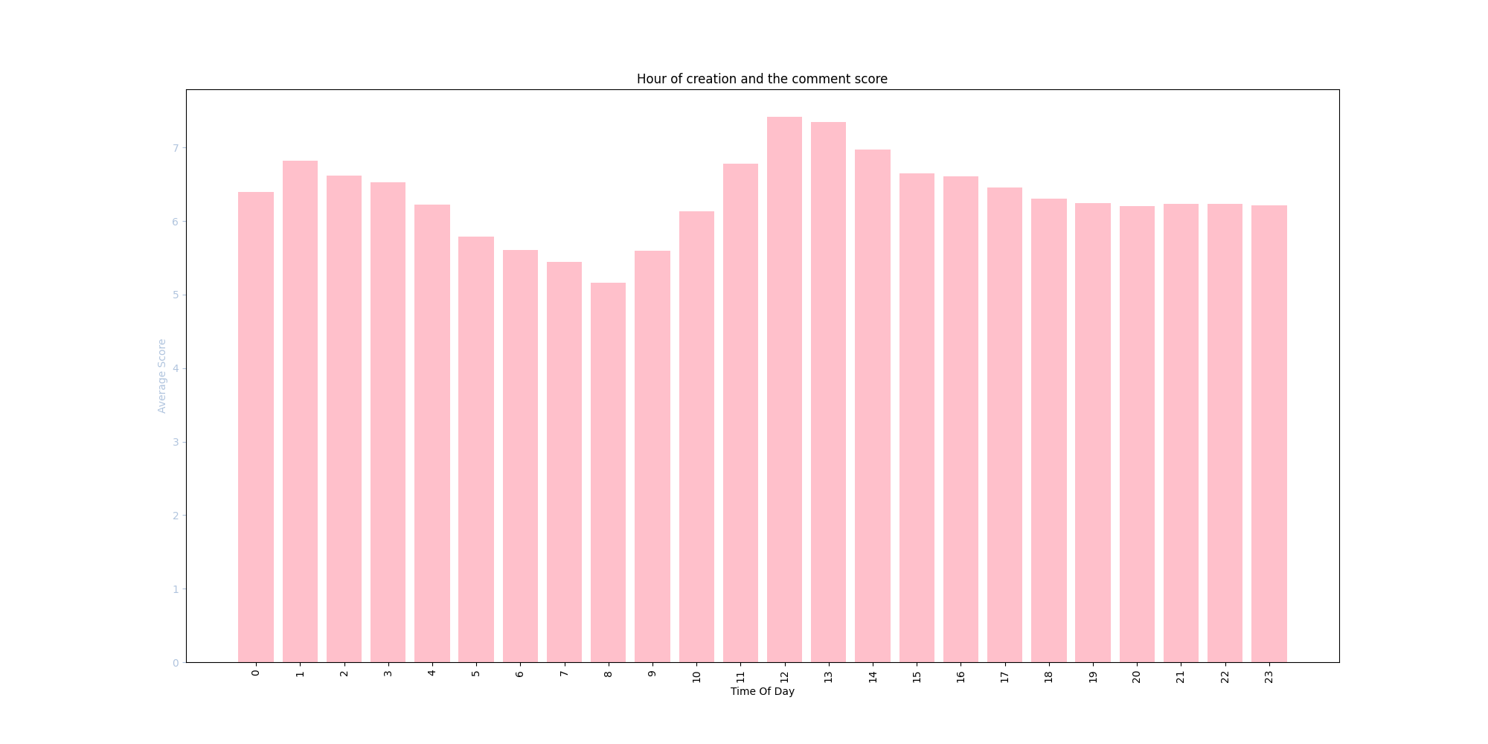
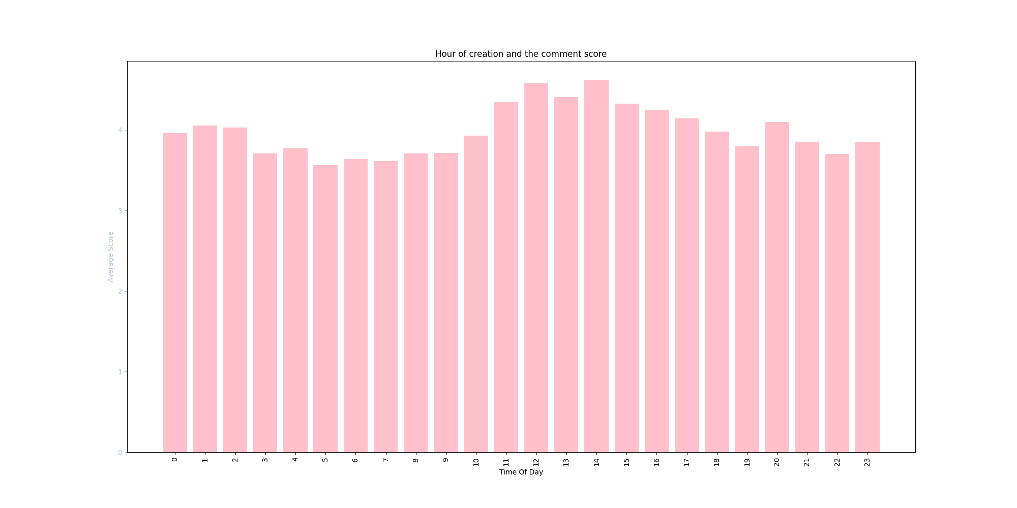
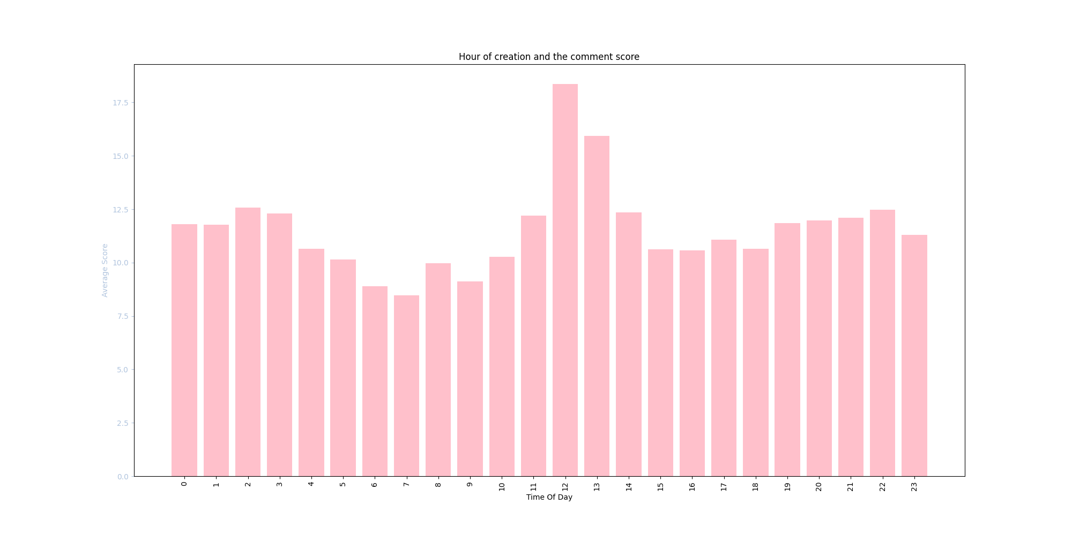
Popularity and Creation Time (Daily)
Popularity of a comment and the time of day in which it is posted has a very similar trend across multiple subreddits. Peak hours all falling around 12 while valleys occur around 8 and 16.
Graph 1 NoNewNormal subreddit and all its comment creation times vs average score.
Graph 2 Doge subreddit and all its comment creation times vs average score.
Graph 3 Trucker subreddit and all its comment creation times vs average score.
Correlation Coefficient =
Notes:
Aside from just the overall change in popularity over time we wanted to see if the time of day a comment was made would affect its popularity. We hypothesized that there would be a trend in which the most popular house would be between work hours, mornings, breaks and after work.
The analysis done on multiple datasets came back to support out hypothesis. As we can see there is an obvious trend with popularity and time of day. We can see that comments made in the early morning, noon, and evenings, on average, do better than those posted during the normal work hours, 8-11 and 1-6.

Slide 10
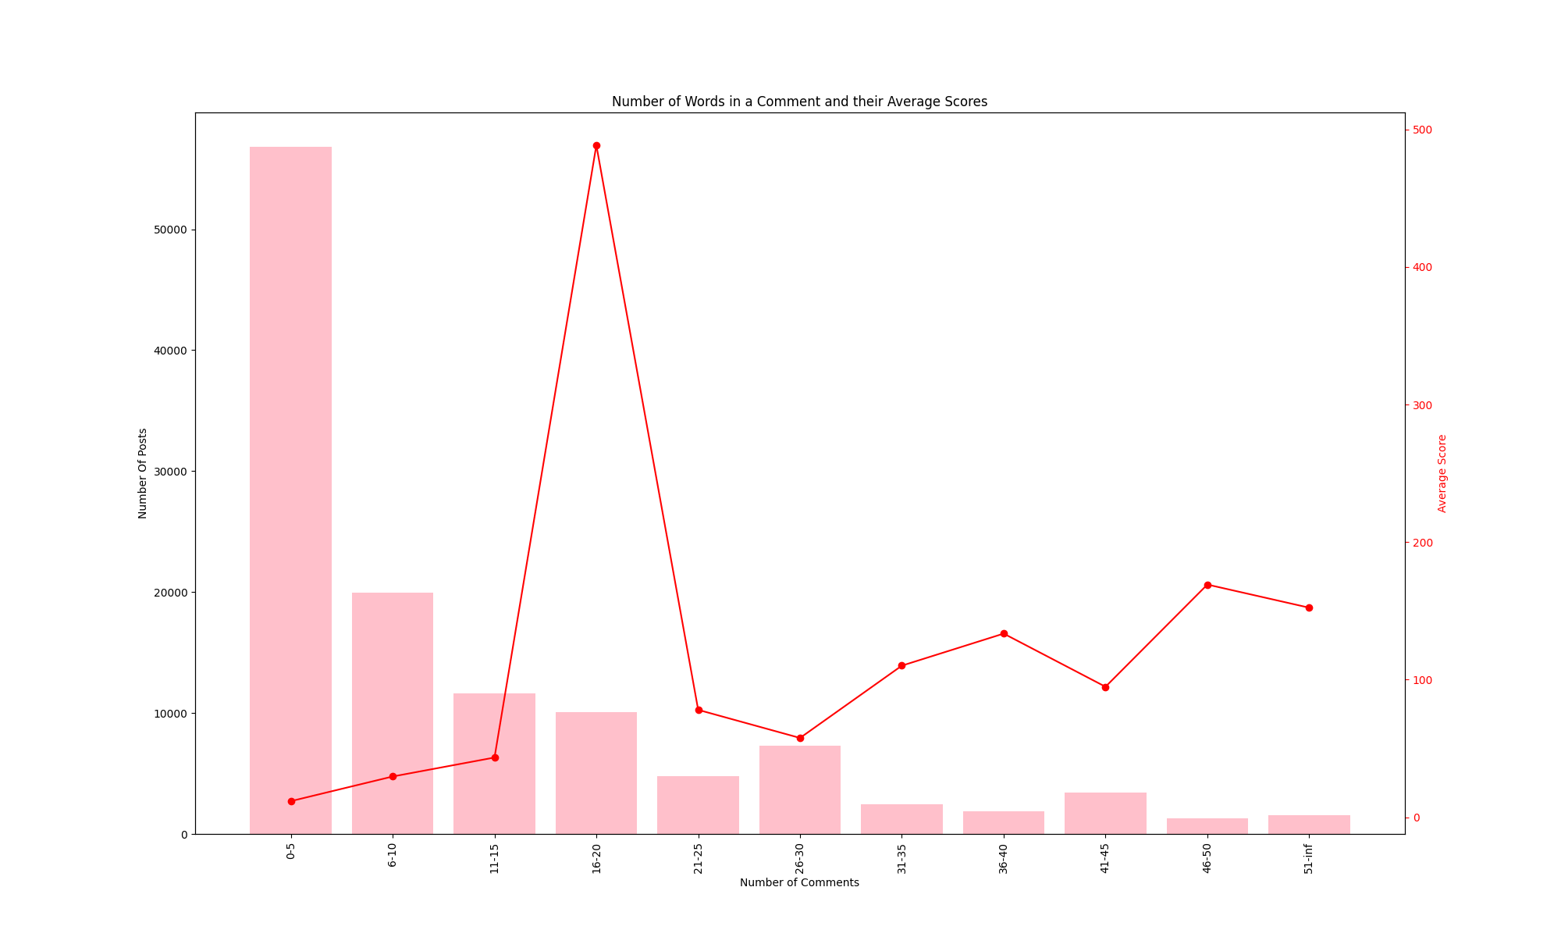
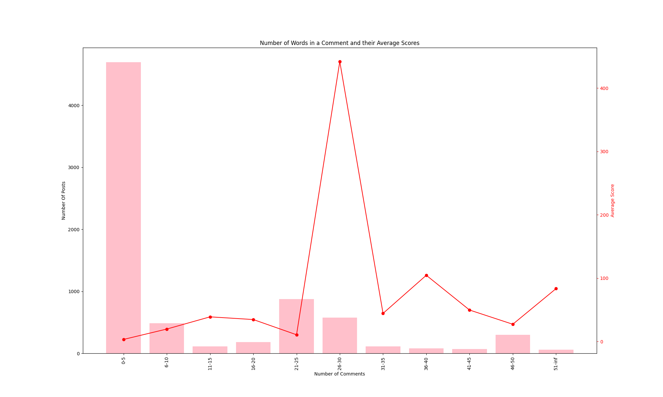
Popularity and Comments
Popularity of a post and the number of comments did not follow what we had initial hypothesized. There was an interesting trend of popularity though that showed up generality of what length is most well liked.
Graph 1 NoNewNormal posts with their respective comments and the average score.
Graph 2 BitCoin posts with their respective comments and the average score.
Correlation Coefficient =

Slide 11

Conclusions
Popularity and Sentiment
No correlation
Popularity and Word Count
No correlation
Found a trend pertaining to social conformity
Popularity and Creation Time (Month)
Over time the average popularity of a topic has a downward trend.
Popularity and Creation Time (Daily)
Time of creation remain relatively consistent in what will gain greater popularity.
Popularity and Comments
Found a trend pertaining to the most liked posts on average are the ones that are “medium” length.

Slide 12
Challenges and Further Research
Data sets
Larger data sets would yield better results
More data sets across more diverse subreddits

Slide 13
Questions?

