Slide 1
Analysis of the popularity of reddit posts
By: Eva Tarr and Kyle Krawec

Slide 2
Definitions
Popularity
In the terms of this study, we will be defining popularity as the number of likes on a particular post. The greater the number of likes the greater the popularity of a post is.
Reddit
Reddit is a social media platform where users can post texts, images and videos.
Sentiment
Sentiment of a post is the attributed emotional tone or attitude that is expressed by the author in the post. It determines if the post has a positive, neutral, or negative sentiment.

Slide 3
Data Sets
SocailGrep (https://socialgrep.com/datasets)
NoNewNormal dataset on Reddit
Comments on the now banned subreddit /r/NoNewNormal
One year of Doge on Reddit
All varied mentions of the term “Doge” on reddit
June 2022 Bitcoin on Reddit
Comments on the /r/Bitcoin subreddit
2022 Freedom Convoy on Reddit
Comments on the /r/Ottawa subreddit
Notes:
Formatted CVS files that contain reddit information

Slide 4
Main Research Questions:
Does the sentiment of a comment result in greater popularity?
Does the number of words in a comment result in greater popularity?
Do more popular post have more comments?
Does the time of creation of a post effect its popularity?
Monthly basis
Daily basis

Slide 5
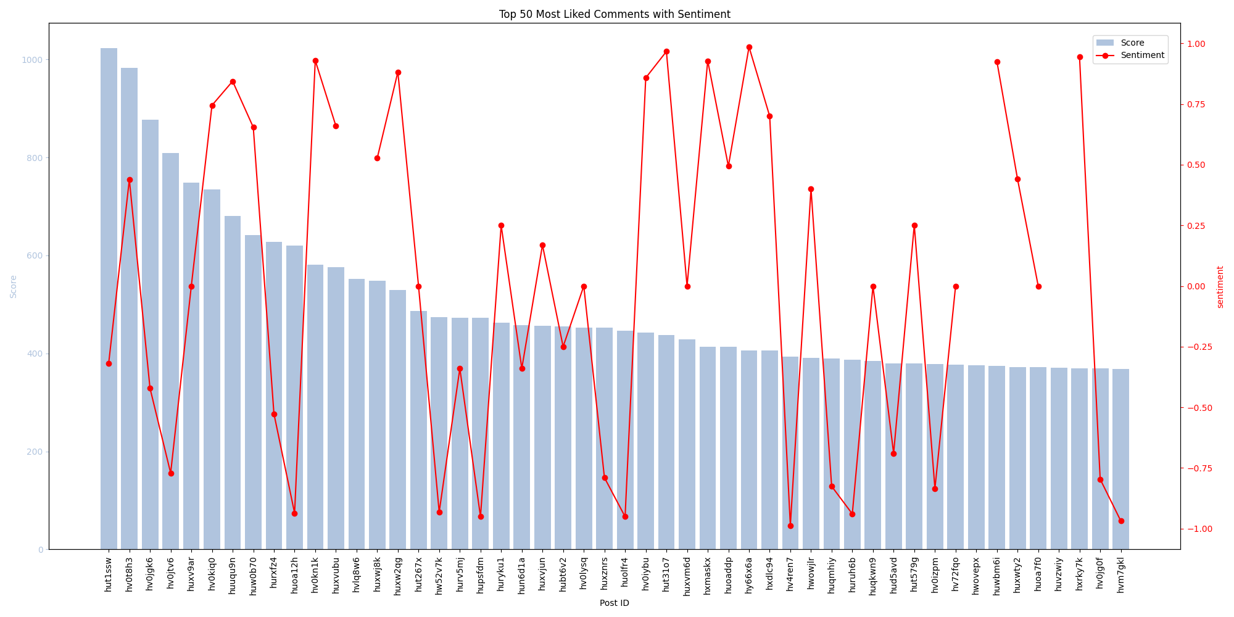
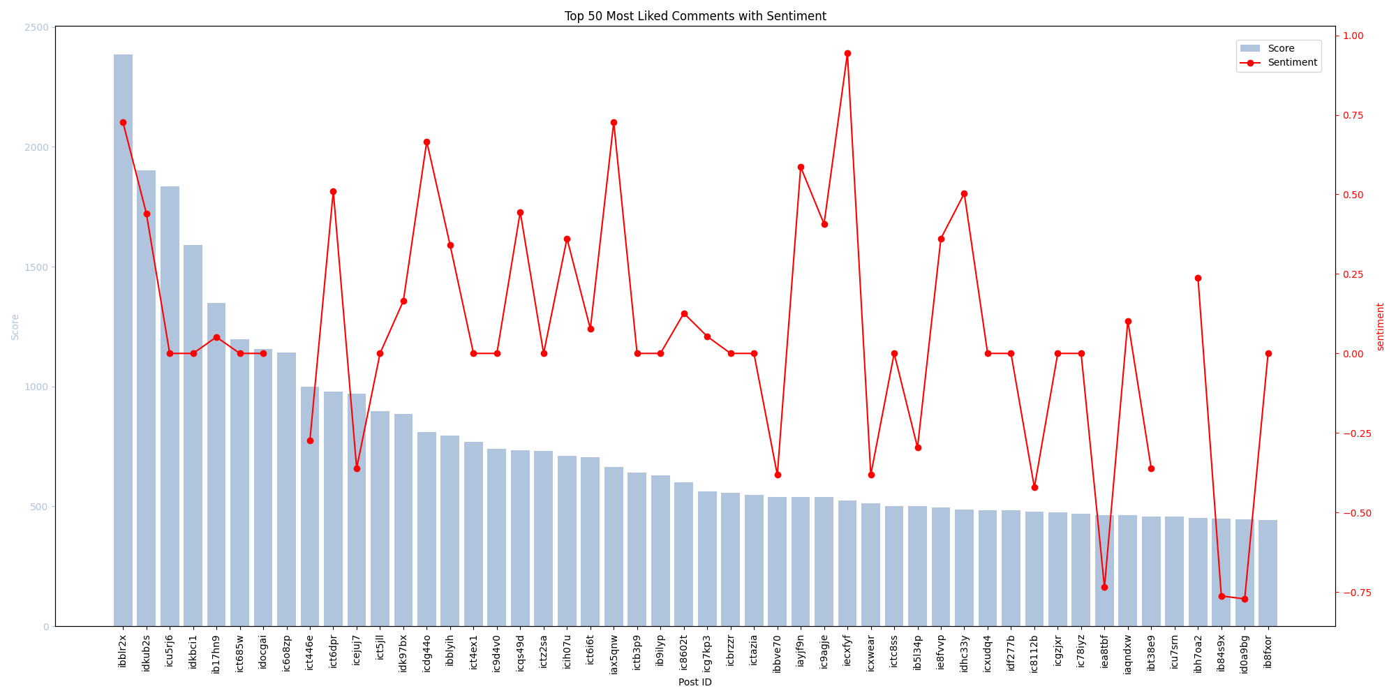
Popularity and Sentiment
Popularity of a comment and the sentiment attached to it does not have a strong correlation. Contrary to our thesis.
Graph 1 shows the most popular comments made on a Freedom Convoy subreddit and its sentiment.
Graph 2 shows the most popular comments made on a Bitcoin subreddit and its sentiment.
Both have 0 correlation coefficients. (KYLE)

Slide 6
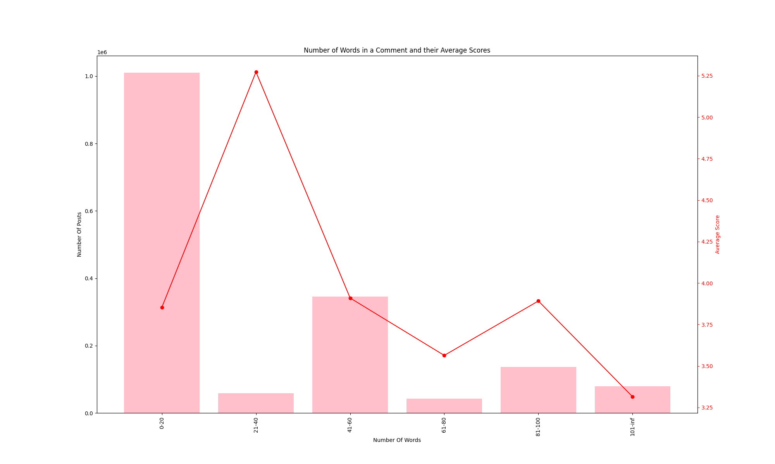
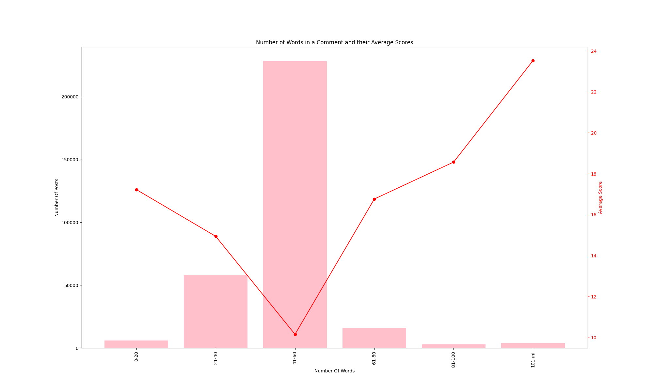
Popularity and Word count
Popularity of a comment and the number of words in the comment has an interesting trend. The number of words in a comment is generally centralized. The score varies.
Graph 1 displays the average scores for all the posts from Doge comments.
Graph 2 displays the average scores for all posts from Freedom Convoy comments
Correlation coefficient (KYLE)

Slide 7
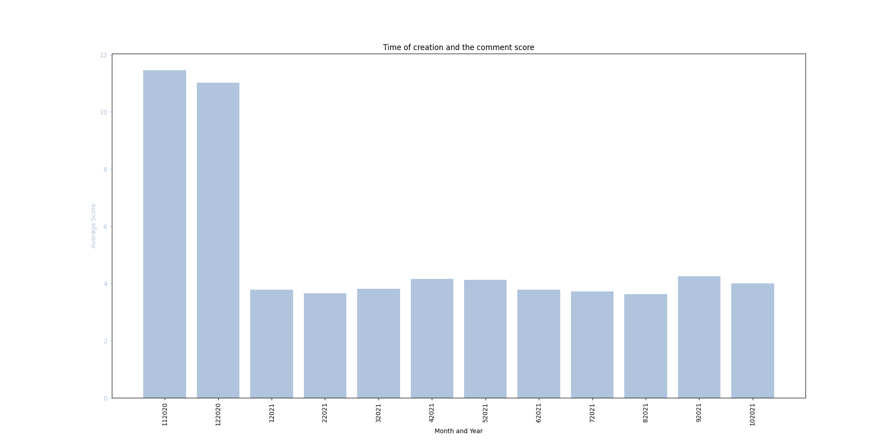
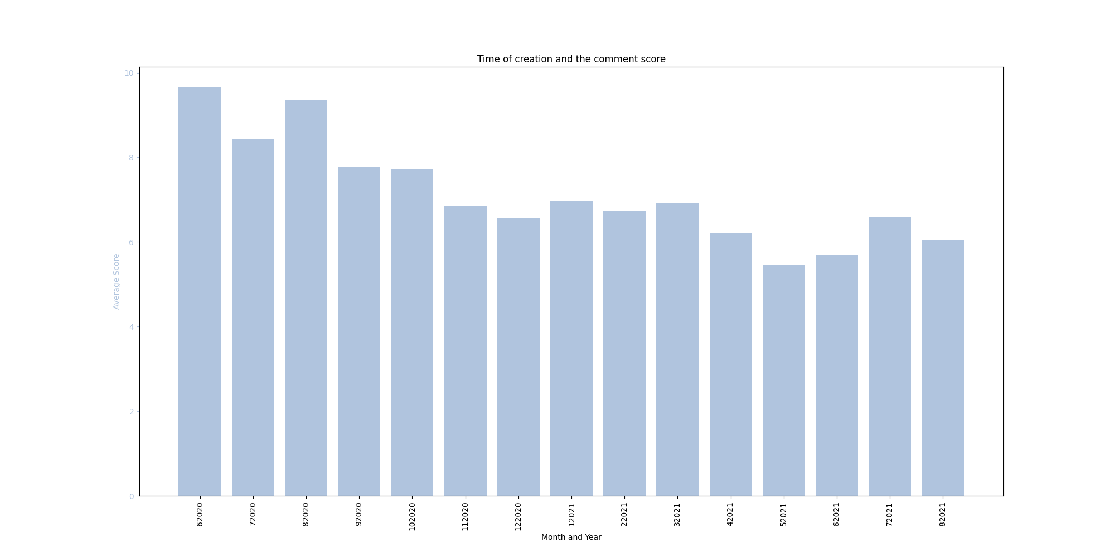
Popularity and Creation Time (month)
Popularity of a comments over time shows a trend that follows our hypothesis. The number of average likes in a subreddit tends to decreased overtime.
Graph 1 Doge comments over the span on one year.
Graph 2 NoNewNormal comments over the span of 15 months.

Slide 8
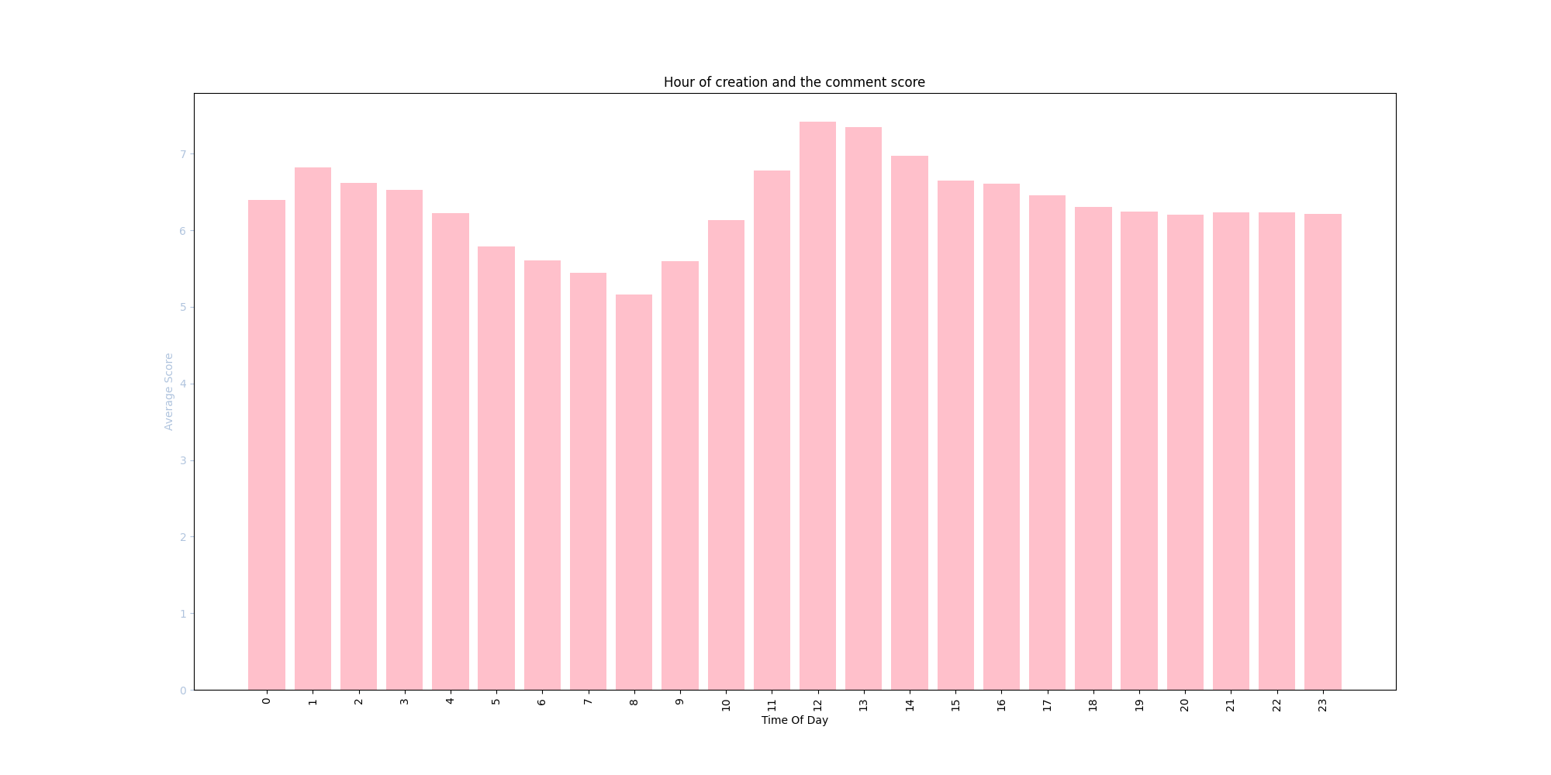
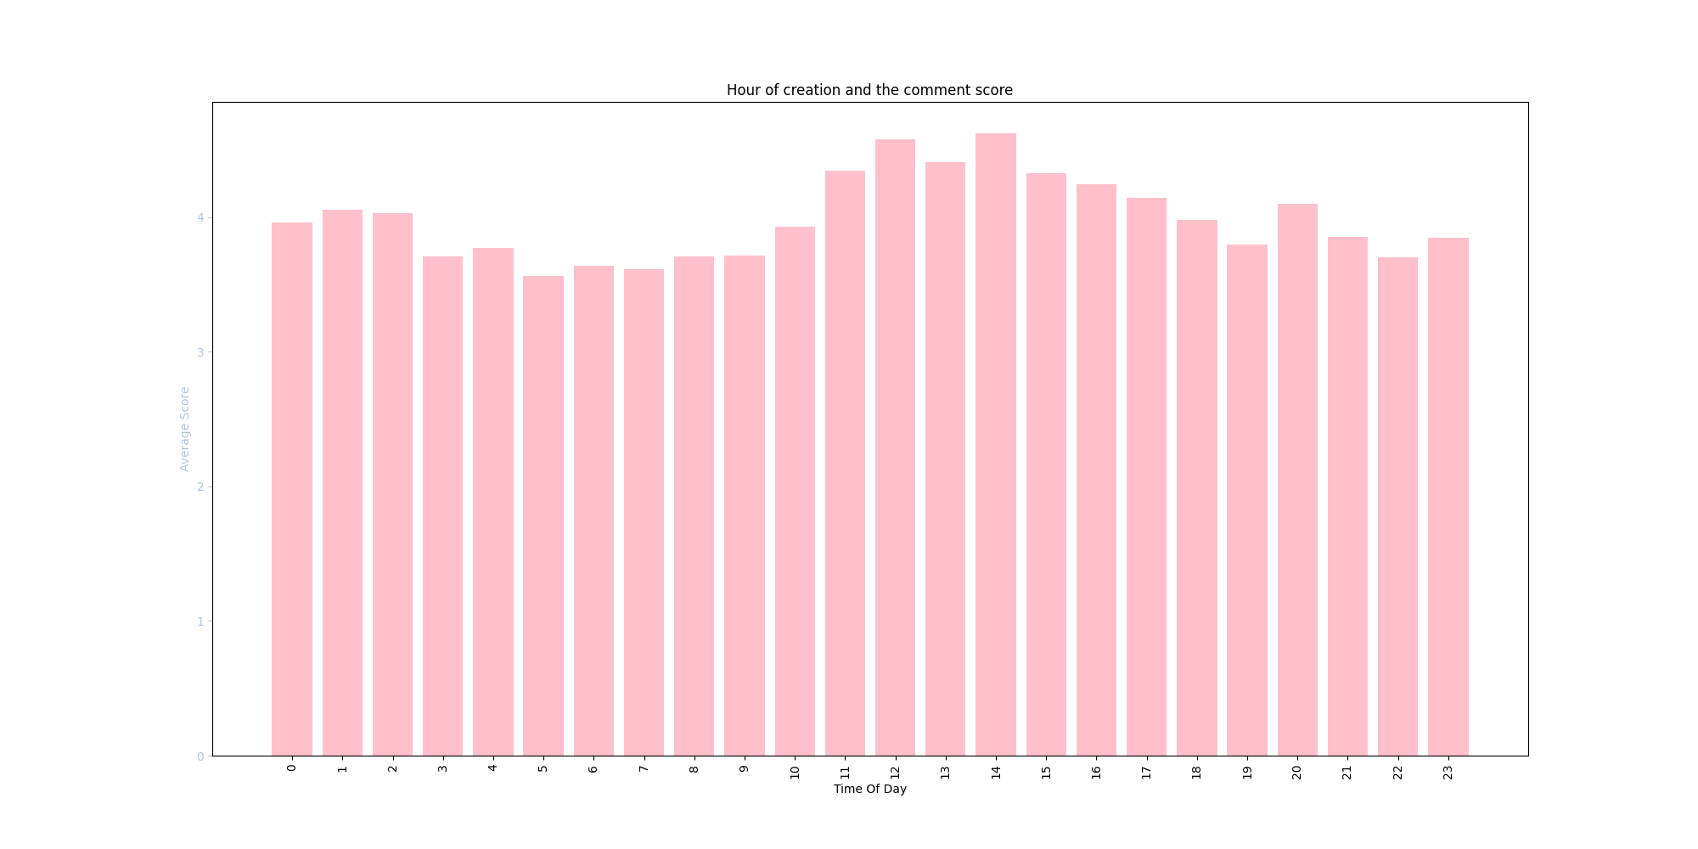
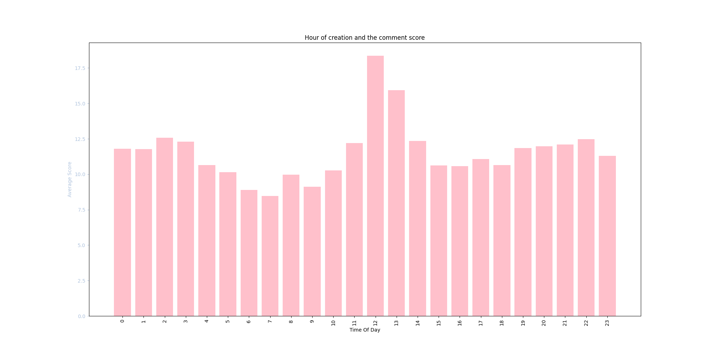
Popularity and Creation Time (daily)
Popularity of a comment and the time of day in which it is posted has a very similar trend across multiple subreddits. Peak hours all falling around 12 while valleys occur around 8 and 16.
Graph 1 NoNewNormal subreddit and all its comment creation times vs average score.
Graph 2 Doge subreddit and all its comment creation times vs average score.
Graph 3 Trucker subreddit and all its comment creation times vs average score.

Slide 9
Popularity and Connectivity
Number of likes and the number of comments comparison.

Slide 10
Conclusions

Slide 11
Challenges and Further Research
Data sets and their length
Larger data sets would yield better analysis
Tools used and computational resources

Slide 12
Questions?

