Slide 1
Analysis of the virality of reddit posts
By: Kyle Krawec and Eva Tarr

Slide 2
Definitions
Popularity
In the terms of this study, we will be defining popularity as the number of likes on a particular post. The greater the number of likes the greater the popularity of a post is.
Reddit
Reddit is a social media platform where users can post texts, images and videos.
Sentiment
Sentiment of a post is the attributed emotional tone or attitude that is expressed by the author in the post. It determines if the post has a positive, neutral, or negative sentiment.

Slide 3
Data Sets
SocailGrep
List all data sets used here

Slide 4
Main Research Questions:
Does the sentiment of a comment result in greater popularity?
Does the number of words in a comment result in greater popularity?
Do more popular post have more comments?
Does the time of creation of a post effect its popularity?
Monthly basis
Daily basis

Slide 5
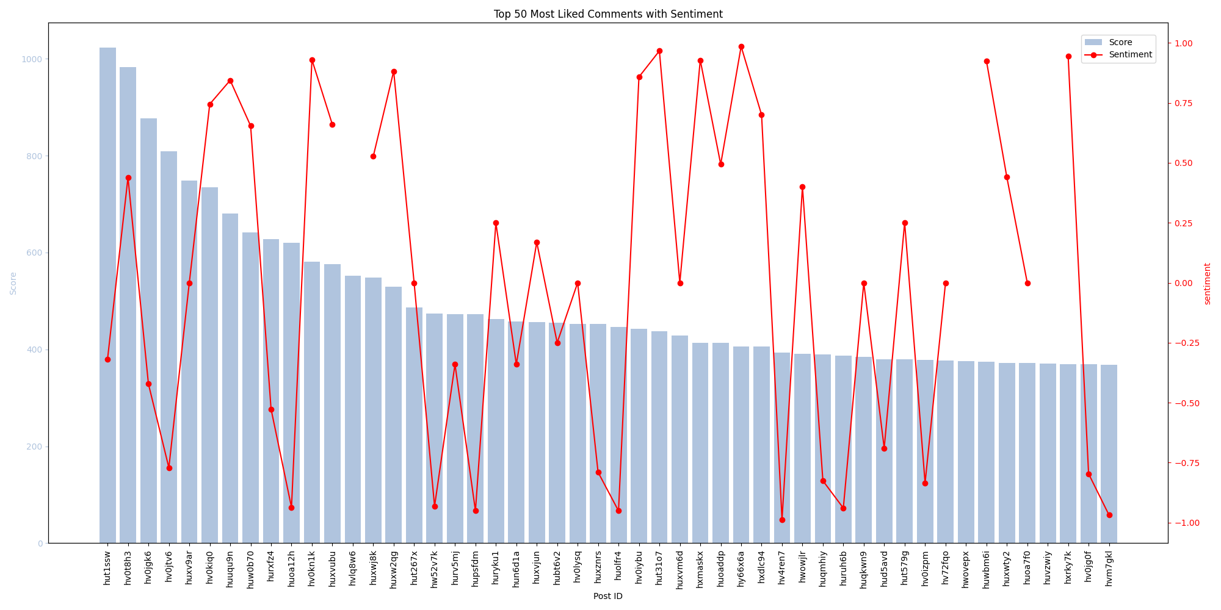
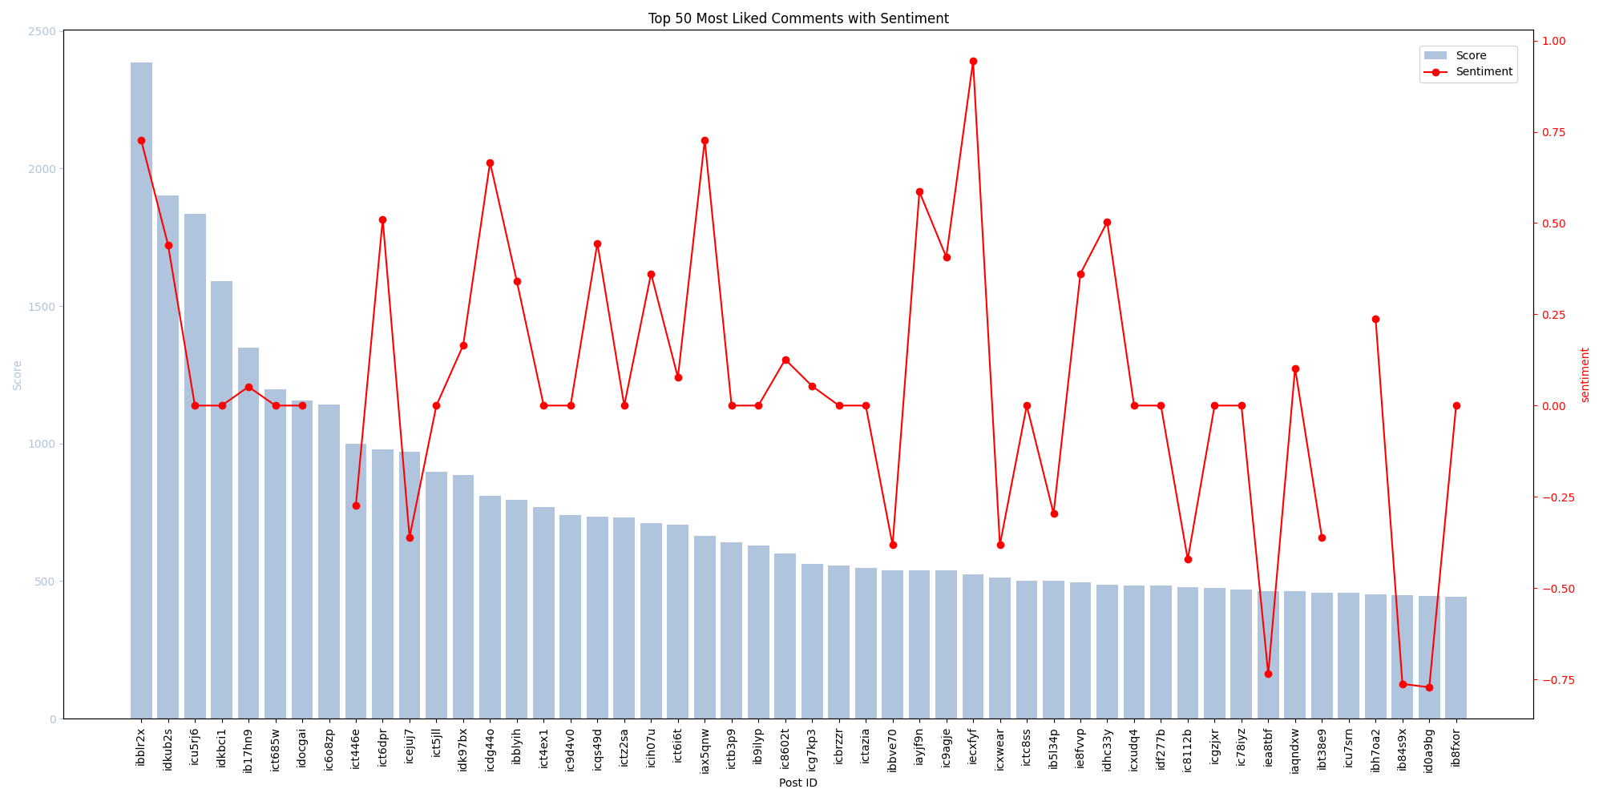
Popularity and Sentiment
Popularity of a comment and the sentiment attached to it does not have a strong correlation. Contrary to our thesis.
Graph 1 shows the most popular comments made on a trucker rally subreddit and its sentiment.
Graph 2 shows the most popular comments made on a bitcoin subreddit and its sentiment.
Both have 0 correlation coefficients. (KYLE)

Slide 6
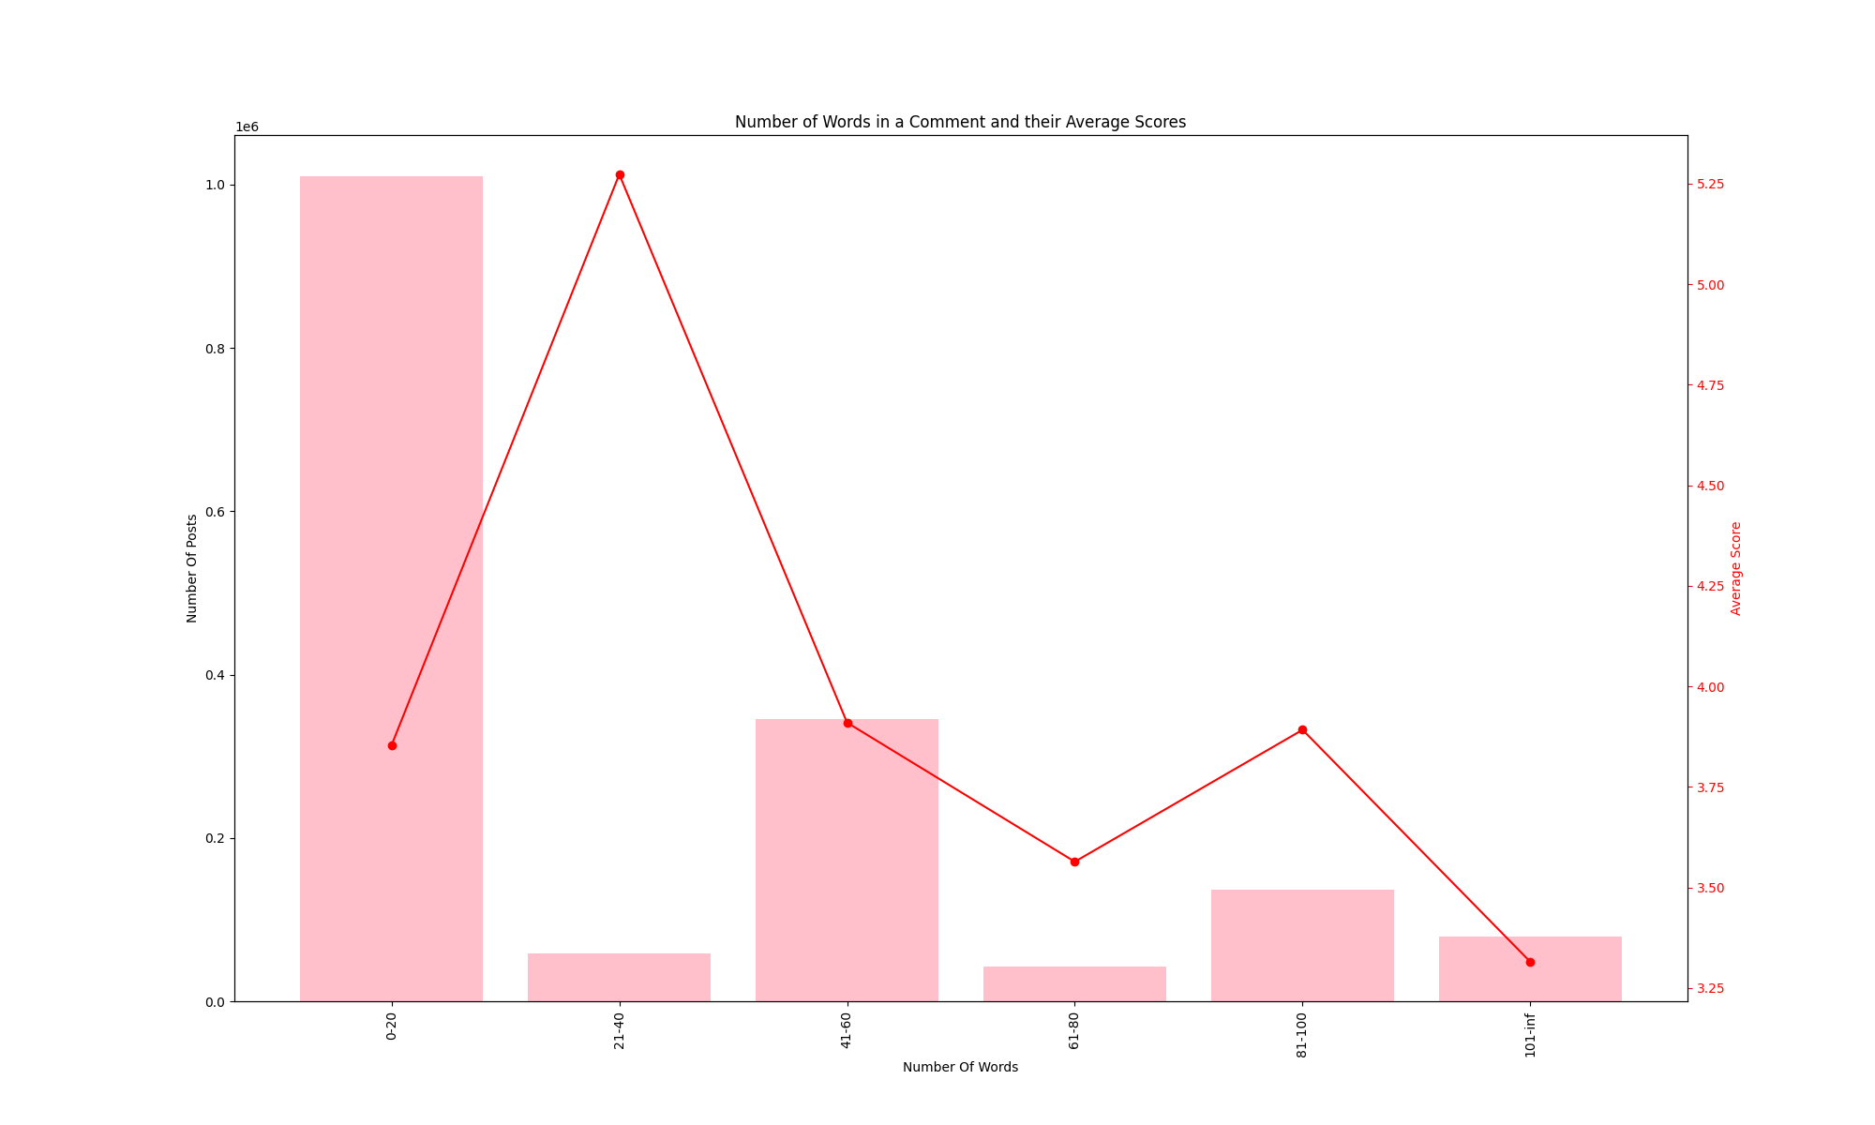
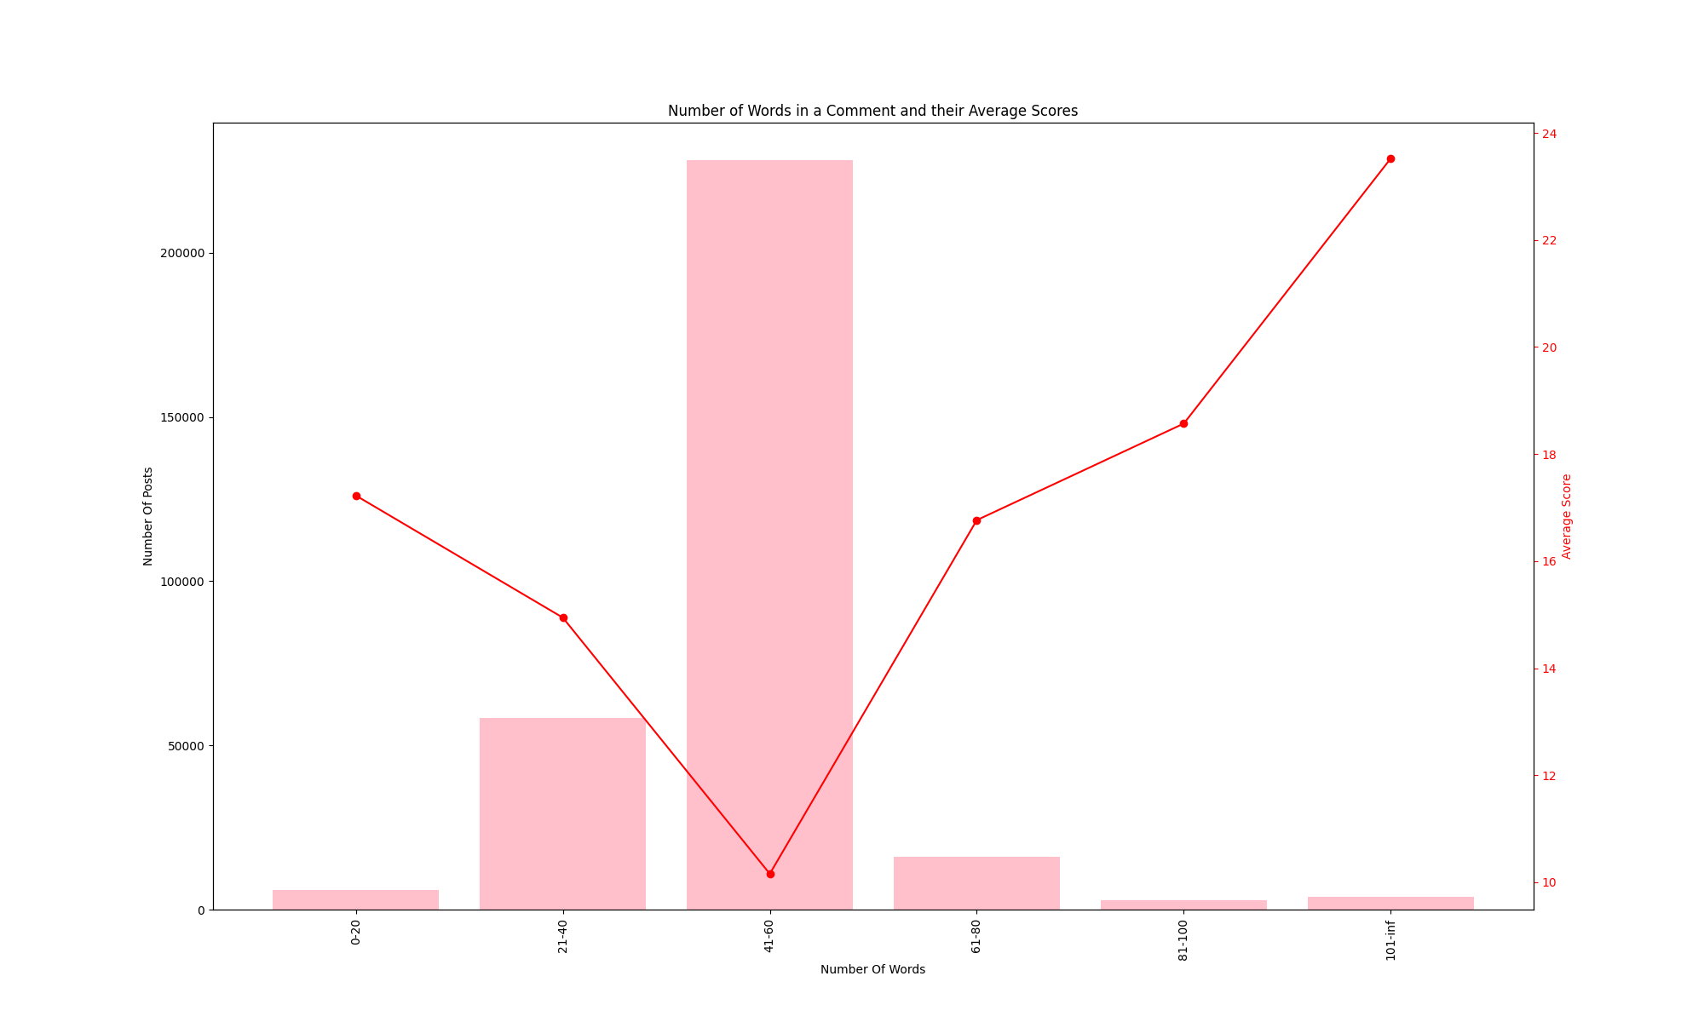
Popularity and Word count
Popularity of a comment and the number of words in the comment has an interesting trend. The number of words in a comment is generally centralized. The score varies.
Graph 1 displays the average scores for all the posts from doge
Graph 2 displays the trucker posts
Correlation coefficient (KYLE)

Slide 7
Popularity and Creation Time (month)

Slide 8
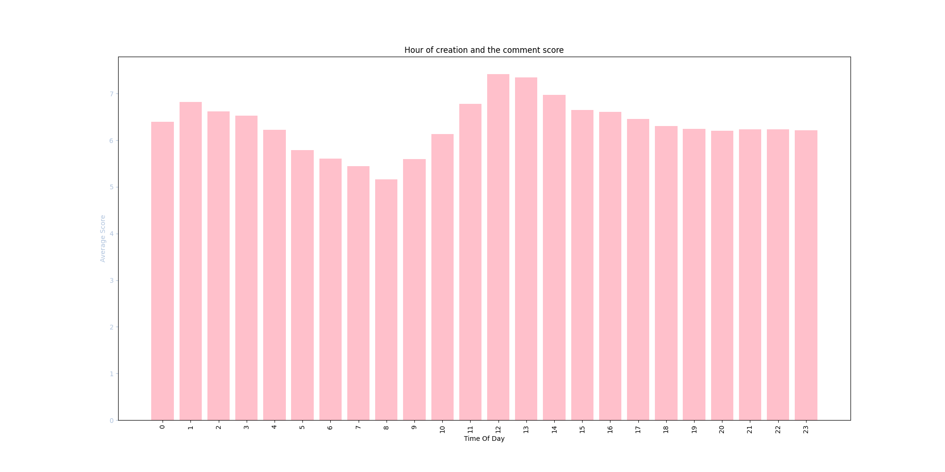
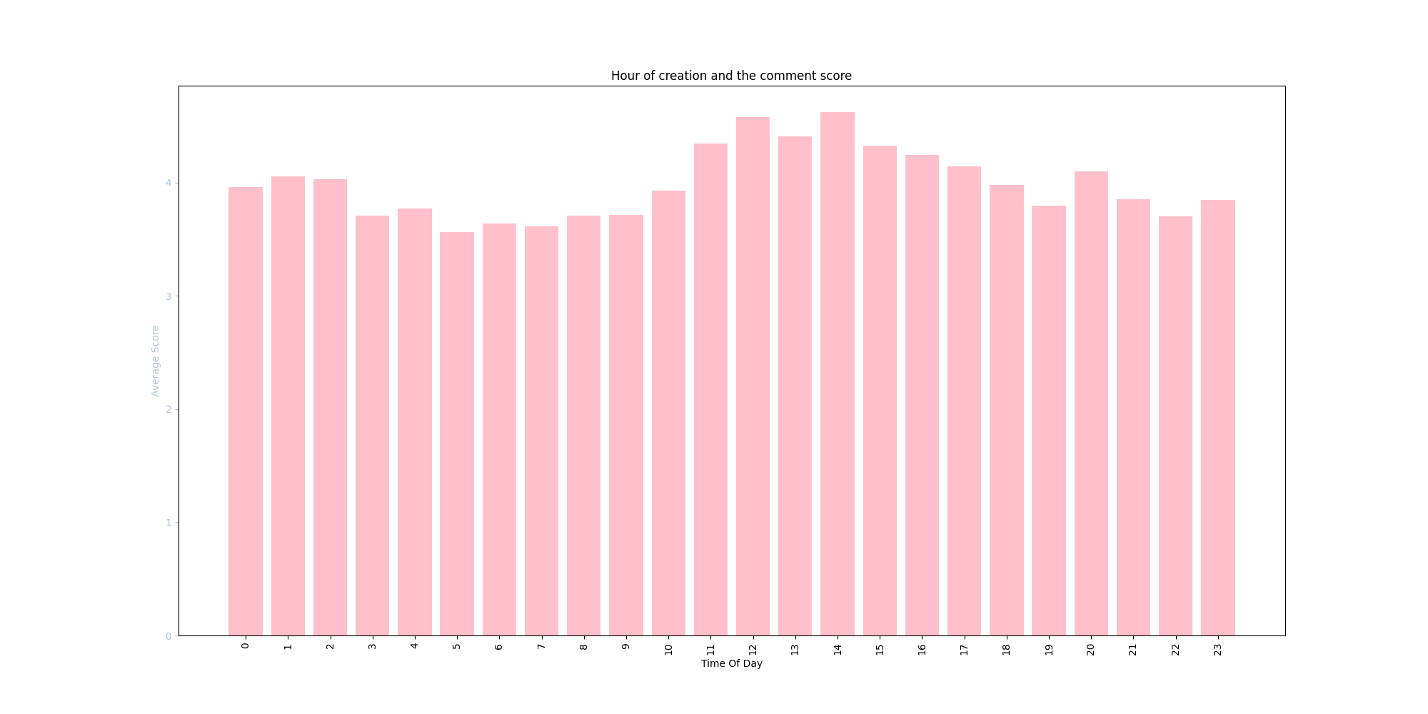
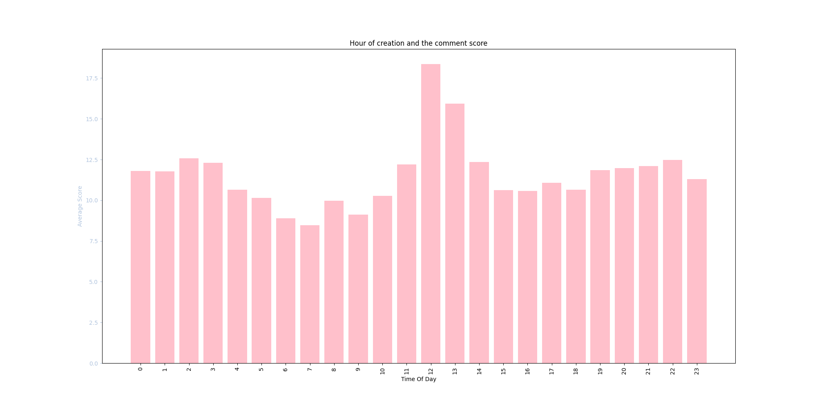
Popularity and Creation Time (daily)
Popularity of a comment and the time of day in which it is posted has a very similar trend across multiple subreddits. Peak hours all falling around 12 while valleys occur around 8 and 16.
Graph 1 NoNewNormal subreddit
Graph 2 Doge subreddit
Graph 3 Trucker subreddit

Slide 9
Conclusions

Slide 10
Challenges and Further Research

Slide 11
Questions?

