Slide 1
Exploring technological trajectories in automotive ecosystem Topic modeling-based patent analysis
Hassan Sherwani

Slide 2
Project
With the strategic importance of discerning opportunities and threats from technological development to achieve sustainable competitiveness, exploring technological trends becomes critical for a successful technology strategy in sustainability domain.
This study proposes a topic modeling-based approach using sustainability-related patents from the years 1990-2017 registered at European Patents Office(EPO).
The core of the suggested approach is latent Dirichlet allocation (LDA), allowing the identiﬁcation of sustainability-related technological topics behind patents .
The topics identiﬁed by LDA are further investigated regarding both ﬁled-level and ﬁrm-level trends.

Slide 3
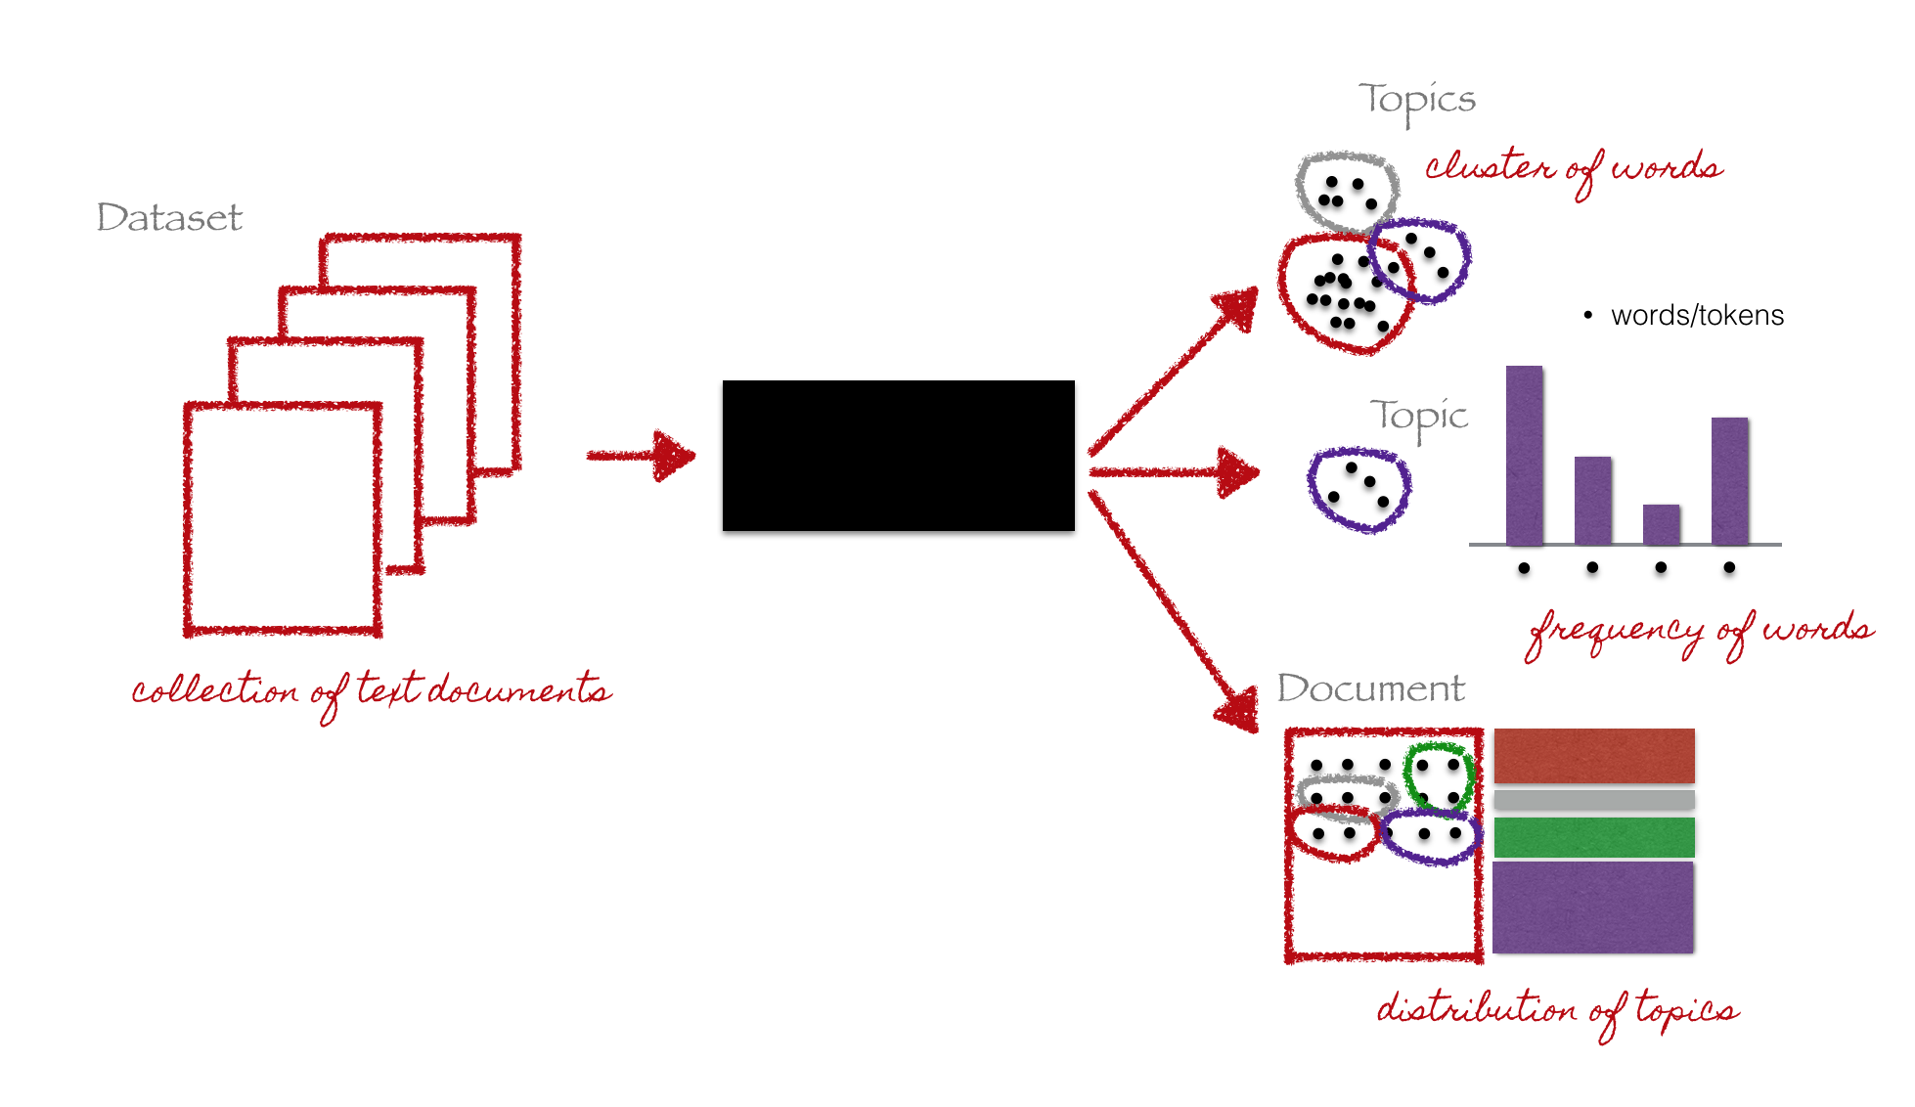
What is Topic Modeling?

Slide 4
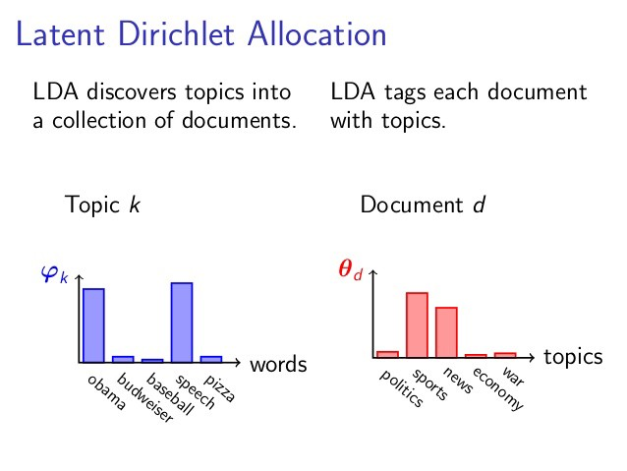

Slide 5
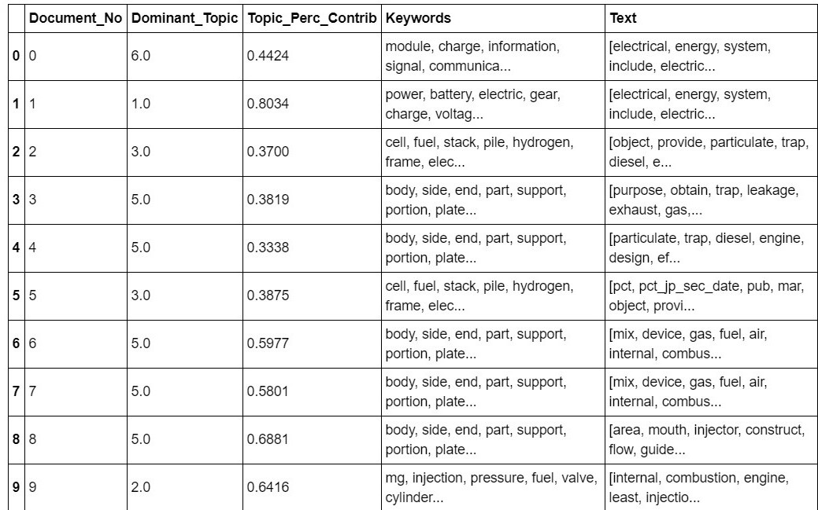
Outcome

Slide 6
Results
Emerging technology topic - small Patent share %age - positive CGAR Topic4(7.79 lower than average, 2.561%) | Dominant Tech topic - Large Patent share %age - Positive CGAR Topic 2 (25.98%, 6.18) Topic 3(21.63%, 3.898) Topic 8(17.7%, 3.15%)
Declining technology topic - Small patent share %age - Negative CGAR Topic 1(3.52%,-3.28%) Topic 5(7.35%,-1.639%) Topic 6(6.41%,-2.80%) | Saturated technology topic - Large patent share %age - Negative CGAR Topic7(9.58%,-2.03%)

