Slide 1

Key Factor Analysis on 1994 Census Income data Eva Xue Nov 2020

Slide 2
Content
Key factors contributing to high (>50K) vs. low (<=50K) income (p.3-p.8)
Marital Status
Education
Work Status
Age
Gender
Profile of successful investors (p.9)

Slide 3
Marital/Relationship Status, Education, Work Status, Age and Gender are top 5 factors impacting Income Status
1994 Census data N= ~49K (Training ~33K, Testing~16K)

Slide 4
Household W stable marriage relationship is more likely to have income >50K
Population | 27K | 22K
% Distribution | 55% | 45%
In Marriage*: Household with both husband-and-wife presence
Others*: divorced, never-married, separated, widowed
1994 Census data N= ~49K (Training ~33K, Testing~16K)

Slide 5
People W Bachelor or Advanced Degree are at least 30% more likely to have income >50K compared W less Education
Population | 6K | 30K | 12K
% Distribution | 13% | 62% | 25%
1994 Census data N= ~49K (Training ~33K, Testing~16K)

Slide 6
People work in Top 2 high-income occupations tend to work overtime compared with the others
Executive
/Managerial
WH >40: 3K(48%)
Prof-specialty
WH >40: 2K(39%)
Others
HIP: 16%
WH >40: 9K(25%)
HIP: 48%
HIP: 45%
Occupation
HIP: High Income Probability
WH >40: Population(%Distribution)
Population | 6K | 30K | 12K
% Distribution | 13% | 62% | 25%
1994 Census data N= ~49K (Training ~33K, Testing~16K)

Slide 7
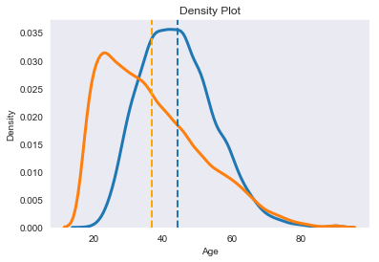
Average age of high-income group is 8 years older than the low-income group
 | Income <= 50K | Income > 50K
Average Age | 36 | 44
Population | 37K | 30K
% Distribution | 24% | 76%
1994 Census data N= ~49K (Training ~33K, Testing~16K)

Slide 8
Male is ~20% more likely to have income >50K
Population | 16K | 33K
% Distribution | 33%* | 67%
*There is significant gap in gender distribution
1994 Census data N= ~49K (Training ~33K, Testing~16K)

Slide 9
6 Key Attributes for A Successful Investor
Successful Investor Profile
Income > 50K
Married W Spouse
Work Hours/ Week
>40
College or Above Education
Self-employment
Prof-specialty or Executive/
Managerial
1994 Census data N= ~49K (Training ~33K, Testing~16K)

Slide 10

Thank you

