Slide 1

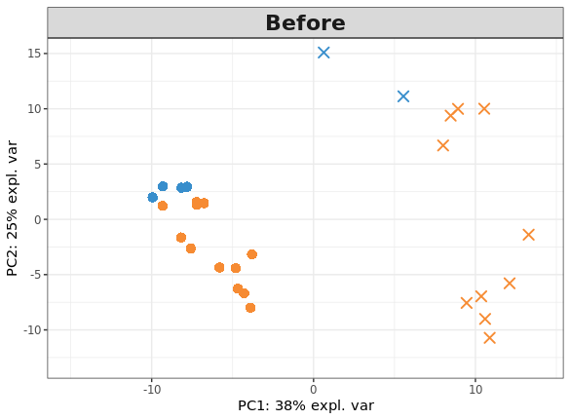
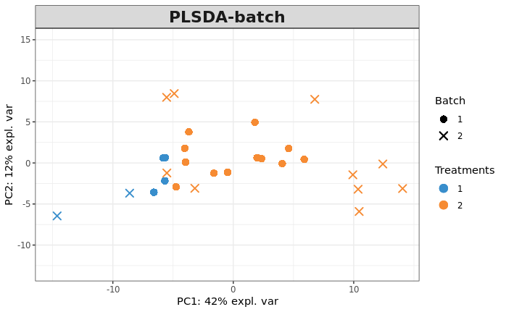
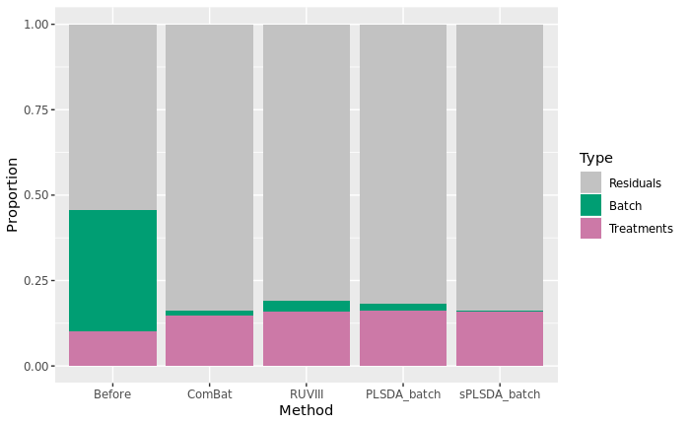
Latent Variable-based Multivariate Methods to Correct for Batch Effects in Microbiome Data
Yiwen Wang*, Kim-Anh Lê Cao
Melbourne Integrative Genomics, School of Mathematics and Statistics, University of Melbourne
PCA before & after batch correction
Microbiome:
(1) All of the genetic material within a microbiota; (2) Metagenome of the microbiota.
Batch effects:
Any unwanted source of variation that is unrelated to, and obscures the biological factor of interest.
No idea which poster to go !!!
Proportion variance explained
Challenges due to data characteristics:
(1) Sparse, overdispersed (2) Uneven library sizes (3) Compositional structure (4) Microbial variables are not independent
PLSDA-batch & sPLSDA-batch:
Based on the Partial Least Squares Discriminant Analysis regression (PLSDA) that take the characteristics of microbiome data into consideration.
P49

