Slide 1
FIT5136-S2-team5
ArushiKumar
LiuxiWang
RuoyuZhang

Slide 2
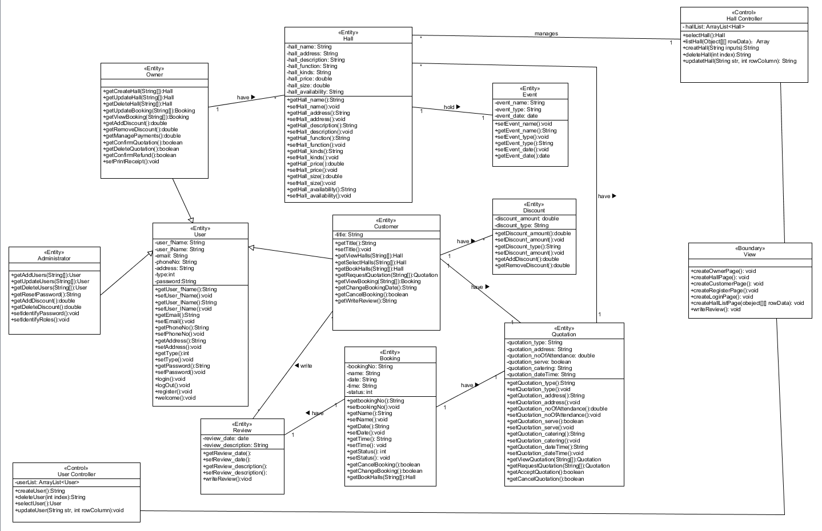
Detailed Class Diagram

Slide 3
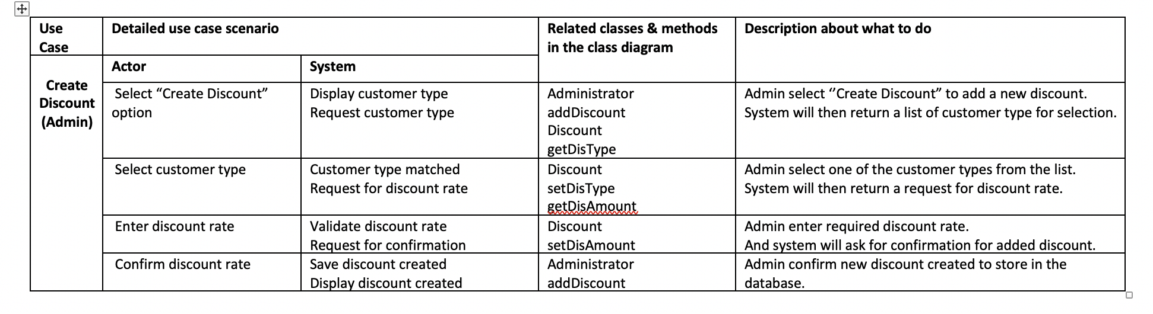
Traceability Matrix (Create Discount -- Admin)

