Slide 1
FIT5136-Team5
Liuxi Wang
Ruoyu Zhang
Arushi Kumar

Slide 2
Contents
Initial Class Diagram
Sequence Diagram
Statechart

Slide 3
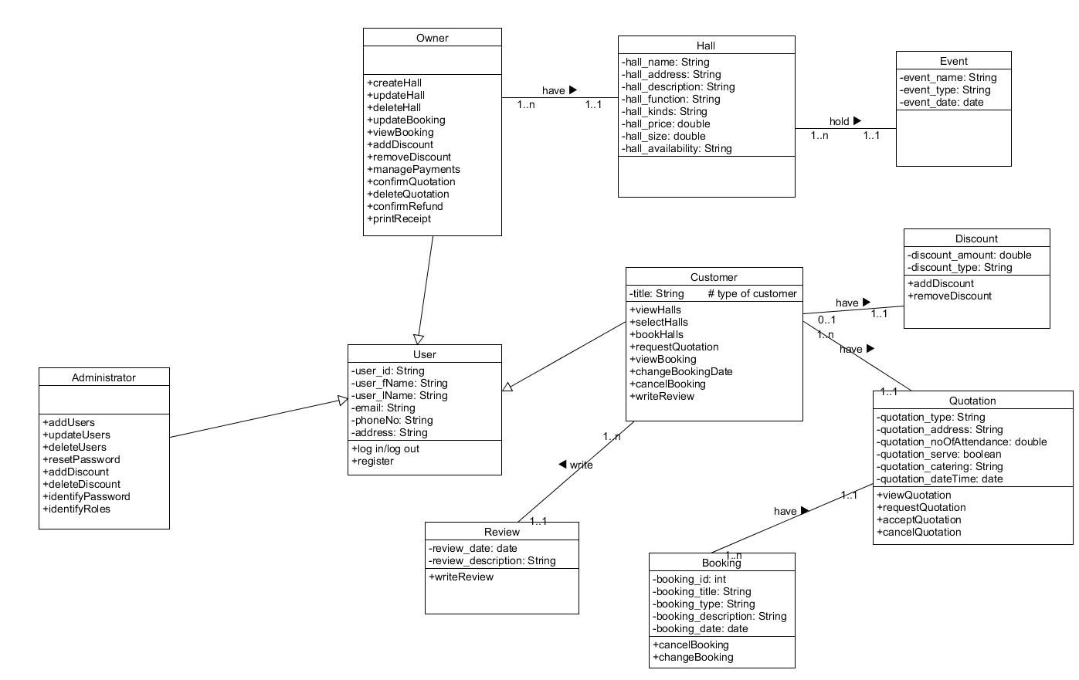
Initial class diagram

Slide 4
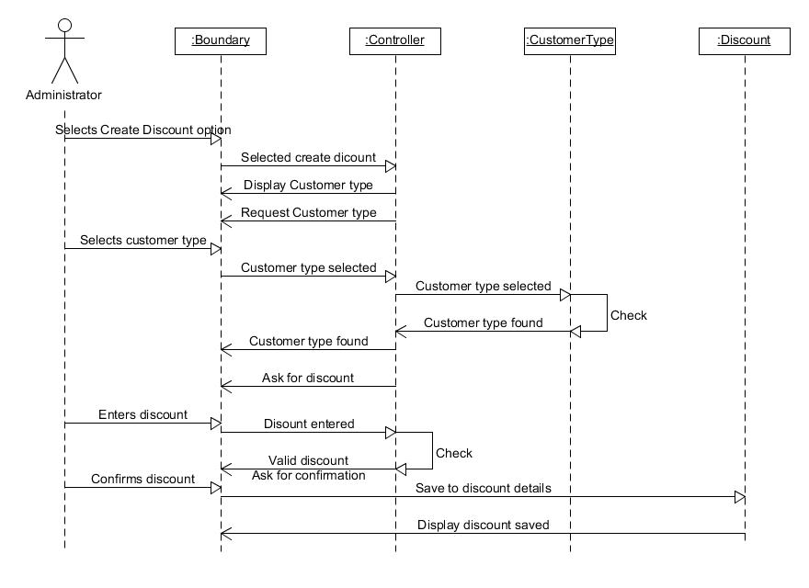
Sequence Diagram

Slide 5
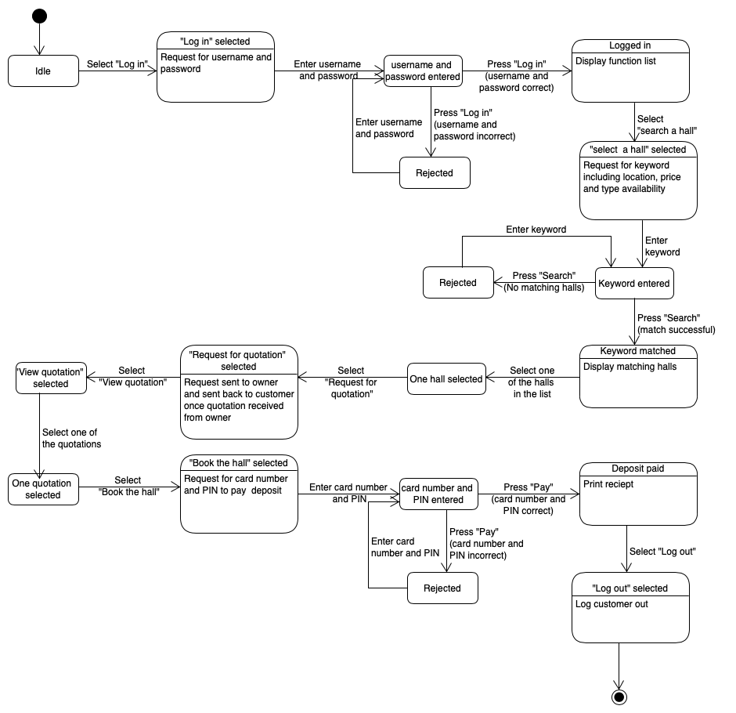
Statechart

Slide 6
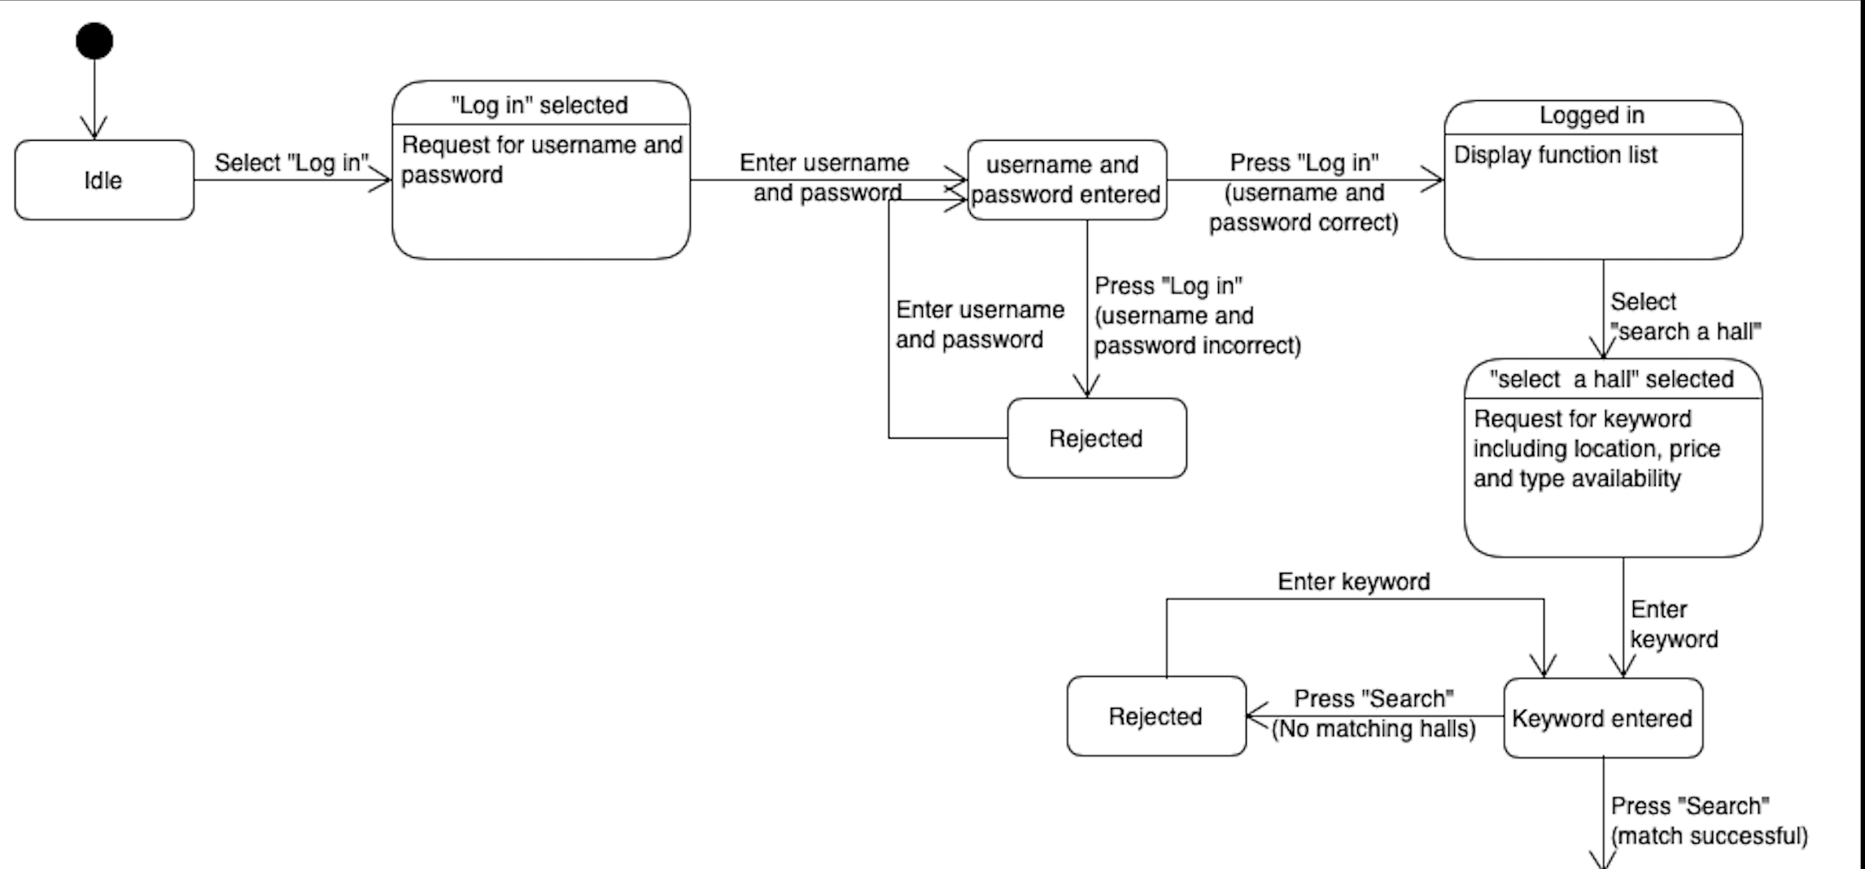
Statechart

Slide 7
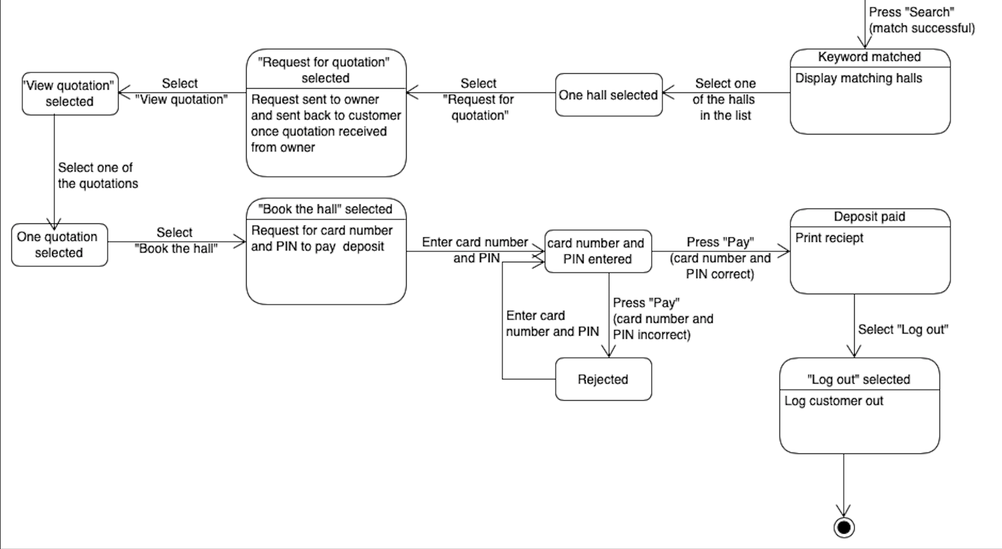
Statechart

