Slide 1
FIT5136-S2-team5
Arushi Kumar
Liuxi Wang
Ruoyu Zhang

Slide 2
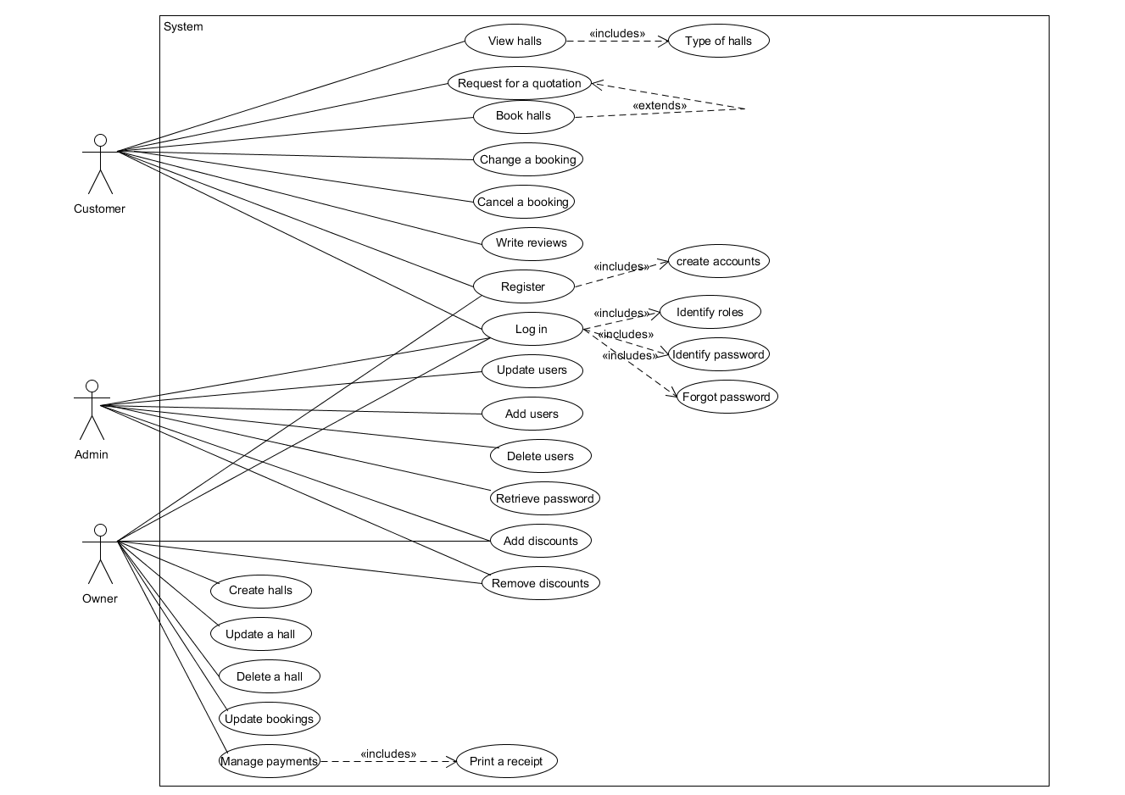
Use case diagram

Slide 3
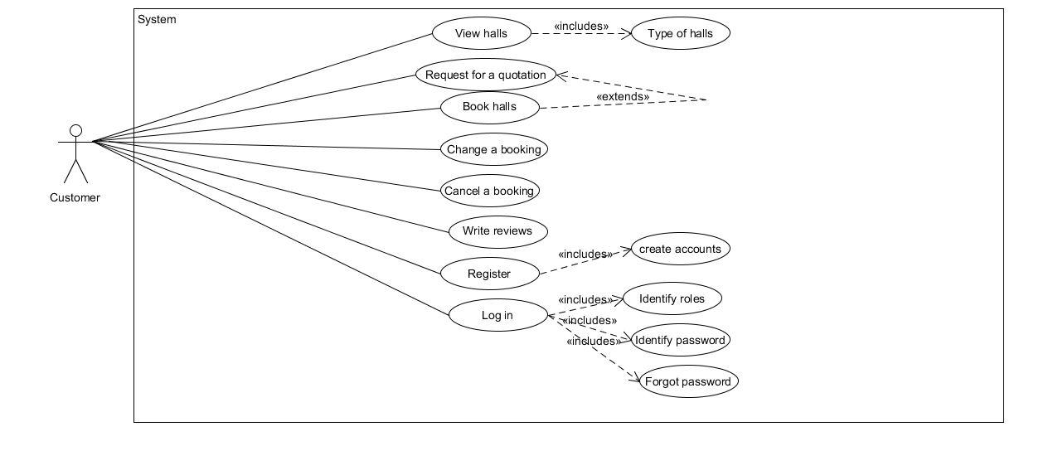
Use Case diagram--Customer

Slide 4
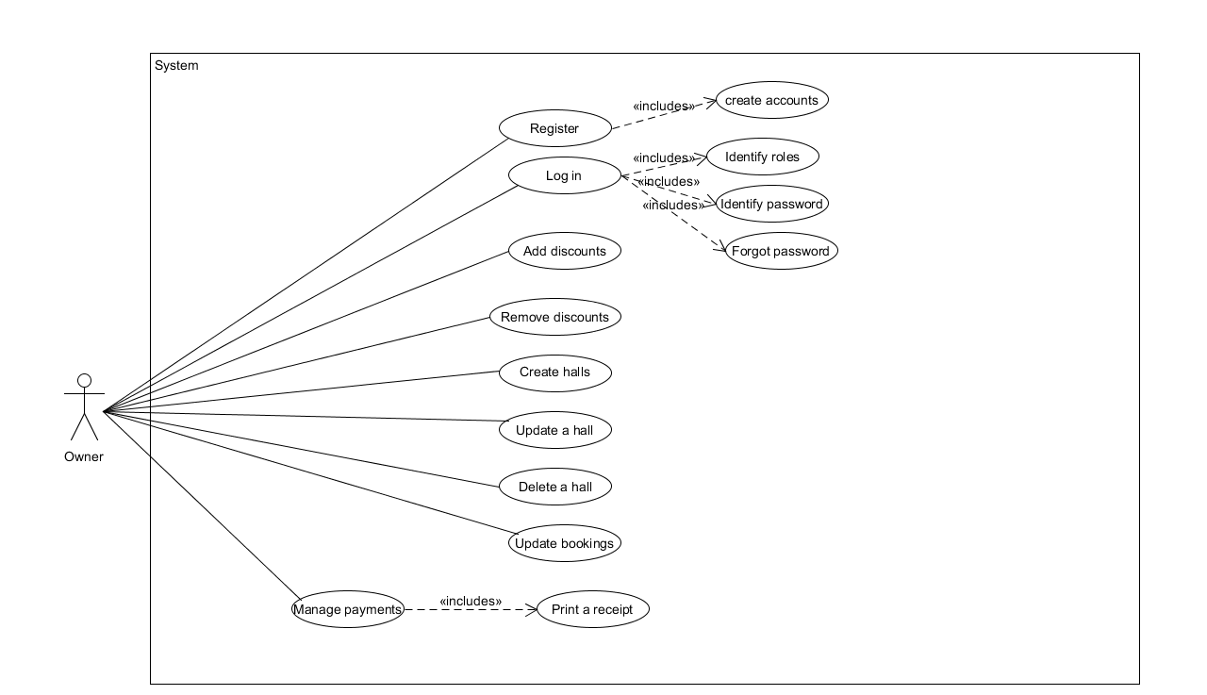
Use case diagram--Owner

Slide 5
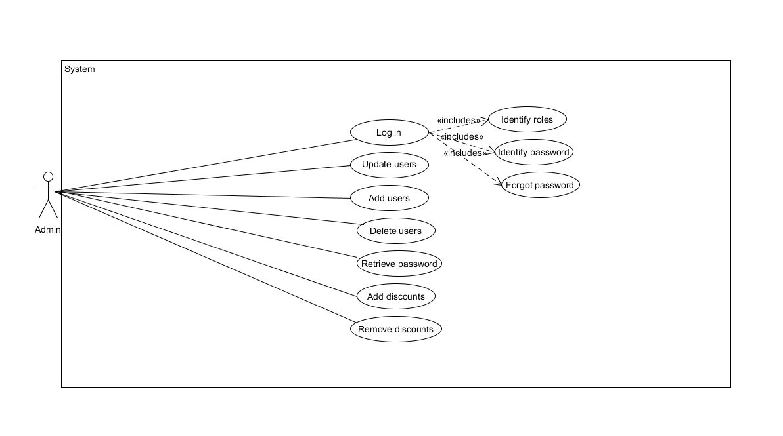
Use case diagram--Admin

Slide 6
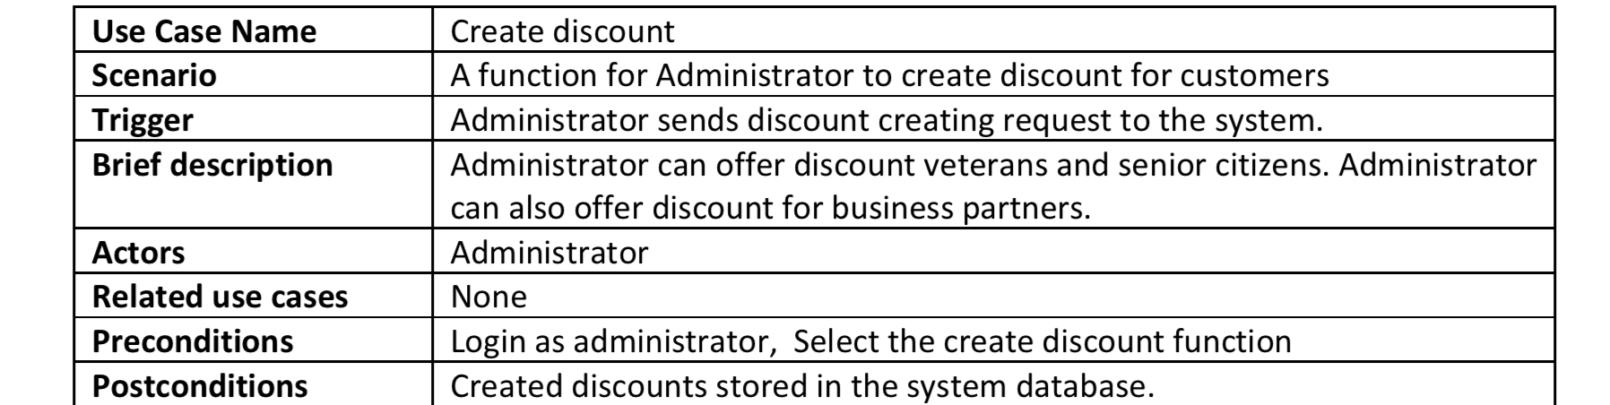
Use Case Scenario--Create Discount(Admin)

Slide 7
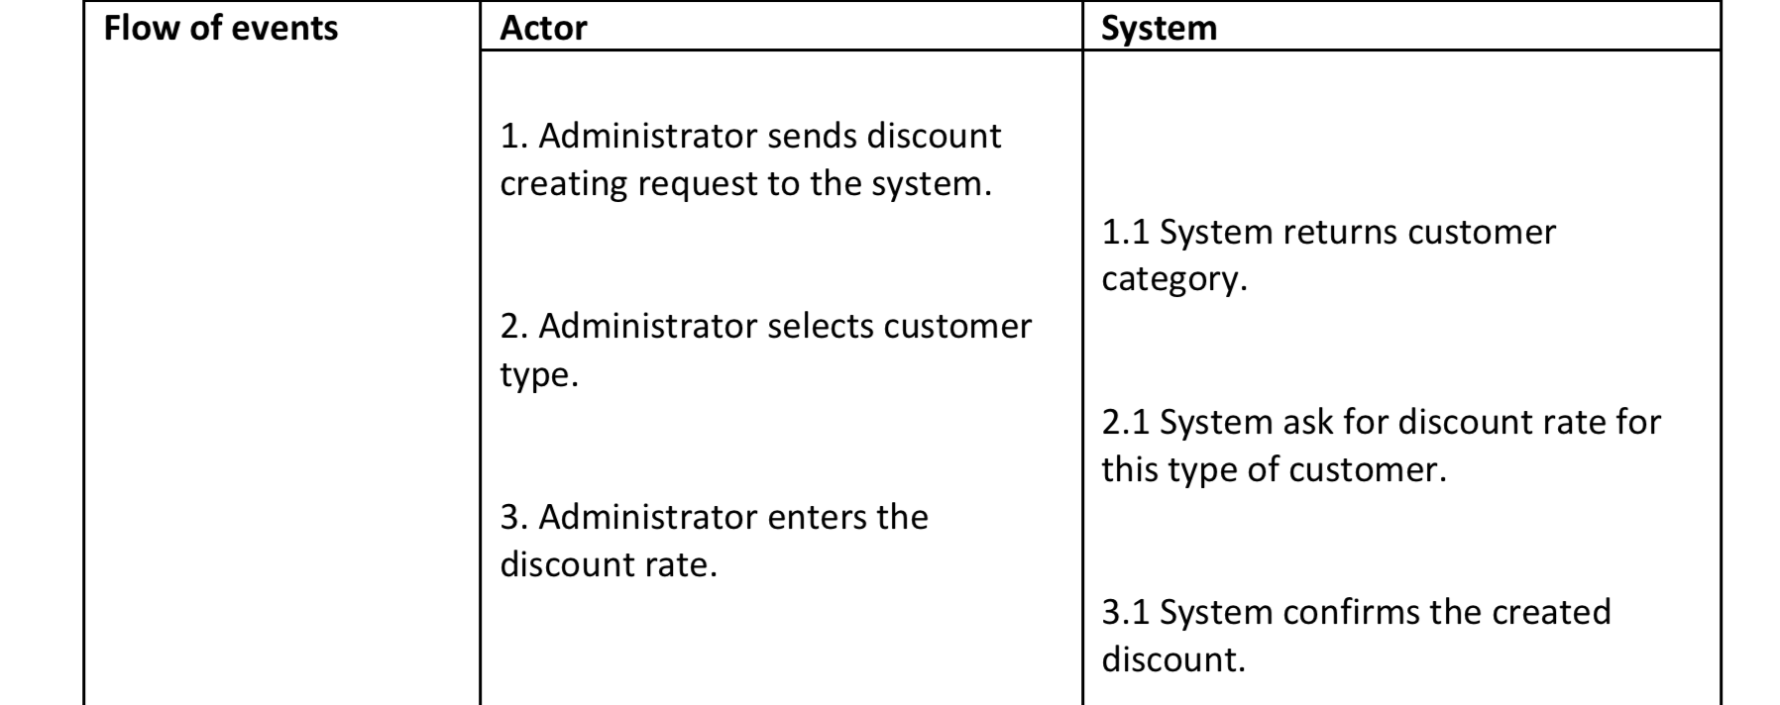
Use Case Scenario--Create Discount(Admin)

Slide 8
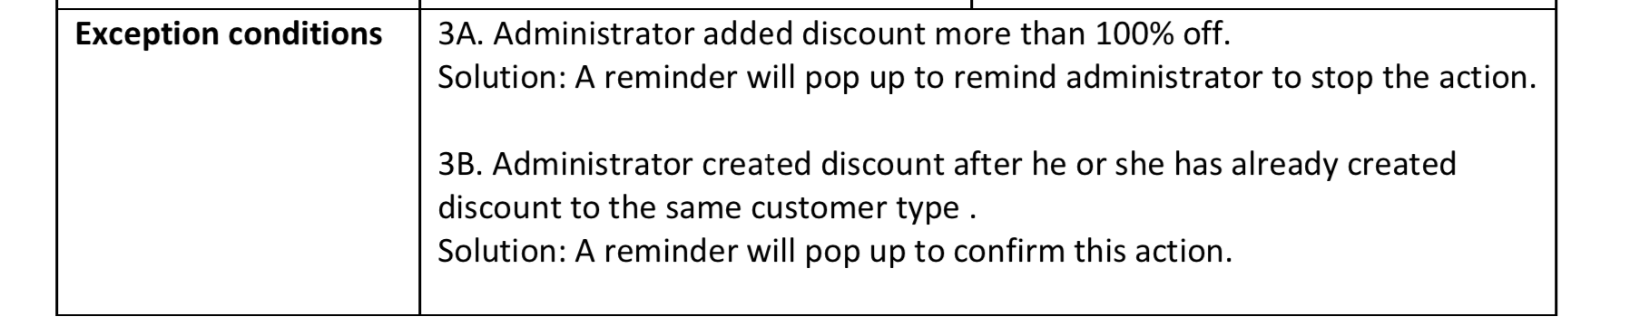
Use Case Scenario--Create Discount(Admin)

Slide 9
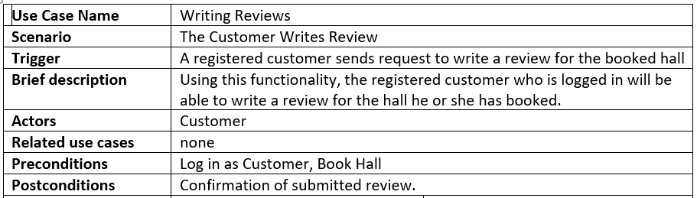
Use Case Scenario - Write Review

Slide 10
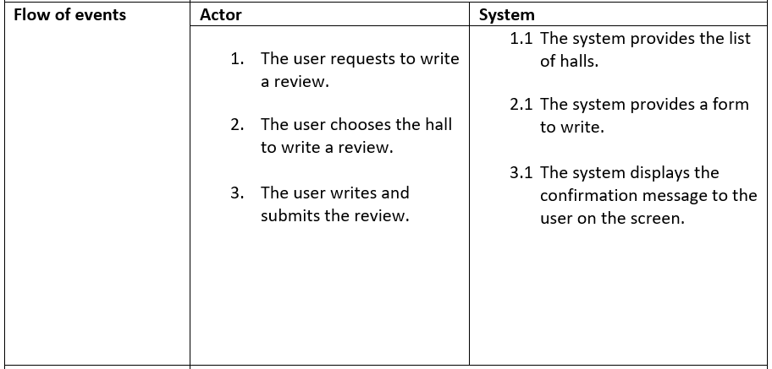
Use Case Scenario - Write Review

Slide 11
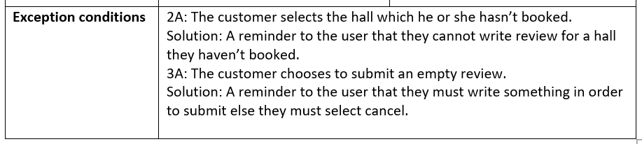
Use Case Scenario - Write Review

Slide 12
Thank you

