Slide 1
Outline
Documenting Rest API with OpenAPI
API Rate Limiting

Slide 2
Documenting Rest API
https://springdoc.org/
https://www.dariawan.com/tutorials/spring/documenting-spring-boot-rest-api-springdoc-openapi-3/
https://github.com/swagger-api/swagger-core/wiki/Swagger-2.X---Annotations
https://swagger.io/
https://smartbear.com/product/ready-api/soapui/overview/
Notes:
https://swagger.io/
https://smartbear.com/product/ready-api/soapui/overview/

Slide 3
API Rate Limiting
2020 JavaEE BJTU

Slide 4
What is Rate Limiting?
Rate limiting is a technology used in networks to control the rate of traffic. We also see applications of this technology in the HTTP world. Services that provide an HTTP API often limit the number of requests that a client is allowed to send over a certain period of time.
In general, rate limiting is used to control the consumption rate of a resource.
For example, up to 10 requests can be served by the server per minute.
Or up to 1MB data can be sent to the network per second.
Rate limiting is necessary for protecting a system from being overloaded.

Slide 5
API Rate Limiting
Rate limiting helps make your API scalable.
Rate limiting also helps make your API secure, as DoS attacks can tank a server with unlimited API requests.

Slide 6
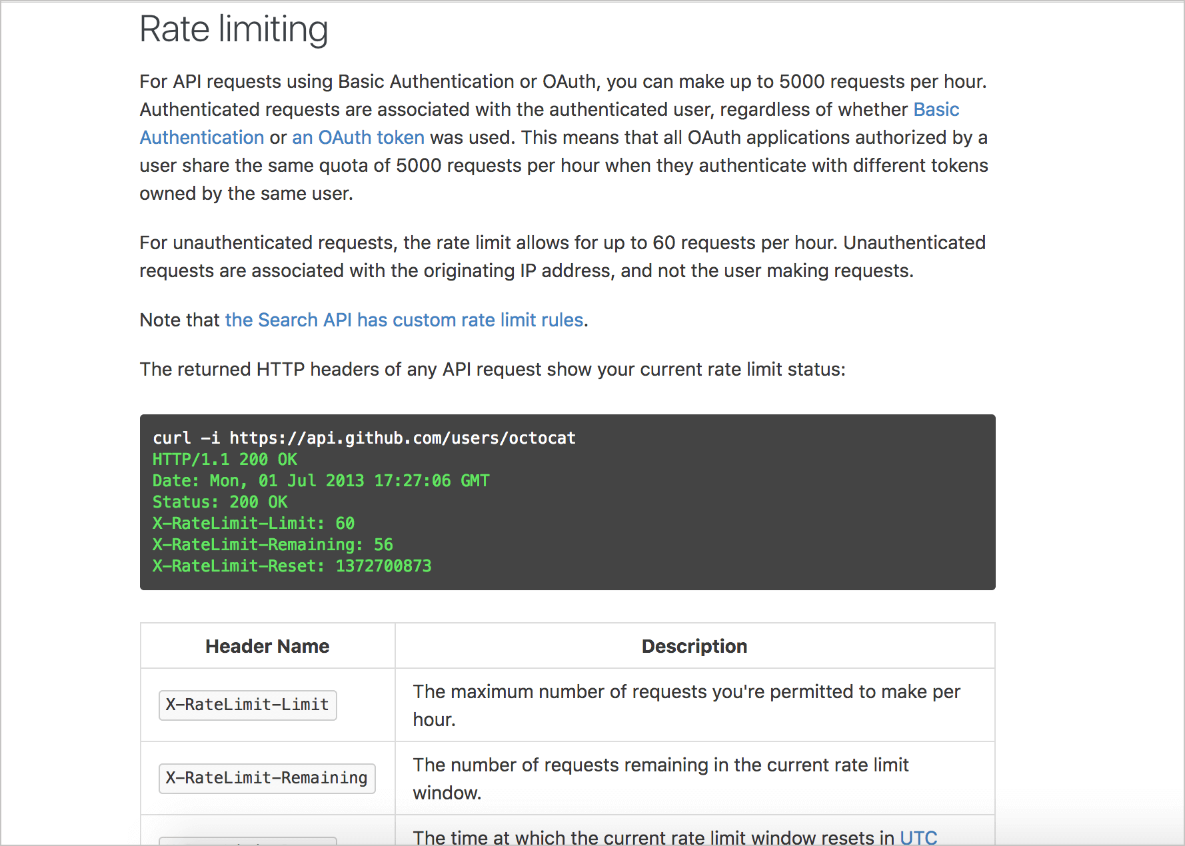
API Rate Limiting Examples
From GitHub’s Rate Limiting Documentation for Developers
Notes:
https://developer.github.com/v3/#rate-limiting

Slide 7
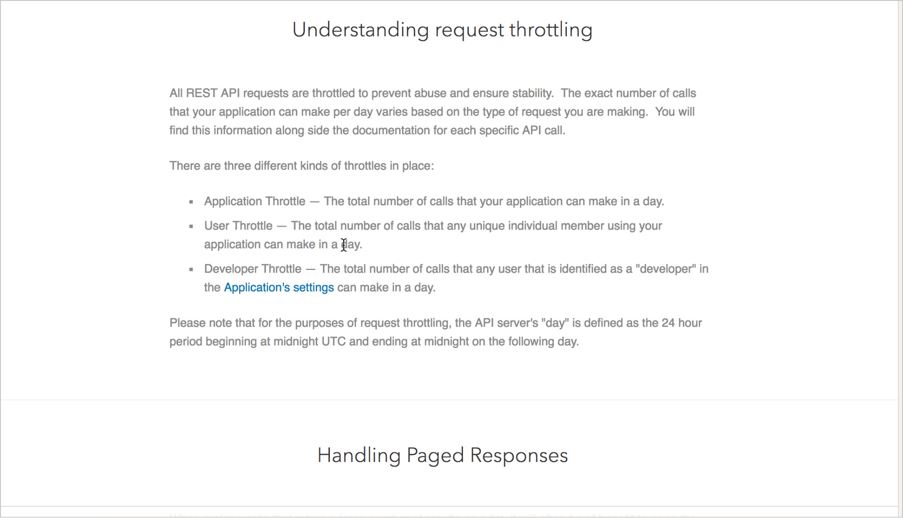
LinkedIn
From LinkedIn’s rules for developers

Slide 8
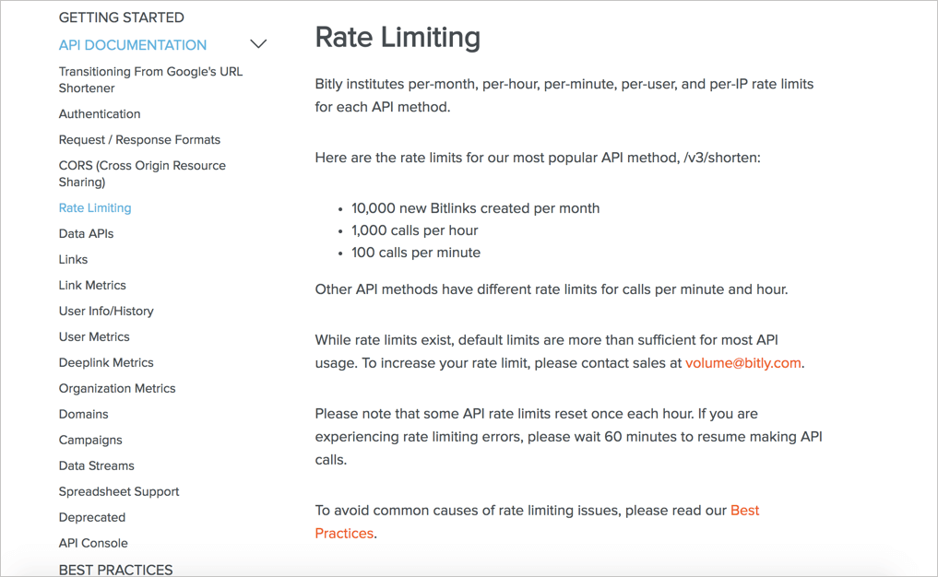

Slide 9
Three Methods Of Implementing API Rate-Limiting
Request Queues
Android Volley
Amazon Simple Queue Service (ASQS)
Throttling Service/API
Throttling limits the speed of all services
Throttling is applied on an individual per user basis, based overall usage within a given time(day/week/month).
E.g, Throttling to Restful APIs or throttling to Database access
Rate-limiting Algorithms

Slide 10
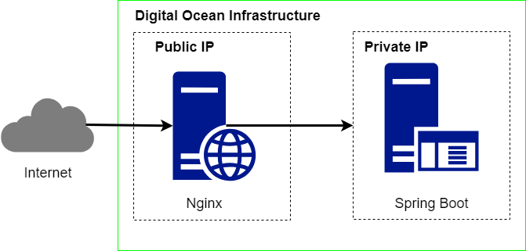
Example: Nginx Rate Limiting
From https://www.nginx.com/blog/rate-limiting-nginx/
Notes:
https://www.nginx.com/blog/rate-limiting-nginx/
https://github.com/sportebois/nginx-rate-limit-sandbox/blob/master/default.conf

Slide 11
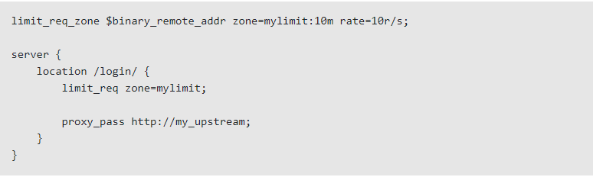
Example: Nginx Rate Limiting
From https://www.nginx.com/blog/rate-limiting-nginx/
Notes:
https://www.nginx.com/blog/rate-limiting-nginx/
https://github.com/sportebois/nginx-rate-limit-sandbox/blob/master/default.conf

Slide 12
Rate Limiting Algorithms
Token bucket
Leaky bucket
Fixed window counter
Sliding window log
Sliding window counter

Slide 13
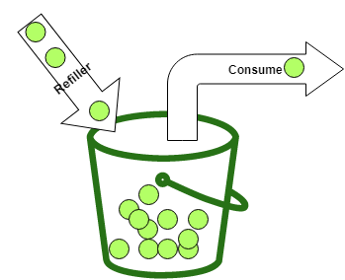
Token bucket
The basics of the algorithm are easy to understand. You have a bucket that holds a maximum number of tokens (capacity).
Whenever a consumer wants to call a service or consume a resource, he takes out one or multiple tokens.
The consumer can only consume a service if he can take out the required number of tokens.

Slide 14
Token bucket cont..
If the bucket does not contain the required number of tokens, he needs to wait until there are enough tokens in the bucket.
When we have somebody that takes out tokens, we also need somebody that puts tokens into the bucket. The refiller periodically creates new tokens and puts them into the bucket.

Slide 15
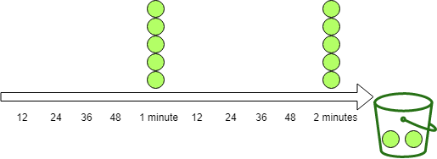
Two types of Refillers in Bucket4J
Refill.intervally(5, Duration.ofMinutes(1)); The "intervally"-refiller waits until the specified amount of time has passed and then puts in all tokens at once. In this example, he adds 10 tokens every minute.

Slide 16
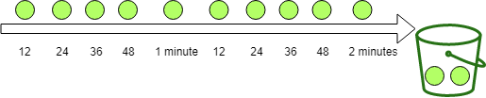
Two types of Refillers in Bucket4J
Refill.greedy(5, Duration.ofMinutes(1)); The "greedy"-refiller adds the tokens more greedily. With this example, he splits one minute into 5 periods and puts 1 token at each of these periods into the bucket. With the configuration above, the refiller puts 1 token every 12 seconds into the bucket. After one minute, both refillers put the same amount of tokens into the bucket.

Slide 17
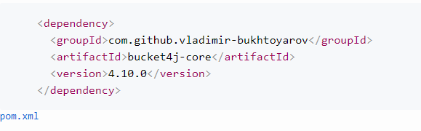
Programming with Bucket4J
Notes:
https://golb.hplar.ch/2019/08/rate-limit-bucket4j.html

Slide 18
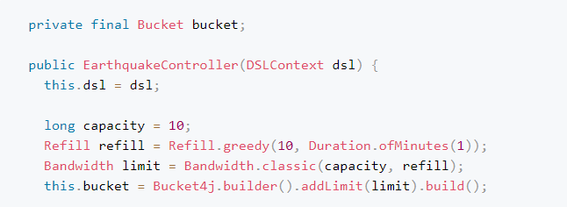
Programming with Bucket4J

Slide 19
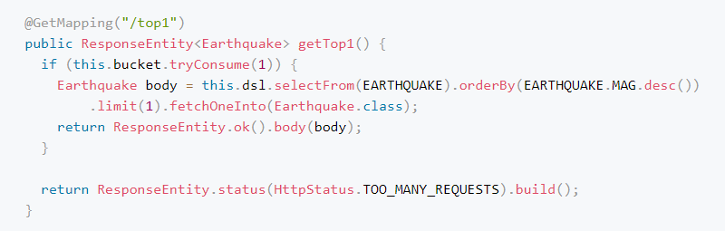
Programming with Bucket4J

Slide 20
More Programming with Bucket4J
Rate limit with Spring MVC Interceptor
Rate limit per client
Multiple refillers

Slide 21
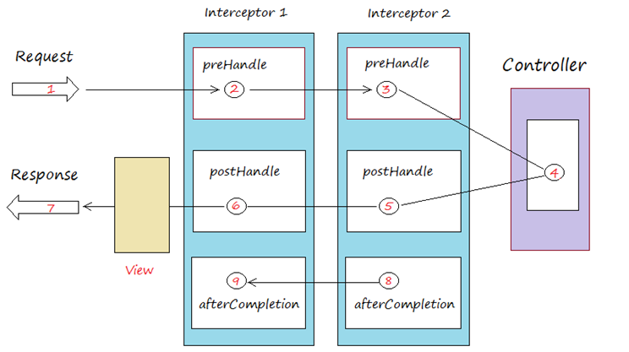
Rate limit with Spring MVC Interceptor
Spring MVC interceptor allows an application to intercept HTTP requests before they reach the service and after they come back. Here we are only interested in the before case so we can either let the request go through or block it and send back the status code 429.

Slide 22
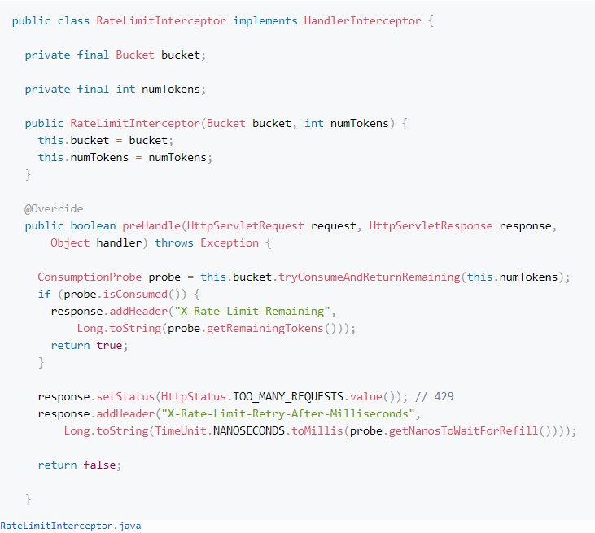
Rate limit with Spring MVC Interceptor

Slide 23
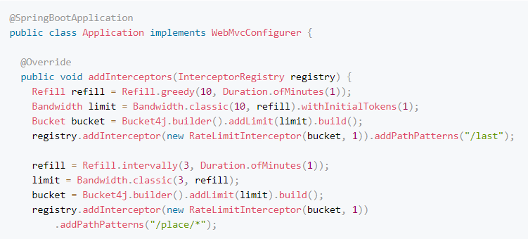
Rate limit with Spring MVC Interceptor

Slide 24
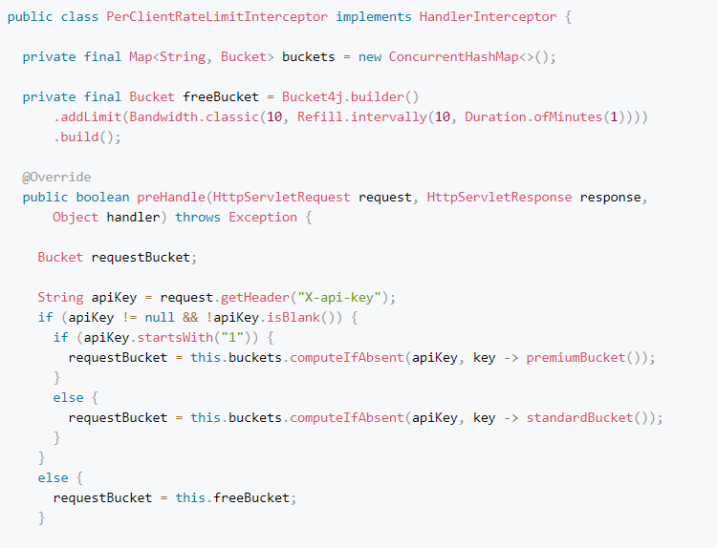
Rate limit per client

Slide 25
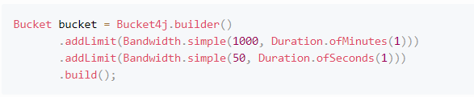
Multiple refillers
bucket4j also supports multiple refillers per bucket. Here an example from the documentation that allows 1000 requests per minute but not more than 50 requests per second.

Slide 26
References
https://www.cnblogs.com/william-cheung/p/8763482.html
https://github.com/vladimir-bukhtoyarov/bucket4j

