Slide 1
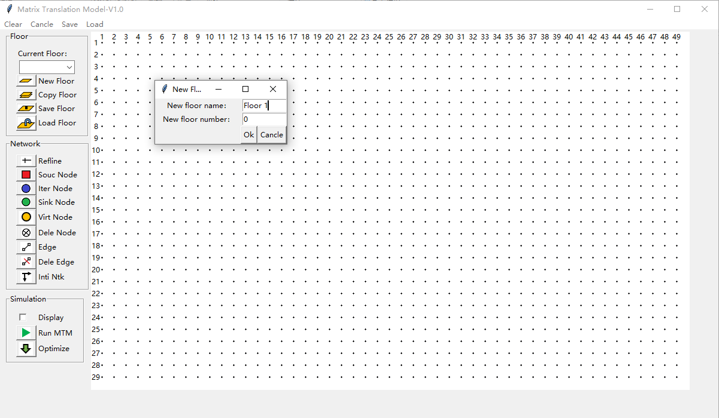
Create a new floor

Slide 2
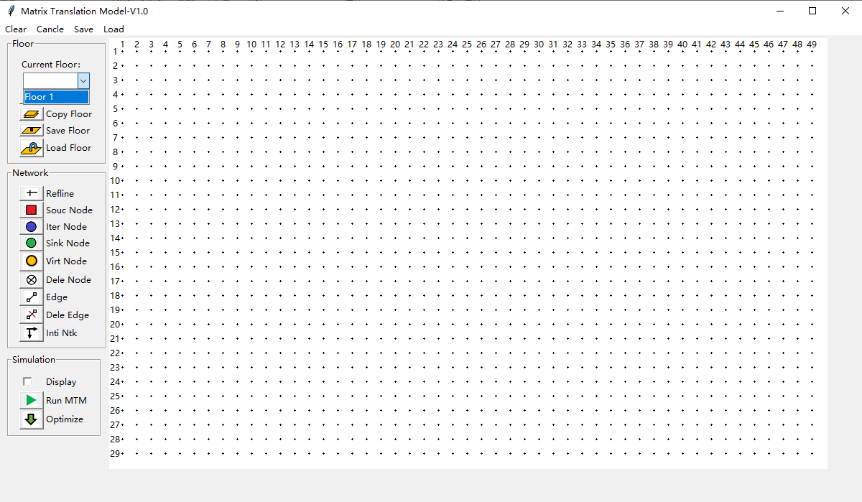
Select a floor

Slide 3
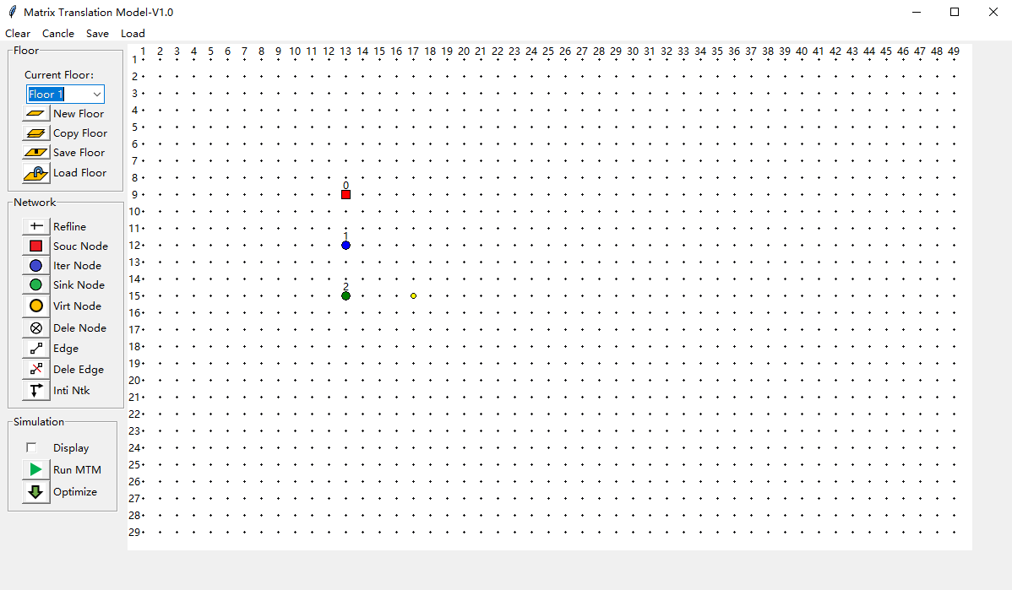
Create a new source/intermediate/sink/virtual node

Slide 4
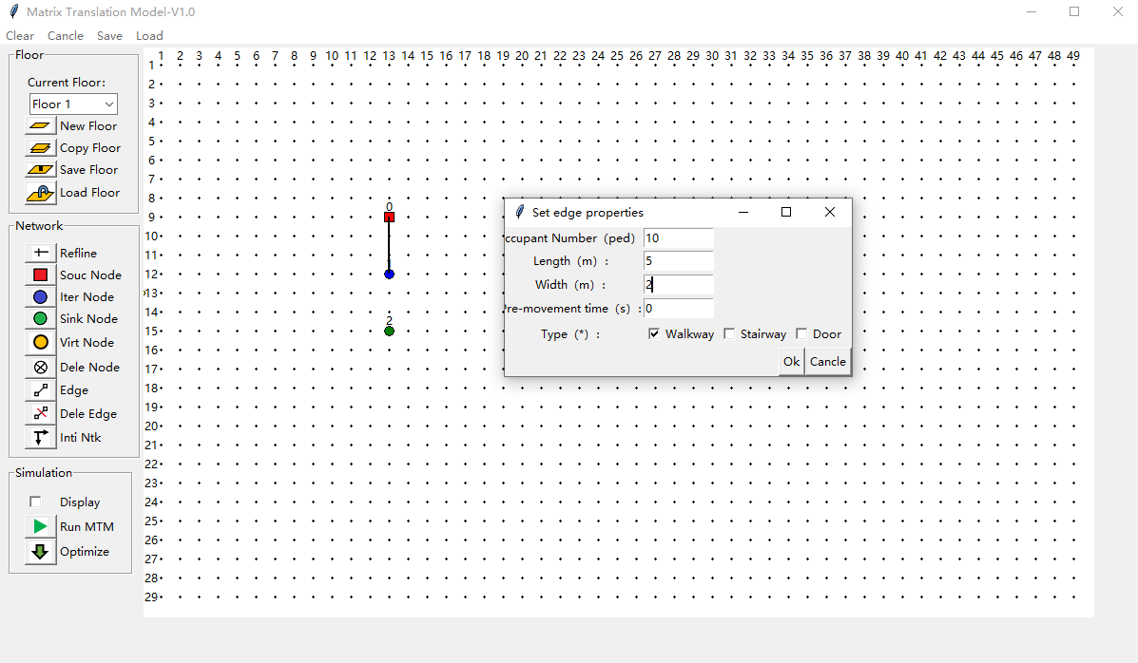
Dialog of setting edge properties
Create an new edge

Slide 5
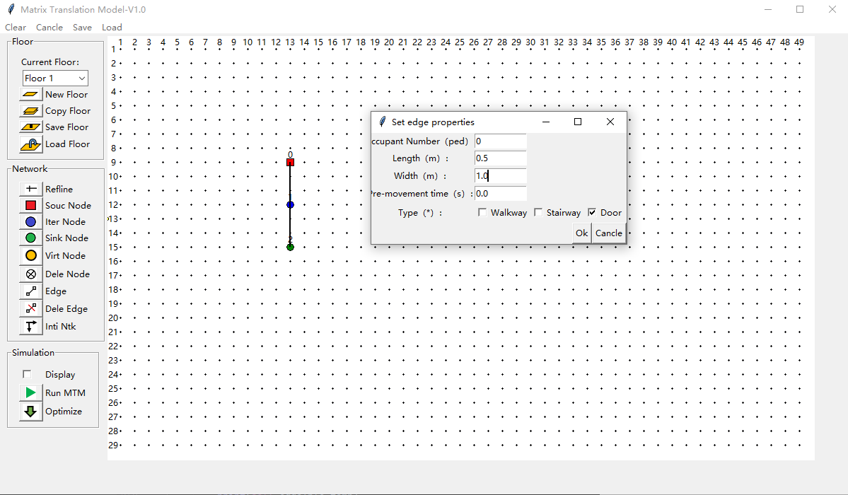
Create the door edge

Slide 6
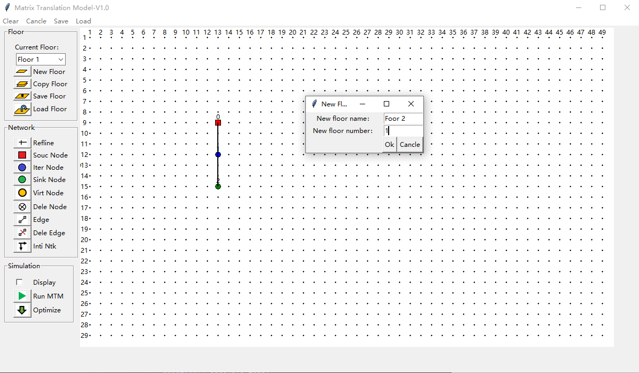
Create the second floor

Slide 7
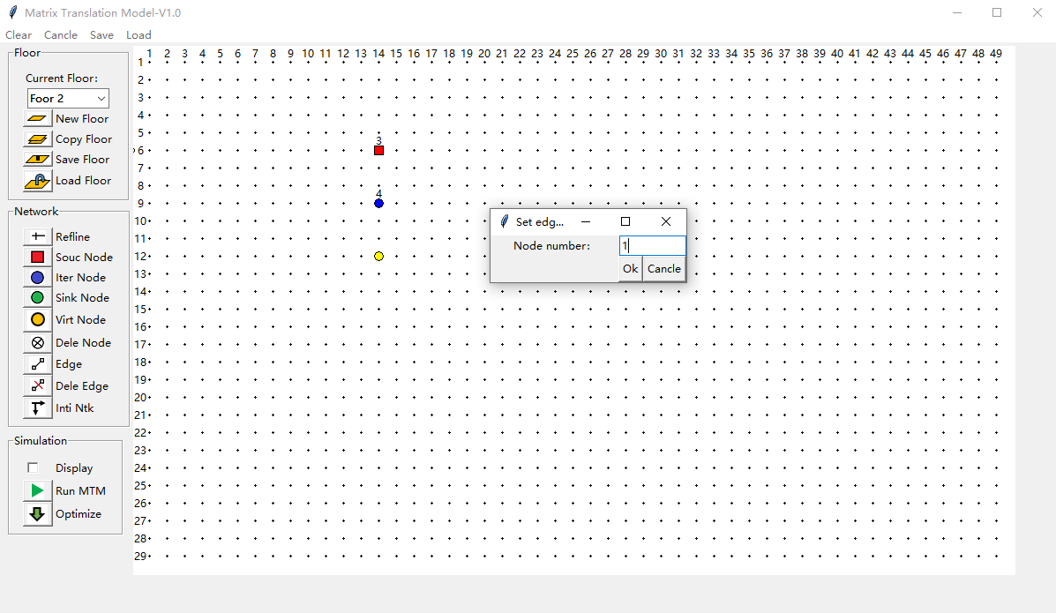
Create a virtual node
The real number of the virtual node
Virtual node dialog

Slide 8
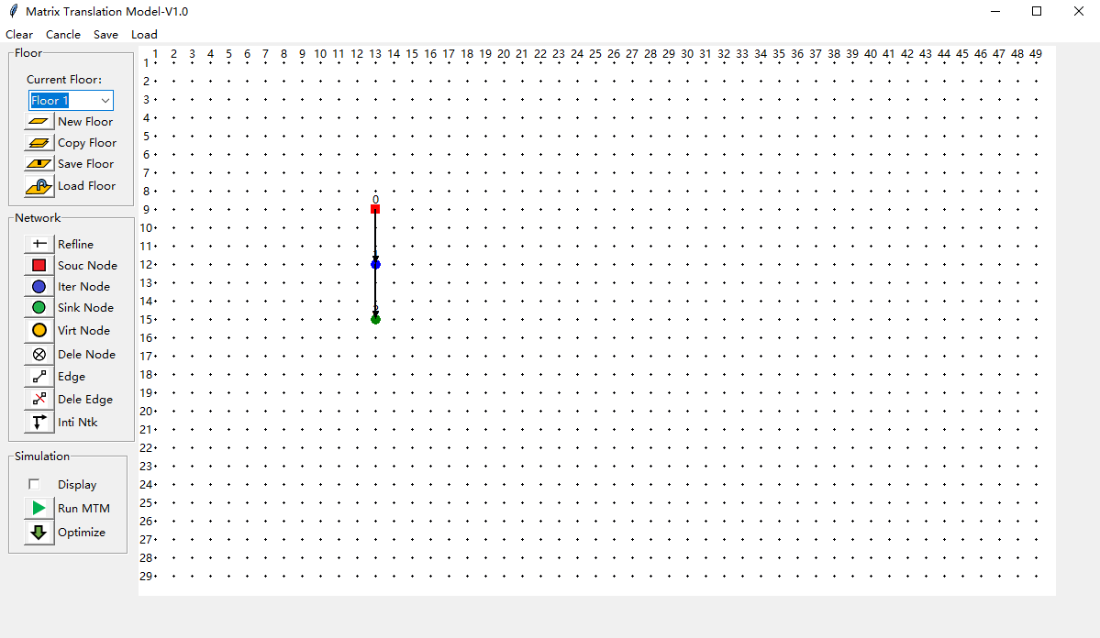
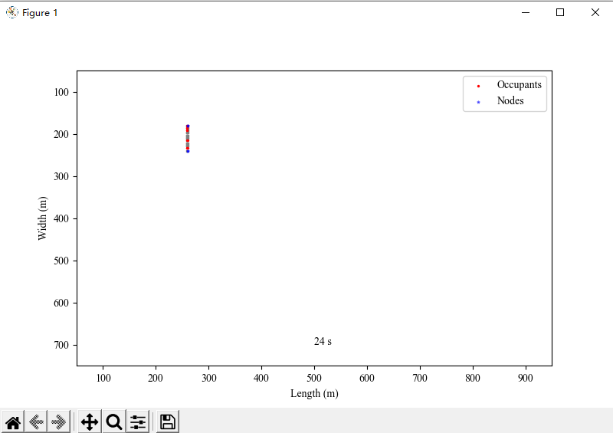
1. Select the floor to be displayed
Real-time display
2. Initialize the network
3. Check to display in real time while simulating
4. Click to run the model

Slide 9
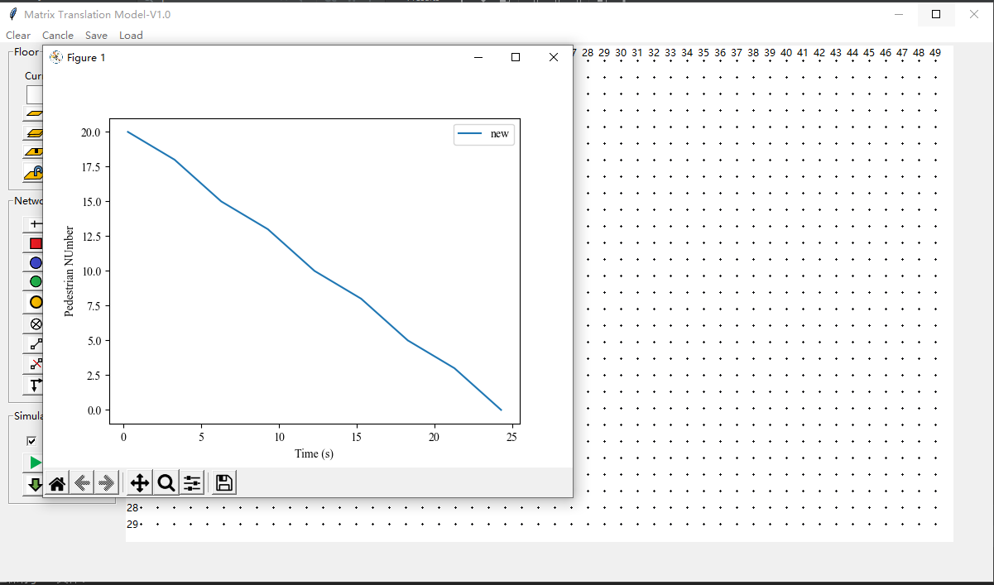
Simulation results:
Ped number-Time

Slide 10
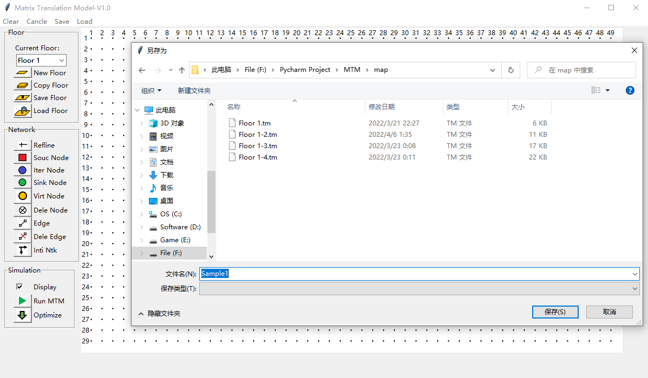
Save the map

Slide 11
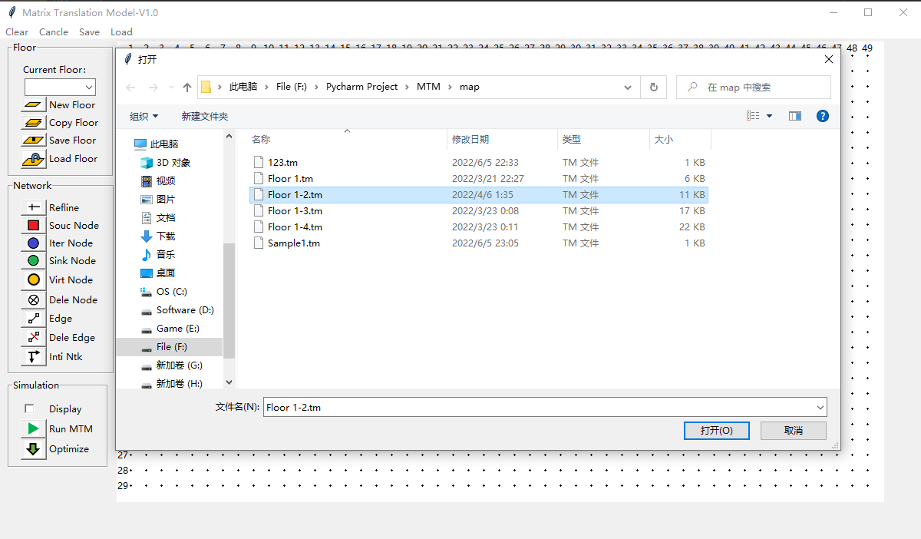
Load a map

Slide 12
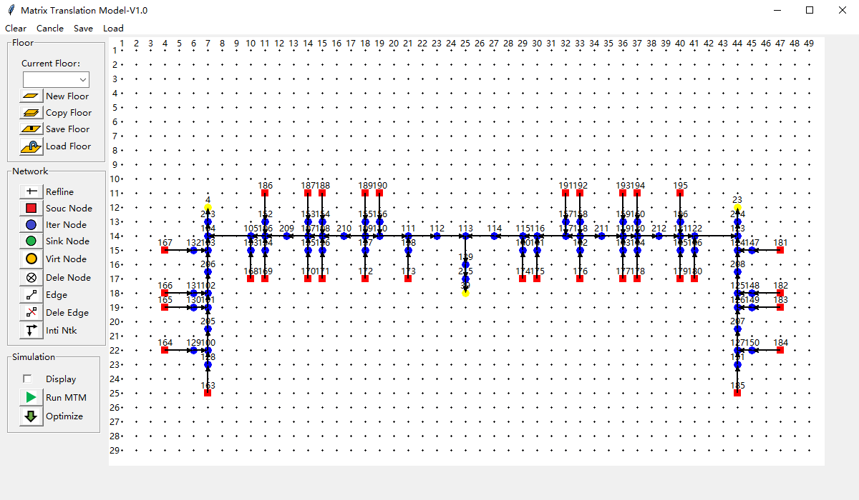
1. Initialize the network
2. Check to display in real time while simulating
3. Click to run the model

Slide 13
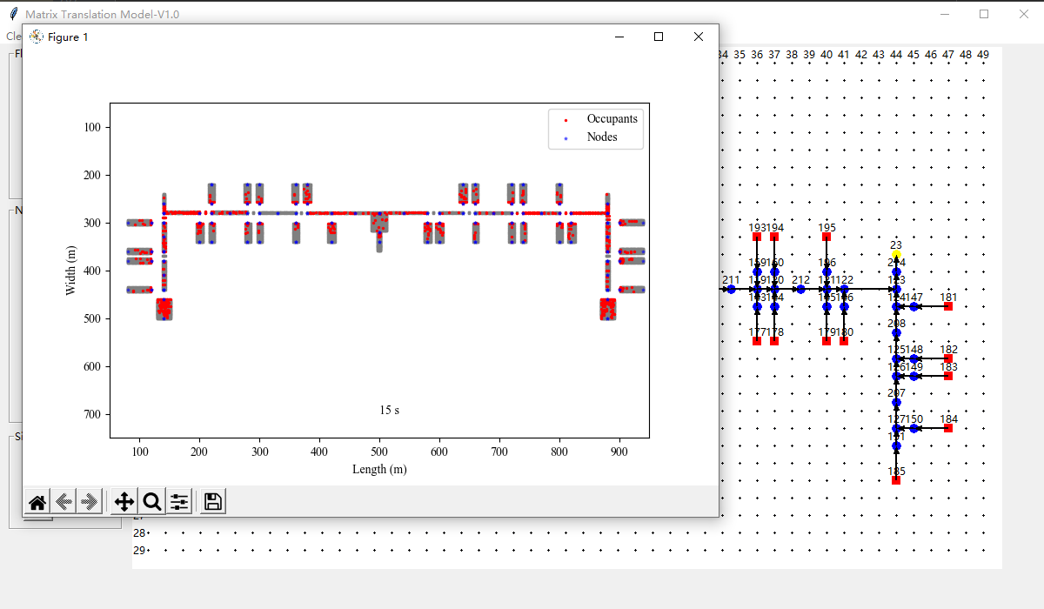
Real-time display

Slide 14
1. Initialize the network
2. Check to display in real time while simulating
3. Click to optimize the evacuation path

Slide 15
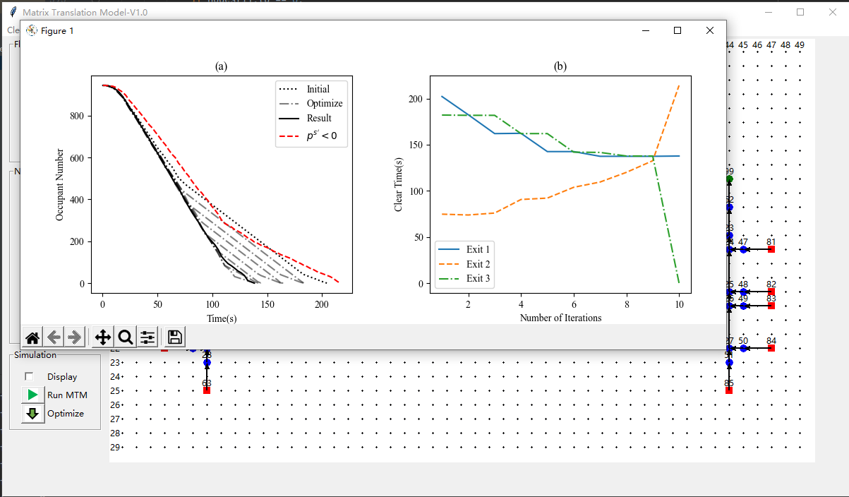
Evacuation processes in different iterations
Clear time of different exits
Optimization results

