Slide 1

17/WAKU2-RLN-RELAY: Privacy-Preserving Peer-to-Peer Economic Spam Protection
Sanaz Taheri Boshrooyeh (Presenter)*
Oskar Thoren*
Barry Whitehat
Wei Jie Koh
Onur Kilic
Kobi Gurkan
*Vac Research and Development
*Status Research and Development, Singapore
Link to the paper: https://github.com/vacp2p/research/blob/master/rln-research/Waku_RLN_Relay.pdf
Notes:
Hi,
Today, I am going to present waku-rln-relay which is a privacy preserving economic spam protection that suits private and anonymous messaging systems
This is a joint work by me, Oskar Thoren, Barry Whitehat, Wei Jie Koh, Onur Kilic, and Kobi Gurkan
The paper is also available in the link below

Slide 2
Contents
WAKU2
WAKU2-RELAY: Privacy-preserving p2p transport protocol
Spam issue in WAKU2-RELAY
Privacy-Preservation and Spam protection
State-of-the-art p2p spam protections
WAKU2-RLN-RELAY: Privacy-Preserving Peer-to-Peer Economic Spam Protection
Future work
Notes:
The agenda is as illustrated
I’ll start by discussing WAKU2 and WAKU-RELAY, I will review the spam issue and the related studies, then I’ll explain waku-rln-relay architecture and how it excels its counterparts. In the end, I will shed light on the future work.

Slide 3
WAKU2 [1]
A family of modular, privacy-preserving peer-to-peer (p2p) protocols for private, secure, censorship resistant communication
Suitable for resource restricted devices e.g., mobile phones
WAKU2 protocols include:
WAKU2-RELAY: privacy-preserving transport
WAKU2-STORE: historical message storage
WAKU2-FILTER: light version of WAKU2-RELAY for bandwidth limited devices
WAKU2-RLN-RELAY: spam-protected version of WAKU2-RELAY
And many more …
For the full list of RFCs is available in rfc.vac.dev
[1] https://rfc.vac.dev/spec/10/
Notes:
Waku2 is a stack of peer-to-peer (p2p) protocols that enable anonymous and privacy-preserving communication.
It is designed to be able to run in resource-restricted environments.
It contains multiple protocols as you see, but
The focus of today’s talk are WAKU-RELAY and WAKU-RLN-RELAY which are the transport layers of Waku

Slide 4
WAKU2-RELAY [1]
Publisher-Subscriber Model
Gossip-based Routing (extension of libp2p GossipSub-v1.1 [2])
Anonymous and Privacy-Preserving
[1] https://rfc.vac.dev/spec/11/
[2] https://github.com/libp2p/specs/tree/master/pubsub/gossipsub
Notes:
Let me start by WAKU2-RELAY transport protocol
It follows publisher-subscriber messaging model
Implements gossip-based routing protocol
Is a minor extension of libp2p GossipSub protocol
Its end goal of this protocol is to provide an anonymous and privacy preserving p2p transport layer

Slide 5

WAKU2-RELAY
Peers subscribed to the same topic form a mesh
Mesh of peers subscribed to the same topic
A
Notes:
Peers in wakurelay congregate around topics they are interested in and can send messages to that topic or receive messages within that topic
here is the illustration of a pubsub mesh of peers subscribed to the same topic

Slide 6
WAKU2-RELAY [1]
Publisher-Subscriber Model
Peers subscribed to the same topic form a mesh
Mesh of peers subscribed to the same topic
[1] https://rfc.vac.dev/spec/11/
Notes:
Let me start by WAKU2-RELAY transport protocol
It follows publisher-subscriber messaging model that is
congregate around topics they are interested in and can send messages to that topic or receive messages within that topic
here is the illustration of a pubsub mesh of peers subscribed to the same topic

Slide 7

WAKU2-RELAY
Publisher-Subscriber Model
Gossip-based Routing (extension of libp2p GossipSub-v1.1 [2])
A
[2] https://github.com/libp2p/specs/tree/master/pubsub/gossipsub
Notes:
It Implements gossip-based routing protocol
Is a minor extension of libp2p GossipSub protocol
Peers route messages by sending them to a subset of their connections
In this example, A as the message owner, forwards its message to a subset of neighbors.

Slide 8
WAKU2-RELAY
Publisher-Subscriber Model
Gossip-based Routing (extension of libp2p GossipSub-v1.1 [2])
A
Notes:
The neighbors proceed similarly till the message reaches the entire mesh.

Slide 9
WAKU2-RELAY
Publisher-Subscriber Model
Gossip-based Routing (extension of libp2p GossipSub-v1.1 [2])
Messages are anonymous [1]
No personally-identifiable information e.g., IP about the publisher
A
B
[1] https://rfc.vac.dev/spec/11/#security-analysis
Notes:
Waku-relay is also an anonymous transport where there is no personally identifiable information like IP address attached to the protocol messages, therefore it is not feasible to identify the origin of a message.

Slide 10

Spam issue in WAKU2-RELAY
We define spammers as entities that publish a large number of messages in a short amount of time, and cause denial-of-service
Spammer
Notes:
Waku Relay, as an open p2p transport protocol can be exploited by spammers;
we define spammers as entities that publish a large number of messages in a short amount of time, and cause Denial of Service attack.

Slide 11

Spam issue in WAKU2-RELAY
We define spammers as entities that publish a large number of messages in a short amount of time, and cause denial-of-service
Spam Protection = Controlled Messaging Rate
Spammer
Notes:
With that definition, Spammers can be controlled if we can control their messaging rate

Slide 12
Privacy-Preservation and Spam protection
Messages are anonymous: No Personally Identifiable information is available
Messages carry no personally identifiable information about the publisher
Normal peer
Spammer
Messages are anonymous
and unlinkable
Normal peer
Notes:
But there is a big issue that is, messages are anonymous
Therefore routing peers just observe a surge of messages coming in without knowing who has published them
Thus spam messages are indistinguishable from non-spam

Slide 13
Privacy-Preservation and Spam protection
Messages are anonymous: No Personally Identifiable information is available
Solutions like IP blocking are not effective
Messages carry no personally identifiable information about the publisher
Normal peer
Spammer
Messages are anonymous
and unlinkable
Normal peer
Notes:
as such solutions like IP blocking are not effective

Slide 14
State-of-the-art p2p spam protections
Proof-of-work [1] deployed by Whisper [2]
Computationally expensive
Not suitable for network of heterogeneous peers with limited resources
Peer Scoring [3] in libp2p
Local to each peer
No global identification of spammer
Subject to inexpensive attacks using bots
Prone to censorship
[1] Cynthia Dwork and Moni Naor. Pricing via processing or combatting junk mail. In Annual 456 international cryptology conference. Springer, 1992.
[2] https://eips.ethereum.org/eips/eip-627.
[3] https://github.com/libp2p/specs/blob/master/pubsub/gossipsub/gossipsub-v1.1.mdpeerscoring.
Notes:
The state-of-the-art p2p spam protection techniques are Proof of Work (POW) deployed by Whisper
and Peer scoring method adopted by libp2p
The PoW is not computationally efficient and does not fit resource limited devices (limited resources won't be able to participate and benefit from the messaging system)
On the other side, peer scoring is a local solution since each peer monitors and scores its direct connections and drops the connections with low scores.
However, a spammer would be still able to continue its activity by switching its connection from one peer to another as soon its score drops a threshold.
Furthermore, there are inexpensive attacks where the spammer can deploy millions of bots to send bulk messages.
~It is also prone to censorship~

Slide 15
WAKU2-RLN-RELAY [1]
WAKU2-RLN-RELAY = WAKU2-RELAY + Rate Limiting Nullifiers (RLN)
P2p solution
Global spam protection
Privacy preserving
Efficient
Economic incentives
Financial punishment for the spammers and a financial reward for those who catch spammers.
[1] https://rfc.vac.dev/spec/17/
Notes:
The good news is that in WAKU-RLN-RELAY we cope with the aforementioned issues
We take the waku-relay protocol as an anonymous transport protocol and combine it with the rate limiting nullifier construct to control the messaging rate
The end result has a p2p structure, with no central entity involved
it allows global identification and removal of spammers
it is privacy-preserving, user anonymity is preserved since there is no need to personally identifiable information e.g., email address, IP, etc. about peers to be able to identify and block spammers
It is efficient i.e., with no unreasonable computational, storage, memory, and bandwidth requirement, as such, it fits the network of heterogeneous peers with limited resources.
It has economic-incentives, i.e., there is a financial punishment for the spammers and a financial reward for those who catch spammers.

Slide 16
RLN Primitive [1]
RLN is a zero-knowledge and rate-limited signaling framework
Each user can only send M messages for each External Nullifier
External nullifier can be seen as a voting booth where each user can only cast one vote
M and external nullifier are application dependent
M=1 for this presentation
[1] https://ethresear.ch/t/semaphore-rln-rate-limiting-nullifier-for-spam-prevention-in-anonymous-p2p-setting/5009
Notes:
Lets begin with the RLN construct
it is a zero-knowledge and rate-limited signaling framework
It allows a set of users to broadcast arbitrary signals (where signal is any value like a string, vote, etc.) while proving they are among a group of authorized users without disclosing their identities
The idea is that each user can only send M messages for a specific external nullifier. External nullifier can be seen as a voting booth where each user can only cast one vote
For the rest of this presentation we consider the messaging rate to be 1

Slide 17
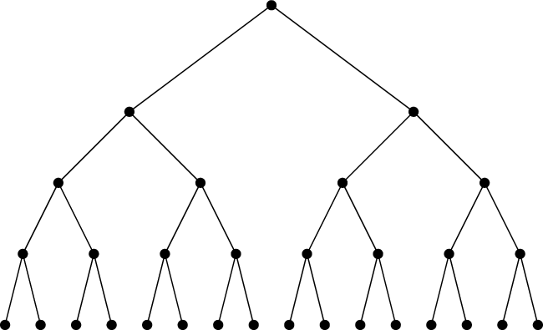

RLN Primitive: Membership Tree
RLN membership group:
Merkle tree
PK1
PK16
SK1, PK1 =H(SK1)
SK16, PK16 =H(SK16)
Notes:
RLN primitive consists of a merkle tree that represents a group of authorized users,
each user has a pk registered in this tree,
the corresponding SK is only known to the user

Slide 18
RLN Primitive: Signaling
RLN membership group:
Merkle tree
SK1, PK1 =H(SK1)
PK1
PK16
M: Message
EN: External Nullifier
IN: Internal Nullifier = H(H(SK1,EN))
Notes:
For the signaling/publishing:
The user specifies an external nullifier
as well as an internal nullifier which is derived from the SK and the external nullifier (as you can see in the slide)

Slide 19
RLN Primitive: Signaling
RLN membership group:
Merkle tree
SK1, PK1 =H(SK1)
Shamir Secret Sharing
PK1
PK16
M: Message
S1: One share of SK1
EN: External Nullifier
IN: Internal Nullifier = H(H(SK1,EN))
Notes:
The user also discloses a share of its secret key using shamir secret sharing scheme
This share will be used to remove the user from the group in case of double signaling

Slide 20
RLN Primitive: Signaling
Shamir Secret Sharing
[SK1]_1
(M,N)-Sharing
SK1
[SK1]_2
[SK1]_N
RLN membership group:
Merkle tree
SK1, PK1 =H(SK1)
[SK1]_i
(M,N)-Construct
M shares
…
SK1
[SK1]_j
Shamir Secret Sharing
PK1
PK16
M: Message
[SK1]_1: One share of SK1
EN: External Nullifier
IN: Internal Nullifier = H(H(SK1,EN))
[1] Adi Shamir. How to share a secret. Communications of the ACM, 22(11):612–613, 1979.
Notes:
For those who dont know about Shamir secret sharing, the high level idea is that it is a technique that allows to split a secret data sk into N pieces
It is possible construct the sk back by having a subset of M shares

Slide 21

RLN Primitive: Signaling
RLN membership group:
Merkle tree
SK1, PK1 =H(SK1)
Shamir Secret Sharing
zkSNARK
PK1
PK16
Zero-Knowledge Proof of
Membership
Correctness of [SK1]_1
Correctness of IN
M: Message
[SK1]_1: One share of SK1
EN: External Nullifier
IN: Internal Nullifier = H(H(SK1,EN))
Notes:
Finally, the user proves in zero knowledge manner that:
It is part of the group
And that has computed the secret share and the Internal nullifier correctly

Slide 22
RLN Primitive: Signaling
Zero-Knowledge Succinct Non-Interactive Argument of Knowledge [1, 2]
Prover
Secret knowledge X
Verifier
RLN membership group:
Merkle tree
SK1, PK1 =H(SK1)
Proof of knowledge X
Verify the Proof
Shamir Secret Sharing
zkSNARK
PK1
PK16
Zero-Knowledge Proof of
Membership
Correctness of [SK1]_1
Correctness of IN
M: Message
[SK1]_1: One share of SK1
EN: External Nullifier
IN: Internal Nullifier = H(H(SK1,EN))
[1] Groth, Jens. "On the size of pairing-based non-interactive arguments." Annual international conference on the theory and applications of cryptographic techniques. Springer, Berlin, Heidelberg, 2016.
[2] Bitansky, Nir, et al. "From extractable collision resistance to succinct non-interactive arguments of knowledge, and back again." Proceedings of the 3rd Innovations in Theoretical Computer Science Conference. 2012.
Notes:
For those not familiar with zk-SNARK, it stands for “Zero-Knowledge Succinct Non-Interactive Argument of Knowledge.”
A zk-SNARK is a cryptographic proof that allows one party to prove the possession of certain information to a verifier without revealing that information.

Slide 23
RLN Primitive: Detecting double signaling
RLN membership group:
Merkle tree
SK1, PK1 =H(SK1)
M, EN, IN, [SK1]_1, P
M’, EN, IN, [SK1]_2, P’
PK1
PK16
Notes:
Users cannot violate the messaging rate, why? Because If a user publishes more than 1 message for the same external nullifier, it will end up having two messages with the same external and internal nullifiers (remember those are deterministic values computed from SK and external nullifier)
So the double signaling attempt can be detected

Slide 24
RLN Primitive: Slashing
RLN membership group:
Merkle tree
SK1, PK1 =H(SK1)
M, EN, IN, [SK1]_1, P
M’, EN, IN, [SK1]_2, P’
PK1
PK16
(2,N)-Construct
SK1
Notes:
Moreover, by sending two messages, the usre will disclose 2 shares of its SK (one per each message)
using which the corresponding SK can be reconstructed

Slide 25

RLN Primitive: Slashing
RLN membership group:
Merkle tree
SK1, PK1 =H(SK1)
M, EN, IN, [SK1]_1, P
M’, EN, IN, [SK1]_2, P’
PK1
PK16
(2,N)-Construct
SK1
Notes:
And the user gets removed from the tree. Thus, it can no longer use that sk for messaging.

Slide 26
WAKU2-RLN-RELAY
RLN group = Peers subscribed to the same topic e.g., waku-rln-relay
Notes:
Now lets see the end to end integration of RLN into Waku-rln-relay
Here, the rln group consists of peers that belong to the same GossipSub layer (subscribed to the same topic)

Slide 27
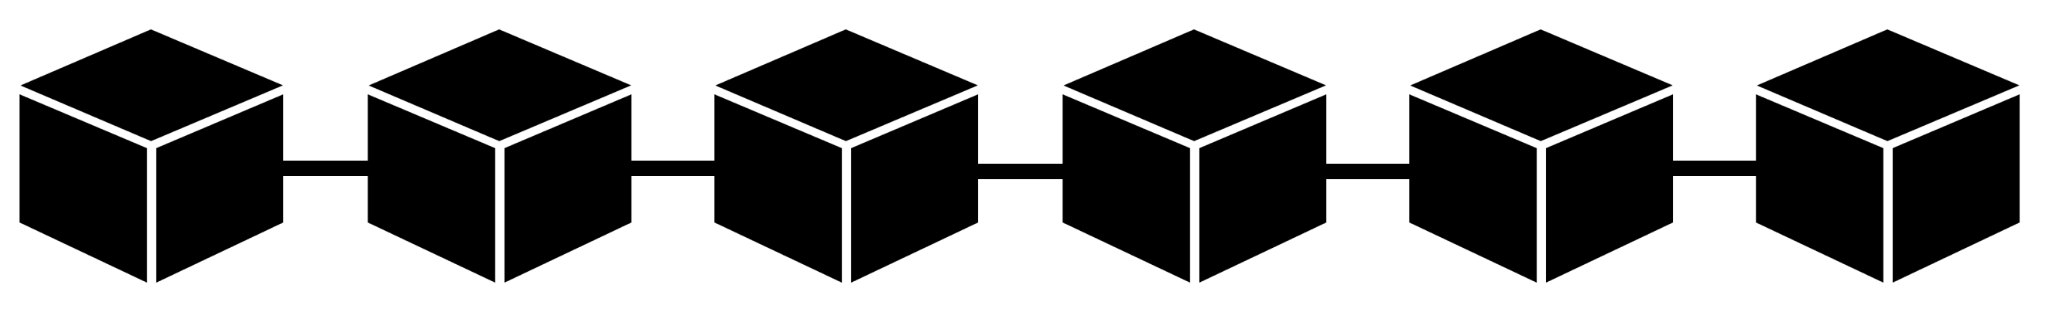


WAKU2-RLN-RELAY: Registration
Membership Contract/Registry
PK1,…,PKn
…
RLN group = Peers subscribed to the same topic e.g., waku-rln-relay
Notes:
Each peer has a rln pk, and the list of pks is stored in a contract deployed on the Eth blockchain.

Slide 28
WAKU2-RLNR-ELAY: Registration
Membership Contract/Registry
PK1,…,PKn
…
TX: Register PK,
RLN group = Peers subscribed to the same topic e.g., waku-rln-relay
Each peer registers to the group and locks some funds
Notes:
A peer willing to publish a message should register by sending a tx to the contract that contains its rln pk and some amount of Ether. This amount is deposited on the contract to prevent spam activity. Registration is a one time action.

Slide 29
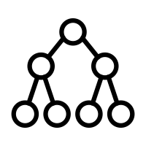
WAKU2-RLN-RELAY: Registration
Membership Contract/Registry
PK1,…,PKn
…
Membership Merkle tree
Notes:
Peers construct the rln membership Merkle tree locally

Slide 30

WAKU2-RLN-RELAY: Registration
Membership Contract/Registry
PK1,…,PKn
…
Registration and Deletion Events
Peers update their local tree
Notes:
And they listen to the registration and deletion events emitted from the contract in order to update their trees.

Slide 31
WAKU2-RLN-RELAY: External Nullifier
External Nullifier = Epoch = the number of T seconds that elapsed since the Unix epoch.
Messaging rate is limited to 1 per epoch.
Notes:
For the external nullifier we denote it by Epoch which is the number of T seconds (where T is a system design parameter) that elapsed since the Unix epoch.
Peers are allowed to publish one message per epoch without being slashed

Slide 32

WAKU2-RLN-RELAY: External Nullifier
External Nullifier = Epoch = the number of T seconds that elapsed since the Unix epoch.
Messaging rate is limited to 1 per epoch.
Each peer locally keeps track of the current epoch
Notes:
Each peer locally keeps track of the current epoch.

Slide 33
WAKU2-RLN-RELAY: Publishing
M, Epoch, IN, [SK]_1, P
Notes:
Message publishing in the network is the same as RLN framework
The message owner, attaches the nullifiers, together with its sk share, and the zero knowledge proof part to the message

Slide 34
WAKU2-RLN-RELAY: Routing
M, Epoch, IN, [SK]_1, P
Notes:
A routing peer follows the regular routing protocol of wakurelay (gossipSub protocol) and in addition
does the verification steps of RLN construct

Slide 35

WAKU2-RLN-RELAY: Routing
Check for double signaling
Check against the local epoch
RLN Proof Verification
M, Epoch, IN, [SK]_1, P
Notes:
It verifies the proof
Also validates the Epoch of the incoming message against its local Epoch to see if there is a huge gap or not
and checks the nullifiers to see if double signaling has happened
If all the checks pass, relays the message

Slide 36

WAKU2-RLN-RELAY: Routing
M, Epoch, IN, [SK]_1, P
Notes:
keeps record of of the nullifiers of the messages, it is needed to catch double signaling for the future incoming messages

Slide 37
WAKU2-RLN-RELAY: Slashing
A past record with the same nullifiers (Epoch, IN, [SK]_2)
M, Epoch, IN, [SK]_1, P
Notes:
But what if the routing peer finds out that the messaging rate is violated, i.e., there has been an old message whose nullifiers match the new message

Slide 38
WAKU2-RLN-RELAY: Slashing
[SK]_2
(2,N)-Construct
SK of spammer
[SK]_1
A past record with the same nullifiers (Epoch, IN, [SK]_2)
M, Epoch, IN, [SK]_1, P
Notes:
In that case, it reconstructs the sk of the spammer

Slide 39
WAKU2-RLN-RELAY: Slashing
Membership Contract/Registry
PK1,…,PKn
…
Remove spammer’s PK
SK of spammer
PK=H(SK)
Notes:
Sends a transaction to the contract and removes the spammer pk from the group

Slide 40

WAKU2-RLN-RELAY: Slashing
Membership Contract/Registry
PK1,…,PKn
…
Remove spammer’s PK
SK of spammer
PK=H(SK)
Notes:
and withdraws the spammer's fund

Slide 41
WAKU2-RLN-RELAY [1]
WAKU2-RLN-RELAY = WAKU2-RELAY + Rate Limiting Nullifiers (RLN)
P2p solution
Global spam protection
Privacy preserving
Efficient
Economic incentives
Financial punishment for the spammers and a financial reward for those who catch spammers.
[1] https://rfc.vac.dev/spec/17/
Notes:
This brings us to the end of the presentation,
We talked about waku-rln-relay, and how the end to end interaction works, and how it enables global spam removal using the rln primitive on top of waku-relay
Also how it brings together anonymity and incentivized spam-resilience in a p2p messaging system

Slide 42
References
Waku-rln-relay specs: https://rfc.vac.dev/spec/17/
Waku-rln-relay paper: https://github.com/vacp2p/research/blob/master/rln-research/Waku_RLN_Relay.pdf
Vac post on Waku-rln-relay: https://vac.dev/rln-relay
Nim-Waku implementation: https://github.com/status-im/nim-waku
js-Waku implementation: https://github.com/status-im/js-waku
RLN Ethereum research post: https://ethresear.ch/t/semaphore-rln-rate-limiting-nullifier-for-spam-prevention-in-anonymous-p2p-setting/5009
RLN medium post: https://medium.com/privacy-scaling-explorations/rate-limiting-nullifier-a-spam-protection-mechanism-for-anonymous-environments-bbe4006a57d
RLN circuits: https://github.com/appliedzkp/rln
RLN circuits spec: https://hackmd.io/7GR5Vi28Rz2EpEmLK0E0Aw
RLN in Rust: https://github.com/kilic/rln
Notes:
References for those interested to read further

Slide 43
Thank you

Slide 45

Future work
Benchmarking
Storage-efficient Merkle tree storage
P2p network of full-nodes and light-nodes
Partial view of Merkle tree
Real-time removal of spammers using off-chain/p2p solutions
Cost-effective way of member insertion and deletion using layer 2 solutions
Notes:
In the end, I would like to wrap up with our future plan
Benchmarking is the first on our future work list
The next is to address storage overhead regarding the maintenance of the full Merkle tree.
Currently, peers maintain the entire tree locally which takes up to 67 MB for tree with depth 20 and almost 274 GB for d=32. This overhead might not fit resource limited devices, so a more optimized solution is desirable.
One solution is to use the light-node and full-node architecture where resource-full nodes retain the entire tree and serve it to the nodes with limited storage.
Another possible solution is to have a partial view of the tree and yet being able to construct and update the tree root and the authentication path when group state changes
We are also looking into an off-chain slashing solution because currently the On-chain slashing is subject to delay (the tx has to be mined), so is the removal of spammers. With an off-chain method, peers can communicate the slashed pks in a p2p manner, hence enjoy a real-time spam-protection
The other direction to pursue is to provide a cost-effective way of member insertion and deletion using layer 2 solutions. The reason is that currently these operations cost almost 40 k gas, which translates to 15 USD which might be not affordable by the users, so an alternative solution is worth investigation

Slide 46

Asymptotic Performance
Setting
17/WAKU2-RLNRELAY utilizes the RLN library [1] for identity key generation and commitment, Shamir secret sharing, zkSNARK circuits, proof generation, and verification.
The underlying Elliptic Curve is BN254 [2].
The instantiated hash function is Poseidon with the security level of 128 bits [2].
Proof system is Groth16 [2].
Computation
Proof generation: According to the benchmarking report [3] for a Merkle tree depth of 24, the proof generation on an iPhone 8 takes almost ~0.5 seconds.
User computation per group update is O(d) hashing operations (where d=20) to calculate the tree root and the authentication path.
Bootstrapping takes O(2^d) hashing operations to construct the entire tree.
[1] https://github.com/kilic/rln
[2] https://hackmd.io/tMTLMYmTR5eynw2lwK9n1w?view
[3] Groth, Jens. "On the size of pairing-based non-interactive arguments." Annual international conference on the theory and applications of cryptographic techniques. Springer, Berlin, Heidelberg, 2016.
Notes:
Use this for more https://hackmd.io/U8nFzfLpQVGu5Zu0dVfJ_Q
0.5 proof generation This is sufficiently fast for many messaging applications, but may not be low enough for e.g. real-time communications.
d is the tree depth which is considered as 20
N is the number of Merkle tree leaves which is 2^d
H is the size of the hash output
A Batch consists of B=128 keys

Slide 47
Asymptotic Performance
Gas costs*
PK Registration: The estimated gas cost is 40k. This is for performing the insertion without locking any ether for the sake of slashing.
PK Slashing: The estimated gas cost is 40k.
Batch registration/slashing: The estimated gas cost is 20k. A Batch consists of B=128 keys
Storage
The Merkle tree with depth 20 takes up ~67MB storage.
Identity keys and identity commitment keys are of size 32 bytes.
Prover key size is approximately ~3.24 MB.
* Derived from https://hackmd.io/JoxnlDq3RT6WhtA-KBxtYg?view
Notes:
Use this for more https://hackmd.io/U8nFzfLpQVGu5Zu0dVfJ_Q
d is the tree depth which is considered as 20
N is the number of Merkle tree leaves which is 2^d
H is the size of the hash output
A Batch consists of B=128 keys

Slide 48
zkSNARK Setup
Parameters generation (for Groth16) done in two phases:
Phase 1: The powers of tau ceremony
Phase 2: MPC for circuit specific parameters

Slide 49
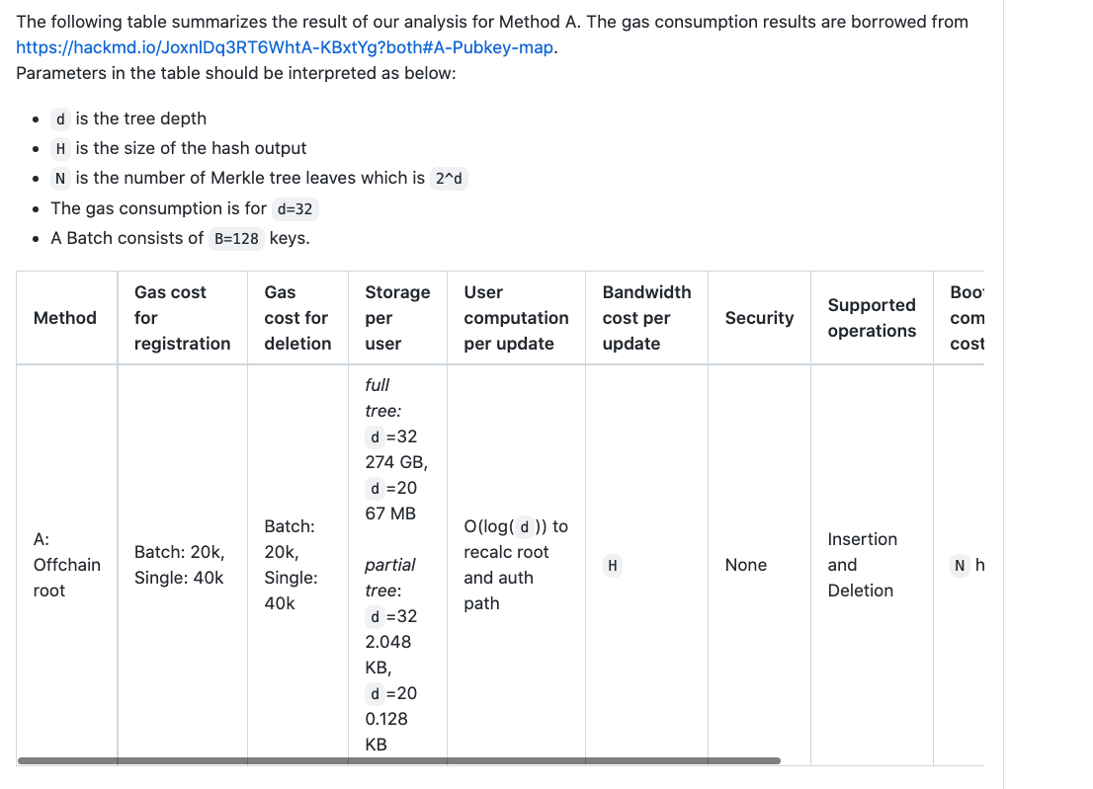
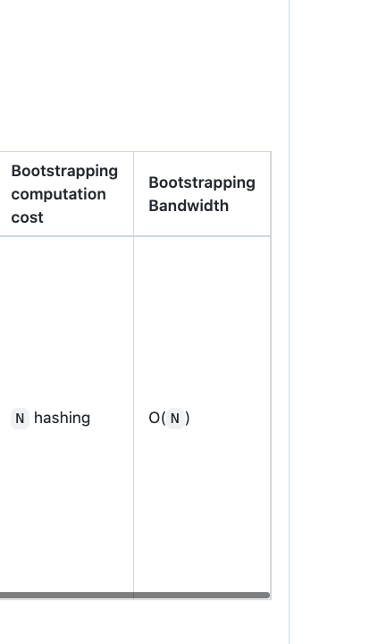
Asymptotic Performance

