Slide 1
Unlocking New Possibilities
Enhancing Power BI with SVGs
Jake Duddy

Slide 2




evaluationcontext.github.io/
linkedin.com/in/jakeduddy/

Slide 3
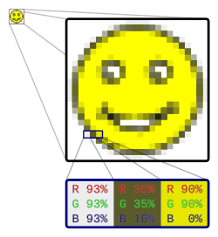
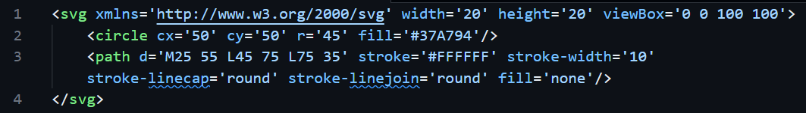

Vector vs Raster
Raster | Vector
JPEG, PNG etc Colour per pixel Blurry or pixelated when scaled up or down | SVG Defined as Code Scales to any size without losing quality Animation

Slide 4
SVG Elements
Shapes
Rectangles <rect>
Circles <circle>
Ellipses <ellipse>
Lines <line>
Polygons <polygon>
Path <path>
Text <text>
Filters <feGaussianBlur> <feComponentTransfer> …
Animation
foo

Slide 5
Which Visuals support SVGs
Table
Matrix
New Card
New Button Slicer
Defined as measures
Data Category: Image URL

Slide 6
Static SVG

Slide 7
Static SVG
x
100
0
y
100
<svg xmlns='http://www.w3.org/2000/svg' width='20' height='20' viewBox='0 0 100 100’>
<circle cx='50' cy='50' r='45' fill='#37A794’/>
<path d='M25 55 L45 75 L75 35' stroke='#FFFFFF' stroke-width='10' stroke- linecap='round' stroke-linejoin='round' fill='none'/>
</svg>

Slide 8
Dynamic SVGs

Slide 9
Creating a SVG Graph
Define marks
Line, Rect, Circle
Define Scale
X, Y, size, colour
Map data to marks
Map data scale to SVG scale

Slide 10
Visualizing Previous Refreshes
Datetime
https://evaluationcontext.github.io/posts/SVG-Sparkline/

Slide 11
Heatmap

Slide 12
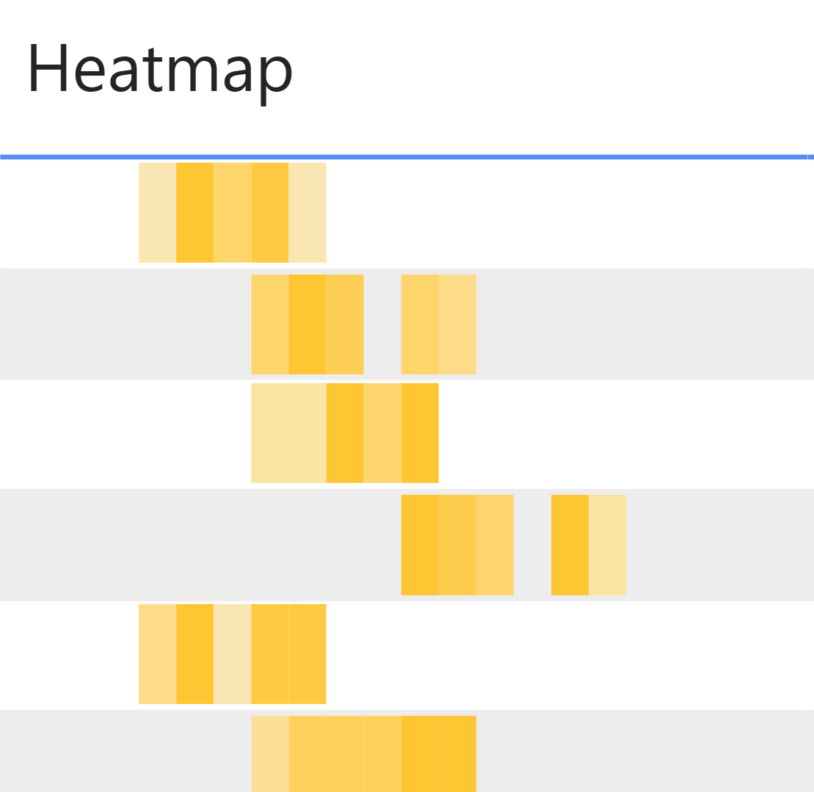
Heatmap

Slide 13
Heatmap
1
2
1
1
0
1
Value
Sample across range
Count number of points in box
Map numeric scale to colour scale
https://evaluationcontext.github.io/posts/SVG-Heatmap-Optimized/

Slide 14
Violin Plot

Slide 15
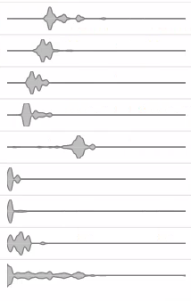
Violin Plot
Shows distribution of data across a scale
Good at identifying multiple data groupings, which can be missed with box and whisker
More widely understood at heatmap
https://evaluationcontext.github.io/posts/SVG-Violin/

Slide 16
Kernel Density Estimation (KDE)
Value
Different Kernels can be used (normal, uniform, gaussian etc.)
Kernel bandwidth with smooth
Sampling rate will affect fitting

Slide 17
Bézier Curves
Bézier Curves are defined by start and end point, plus 1 or more control points, which act like gravity pulling the curve towards them
In SVG paths the cubic curve is specified by
C x1 y1, x2 y2, x y
S x2 y2, x y
assumes the first control point is a reflection of the one used previously in the path
Link

Slide 18
Control Points
Value
Assume control points are mid point between KDE points

Slide 19
Sparklines

Slide 20
What Can We Learn From Sparklines?
Structured like SVG
"{""p"":
[[45725,100.0], … [45754,31.0]],
""yl"":3314,
""yh"":7360,
""xl"":45725,
""xh"":45755,
""md"":1
}"
Creates an adhoc measure with a performant query template for generating dynamic SVGs
https://evaluationcontext.github.io/posts/SVG-Sparkline/

Slide 21
Best Practices

Slide 22
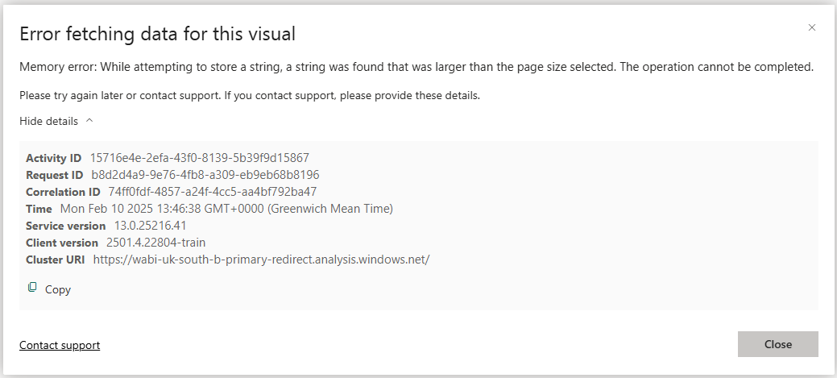
A Wild Error Appears
Power BI has limits on the length of DAX measures (~32k characters)

Slide 23
Data Minimization
SAMPLE()
TOPN()
Grain

Slide 24
String Minimization
 | Example | chars
<line> | <line x1='1' y1='2.5' x2='1' y2='7.5' stroke='#37A794' stroke-width='2'/> ... <line x1='150' y1='2.5' x2='150' y2='7.5' stroke='#37A794' stroke-width='2'/> | 78
<path> | <path d='M1,2.5 L2,7.5' stroke='#37A794' stroke-width='2'/> ... <path d='M150,2.5 L150,7.5' stroke='#37A794' stroke-width='2'/> | 63 (19.2%)
<defs> <use> | <defs> <path id='L1' d='M1,1 L1,9' stroke='#37A794' stroke-width='2'/> </defs> <use href='#L1' x='1'/> ... <use href='#L1' x='150'/> | 25 (67.9%)
https://evaluationcontext.github.io/posts/minimizing-svg-strings/

Slide 25
References
SVGs Docs
https://www.w3schools.com/graphics/svg_intro.asp
https://developer.mozilla.org/en-US/docs/Web/SVG
Kerry Kolosko
SVG Portfolio
Kurt Buhler
Github [data-goblin/powerbi-macguyver-toolbox

