Slide 1
Translytical Sudoku
Playing with Translytical Task Flows
Jake Duddy

Slide 2

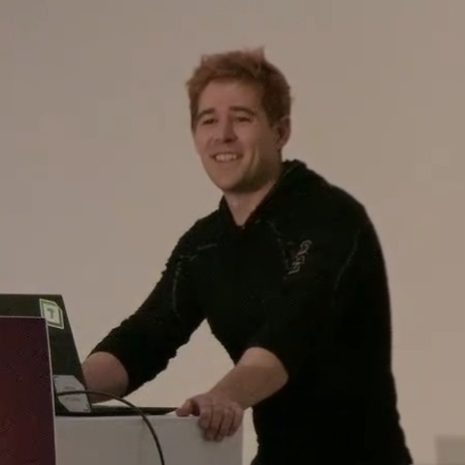




Jake Duddy
Data Platform Microsoft MVP
Fabric Community Super User
EvaluationContext Blog
Devon and Cornwall Power BI Group Co-organizer
Jake Duddy
evaluationcontext.github.io/
linkedin.com/in/jakeduddy/

Slide 3
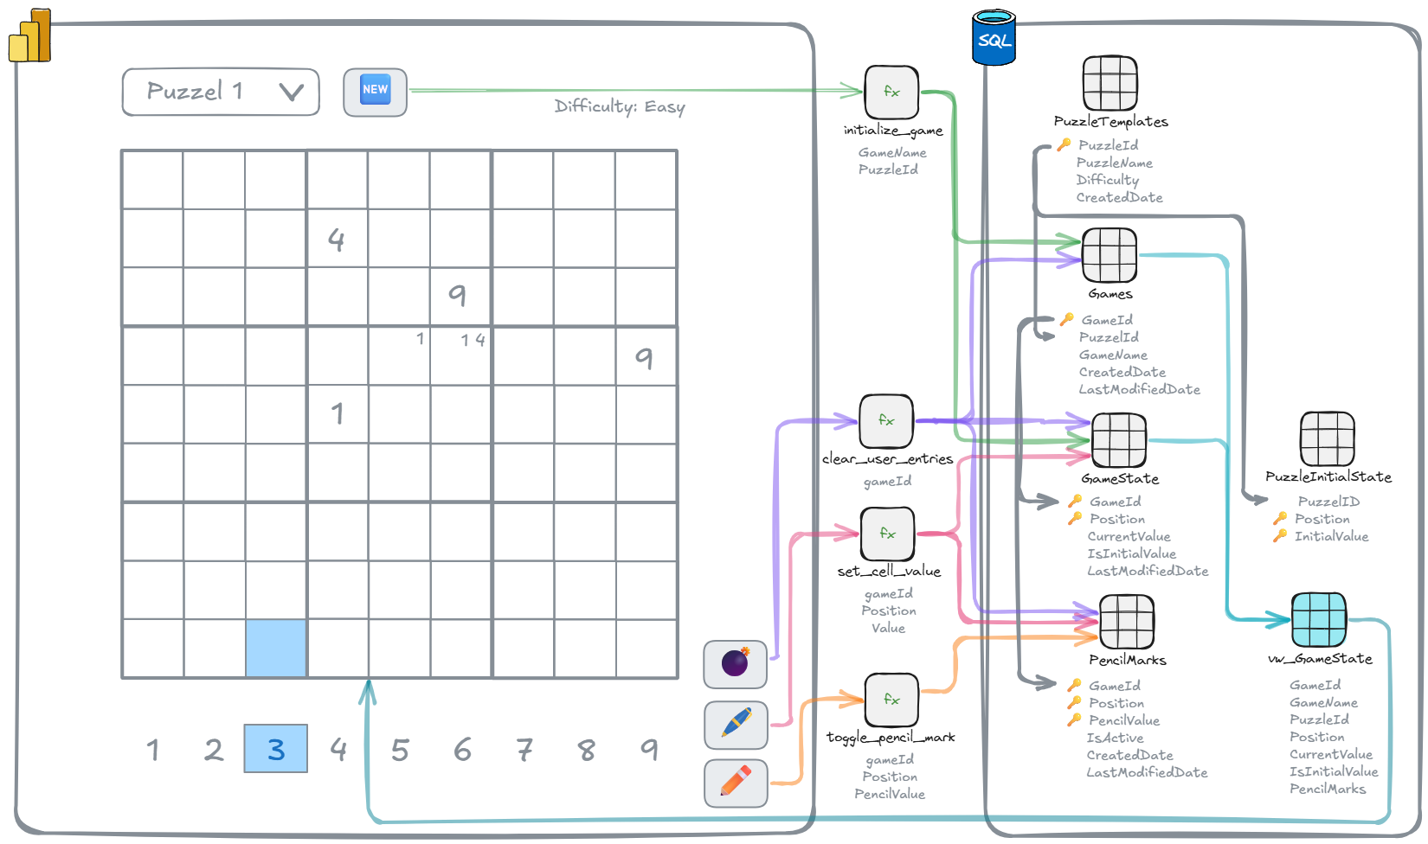
https://evaluationcontext.github.io/posts/sudoku/

